Slide 1
Incremental String Comparison
Gad M. Landau, Eugene W. Myers, Jeanette P. Schmidt
SIAM J. Comput., Vol. 27, No. 2, pp. 557-582 (1998)
Presenter: Shao-Xuan Lee
Date: May. 27, 2020

Slide 2
Abstract (1/2)
The problem of comparing two sequences A and B to determine their longest common subsequence (LCS) or the edit distance between them has been much studied. In this paper we consider the following incremental version of these problems: given an appropriate encoding of a comparison between A and B, can one incrementally compute the answer for A and bB, and the answer for A and Bb with equal efficiency, where b is an additional symbol? Our main result is a theorem exposing a surprising relationship between the dynamic programming solutions for two such “adjacent” problems.

Slide 3
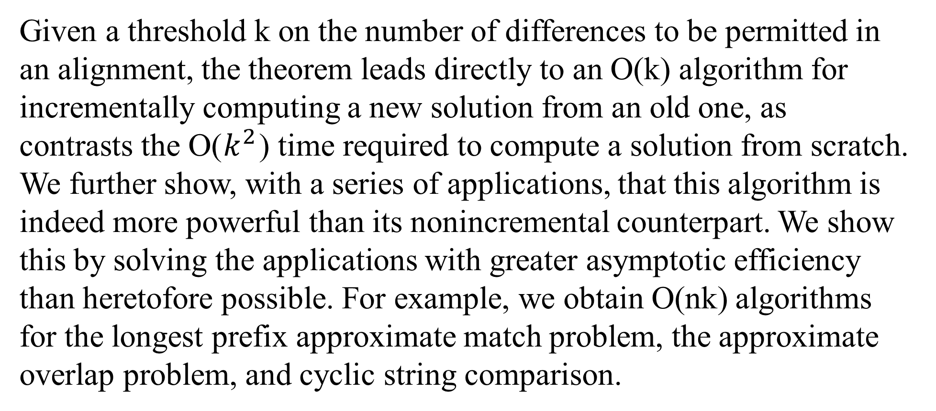
Abstract (2/2)
Given a threshold k on the number of differences to be permitted in an alignment, the theorem leads directly to an O(k) algorithm for incrementally computing a new solution from an old one, as contrasts the O($k^{2}$) time required to compute a solution from scratch. We further show, with a series of applications, that this algorithm is indeed more powerful than its nonincremental counterpart. We show this by solving the applications with greater asymptotic efficiency than heretofore possible. For example, we obtain O(nk) algorithms for the longest prefix approximate match problem, the approximate overlap problem, and cyclic string comparison.

Slide 4
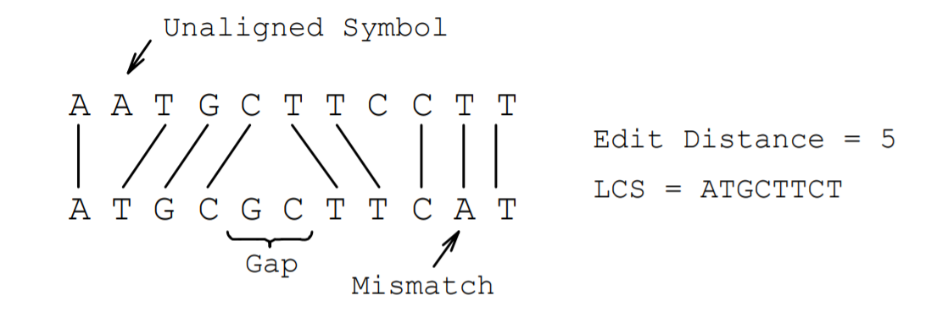
Mismatch = 1
Unaligned symbol = 1
Aligned = 0

Slide 5
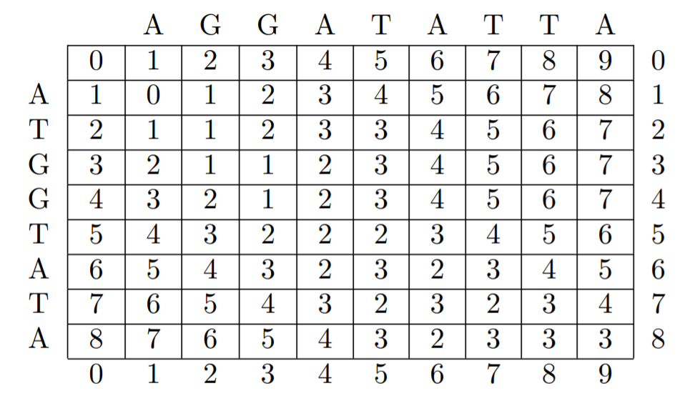

Slide 6
0
1
-1

Slide 8
 | -3 | -2 | -1 | 0 | 1 | 2 | 3
0 |  |  |  | 1
1 |  |  | 4 | 3 | 1
2 |  | 8 | 5 | 7 | 3 | 1
3 | 8 | ∞ | 8 | 8 | 8 | 3 | 2

Slide 9
 | -3 | -2 | -1 | 0 | 1 | 2 | 3
0 |  |  |  | 1
1 |  |  | 4 | 3 | 1
2 |  | 8 | 5 | 7 | 3 | 1
3 | 8 | ∞ | 8 | 8 | 8 | 3 | 2

Slide 10
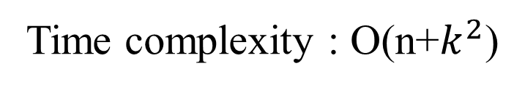
 | -3 | -2 | -1 | 0 | 1 | 2 | 3
0 |  |  |  | 1
1 |  |  | 4 | 3 | 1
2 |  | 8 | 5 | 7 | 3 | 1
3 | 8 | ∞ | 8 | 8 | 8 | 3 | 2
Time complexity : O(n+$k^{2}$)

Slide 11
 | -3 | -2 | -1 | 0 | 1 | 2 | 3
0 |  |  |  | 1
1 |  |  | 4 | 3 | 1
2 |  | 8 | 5 | 7 | 3 | 1
3 | 8 | ∞ | 8 | 8 | 8 | 3 | 2

Slide 12

T
0 | 1 | 2 | 3 | 4 | 5 | 6 | 7 | 8 | 9 | 10
1 | 1 | 1 | 2 | 3 | 4 | 5 | 6 | 7 | 8 | 9
2 | 1 | 2 | 2 | 3 | 4 | 4 | 5 | 6 | 7 | 8
3 | 2 | 2 | 3 | 2 | 3 | 4 | 5 | 6 | 7 | 8
4 | 3 | 3 | 2 | 3 | 3 | 4 | 5 | 6 | 7 | 8
5 | 4 | 4 | 3 | 3 | 4 | 3 | 4 | 5 | 6 | 7
6 | 5 | 4 | 4 | 4 | 3 | 4 | 3 | 4 | 5 | 6
7 | 6 | 5 | 5 | 5 | 4 | 3 | 4 | 3 | 4 | 5
8 | 7 | 6 | 6 | 6 | 5 | 4 | 3 | 4 | 5 | 4

Slide 13
T
-1
0 | 1 | 2 | 3 | 4 | 5 | 6 | 7 | 8 | 9 | 10
1 | 1 | 1 | 2 | 3 | 4 | 5 | 6 | 7 | 8 | 9
2 | 1 | 2 | 2 | 3 | 4 | 4 | 5 | 6 | 7 | 8
3 | 2 | 2 | 3 | 2 | 3 | 4 | 5 | 6 | 7 | 8
4 | 3 | 3 | 2 | 3 | 3 | 4 | 5 | 6 | 7 | 8
5 | 4 | 4 | 3 | 3 | 4 | 3 | 4 | 5 | 6 | 7
6 | 5 | 4 | 4 | 4 | 3 | 4 | 3 | 4 | 5 | 6
7 | 6 | 5 | 5 | 5 | 4 | 3 | 4 | 3 | 4 | 5
8 | 7 | 6 | 6 | 6 | 5 | 4 | 3 | 4 | 5 | 4

Slide 14
new
T
0 | 1 | 2 | 3 | 4 | 5 | 6 | 7 | 8 | 9 | 10
1 | 1 | 1 | 2 | 3 | 4 | 5 | 6 | 7 | 8 | 9
2 | 1 | 2 | 2 | 3 | 4 | 4 | 5 | 6 | 7 | 8
3 | 2 | 2 | 2 | 2 | 3 | 4 | 5 | 6 | 7 | 8
4 | 3 | 3 | 2 | 2 | 3 | 4 | 5 | 6 | 7 | 8
5 | 4 | 4 | 3 | 3 | 3 | 3 | 4 | 5 | 6 | 7
6 | 5 | 4 | 4 | 4 | 3 | 4 | 3 | 4 | 5 | 6
7 | 6 | 5 | 5 | 5 | 4 | 3 | 4 | 3 | 4 | 5
8 | 7 | 6 | 6 | 6 | 5 | 4 | 3 | 4 | 4 | 4
 | -4 | -3 | -2 | -1 | 0 | 1 | 2 | 3
0 |  |  |  | 0
1 |  |  | 2 | 1 | 1
2 |  | 3 | 4 | 4 | 3 | 1
3 | 4 | 5 | 8 | 5 | 7 | 3 | 1
4 | 6 | 8 | ∞ | 8 | 8 | 8 | 3 | 2

Slide 15
new
old
 | -4 | -3 | -2 | -1 | 0 | 1 | 2 | 3
0 |  |  |  | 0
1 |  |  | 2 | 1 | 1
2 |  | 3 | 4 | 4 | 3 | 1
3 | 4 | 5 | 8 | 5 | 7 | 3 | 1
4 | 6 | 8 | ∞ | 8 | 8 | 8 | 3 | 2
 | -3 | -2 | -1 | 0 | 1 | 2 | 3
0 |  |  |  | 1
1 |  |  | 4 | 3 | 1
2 |  | 8 | 5 | 7 | 3 | 1
3 | 8 | ∞ | 8 | 8 | 8 | 3 | 2

Slide 16
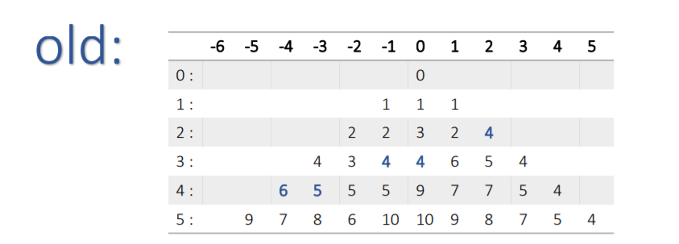
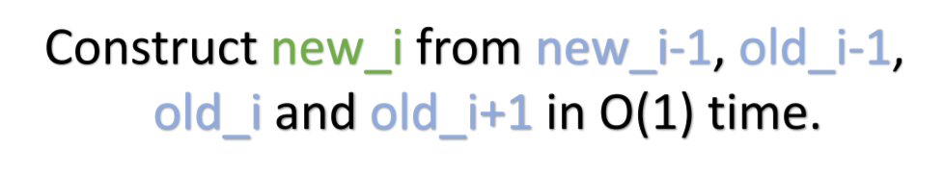
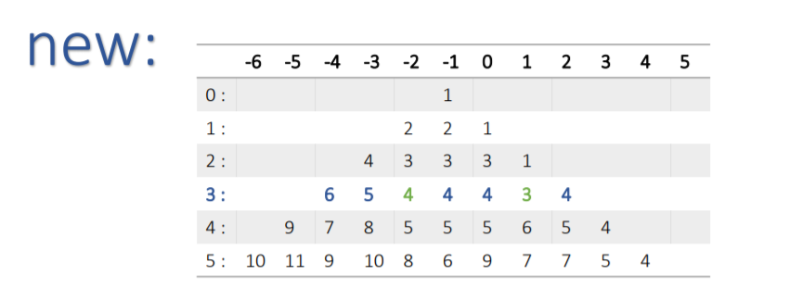

Slide 17
old_i-2
old_i-1
old_i
old_i+1
new_i-1
new_i

Slide 18
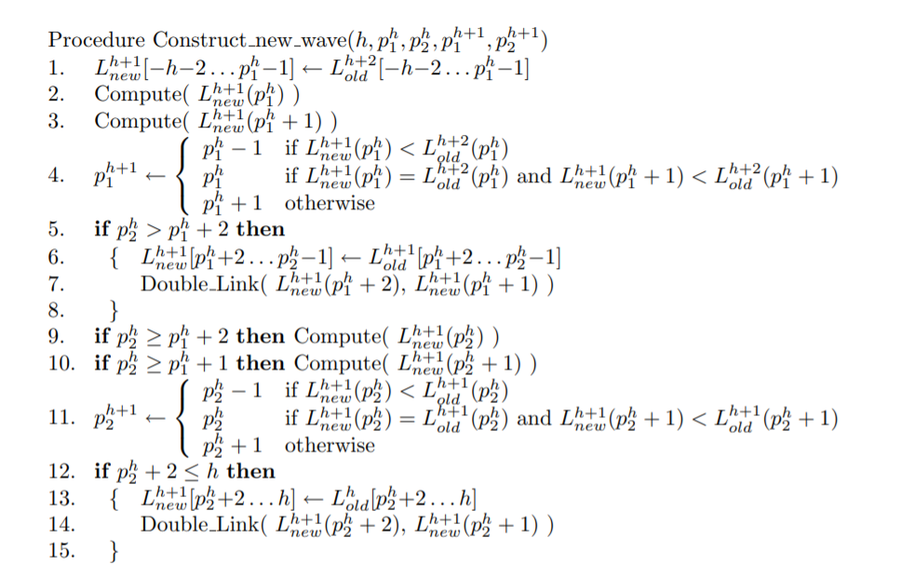

Slide 19
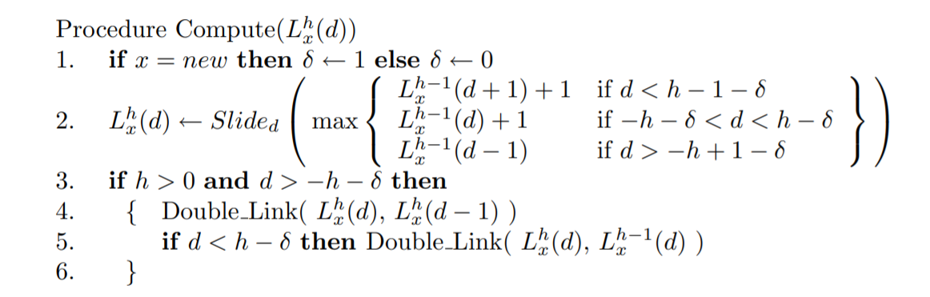

Slide 20
D
C
B
A
D
B
D
C
0 | 1 | 2 | 3 | 4 | 5 | 6 | 7 | 8
1 | 0 | 1 | 2 | 3 | 4 | 5 | 6 | 7
2 | 1 | 0 | 1 | 2 | 3 | 4 | 5 | 6
3 | 2 | 1 | 0 | 1 | 2 | 3 | 4 | 5
4 | 3 | 2 | 1 | 1 | 1 | 2 | 3 | 4
D
C
B
D

Slide 21
