Slide 1
Addressing inaccuracies in BLOSUM computation improves homology search performance
Martin Hess, Frank Keul, Michael Goesele, and Kay Hamacher
BioMed Central Bioinformatics volume 17, Article number: 189 (2016)
Presenter : Feng-Yang Tsai
Date: May 27, 2020.

Slide 2
Abstract(1/2)
BLOSUM matrices belong to the most commonly used substitution matrix series for protein homology search and sequence alignments since their publication in 1992. In 2008, Styczynski et al. discovered miscalculations in the clustering step of the matrix computation. Still, the RBLOSUM64 matrix based on the corrected BLOSUM code was reported to perform worse at a statistically significant level than the BLOSUM62. Here, we present a further correction of the (R)BLOSUM code and provide a thorough performance analysis of BLOSUM-, RBLOSUM- and the newly derived CorBLOSUM-type matrices.

Slide 3
Abstract(2/2)
Thereby, we assess homology search performance of these matrix-types derived from three different BLOCKS databases on all versions of the ASTRAL20, ASTRAL40 and ASTRAL70 subsets resulting in 51 different benchmarks in total. Our analysis is focused on two of the most popular BLOSUM matrices — BLOSUM50 and BLOSUM62.

Slide 4
Building the Database:
• SCOP (version 1.61)
• Evolutionary interrelations are known
• Homologous domains placed in same superfamily
• Subset is non-redundant
• ASTRAL provides SCOP subsets

Slide 5
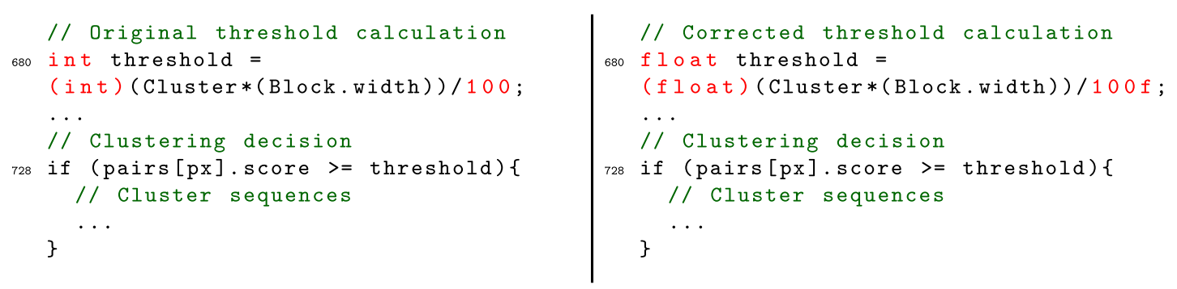
Scoring Matrices:
RBLOSUM:
revealed inconsistencies in the cluster weighting procedure of the matrix calculation.
CorBLOSUM:

Slide 6
The Blocks Database:
• The Blocks Database contains multiple alignments of conserved regions in protein families.
• Blocks are multiply aligned un-gapped segments corresponding to the most highly conserved regions of proteins.
• The blocks for the BLOCKS database are made automatically by looking for the most highly conserved regions in groups of proteins represented in the PROSITE database.

Slide 7
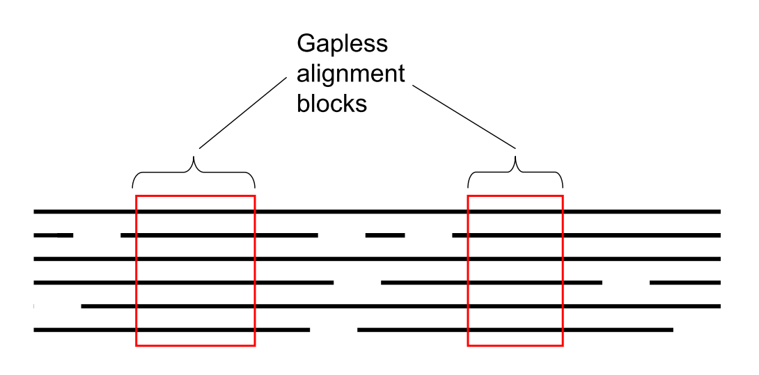
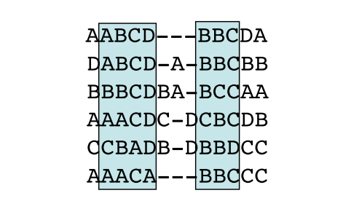
The Blocks Database:

Slide 8
Example of BLOSUM Calculation
An overview of the clustering and normalization process:
2 pairs of weight 1/6,
resulting in a total of 1/3 K-K pairs
Sequence | Position
Seq1 | K | L | W
Seq2 | K | L | A
Seq3 | R | L | W
Seq4 | K | K | L
Seq5 | V | K | L
Seq6 | P | I | L
1/6 for R-K,
1/3 for K-V,
7/6 for K-P,
1/6 for R-V,
1/3 for R-P,
1/2 for VP, which adds up to a total of 3 pairs

Slide 9
Example of BLOSUM Calculation
An overview of the clustering and normalization process:
2 pairs of weight 1/2,
resulting in a total of 1 K-K pairs
Sequence | Position
Seq1 | K | L | W
Seq2 | K | L | A
Seq3 | R | L | W
Seq4 | K | K | L
Seq5 | V | K | L
Seq6 | P | I | L
1/2 for R-K,
1 for K-V,
3 for K-P,
1/2 for R-V,
1 for R-P,
1 for VP, which adds up to a total of 8 pairs

Slide 10
Scoring Matrices:
RBLOSUM:
revealed inconsistencies in the cluster weighting procedure of the matrix calculation.
CorBLOSUM:

Slide 11
Performance Evaluation:
• Collect alignment scores (E-values) from pair-wise alignment of all sequences in the database
• E-value: number of alignments with scores greater than or equal to score S that are expected to occur by chance in a database search
• Vary the alignment score threshold
• Allow few false positive errors with stringent cutoff

Slide 12
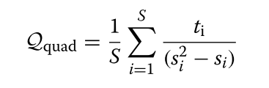
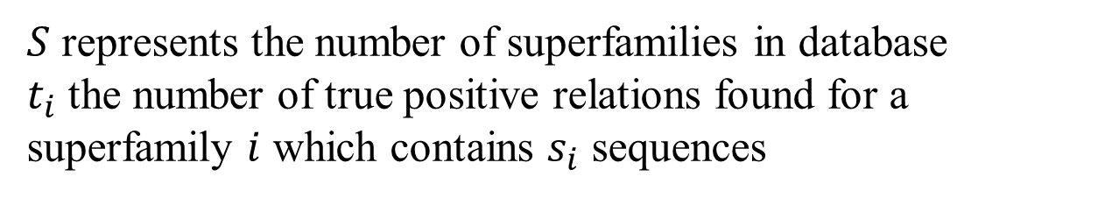
Performance Evaluation:
$S$ represents the number of superfamilies in database
$t_{i}$ the number of true positive relations found for a superfamily $i$ which contains $s_{i}$ sequences

Slide 13
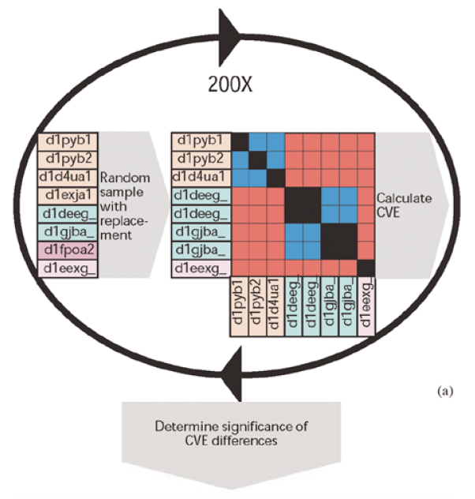
Bootstrapping:
CVE results from any two database search methods (or parameter sets, or scoring schemes, etc.) can be compared but it is not immediately obvious how significant any performance difference may be.
Notes:
可以比較來自任何兩種數據庫搜索方法（或參數集或計分方案等）的CVE結果，
但並不能立即明顯看出任何性能差異有多大。
為了解決這個問題，我們使用了布拉德·埃夫隆（Brad Efron）率先提出的一種稱為引導（bootstrapping）的技術。

Slide 14
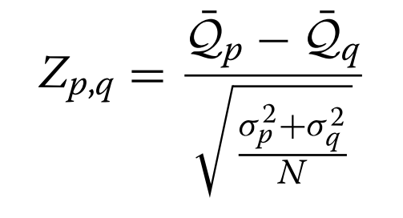
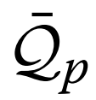
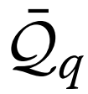
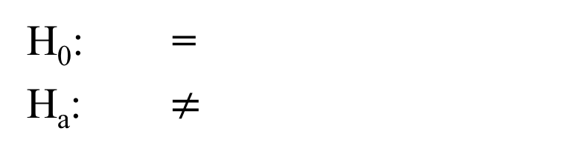
Performance Evaluation:
Two-Sample Z test
H₀: =
H_{a}: $≠$
Reject H
Reject H
0
0
-1.96
0
1.96
Z
If the Z-statistic is >1.96, we reject the hypothesis that the methods possess equivalent performance at 97.5% conﬁdence.

Slide 15
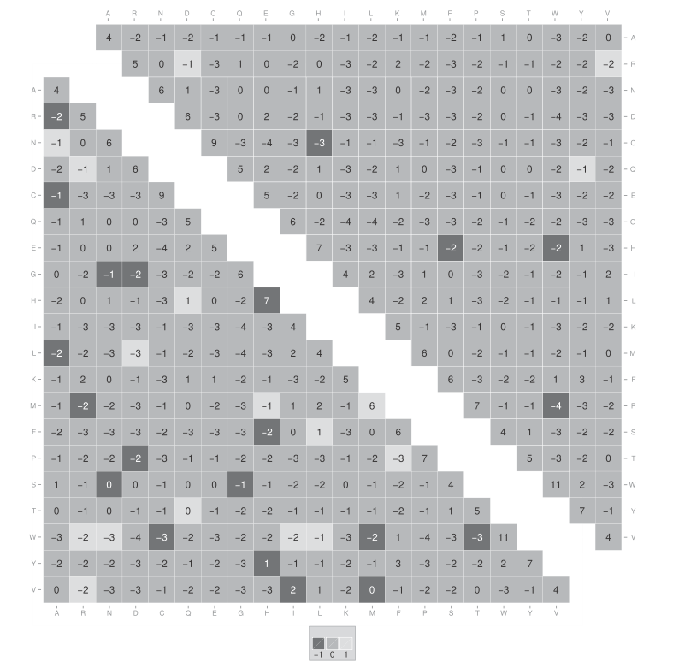
Result:

Slide 16
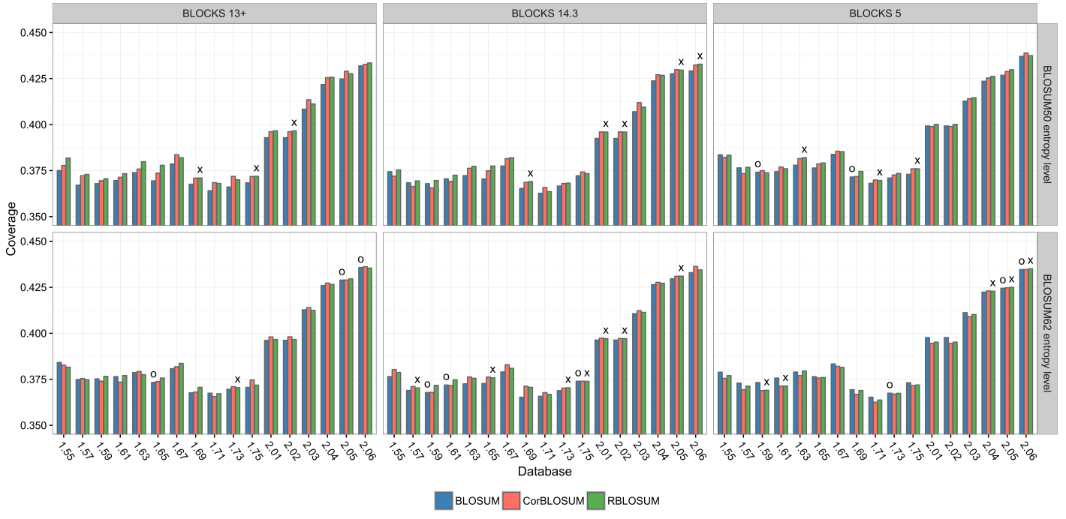
Result:

