Slide 1
Assessing Sequence Comparison Methods with Reliable Structurally Identified Distant Evolutionary Relationships
Steven E. Brenner, Cyrus Chothia, Tim J. P. Hubbard
Proceedings of the National Academy of Sciences, 1998,
Vol. 95, No. 11, pp. 6073-6078.
Presenter : Tz-Hsu Lee
Date : Jun 03, 2020.
Notes:
美國國家科學院院刊

Slide 2
Abstract(1/2)
Pairwise sequence comparison methods have been assessed using proteins whose relationships are known reliably from their structures and functions, as described in the SCOP database. The evaluation tested the programs BLAST, WU-BLAST2, FASTA, and SSEARCH and their scoring schemes. The error rate of all algorithms is greatly reduced by using statistical scores to evaluate matches rather than percentage identity or raw scores. The E-value statistical scores of SSEARCH and FASTA are reliable: the number of false positives found in our tests agrees well with the scores reported. However, the P-values reported by BLAST and WU-BLAST2 exaggerate significance by orders of magnitude.
Notes:
這篇主要在說生物的同源性，先從相似性推論到同源性，再從同源性推論到功能性，然後也說明怎樣能夠有效率的來識別是否為同源。

Slide 3
Abstract(2/2)
SSEARCH, FASTA ktup = 1, and WU-BLAST2 perform best, and they are capable of detecting almost all relationships between proteins whose sequence identities are >30%. For more distantly related proteins, they do much less well; only one-half of the relationships between proteins with 20–30% identity are found. Because many homologs have low sequence similarity, most distant relationships cannot be detected by any pairwise comparison method; however, those which are identified may be used with confidence.
Notes:
這篇主要在說生物的同源性，先從相似性推論到同源性，再從同源性推論到功能性，然後也說明怎樣能夠有效率的來識別是否為同源。

Slide 4

Previous assessments of sequence comparison
Pearson : the rigorous Smith–Waterman algorithm worked slightly better than FASTA, which was in turn more effective than BLAST.
Henikoff : the BLOSUM62 matrix performed markedly better than the extrapolated PAM-series matrices, which previously had been popular.
Sander and Schneider : proteins with 25% identity over 80 residues will have similar structures, whereas shorter alignments require higher identity.
Notes:
Pearson的database是PIR
Henikoff是評價BLAST和FASTA的效能，用的是SWISS-PROT database
Sander and Schneider用蛋白質結構來評估

Slide 5
A database for testing homology detection
SCOP database
PDB90D-B、PDB40D-B
Notes:
血紅蛋白和肌紅蛋白雖然序列並不相似，但他們是非常接近的，所以看結構和功能會比看序列來得好。
蛋白質結構分類數據庫主要是根據蛋白質結構域的結構和氨基酸序列的相似性對蛋白質結構域進行手動分類。進行這種分類的動機是確定蛋白質之間的進化關係。具有相同形狀但幾乎沒有序列或功能相似性的蛋白質被置於不同的超家族中，並且被認為僅具有非常遙遠的共同祖先。
PDB40D-B有1323個domain，9044個有序的遠距離關係列
PDB90D-B有2079個domain，53988個有序的遠距離關係列
但是PDB40D-B著眼於遠距離相關的蛋白質，減少了少數家族在PDB中的過度表達，而PDB90D-B（具有更多的序列）改善了對統計數據的評估

Slide 6
Assessment Data and Procedure(1/5)
BLAST, version 1.4.9MP, used BLOSUM62
WUBLAST2, version 2.0a13MP, used BLOSUM62
FASTA, version 3.0t76, used BLOSUM45
Notes:
2.10
36

Slide 7
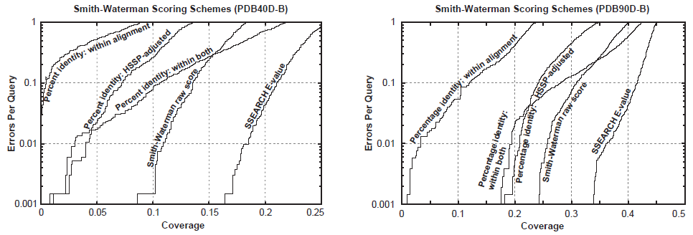
Assessment Data and Procedure(2/5)
1. Using just a single sequence comparison algorithm at a time, and evaluated the effectiveness of different scoring schemes
Notes:
EPQ:超出閾值的非同源對的數量除以查詢數量
the x axis indicates the fraction of all homologs in the database (known from structure) which have been detected.
Percentage identity within alignment is the degree of identity within the aligned region of the proteins, without consideration of the alignment length.
Percentage identity within both is the number of identical residues in the aligned region as a percentage of the average length of the query and target proteins
The HSSP equation (17) is H 5 290.15*l的-0.562次方 where l is length for 10 < l < 80; H > 100 for l < 10; H = 24.7 for l > 80. The percentage identity HSSP-adjusted score is the percent identity within the alignment minus H.

Slide 8
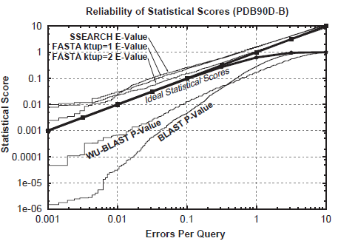
Assessment Data and Procedure(3/5)
2. Assessing the reliability of scoring procedures, including an evaluation of the validity of statistical scoring
Notes:
SSEARCH和FASTA的E值與EPQ有很好的一致性，但其重要性略有低估。 BLAST和WU-BLAST2過於自信，誇張程度取決於得分。

Slide 9
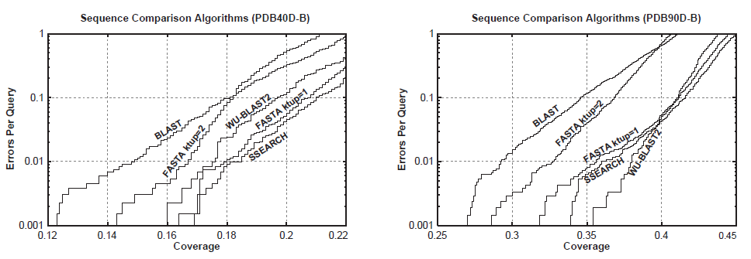
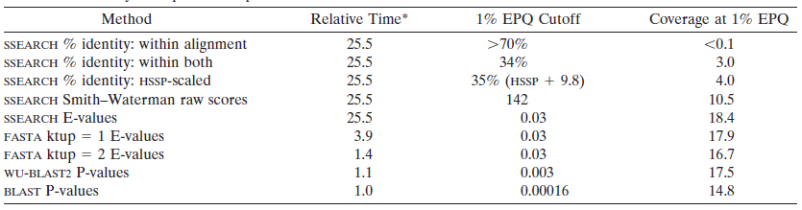
Assessment Data and Procedure(4/5)
3. Compared sequence comparison algorithms (using the optimal scoring scheme) to determine their relative performance
Notes:
ktup參數由用戶指定，其整數值可以為1-6（包括1-6）（默認= 2）。 這確定了匹配需要多少個連續的相同殘基。 這對搜索的敏感性和選擇性有影響。增大ktup參數就會減少字串命中的數目，也就會減少所需要的最佳搜尋的數目和搜尋的速度。

Slide 10
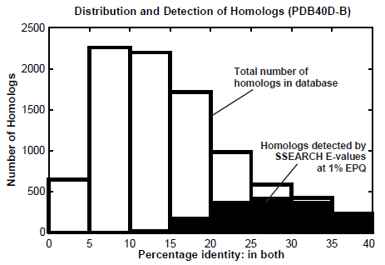
Assessment Data and Procedure(5/5)
4. Examined the distribution of homologs and considered the power of pairwise sequence comparison to recognize them
Notes:
Explain why most distant homologs cannot be found by sequence comparison

Slide 11
Conclusion
The E-values reported by FASTA and SSEARCH give fairly accurate estimates of the significance of each match, but the P-values provided by BLAST and WU-BLAST2 underestimate the true extent of errors.
SSEARCH, WU-BLAST2, and FASTA ktup = 1 perform best, though BLAST and FASTA ktup = 2 detect most of the relationships found by the best procedures and are appropriate for rapid initial searches.
Notes:
FASTA和SSEARCH報告的E值對每個匹配的重要性給出了相當準確的估計，但是BLAST和WU-BLAST2提供的P值低估了錯誤的真實程度。
SEARCH，EU-BLAST和FASTA ktup = 1的效果最佳，儘管BLAST和FASTA ktup = 2可以檢測出通過最佳方法發現的大多數關係，並且適用於快速的初始搜索。

