Slide 1
FOGSAA: Fast Optimal Global Sequence Alignment Algorithm
Angana Chakraborty, Sanghamitra Bandyopadhyay
Scientific Reports volume 3 2013 Apr. 29. doi: 10.1038/srep01746
Presenter: Yuan-Hsiu Tsai
Date: June 3, 2020

Slide 2
Abstract(1/2)
In this article we propose a Fast Optimal Global Sequence Alignment Algorithm, FOGSAA, which aligns a pair of nucleotide/protein sequences faster than any optimal global alignment method including the widely used Needleman-Wunsch (NW) algorithm. FOGSAA is applicable for all types of sequences, with any scoring scheme, and with or without affine gap penalty. Compared to NW, FOGSAA achieves a time gain of (70-90)% for highly similar nucleotide sequences (> 80% similarity), and (54-70)% for sequences having (30-80)% similarity.

Slide 3
Abstract(2/2)
For other sequences, it terminates with an approximate score. For protein sequences, the average time gain is between (25-40)%. Compared to three heuristic global alignment methods, the quality of alignment is improved by about 23%-53%. FOGSAA is, in general, suitable for aligning any two sequences defined over a finite alphabet set, where the quality of the global alignment is of supreme importance.

Slide 4
Introduction-Parameter
(P1,P2) : current position P1,P2 are pair of the sequence.
Present Score Sum of score of current position.
Future Score – F_{min}, F_{max} Predict score by current position.
Fitness Score – T_{min},T_{max} Sum of Present Score and Future Score

Slide 5
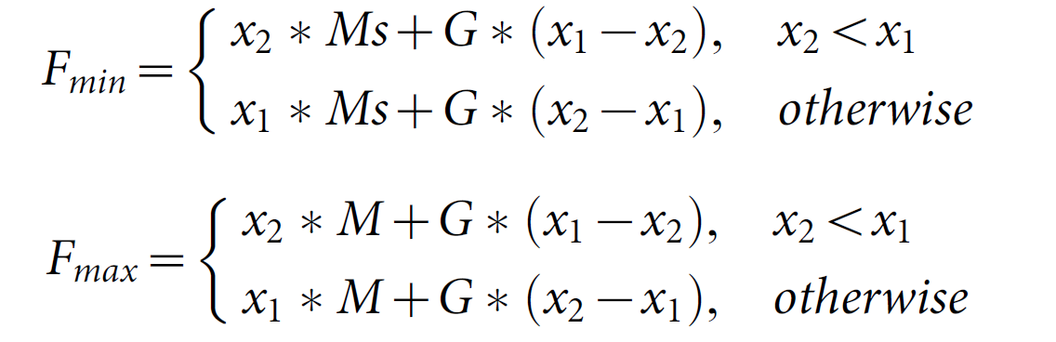
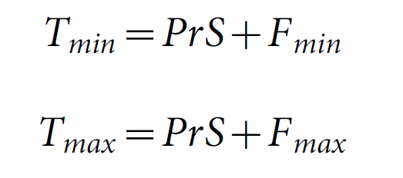
Introduction

Slide 6
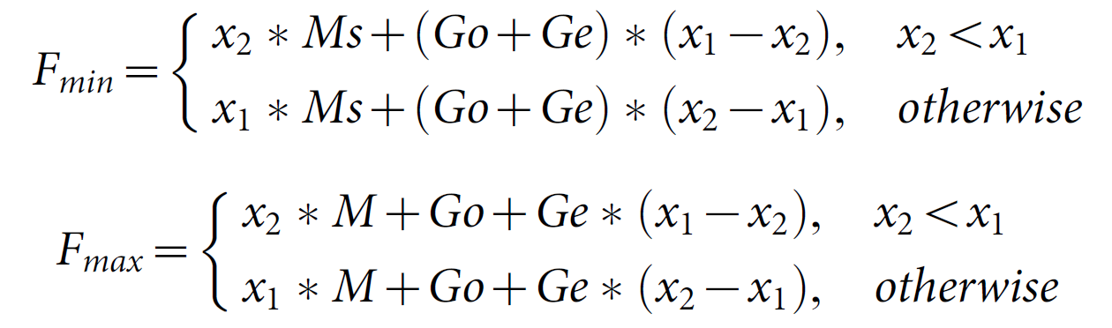

Slide 7
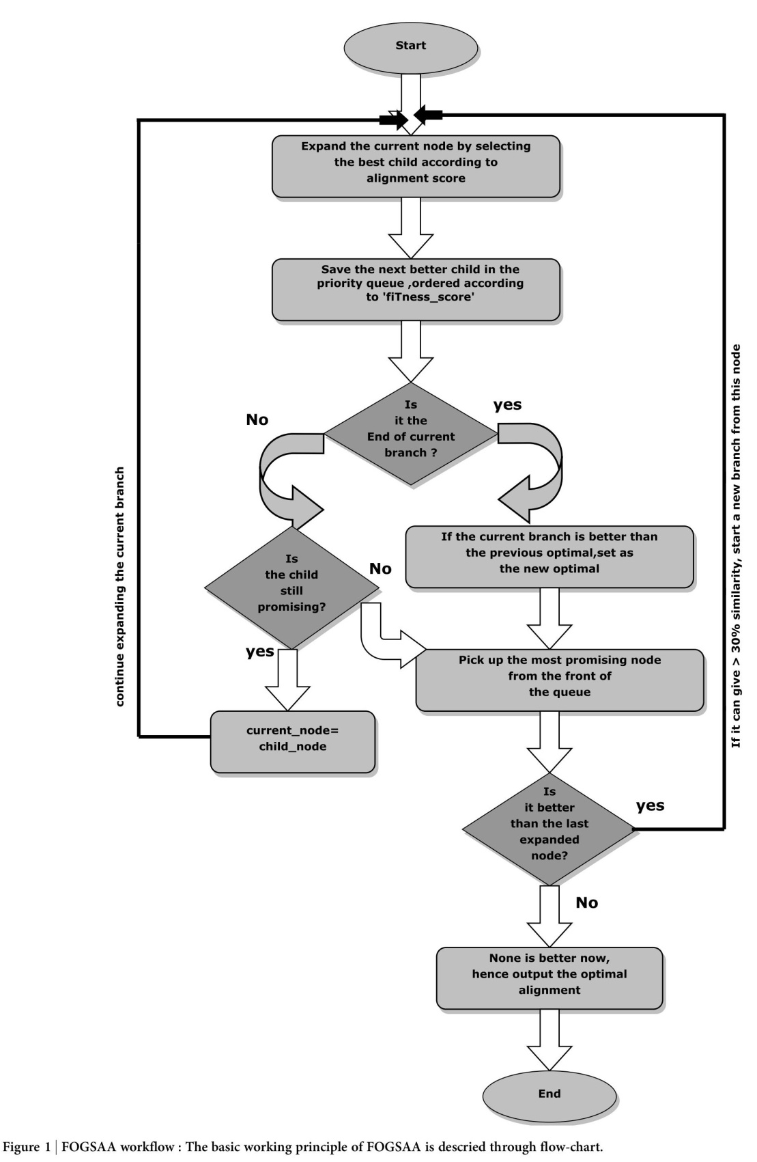

Slide 8
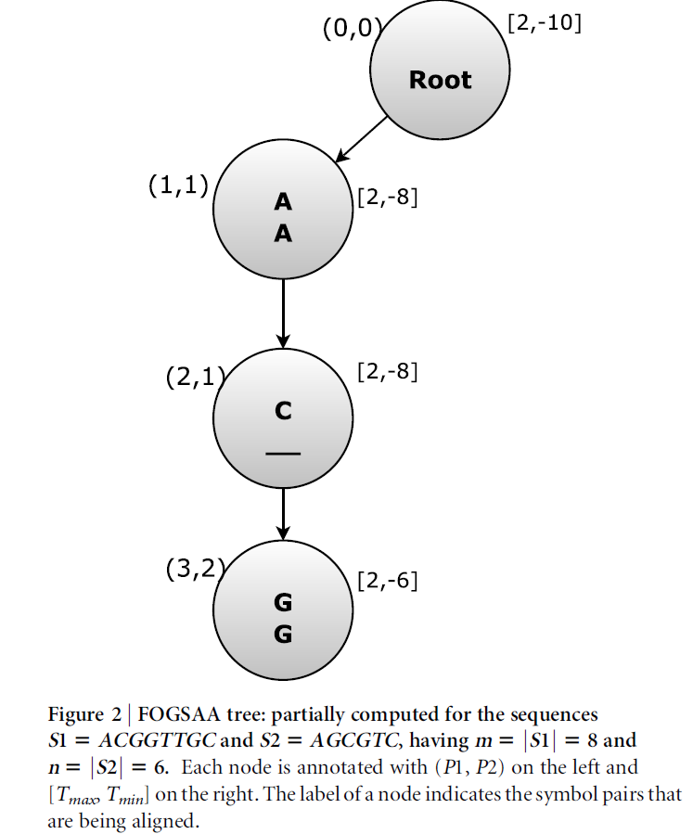

Slide 9
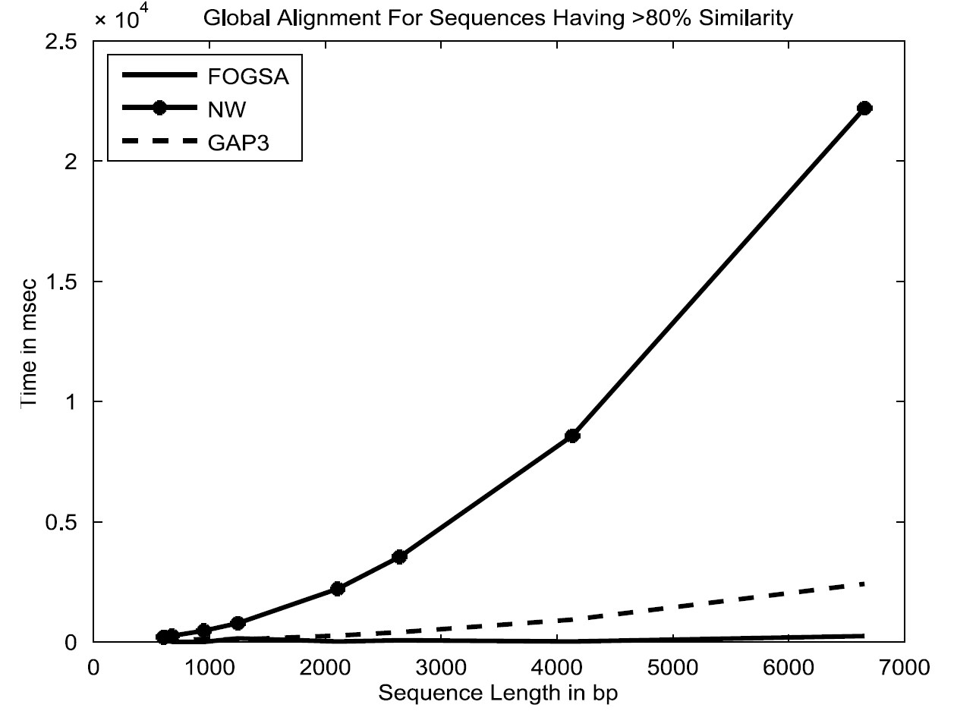

Slide 10
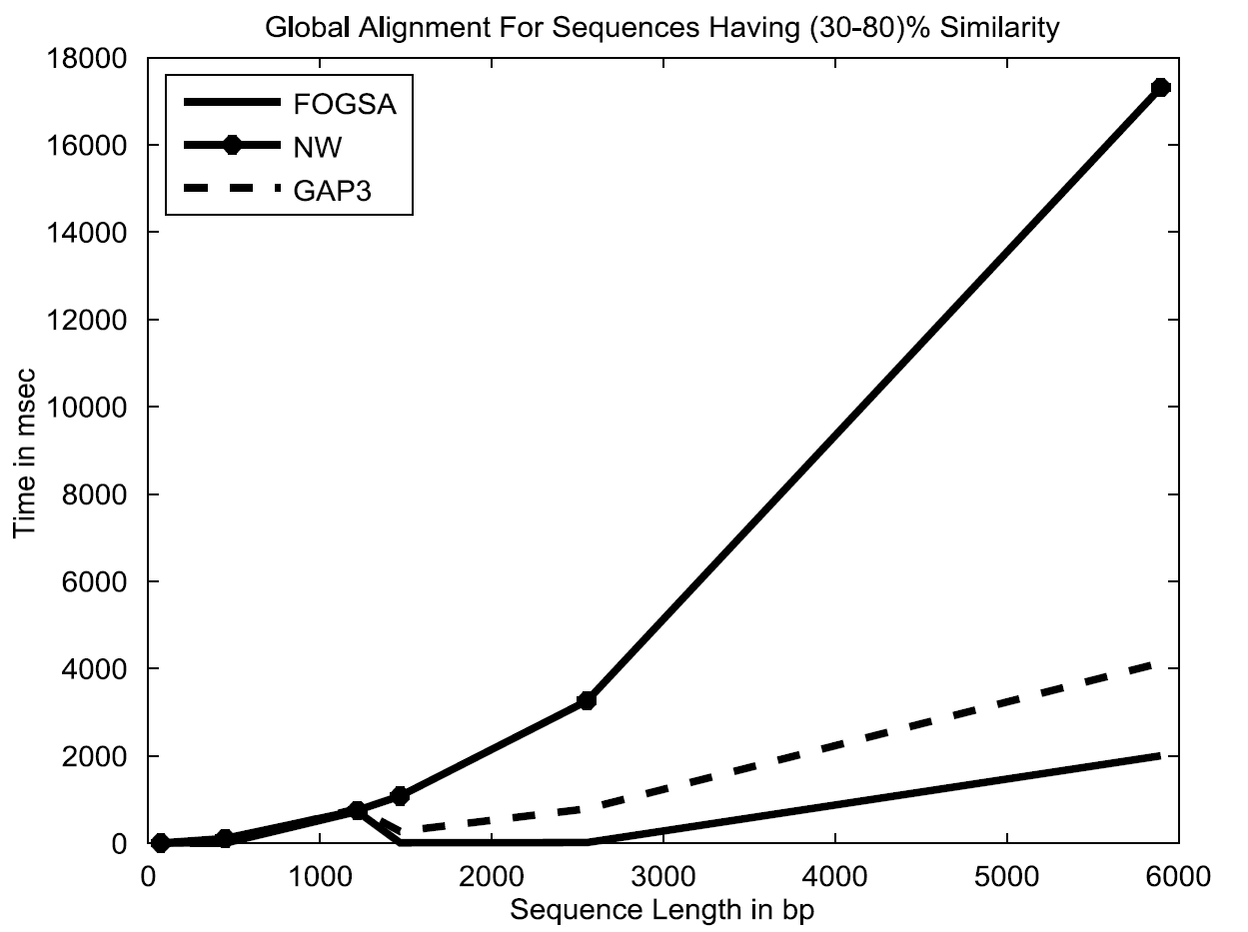

Slide 11
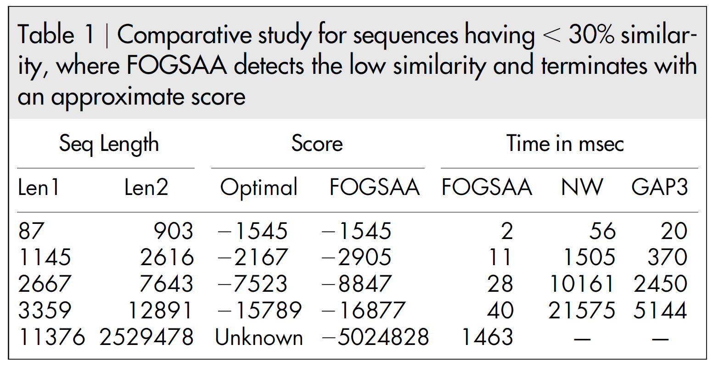

Slide 12
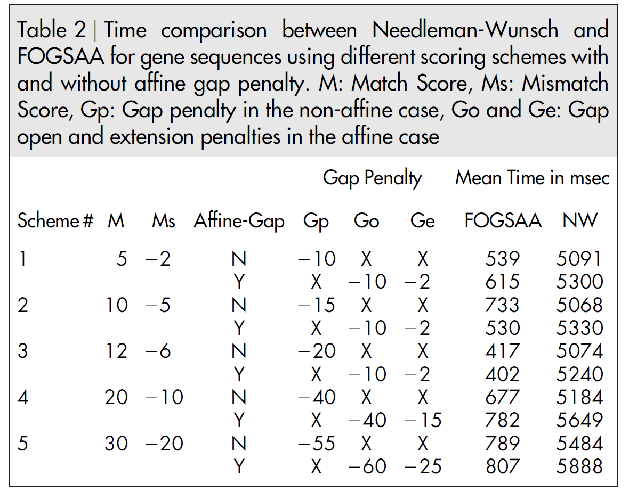

Slide 13
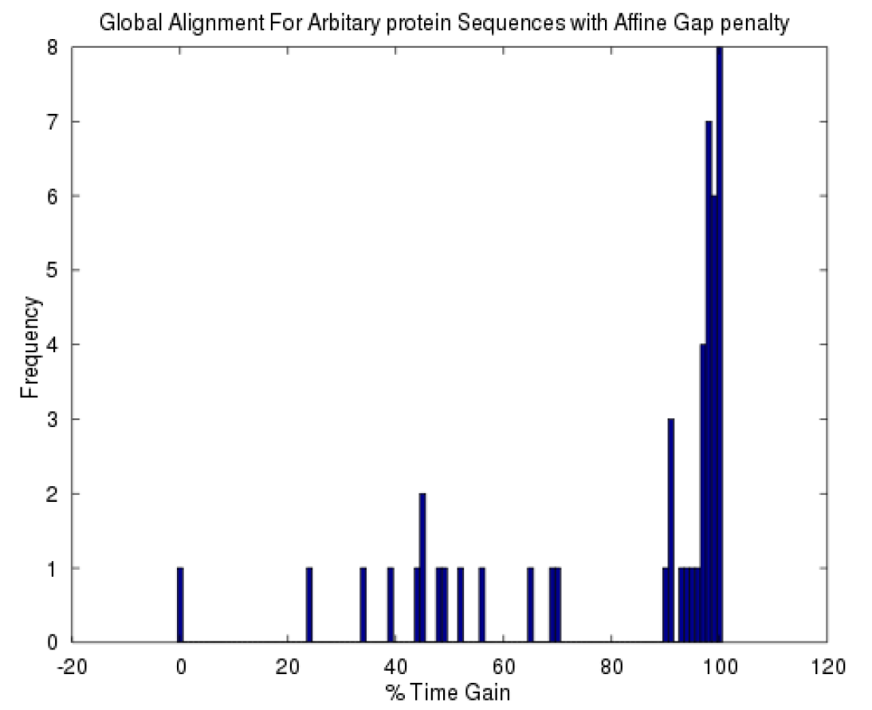

Slide 14
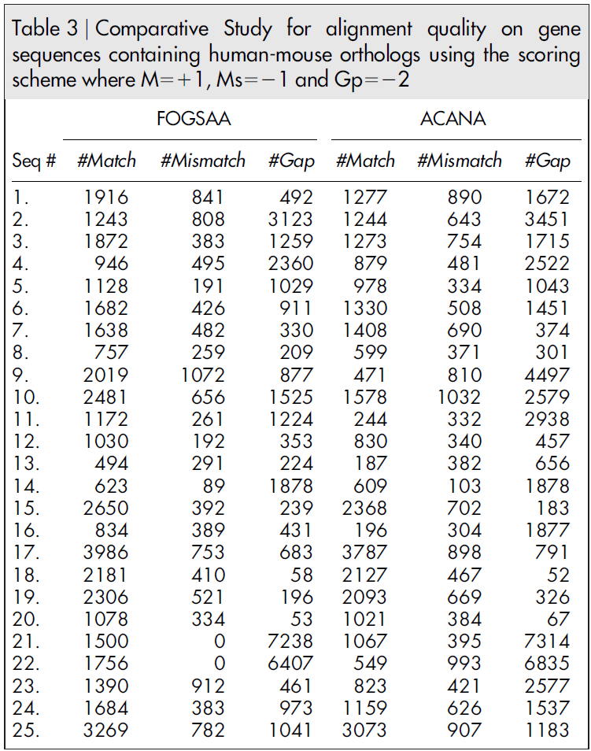

Slide 15
Summary
FOGSAA can get the optimal alignment. (It use branch and bound, not heuristic method)
FOGSAA is suitable for all score matrix. (protein score matrix need to check)
FOGSAA is slower than other heuristic method like FASTA, BLAST, but is faster than Needleman-Wunsch algorithm(NW).

