Slide 1
Firefly Algorithm, L´evy Flights and Global Optimization
Yang, Xin-She
Research and development in intelligent systems XXVI. Springer, London, 2010. p. 209-218.
Presenter : Tz-Hsu Lee
Date : Jul 08, 2020.
Notes:
各位老師同學學長大家好，我是今天的報告者李子旭，今天我要報告的主題是，作者是，他是維吉尼亞大學的生物化學和分子遺傳學的教授，在美國，他是以開發FASTA而聞名，那我先開始念一下摘要。

Slide 2
Abstract
Nature-inspired algorithms such as Particle Swarm Optimization and Fire-fly Algorithm are among the most powerful algorithms for optimization. In this paper, we intend to formulate a new metaheuristic algorithm by combining L´evy flights with the search strategy via the Firefly Algorithm. Numerical studies and results suggest that the proposed L´evy-flight firefly algorithm is superior to existing metaheuristic algorithms. Finally implications for further research and wider applications will be discussed.
Notes:
這篇主要在說生物的同源性，先從相似性推論到同源性，再從同源性推論到功能性，然後也說明怎樣能夠有效率的來識別是否為同源。

Slide 3

Firefly Algorithm
All fireflies are unisex so that one firefly will be attracted to other fireflies regardless of their sex
For any two flashing fireflies, the less brighter one will move towards the brighter one.
The brightness of a firefly is affected or determined by the landscape of the objective function
Notes:
Pearson的database是PIR
Henikoff是評價BLAST和FASTA的效能，用的是SWISS-PROT database
Sander and Schneider用蛋白質結構來評估

Slide 4
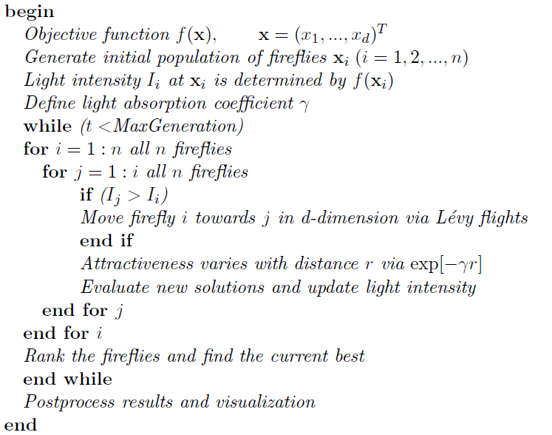
L´evy-Flight Firefly Algorithm(1/2)
Notes:
血紅蛋白和肌紅蛋白雖然序列並不相似，但他們是非常接近的，所以看結構和功能會比看序列來得好。
蛋白質結構分類數據庫主要是根據蛋白質結構域的結構和氨基酸序列的相似性對蛋白質結構域進行手動分類。進行這種分類的動機是確定蛋白質之間的進化關係。具有相同形狀但幾乎沒有序列或功能相似性的蛋白質被置於不同的超家族中，並且被認為僅具有非常遙遠的共同祖先。
PDB40D-B有1323個domain，9044個有序的遠距離關係列
PDB90D-B有2079個domain，53988個有序的遠距離關係列
但是PDB40D-B著眼於遠距離相關的蛋白質，減少了少數家族在PDB中的過度表達，而PDB90D-B（具有更多的序列）改善了對統計數據的評估

Slide 5

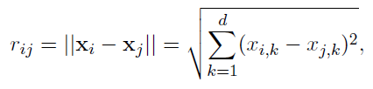
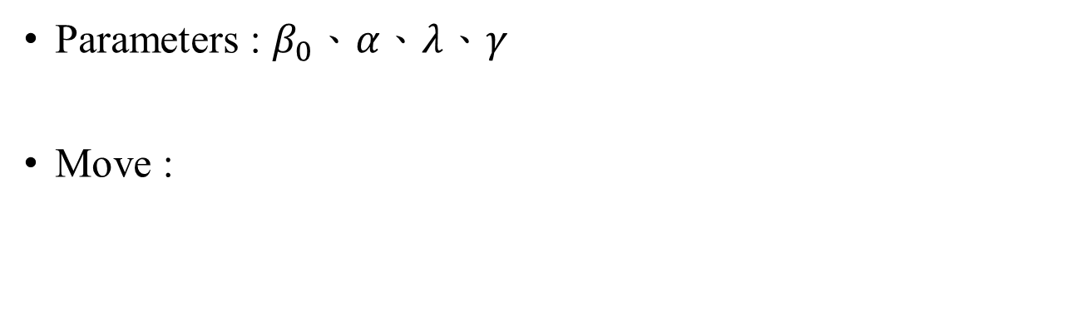
L´evy-Flight Firefly Algorithm(2/2)
Parameters : $β_{0}$、$α、λ$、$γ$
Move :
Notes:
Pearson的database是PIR
Henikoff是評價BLAST和FASTA的效能，用的是SWISS-PROT database
Sander and Schneider用蛋白質結構來評估

Slide 6





L´evy-Flight(1/4)
Levy flights process a step length which be calculated by using Mantegna’s algorithm :
𝑤 and 𝑢 are described from normal distribution :
$$S=\frac{w}{{|u|}^{\frac{1}{β}}}$$
$$σ_{w}^{}={\left\{ \frac{τ(1+β)\sin{\frac{πβ}{2}}}{τ[\frac{(1+β)}{2}]β2^{\frac{β−1}{2}}}\right\}}^{\frac{1}{β}}$$
$$w\sim N(0,σ_{w}^{2})$$
,
$$u\sim N\left(0,σ_{u}^{2}\right)$$
with
,
$$σ_{u}^{}=1$$
Notes:
2.10
36

Slide 7
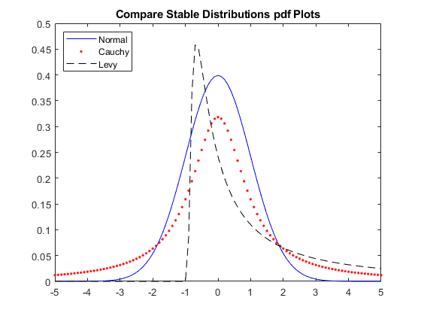
L´evy-Flight(2/4)
Notes:
2.10
36

Slide 8
L´evy-Flight(3/4)
Large β of 𝐿𝑒𝑣𝑦 𝐹𝑙𝑖𝑔ℎ𝑡𝑠 : more often to cause big jumps to unexplored areas (higher exploration), and it prevent getting stuck in local optimums.
Small β of 𝐿𝑒𝑣𝑦 𝐹𝑙𝑖𝑔ℎ𝑡𝑠 : more often to considered new solution near the current solutions (higher exploitation), that help finding a better solution more efficiently.
Notes:
2.10
36

Slide 9
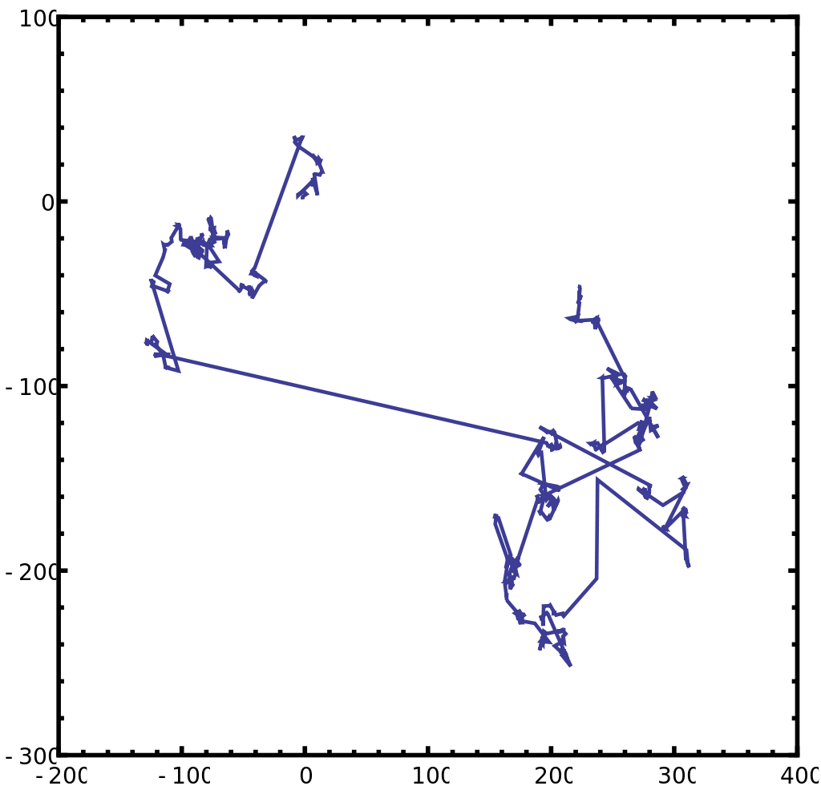
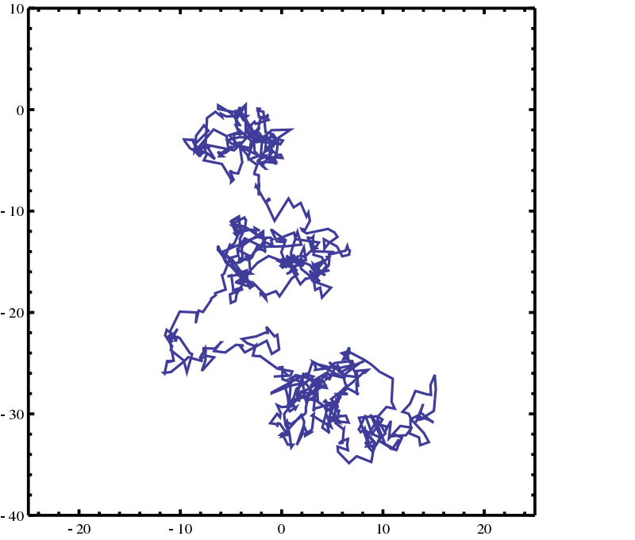
L´evy-Flight(4/4)
Lévy flight in two dimensions
step size is distributed according to a Lévy
Brownian motion in two dimensions
step size is distributed according to a normal distribution
Notes:
2.10
36

Slide 10
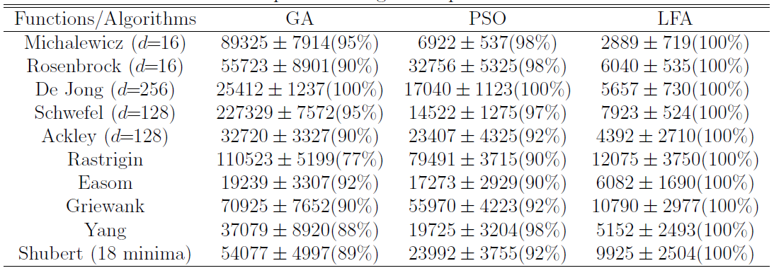
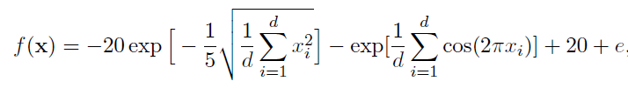

Simulations and Results(1/4)
$β_{0}$=1、𝛼=0.2、𝜆=1.5、𝛾=1
Ackley function :

Slide 11
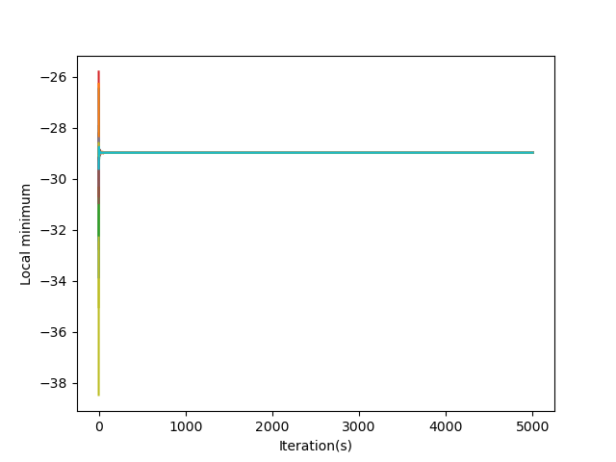
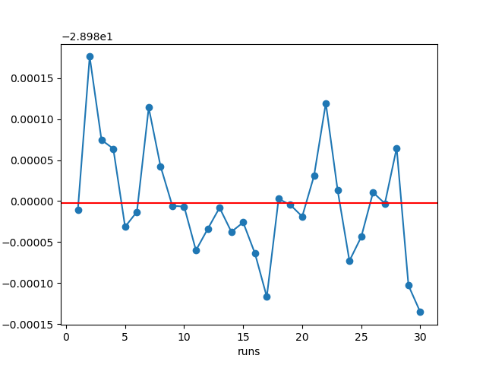
Simulations and Results(2/4)
Michalewicz(d=30)

Slide 12
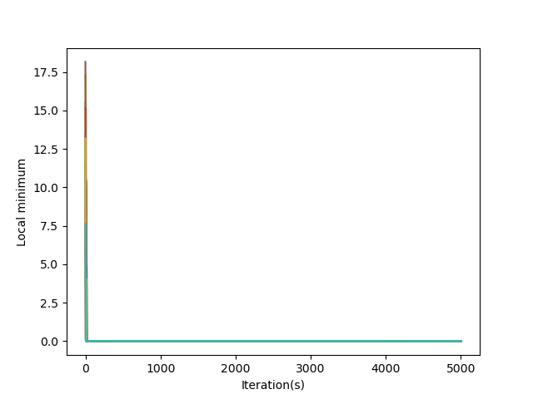
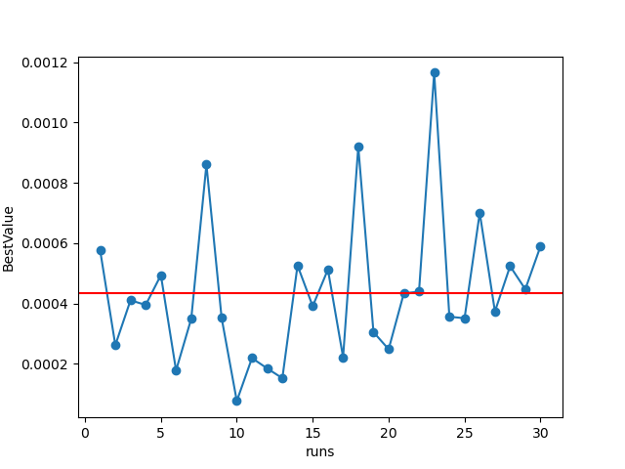
Simulations and Results(3/4)
Ackley(d=2)

Slide 13
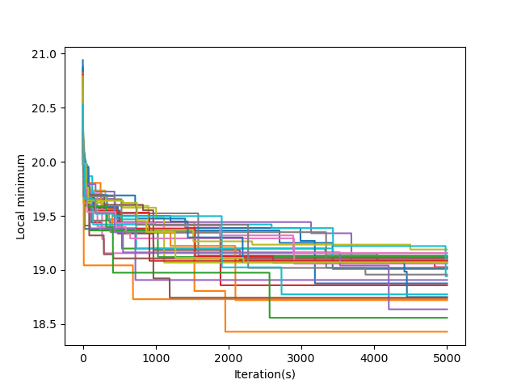
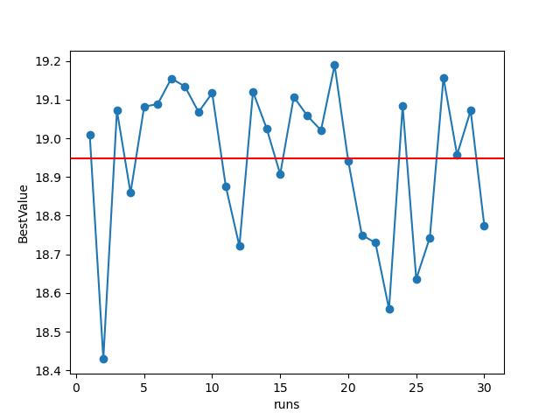
Simulations and Results(4/4)
Ackley(d=30)

