Slide 1
Fully Incremental LCS Computation
Yusuke Ishida, Shunsuke Inenaga, Ayumi Shinohara, and Masayuki Takeda, LNCS 3623, pp. 563–574, 2005.
Presenter: Shao-Xuan Lee
Date: Jul. 15, 2020

Slide 2
Abstract
Sequence comparison is a fundamental task in pattern matching. Its applications include file comparison, spelling correction, information retrieval, and computing (dis)similarities between biological sequences. A common scheme for sequence comparison is the longest common subsequence (LCS) metric. This paper considers the fully incremental LCS computation problem as follows: For any strings A, B and characters a, b, compute LCS(aA, B), LCS(A, bB), LCS(Aa, B), and LCS(A, Bb), provided that L = LCS(A, B) is already computed. We present an efficient algorithm that computes the four LCS values above, in O(L) or O(n) time depending on where a new character is added, where n is the length of A. Our algorithm is superior in both time and space complexities to the previous known methods.

Slide 3
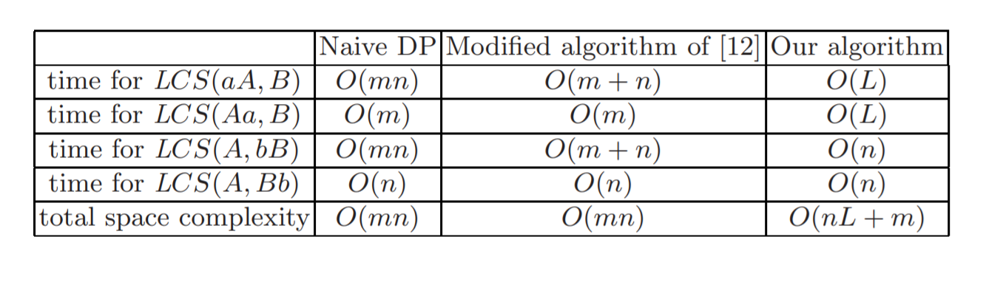

Slide 4
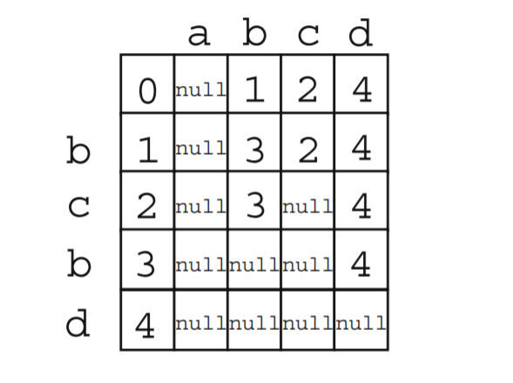
1. LCS(aA,B)

Slide 5
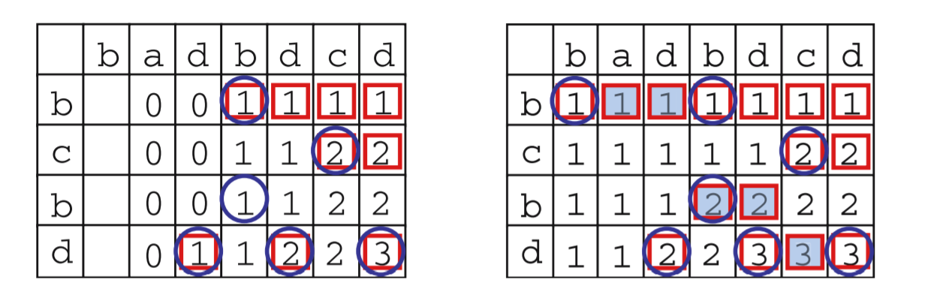
Circle : match points
Rectangle : partition points
Grey rectangles : new partition points

Slide 6
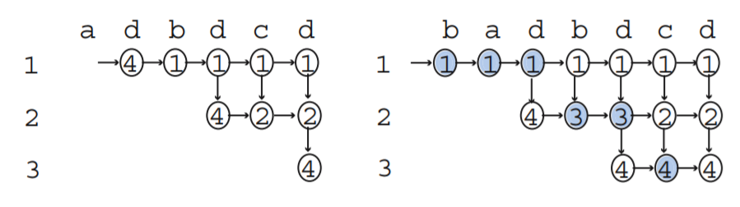
LCS(aA, B) is computable in amortized O(L) time

Slide 7
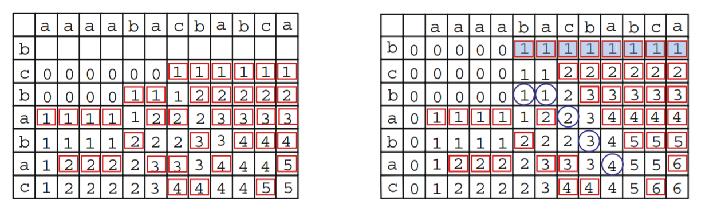
2. LCS(A,bB)
LCS(A, bB) is computable in O(n) time

Slide 8
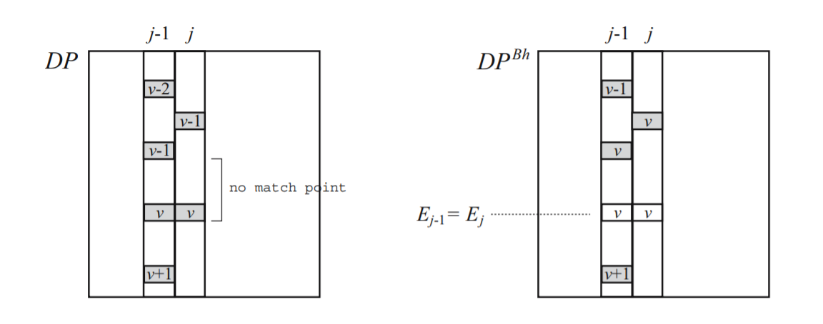

Slide 9
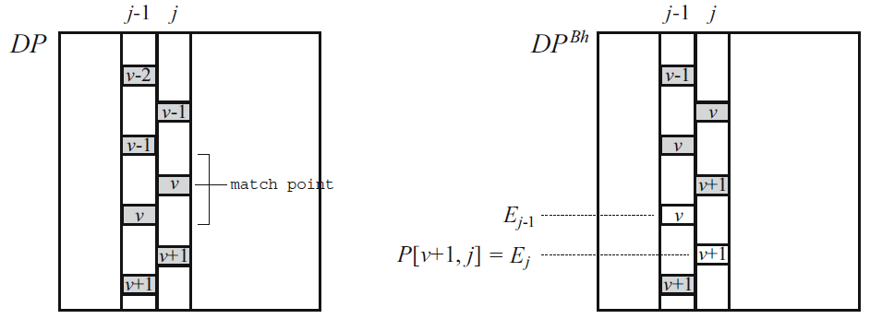

Slide 10
3. LCS(Aa,B)
 | b | a | d | b | d | c | d | b
b | 1 | 1 | 1 | 1 | 1 | 1 | 1
c | 1 | 1 | 1 | 1 | 1 | 2 | 2
b | 1 | 1 | 1 | 2 | 2 | 2 | 2
d | 1 | 1 | 2 | 2 | 3 | 3 | 3
 | b | a | d | b | d | c | d | b
b | 1 | 1 | 1 | 1 | 1 | 1 | 1 | 1
c | 1 | 1 | 1 | 1 | 1 | 2 | 2 | 2
b | 1 | 1 | 1 | 2 | 2 | 2 | 2 | 3
d | 1 | 1 | 2 | 2 | 3 | 3 | 3 | 3
LCS(Aa, B) is computable in O(L) time.

Slide 11
4. LCS(A,Bb)
 | b | a | d | b | d | c | d
b | 1 | 1 | 1 | 1 | 1 | 1 | 1
c | 1 | 1 | 1 | 1 | 1 | 2 | 2
b | 1 | 1 | 1 | 2 | 2 | 2 | 2
d | 1 | 1 | 2 | 2 | 3 | 3 | 3
d
 | b | a | d | b | d | c | d
b | 1 | 1 | 1 | 1 | 1 | 1 | 1
c | 1 | 1 | 1 | 1 | 1 | 2 | 2
b | 1 | 1 | 1 | 2 | 2 | 2 | 2
d | 1 | 1 | 2 | 2 | 3 | 3 | 3
d | 1 | 1 | 2 | 2 | 3 | 3 | 4
LCS(A, Bb) is computable in O(n) time

