Slide 1
Optimum Scheduling System for Container Truck Based on Genetic Algorithm on Spin(simulator Pelabuhan Indonesia)
Handoko Supeno, Pranoto H Rusmin, Hilwadi Hindersah
2015 4th International Conference on Interactive Digital Media (ICIDM), 1-5 Dec. 2015, Bandung, Indonesia
Presenter : Chih-Kai Wu
Date: 7.15, 2020.
Notes:
聖胡安是美國自治領地波多黎各的首府和最大城市

Slide 2
Abstract (1/2)
The logistic process of Container is very crucial to the port, but often problem occur due to lack of truck scheduling so that adds to the turn around time. Response to this problem, this thesis will try to generate scheduling trucks by genetic algorithm to minimizes the traveling distance when operating in unloading and loading cargo so can reduce the turn around time. This optimization will embedded to SPIN (Simulator Pelabuhan Indonesia) so user can see the result with 3d visualization. Because the genetic algorithm used in a simulator, the computing time becomes an important issue.

Slide 3
Abstract (2/2)
Therefore, genetic algorithms built using several techniques, such as permutation with two part chromosome, crossover, tournament selection, and simple swap mutation.The test results of this study prove that by using the techniques described above, the time and distance it takes to complete the process of unloading is a decreased and computation time program is relatively small. From the results of experiments conducted it was concluded that genetic algorithms can reduce unloading time that there is a way to assign the truck to the next job that has the shortest distance. With shorter unloading time, the direct impact on the costs to be incurred by mooring the vessel so that the port becomes more underserved customers.

Slide 4
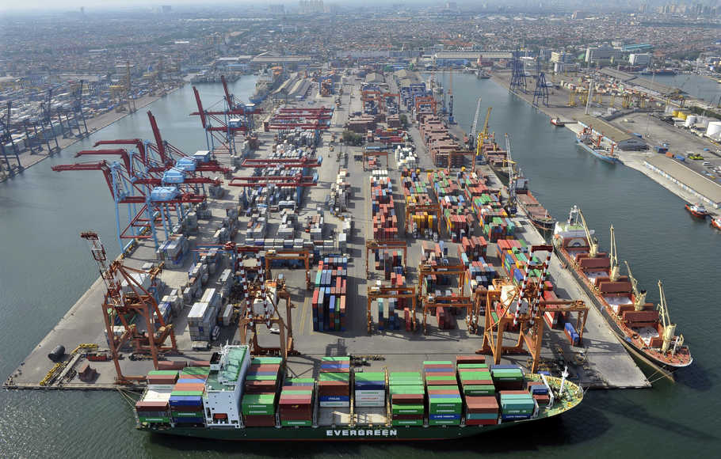
Tanjung Priok

Slide 5
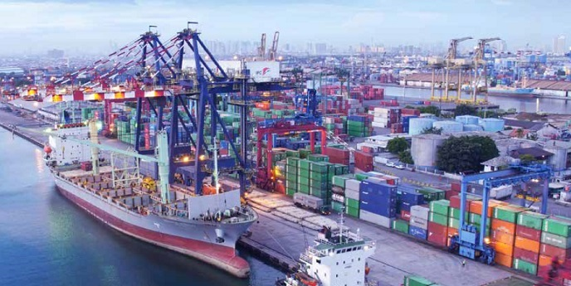
Tanjung Priok

Slide 6
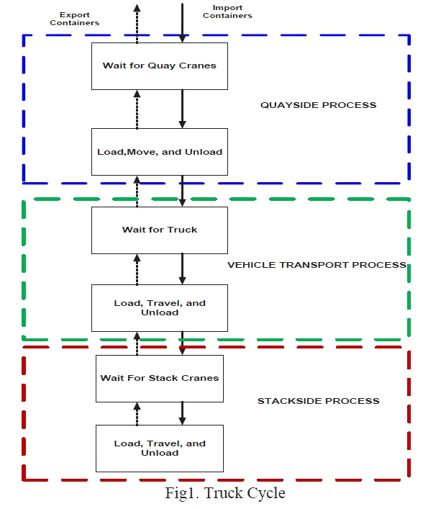
Experiment

Slide 7
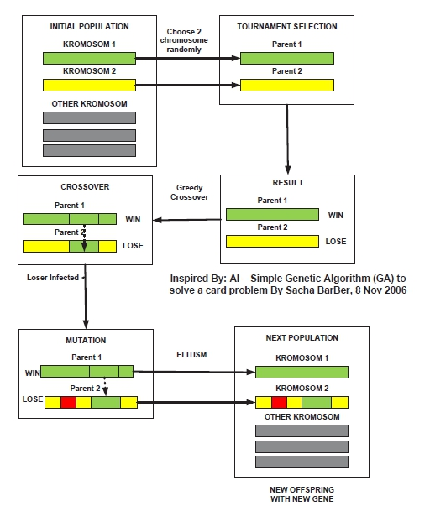
Experiment

Slide 8
Experiment
W
5 | 4 | 2 | 6 | 8 | 1 | 3 | 7 | 9
L
3 | 2 | 7 | 5 | 6 | 9 | 4 | 1 | 8
5 | 4 | 2 | 6 | 8 | 1 | 3 | 7 | 9
3 | 2 | 7 | 5 | 6 | 9 | 4 | 1 | 8

Slide 9
Experiment
5 | 4 | 2 | 6 | 8 | 1 | 3 | 7 | 9
3 | 2 | 7 | 5 | 8 | 1 | 3 | 1 | 8
4 | 2 | 7 | 5 | 8 | 1 | 3 | 9 | 6
final
5 | 4 | 2 | 6 | 8 | 1 | 3 | 7 | 9
4 | 2 | 7 | 5 | 8 | 1 | 3 | 9 | 6

Slide 10
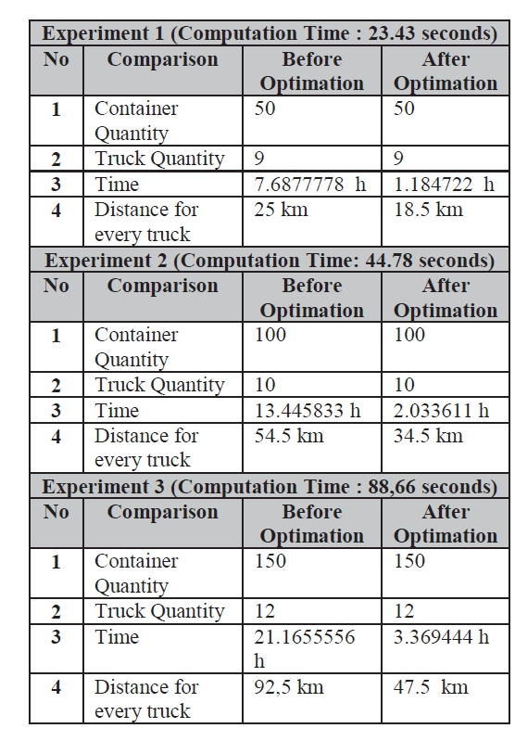
Experiment

