Slide 1
Sequence Alignment using FastLSA
Kevin Charter, Jonathan Schaeer, Duane Szafron,
In Proceedings of the 2000 International Conference on Mathematics and
Engineering Techniques in Medicine and Biological Sciences, 2000.
Presenter: Shao-Xuan Lee
Date: Aug. 11, 2020

Slide 2
Abstract
For two strings of length m and n, optimal sequence alignment takes time and space proportional to m×n to compute. The time actually consists of two parts: computing the score of the best alignment and then extracting the alignment (by reading the computed values). The space requirement is usually prohibitive. Hirschberg's algorithm reduces the space needs to roughly 2×m, but doubles the cost of computing and extracting the alignment. This paper introduces the FastLSA algorithm that is adaptive to the amount of space available. At one extreme, it uses linear space, while at the other it uses quadratic space. Based on the memory resources available, the algorithm saves the maximum amount of information to achieve the lowest extraction cost. The algorithm is shown to be analytically and experimentally superior to Hirschberg's algorithm.

Slide 3
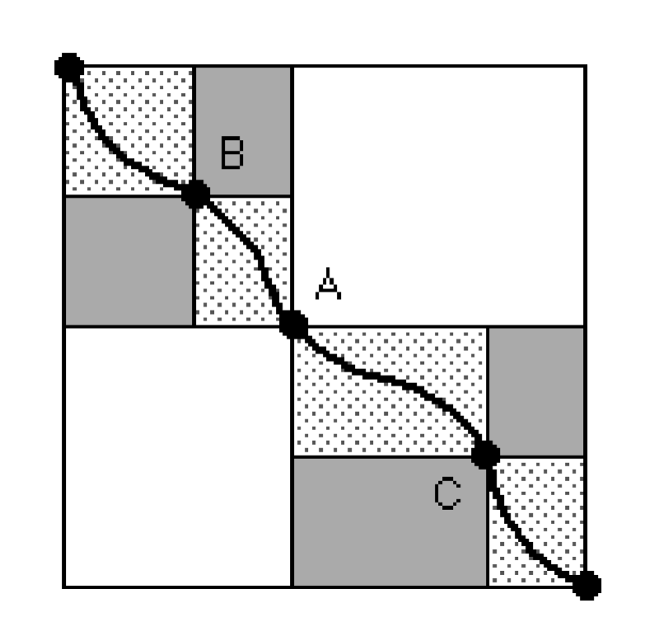
Hirschberg’s algorithm
Notes:
https://www.youtube.com/watch?v=cPQeJt-2Y1Q

Slide 4
Hirschberg’s algorithm
Notes:
https://www.youtube.com/watch?v=cPQeJt-2Y1Q

Slide 5
Hirschberg’s algorithm
Notes:
https://www.youtube.com/watch?v=cPQeJt-2Y1Q

Slide 6
Hirschberg’s algorithm
Notes:
https://www.youtube.com/watch?v=cPQeJt-2Y1Q

Slide 7
Hirschberg’s algorithm
Notes:
https://www.youtube.com/watch?v=cPQeJt-2Y1Q

Slide 8
Hirschberg’s algorithm
Notes:
https://www.youtube.com/watch?v=cPQeJt-2Y1Q

Slide 9
FactLSA
K = 4

Slide 10
FactLSA

Slide 11
FactLSA

Slide 12
FactLSA

Slide 13
FactLSA

Slide 14
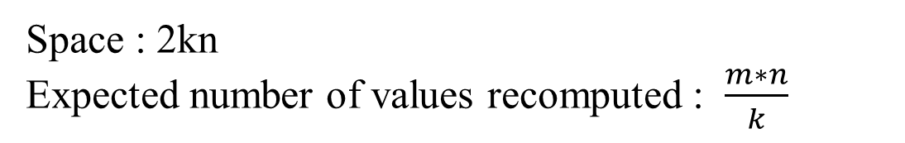
FactLSA
Space : 2kn
Expected number of values recomputed : $\frac{m∗n}{k}$

Slide 15
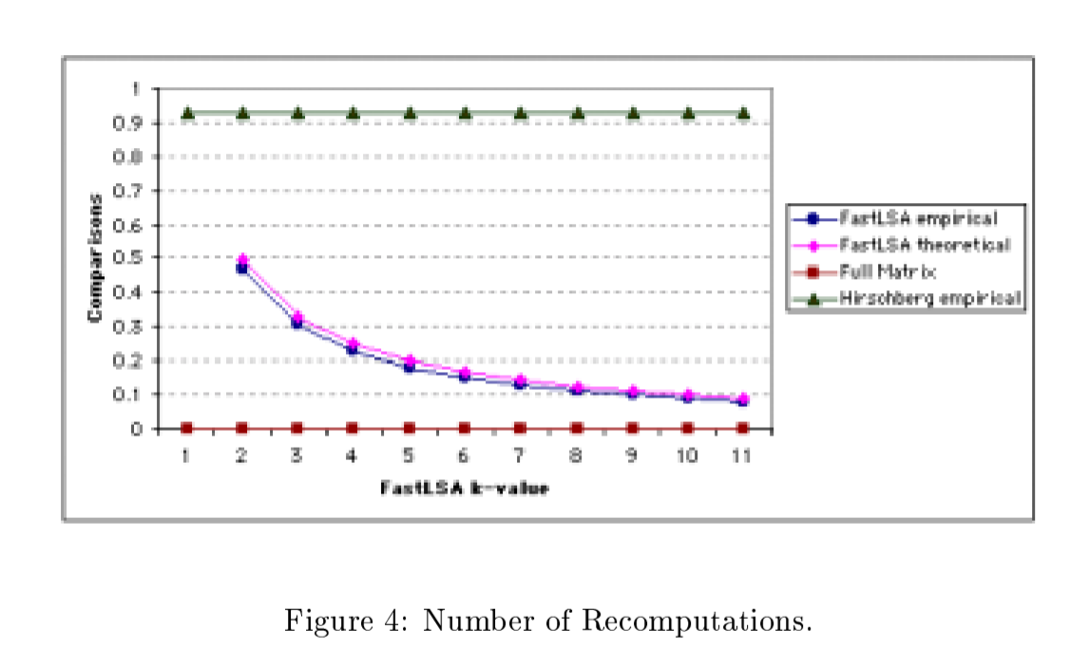
Experimental Result
Notes:
Experimental Result

