Slide 1
A Fast Convex Hull Algorithm
Selim G.Akl and Godfried T.Toussaint
Information Processing Letters
Volume 7, Issue 5, August 1978, Pages 219-222
Presenter: Yuan-Hsiu Tsai
Date: Aug. 11, 2020

Slide 2
Introduction
Several algorithms for determining the convex hull of set of points in two and three dimensions have been published recently. It has also been established that the complexity of the 2-dimensional convex hull problem is O(n logn). In this note we describe a new algorithm for obtaing the convex hull of a set of points in the plane and empirically compare and speed of the proposed algorithm make it worth reporting.

Slide 3
Introduction - Gift wrapping
時間複雜度
O(nh)
Worst case
O(n²)
Notes:
1970

Slide 4
Introduction - Graham scan
時間複雜度
O(nlogn)
若已排序
O(n)
Notes:
1972

Slide 5
Introduction - Quickhull
時間複雜度
O(nlogn)
Worst case
O(n²)
Notes:
1977

Slide 6
Introduction - Monotone chain
時間複雜度
O(nlogn)
若已排序
O(n)
Notes:
1979

Slide 7
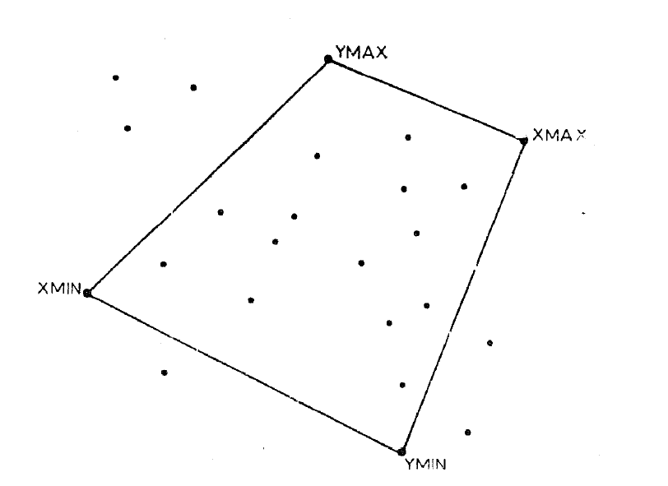
Algorithm - AKL
Notes:
1978

Slide 8
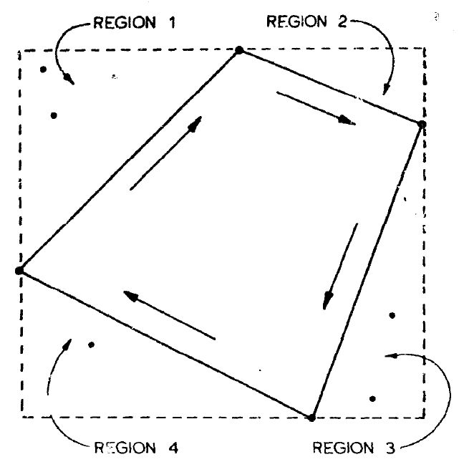
Algorithm - AKL

Slide 9
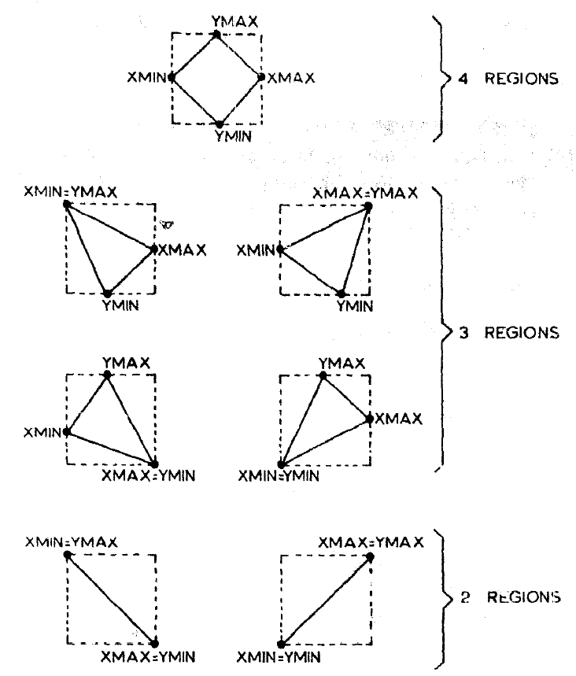
Algorithm - AKL

Slide 10
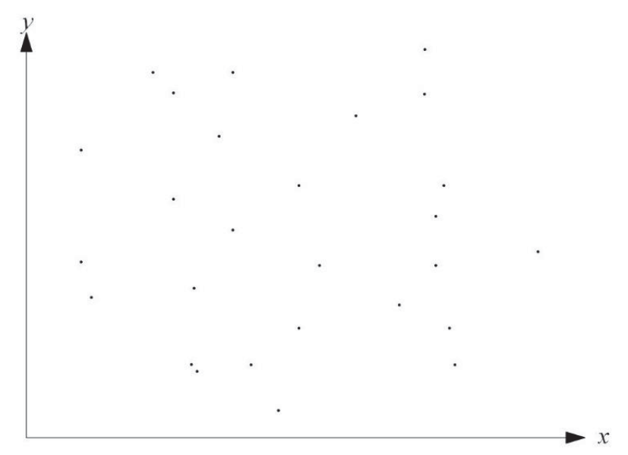
Algorithm – 研討會版
Notes:
2020

Slide 11
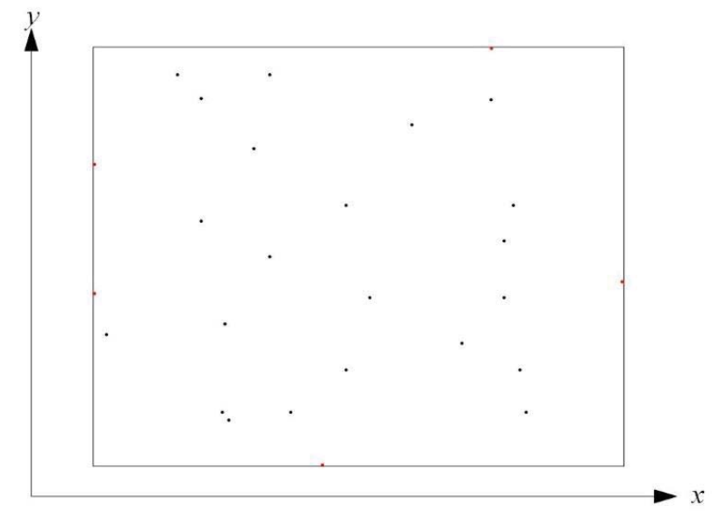
Algorithm – 研討會版

Slide 12
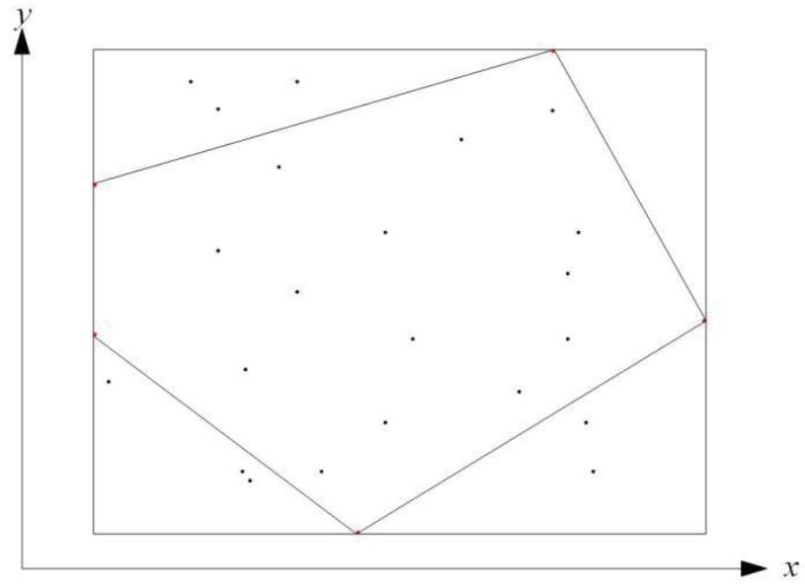
Algorithm – 研討會版

Slide 13
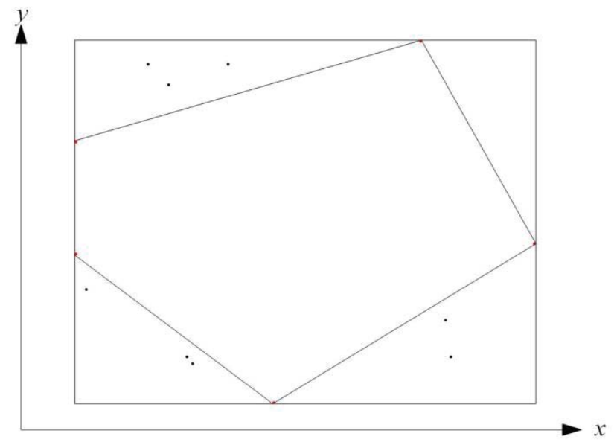
Algorithm – 研討會版

Slide 14
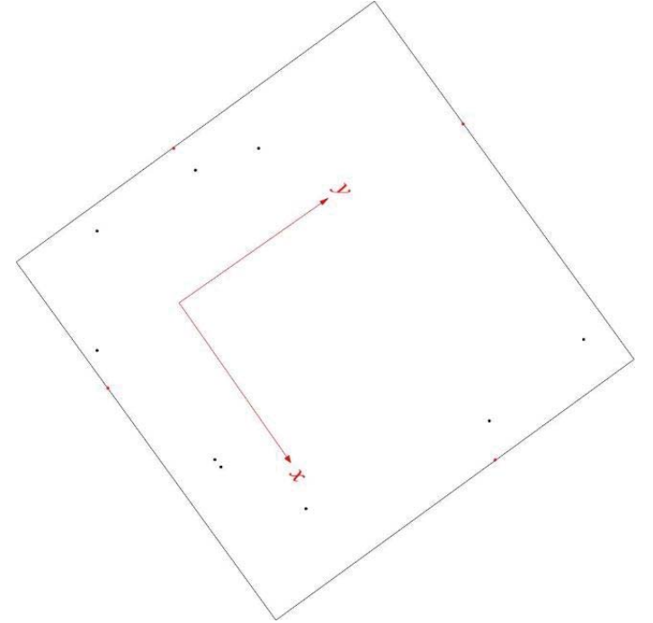
Algorithm – 研討會版

Slide 15
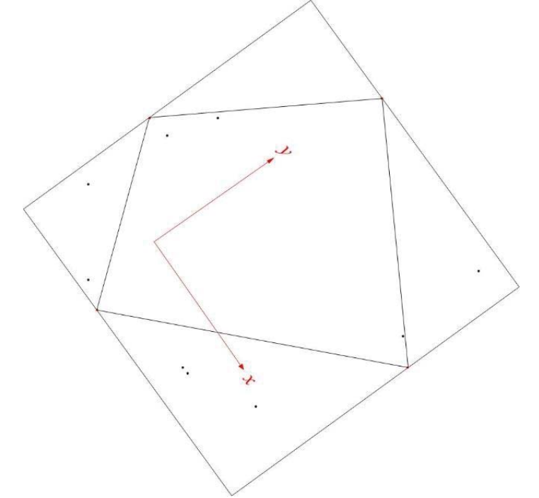
Algorithm – 研討會版

Slide 16
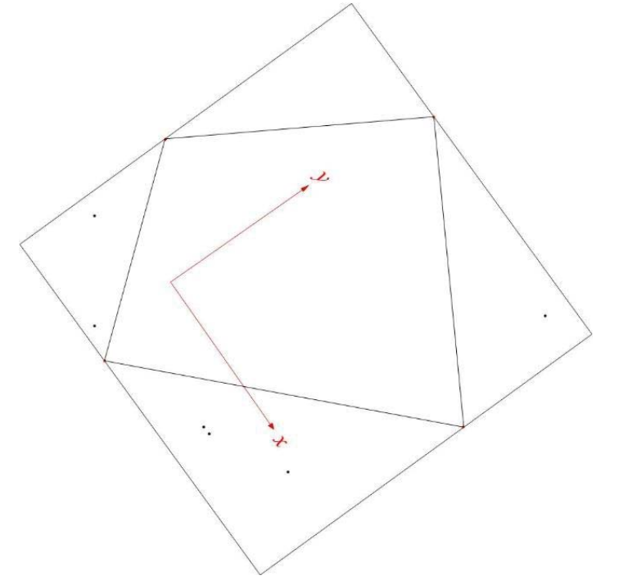
Algorithm – 研討會版

Slide 17

Algorithm – 研討會版

Slide 18
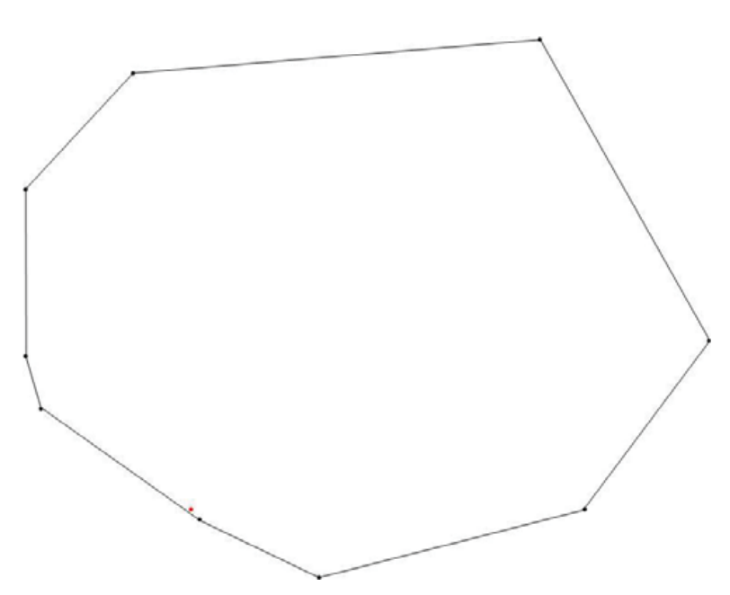
Algorithm – 研討會版

Slide 19
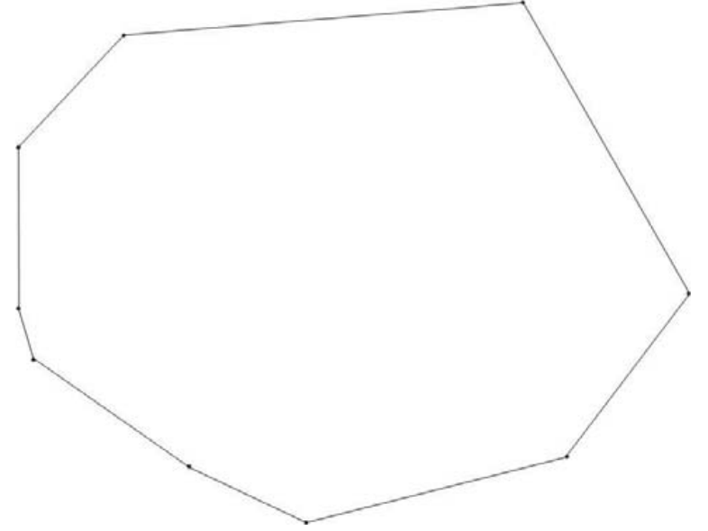
Algorithm – 研討會版

Slide 20
Algorithm – 研討會版
 | Gift | AKL | Jiang | Jan
Average-case | O(nh) | O(n) | O(n) | O(n)
Worst-case | O(n²) | O(nlogn) | O(nlogn) | O(nlogn)

