Slide 1
Efficient all path score computations on grid graphs Ury Matarazzo, Dekel Tsur, Michal Ziv-Ukelson
Theoretical Computer Science 525(2014)P138-149
Presenter : Yu-ju,Liao
Date : 2020.9.29

Slide 2
Abstract
We study the Integer-weighted Grid All Paths Scores (IGAPS) problem, which is given a grid graph, to compute the maximum weights of paths between every pair of a vertex on the first row of the graph and a vertex on the last row of the graph. We also consider a variant of this problem, periodic IGAPS, where the input grid graph is periodic and infinite. For these problems, we consider both the general (dense) and the sparse cases. For the sparse periodic IGAPS problem with 0–1 weights, we give an O(r log³(n²/r)) time algorithm, where r is the number of (diagonal) edges of weight 1. Our result improves upon the previous O(n √r ) result by Krusche and Tiskin for this problem. For the periodic IGAPS problem we give an O(Cn²) time algorithm, where C is the maximum weight of an edge. This improves upon the previous O(C²n²) algorithm of Tiskin. We also show a reduction from periodic IGAPS to IGAPS. This reduction yields O(n²) algorithms for this problem.

Slide 3
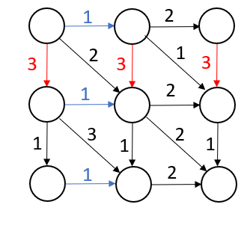
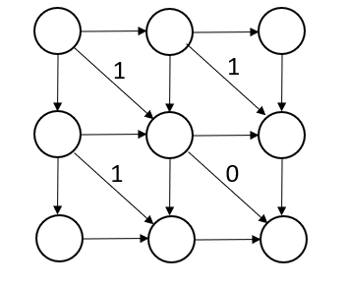
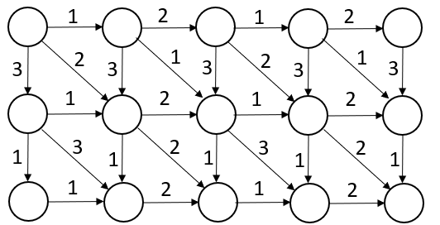
Introduction
Integer GAPS Binary GAPS periodic grid graph
(IGAPS) (BGAPS)
C = 3

Slide 4
Algorithm for BGAPS
Opt_{i}(k, j) : |(0,k) - (i,j)|
(0,1)
1
0
1
Opt₂(1, 3)
= |(0,1) - (2,3)|=1
0
1
1
j
(2,3)
1
0
0
i

Slide 5
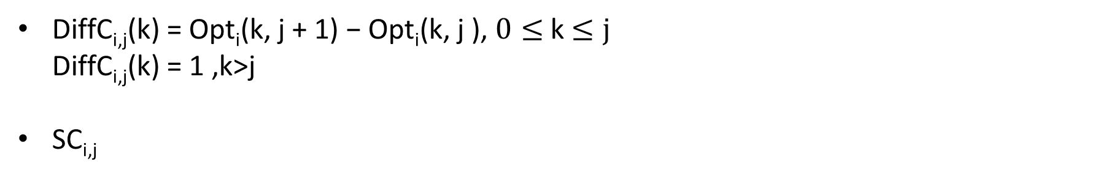
Algorithm for BGAPS
DiffC_{i,j}(k) = Opt_{i}(k, j + 1) − Opt_{i}(k, j ), $0≤$k $≤j$
DiffC_{i,j}(k) = 1 ,k>j
SC_{i,j}
(i, j) = (1,2)
(i, j+1) = (1,3)
1
0
1
 | Opt₁(k,2) | Opt₁(k,3) | DiffC_{1,2}(k)
k=0 | 1 | 1 | 0
k=1
k=2
k=3 (k>j)
j
0
1
1
0
1
1
i
0
1
1
1
0
0

Slide 6
Algorithm for BGAPS
DiffC_{i,j}(k) = Opt_{i}(k, j + 1) − Opt_{i}(k, j ), $0≤$k $≤j$
DiffC_{i,j}(k) = 1 ,k>j
SC_{i,j}
(i, j) = (1,2)
(i, j+1) = (1,3)
1
0
1
 | Opt₁(k,2) | Opt₁(k,3) | DiffC_{1,2}(k)
k=0 | 1 | 1 | 0
k=1 | 0 | 1 | 1
k=2 | 0 | 1 | 1
k=3 (k>j)
j
0
1
1
SC_{1,2}= 1
i
1
0
0
1

Slide 7
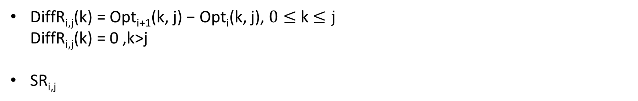
Algorithm for BGAPS
DiffR_{i,j}(k) = Opt_{i+1}(k, j) − Opt_{i}(k, j), $0≤$k $≤j$
DiffR_{i,j}(k) = 0 ,k>j
SR_{i,j}
(i, j) = (1,2)
(i+1, j) = (2,2)
1
0
1
 | Opt₁(k,2) | Opt₂(k,2) | DiffR_{1,2}(k)
k=0 | 1 | 2 | 1
k=1 | 0 | 1 | 1
k=2 | 0 | 0 | 0
k=3 (k>j)
j
0
1
1
i
SR_{1,2}= 2
1
0
0
0

Slide 8
Algorithm for BGAPS
SC_{1,2}= 2
W_{i,j} = 1
SC_{i+1,j} = SR_{i,j}
SR_{i,j+1} = SC_{i,j}
W_{i,j} = 0
SC_{i+1,j} = max(SC_{i,j}, SR_{i,j})
SR_{i,j+1} = min(SC_{i,j}, SR_{i,j})
SR_{1,2}= 1
SR_{1,3}= 2
1
SC_{2,2}= 1
SC_{1,2}= 2
SR_{1,2}= 1
SR_{1,3}= 1
0
SC_{2,2}= 2

Slide 9
Algorithm for BGAPS
Initialization
SC_{0,j} = j + 1
SR_{i,0} = −i
 | j=0 | j=1 | j=2 | j=3
i=0 | SC_{0,0} = 1 SR_{0,0} = 0 | SC_{0,1} = 2 | SC_{0,2} = 3
i=1 | SR_{0,1}= -1
i=2 | SR_{0,2}= -2
i=3
1
0
1
j
0
1
1
1
0
0
i

Slide 10
Algorithm for BGAPS
 | j=0 | j=1 | j=2 | j=3
i=0 | SC_{0,0} = 1 SR_{0,0} = 0 | SC_{0,1} = 2 SR_{0,1} = 1 | SC_{0,2} = 3
i=1 | SC_{1,0} = 0 SR_{1,0}= -1
i=2 | SR_{2,0}= -2
i=3
 | j=0 | j=1 | j=2 | j=3
i=0 | SC_{0,0} = 1 SR_{0,0} = 0 | SC_{0,1} = 2 SR_{0,1} = 1 | SC_{0,2} = 3 SR_{0,2} = 1
i=1 | SC_{1,0} = 0 SR_{1,0}= -1 | SC_{1,1} = 2
i=2 | SR_{2,0}= -2
i=3
1
0
1
j
0
1
1
1
0
0
i

Slide 11
Algorithm for BGAPS
Out(G) = (SC_{m,0}, SC_{m,1},..., SC_{m,n−1}, SR_{m−1,n}, SR_{m−2,n},..., SR_{0,n})
=(-2,0,2,-1,3,3)
 | j=0 | j=1 | j=2 | j=3
i=0 | SC_{0,0} = 1 SR_{0,0} = 0 | SC_{0,1} = 2 SR_{0,1} = 1 | SC_{0,2} = 3 SR_{0,2} = 1 | SR_{0,3} = 3
i=1 | SC_{1,0} = 0 SR_{1,0}= -1 | SC_{1,1} = 2 SR_{1,1}=-1 | SC_{1,2} = 3 SR_{1,2} = 2 | SR_{1,3} = 3
i=2 | SC_{2,0} = 0 SR_{2,0}= -2 | SC_{2,1} =-1 SR_{2,1} = 0 | SC_{2,2} = 2 SR_{2,2} =-1 | SR_{2,3} =-1
i=3 | SC_{3,0} =-2 | SC_{3,1} = 0 | SC_{3,2} = 2
1
0
1
j
0
1
1
1
0
0
i

Slide 12
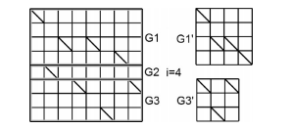
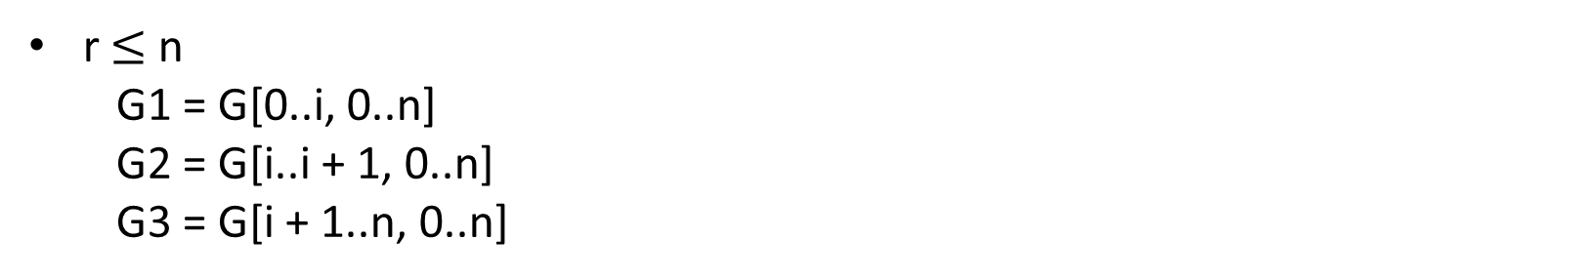
Algorithm for BGAPS
r$≤$ n
G1 = G[0..i, 0..n]
G2 = G[i..i + 1, 0..n]
G3 = G[i + 1..n, 0..n]
G1’
G3’
Time complexity : O(n logn)

Slide 13
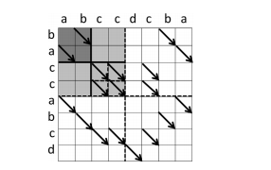
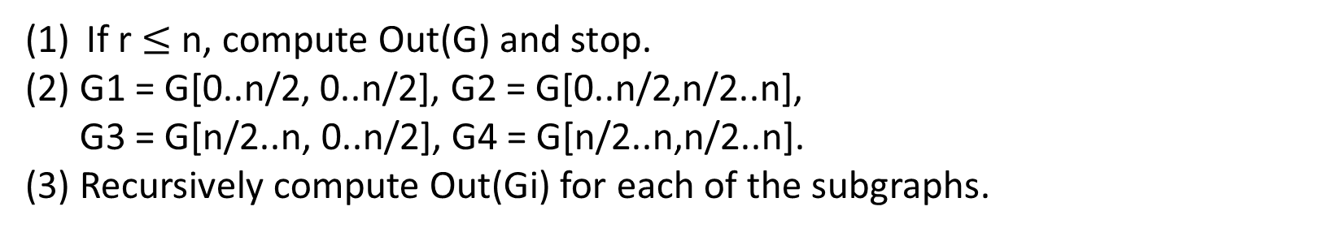
Algorithm for BGAPS
If r $≤$ n, compute Out(G) and stop.
(2) G1 = G[0..n/2, 0..n/2], G2 = G[0..n/2,n/2..n],
G3 = G[n/2..n, 0..n/2], G4 = G[n/2..n,n/2..n].
(3) Recursively compute Out(Gi) for each of the subgraphs.
Time complexity : O( r log³(n²/r) )

Slide 14

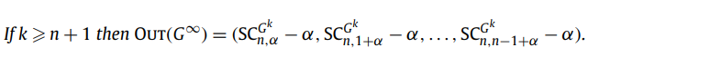


Algorithms for periodic BGAPS
$$α=\left(k−1\right)n$$
SC_{0,0}
SC_{0,1}
SC_{0,2}
SC_{0,3}
SR_{0,0}
SR_{0,3}
G$∞$
SR_{1,0}
SR_{2,3}
SR_{2,0}
SR_{2,3}
SR_{3,0}
SR_{3,3}
SC_{3,0}
SC_{3,1}
SC_{3,2}
SC_{3,3}

Slide 15
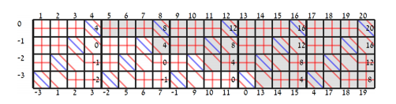

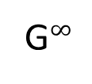


Algorithms for periodic BGAPS
$$α=\left(k−1\right)n$$
G⁵
1
2
3
4
17
18
19
20
0
4
16
20
-4
0
-(4*4)
12
16
G$∞$
-8
-4
$$−α$$
8
12
-12
-8
4
8
OUT(G$∞$) =(-12,1,2,3)
-12
1
2
3
4
17
18
19

