Slide 1
A task duplication based bottom-up scheduling algorithm for heterogeneous environments
D. Bozdag, U. Catalyurek and F. Ozgune
Proceedings 20th IEEE International Parallel & Distributed Processing Symposium, 26 June 2006, Rhodes Island, Greece
Presenter : Chih-Kai Wu
Date: Sept.29, 2020.

Slide 2
Abstract
We propose a new duplication-based DAG scheduling algorithm for heterogeneous computing environments. Contrary to the traditional approaches, proposed algorithm traverses the DAG in a bottom-up fashion while taking advantage of task duplication and task insertion. Experimental results on random DAGs and three different application DAGs show that the makespans generated by the proposed DBUS algorithm are much better than those generated by the existing algorithms, HEFT, HCPFD and HCNF.

Slide 3
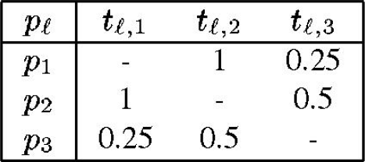
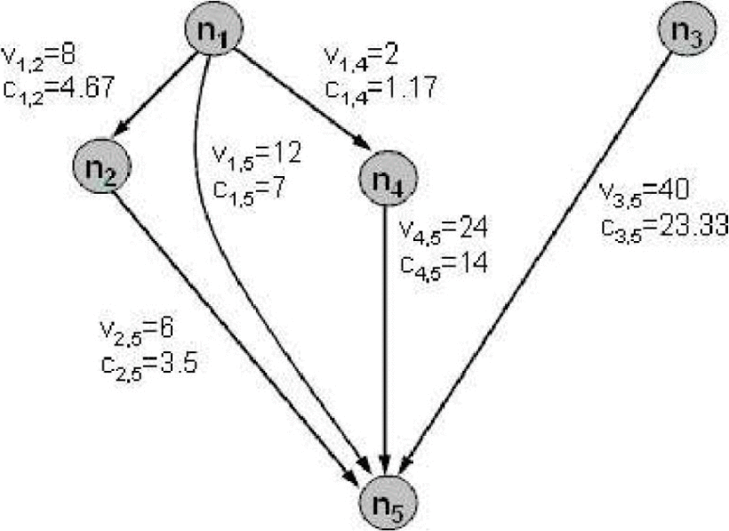
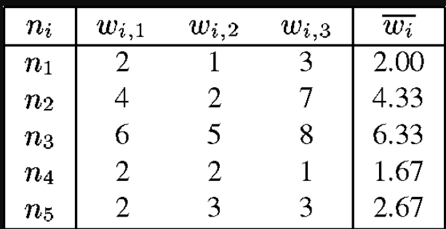
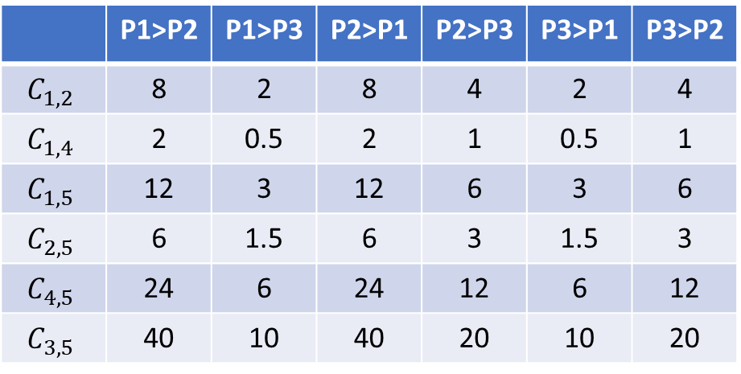
 | P1>P2 | P1>P3 | P2>P1 | P2>P3 | P3>P1 | P3>P2
$$C_{1,2}$$ | 8 | 2 | 8 | 4 | 2 | 4
$$C_{1,4}$$ | 2 | 0.5 | 2 | 1 | 0.5 | 1
$$C_{1,5}$$ | 12 | 3 | 12 | 6 | 3 | 6
$$C_{2,5}$$ | 6 | 1.5 | 6 | 3 | 1.5 | 3
$$C_{4,5}$$ | 24 | 6 | 24 | 12 | 6 | 12
$$C_{3,5}$$ | 40 | 10 | 40 | 20 | 10 | 20

Slide 4
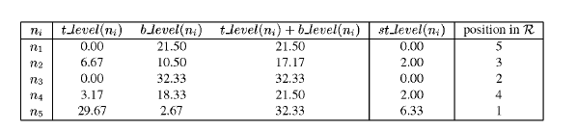
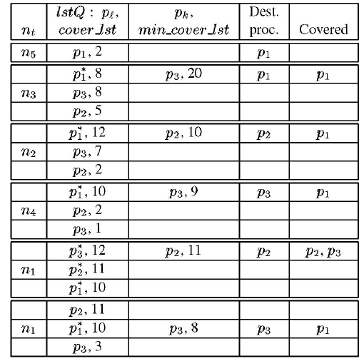
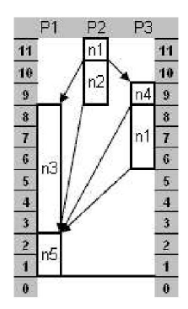

Slide 5
Task | Rank
n3 | 32.33
n1 | 21.51
n4 | 18.34
n2 | 10.5
n5 | 2.67

Slide 6
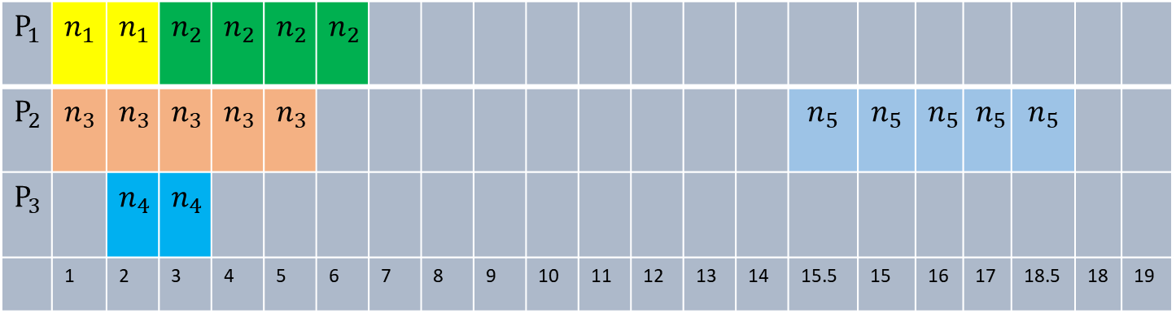
$$P_{1}$$ | $$n_{1}$$ | $$n_{1}$$ | $$n_{2}$$ | $$n_{2}$$ | $$n_{2}$$ | $$n_{2}$$
$$P_{2}$$ | $$n_{3}$$ | $$n_{3}$$ | $$n_{3}$$ | $$n_{3}$$ | $$n_{3}$$ |  |  |  |  |  |  |  |  |  | $$n_{5}$$ | $$n_{5}$$ | $$n_{5}$$ | $$n_{5}$$ | $$n_{5}$$
$$P_{3}$$ |  | $$n_{4}$$ | $$n_{4}$$
 | 1 | 2 | 3 | 4 | 5 | 6 | 7 | 8 | 9 | 10 | 11 | 12 | 13 | 14 | 15.5 | 15 | 16 | 17 | 18.5 | 18 | 19

Slide 7
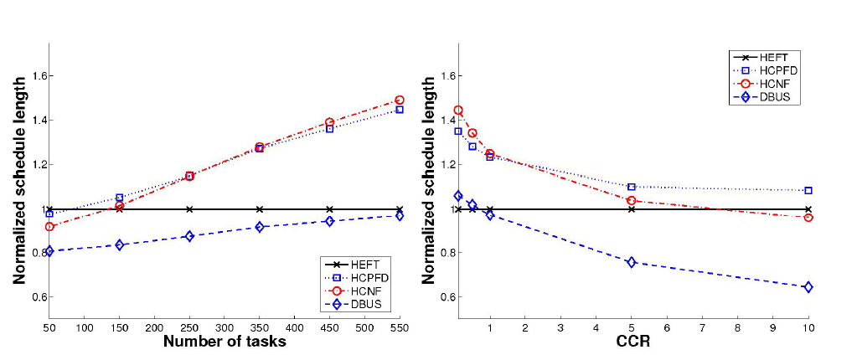
HEFT$O\left(n^{2}∗p\right)$
DBUS$O\left(n^{2}∗p^{2}\right)$

Slide 8
Performance-effective and low-complexity task scheduling for heterogeneous computing
H. Topcuoglu, S. Hariri, Min-You Wu
IEEE Transactions on Parallel and Distributed Systems, vol. 13, no. 3, pp. 260-274, March 2002
Presenter : Chih-Kai Wu
Date: Sept.29, 2020.

Slide 9
Abstract(1/3)
Efficient application scheduling is critical for achieving high performance in heterogeneous computing environments. The application scheduling problem has been shown to be NP-complete in general cases as well as in several restricted cases. Because of its key importance, this problem has been extensively studied and various algorithms have been proposed in the literature which are mainly for systems with homogeneous processors. Although there are a few algorithms in the literature for heterogeneous processors, they usually require significantly high scheduling costs and they may not deliver good quality schedules with lower costs.

Slide 10
Abstract(2/3)
In this paper, we present two novel scheduling algorithms for a bounded number of heterogeneous processors with an objective to simultaneously meet high performance and fast scheduling time, which are called the Heterogeneous Earliest-Finish-Time (HEFT) algorithm and the Critical-Path-on-a-Processor (CPOP) algorithm. The HEFT algorithm selects the task with the highest upward rank value at each step and assigns the selected task to the processor, which minimizes its earliest finish time with an insertion-based approach. On the other hand, the CPOP algorithm uses the summation of upward and downward rank values for prioritizing tasks.

Slide 11
Abstract(3/3)
Another difference is in the processor selection phase, which schedules the critical tasks onto the processor that minimizes the total execution time of the critical tasks. In order to provide a robust and unbiased comparison with the related work, a parametric graph generator was designed to generate weighted DAGs with various characteristics. The comparison study, based on both randomly generated graphs and the graphs of some real applications, shows that our scheduling algorithms significantly surpass previous approaches in terms of both quality and cost of schedules, which are mainly presented with schedule length ratio, speedup, frequency of best results, and average scheduling time metrics.

Slide 12
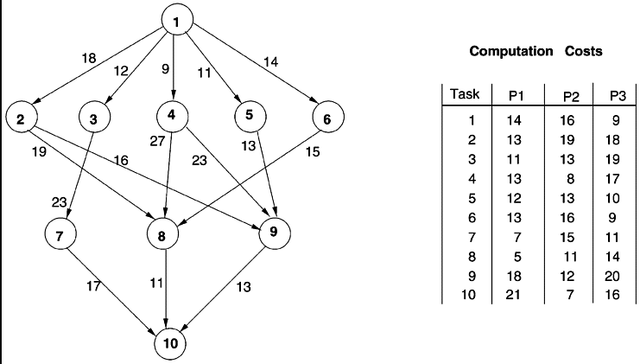
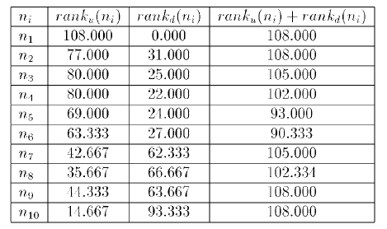

Slide 13
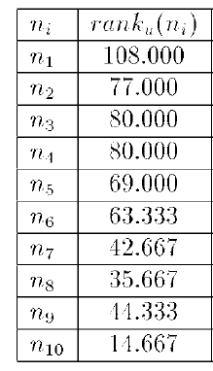
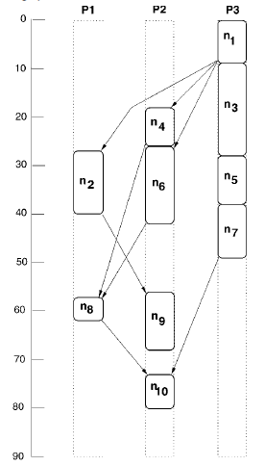

Slide 14
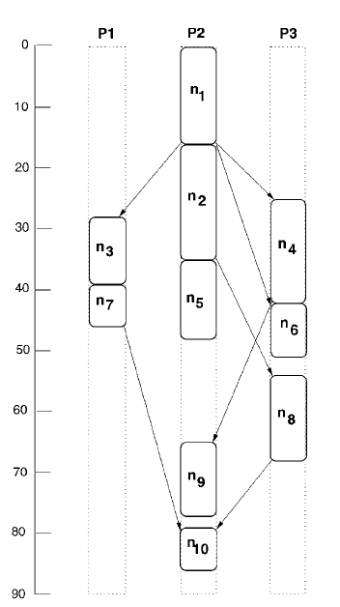

Slide 15
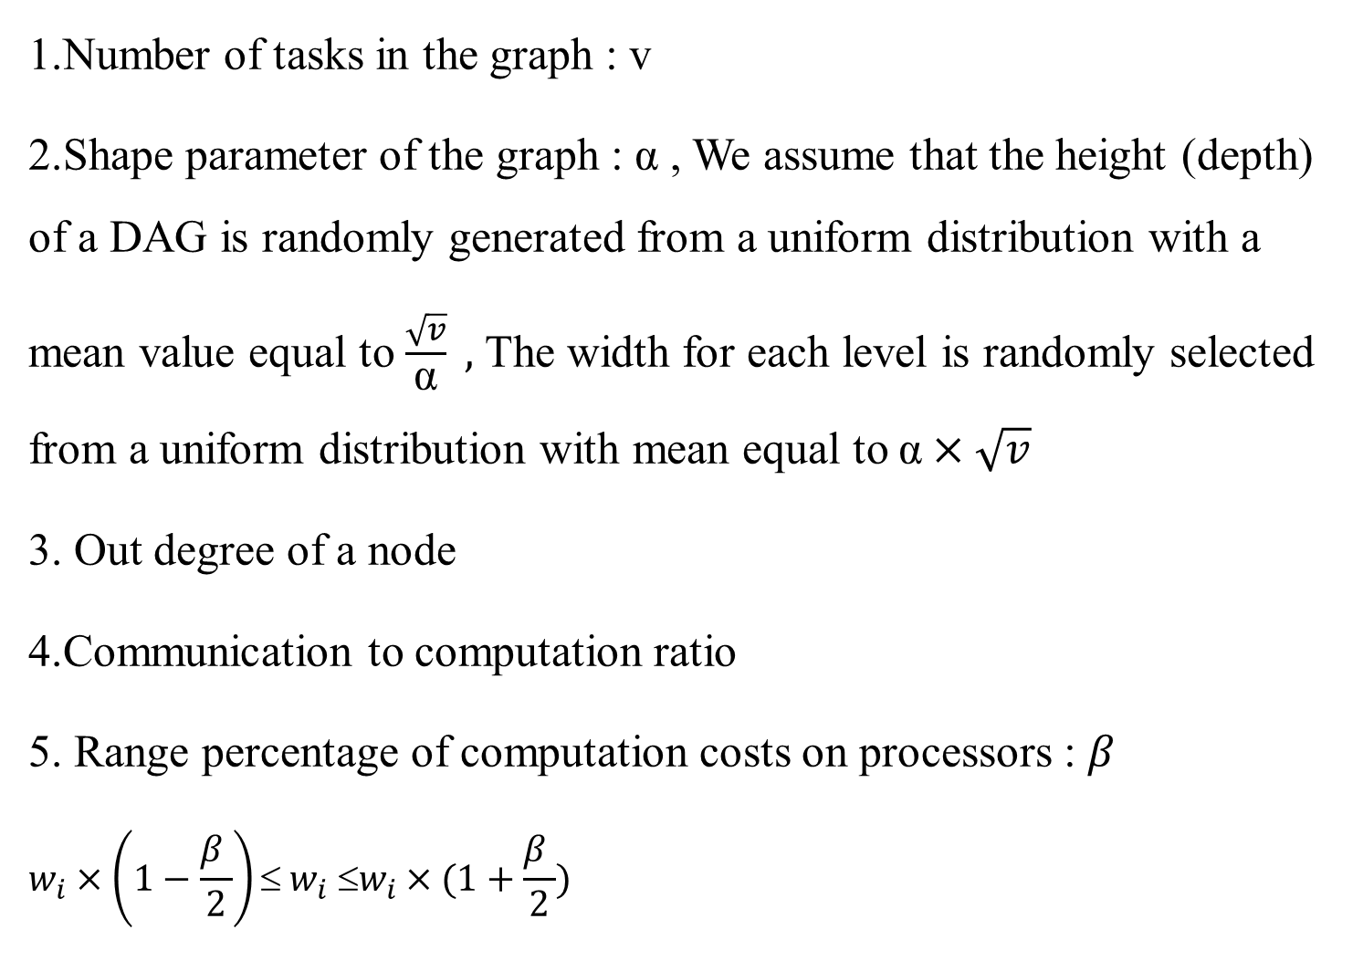
Random Graph Generator
1.Number of tasks in the graph : v
2.Shape parameter of the graph : α , We assume that the height (depth) of a DAG is randomly generated from a uniform distribution with a mean value equal to $\frac{\sqrt{v}}{\text{α}} ,$ The width for each level is randomly selected from a uniform distribution with mean equal to $\text{α}×\sqrt{v}$
3. Out degree of a node
4.Communication to computation ratio
5. Range percentage of computation costs on processors : $β$
$$w_{i}×\left(1−\frac{β }{\text{2}}\right)≤ w_{i} ≤w_{i}×(1+\frac{β }{\text{2}})$$
Notes:
通過選擇α>> 1.0可以生成密集圖（具有較高並行度的較短圖）如果α<< 1.0，將生成一個較低並行度的較長圖形。

Slide 16
