Slide 1
The LCA Problem Revisited
Michael A. Bender, Martín Farach-Colton
LATIN Proceedings of the 4th Latin American Symposium on Theoretical Informatics, pp. 88-94 (2000)
Presenter：Yu-Cheng Chang
Date：Oct. 22, 2020

Slide 2
Abstract
We present a very simple algorithm for the Least Common Ancestor problem. We thus dispel the frequently held notion that an optimal LCA computation is unwieldy and unimplementable. Interestingly, this algorithm is a sequentialization of a previously known PRAM algorithm of Berkman, Breslauer, Galil, Schieber, and Vishkin

Slide 3
Least Common Ancestor (LCA)
LCA(2,9) = 1
LCA(6,7) = 8
1
5
8
2
4
9
3
7
6

Slide 4
Previous Search
Harel and Tarjan, Fast algorithms for finding nearest common ancestors. SIAM J. Comput., 13(2):338–355, 1984
LCA queries can be answered in constant time after only linear preprocessing
too complicated to implement effectively
Schieber and Vishkin, On finding lowest common ancestors: Simplification and parallelization. SIAM J. Comput., 17:1253–1262, 1988.
PRAM algorithm
preprocesses and answers queries in O(α(n)) time and preprocesses in linear work

Slide 5
Range Minimum Query (RMQ)
RMQ(5,9) = 7
Index | 1 | 2 | 3 | 4 | 5 | 6 | 7 | 8 | 9
Value | 2 | 5 | 4 | 1 | 9 | 7 | 3 | 6 | 8
RMQ(2,5) = 4

Slide 6
Reduce LCA to RMQ
1
LCA(2,9) = E[RMQ_{L}(3,9)] = E[7] = 1
5
8
2
4
9
3
7
6
E | 1 | 2 | 3 | 4 | 5 | 6 | 7 | 8 | 9 | 10 | 11 | 12 | 13 | 14 | 15 | 16 | 17
 | 1 | 5 | 2 | 5 | 4 | 5 | 1 | 8 | 9 | 8 | 3 | 6 | 3 | 8 | 7 | 8 | 1
L | 1 | 2 | 3 | 4 | 5 | 6 | 7 | 8 | 9 | 10 | 11 | 12 | 13 | 14 | 15 | 16 | 17
 | 0 | 1 | 2 | 1 | 2 | 1 | 0 | 1 | 2 | 1 | 2 | 3 | 2 | 1 | 2 | 1 | 0
R | 1 | 2 | 3 | 4 | 5 | 6 | 7 | 8 | 9
 | 1 | 3 | 11 | 5 | 2 | 12 | 15 | 8 | 9

Slide 7
Reduce LCA to RMQ
RMQ：〈f(n) , g(n)〉- time
f(n) means preprocessing time, g(n) means query time
LCA：〈f(2n - 1) + O(n) , g(2n - 1) + O(1)〉- time

Slide 8
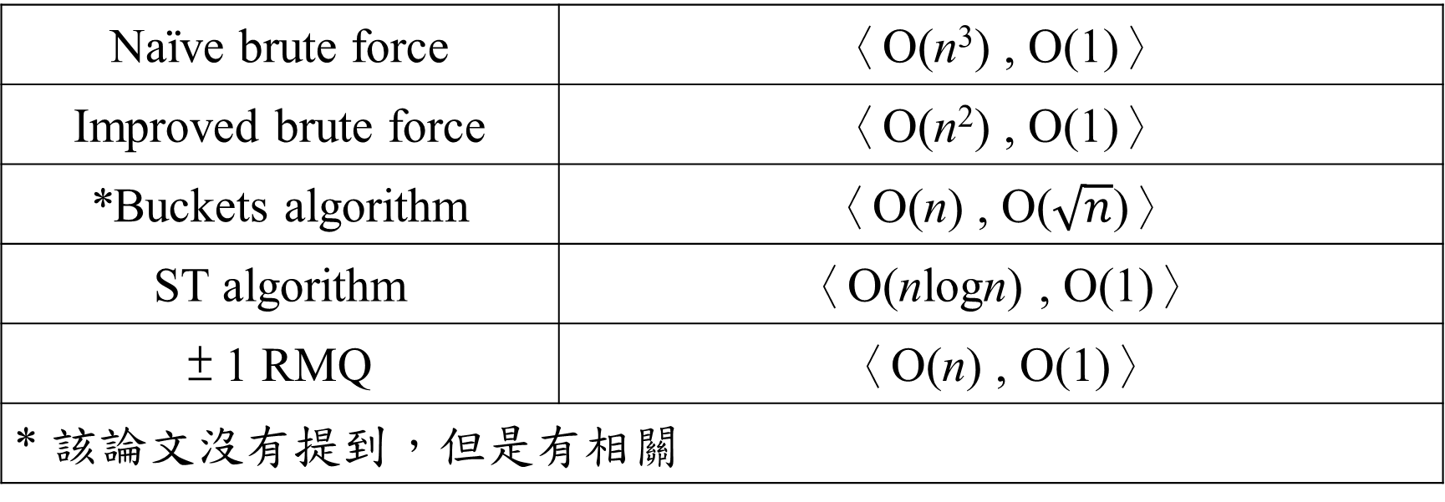
RMQ
Naïve brute force | 〈O(n³) , O(1)〉
Improved brute force | 〈O(n²) , O(1)〉
*Buckets algorithm | 〈O(n) , O($\sqrt{n}$)〉
ST algorithm | 〈O(nlogn) , O(1)〉
± 1 RMQ | 〈O(n) , O(1)〉
* 該論文沒有提到，但是有相關

Slide 9
RMQ – Brute Force
Naïve brute force： 〈O(n³) , O(1)〉，選起點&終點，暴力找最小
Improved brute force ： 〈O(n²) , O(1)〉，使用DP
Index | 1 | 2 | 3 | 4 | 5 | 6 | 7 | 8 | 9
Value | 2 | 5 | 4 | 1 | 9 | 7 | 3 | 6 | 8

Slide 10
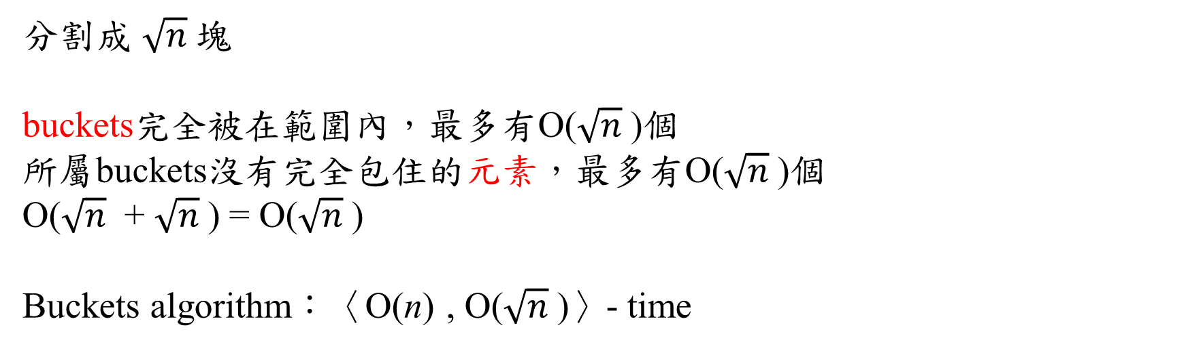


*RMQ – Buckets
$$\sqrt{n}$$
 | 1 | 2 | 3 | 4 | 5 | 6 | 7 | 8 | 9
 | 2 | 5 | 4 | 1 | 9 | 7 | 3 | 6 | 8
RMQ | 2 |  |  | 1 |  |  | 3
$$\sqrt{n}$$
分割成 $\sqrt{n}$塊
buckets完全被在範圍內，最多有O($\sqrt{n}$)個
所屬buckets沒有完全包住的元素，最多有O($\sqrt{n}$)個
O($\sqrt{n}$ + $\sqrt{n}$) = O($\sqrt{n}$)
Buckets algorithm：〈O(n) , O($\sqrt{n}$)〉- time

Slide 11
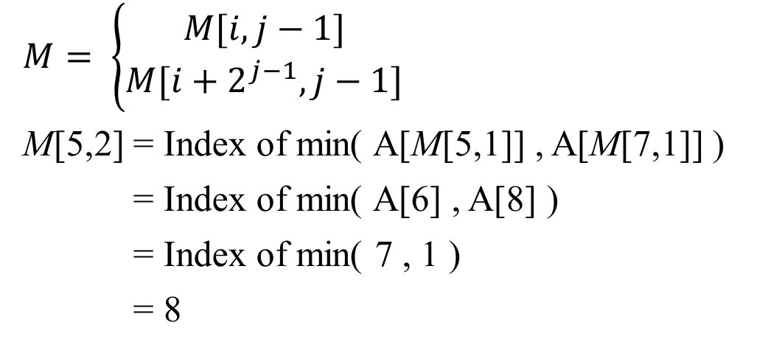
RMQ – ST
M | 0 | 1 | 2 | 3
1 | 1 | 1 | 4 | 8
2 | 2 | 4 | 4 | 8
3 | 3 | 4 | 4 | 8
4 | 4 | 4 | 4 | 8
5 | 5 | 6 | 8 | 8
6 | 6 | 7 | 8 | 8
7 | 7 | 8 | 8 | 8
8 | 8 | 8 | 8 | 8
$$M= \left\{\begin{aligned}M[i,j−1] \\ M[i+2^{j−1},j−1]\end{aligned}\right.$$
M[5,2] = Index of min( A[M[5,1]] , A[M[7,1]] )
= Index of min( A[6] , A[8] )
= Index of min( 7 , 1 )
= 8
A
Index | 1 | 2 | 3 | 4 | 5 | 6 | 7 | 8
Value | 4 | 5 | 6 | 2 | 9 | 7 | 3 | 1

Slide 12
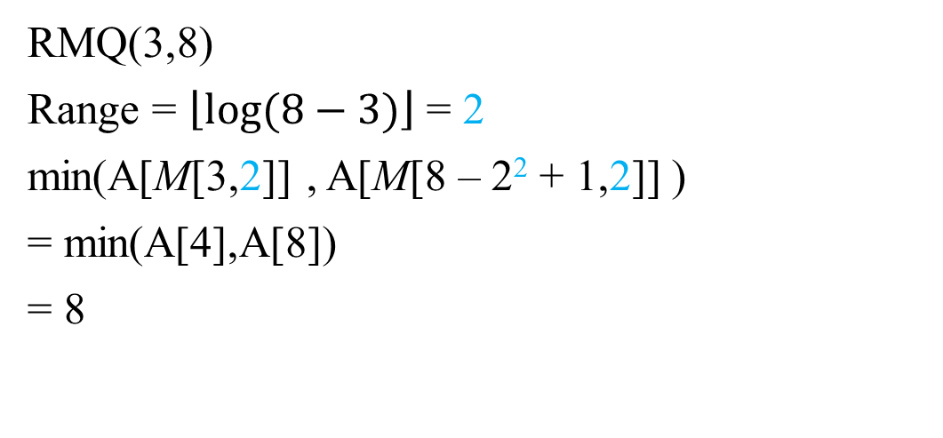
RMQ – ST
M | 0 | 1 | 2 | 3
1 | 1 | 1 | 4 | 8
2 | 2 | 4 | 4 | 8
3 | 3 | 4 | 4 | 8
4 | 4 | 4 | 4 | 8
5 | 5 | 6 | 8 | 8
6 | 6 | 7 | 8 | 8
7 | 7 | 8 | 8 | 8
8 | 8 | 8 | 8 | 8
RMQ(3,8)
Range = $\left\lfloor log⁡(8−3)\right\rfloor$ = 2
min(A[M[3,2]] , A[M[8 – 2² + 1,2]] )
= min(A[4],A[8])
= 8
A
Index | 1 | 2 | 3 | 4 | 5 | 6 | 7 | 8
Value | 4 | 5 | 6 | 2 | 9 | 7 | 3 | 1

Slide 13
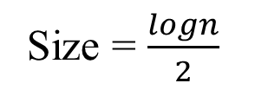
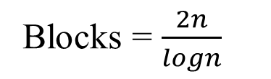
Faster RMQ
A | 1 | 2 | 3 | 4 | 5 | 6 | 7 | 8
 | 4 | 5 | 6 | 2 | 9 | 7 | 3 | 1
B | 1 | 2 | 3 | 4
 | 1 | 4 | 6 | 8
Size = $\frac{logn}{2}$
1 | 2
4 | 5
3 | 4
6 | 2
5 | 6
9 | 7
7 | 8
3 | 1
A’ | 1 | 2 | 3 | 4
 | 4 | 2 | 7 | 1
Blocks = $\frac{2n}{logn}$

Slide 14

Faster RMQ
ST algorithm ：O(nlogn)
Size of A’ ： $\frac{2n}{logn}$
ST(A’) = O($\frac{2n}{logn}$ log $\frac{2n}{logn}$) = O(n)
ST(A’) ：〈O(n) , O(1)〉- time

Slide 15
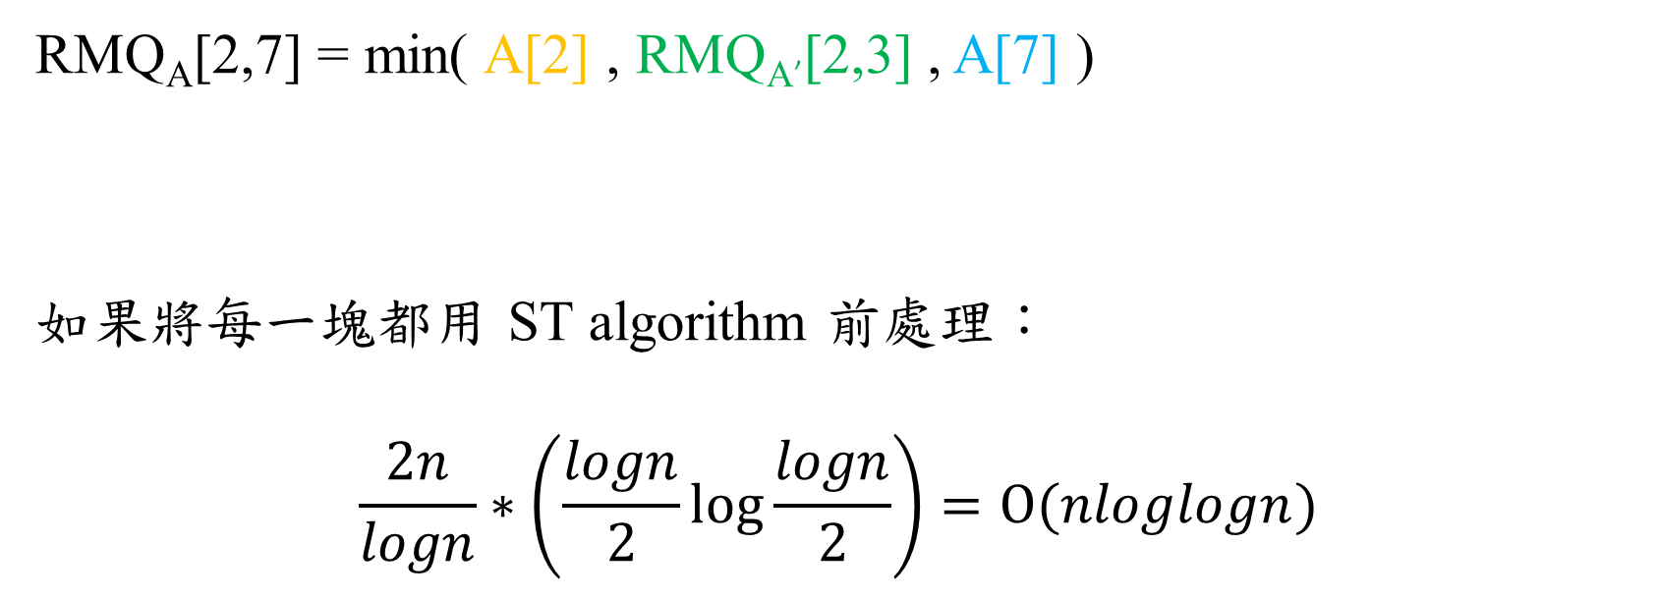
Faster RMQ – Query
A | 1 | 2 | 3 | 4 | 5 | 6 | 7 | 8
 | 4 | 5 | 6 | 2 | 9 | 7 | 3 | 1
A’ | 1 | 2 | 3 | 4
 | 4 | 2 | 7 | 1
B | 1 | 2 | 3 | 4
 | 1 | 4 | 6 | 8
RMQ_{A}[2,7] = min( A[2] , RMQ_{A’}[2,3] , A[7] )
如果將每一塊都用 ST algorithm 前處理：
$$\frac{2n}{logn}∗\left(\frac{logn}{2}\log{\frac{logn}{2}}\right)=O(nloglogn)$$
?
O(1)
?

Slide 16
± 1 RMQ
1
5
8
2
4
9
3
7
6
E | 1 | 2 | 3 | 4 | 5 | 6 | 7 | 8 | 9 | 10 | 11 | 12 | 13 | 14 | 15 | 16 | 17
 | 1 | 5 | 2 | 5 | 4 | 5 | 1 | 8 | 9 | 8 | 3 | 6 | 3 | 8 | 7 | 8 | 1
L | 1 | 2 | 3 | 4 | 5 | 6 | 7 | 8 | 9 | 10 | 11 | 12 | 13 | 14 | 15 | 16 | 17
 | 0 | 1 | 2 | 1 | 2 | 1 | 0 | 1 | 2 | 1 | 2 | 3 | 2 | 1 | 2 | 1 | 0
R | 1 | 2 | 3 | 4 | 5 | 6 | 7 | 8 | 9
 | 1 | 3 | 11 | 5 | 2 | 12 | 15 | 8 | 9

Slide 17
± 1 RMQ – Observation 5 & Lemma 6
A | 1 | 2 | 3 | 4 | 5 | 6 | 7 | 8
 | 4 | 5 | 4 | 5 | 4 | 3 | 4 | 5
RMQ_{A}(i,j) = RMQ_{B}(i,j)
只要建表，就可重複利用，減少對零碎片段進行RMQ的時間
A[i] = B[i] + C, ∀i
-3
B | 1 | 2 | 3 | 4 | 5 | 6 | 7 | 8
 | 1 | 2 | 1 | 2 | 1 | 0 | 1 | 2
L | 1 | 2 | 3 | 4 | 5 | 6 | 7 | 8
 |  | +1 | -1 | +1 | -1 | -1 | +1 | +1

Slide 18
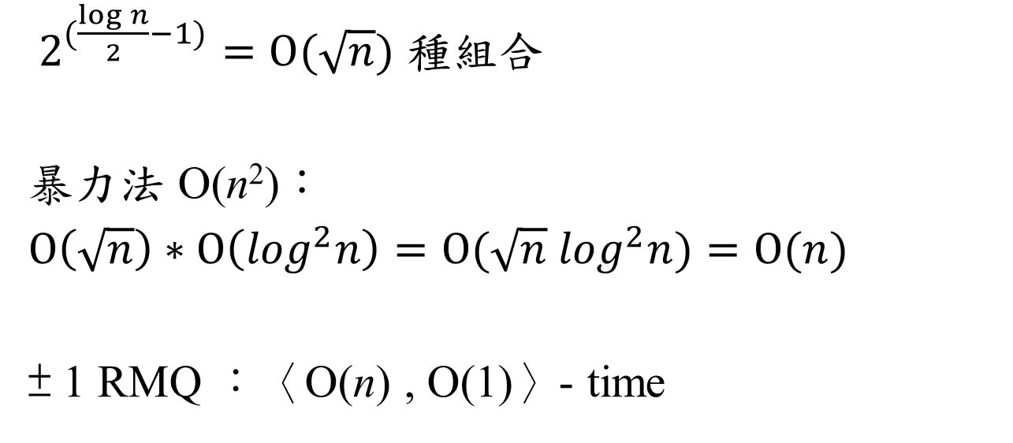
± 1 RMQ
L | 1 | 2 | 3 | 4 | 5 | 6 | 7 | 8 | 9 | 10 | 11 | 12 | 13 | 14 | 15 | 16 | 17
 | 0 | 1 | 2 | 1 | 2 | 1 | 0 | 1 | 2 | 1 | 2 | 3 | 2 | 1 | 2 | 1 | 0
 |  | +1 | +1 | -1 | +1 | -1 | -1 | +1 | +1 | -1 | +1 | +1 | -1 | -1 | +1 | -1 | -1
$2^{(\frac{\log{n}}{2}−1)}=O(\sqrt{n})$ 種組合
暴力法 O(n²)：
$O\left(\sqrt{n}\right)∗O\left(\log^{2}n\right)=O(\sqrt{n}$ $\log^{2}n)=O(n)$
± 1 RMQ ：〈O(n) , O(1)〉- time
x | y | Min
* | +1 | x
* | -1 | y

Slide 19
General RMQ
Reduce RMQ to LCA (through Cartesian tree)
Reduce LCA to ± 1 RMQ
so…
LCA：〈O(n) , O(1)〉- time
RMQ ：〈O(n) , O(1)〉- time

Slide 20
Cartesian tree (笛卡爾樹)
1 | 2 | 3 | 4 | 5 | 6 | 7 | 8
4 | 6 | 5 | 2 | 9 | 7 | 3 | 1
4

Slide 21
Cartesian tree (笛卡爾樹)
1 | 2 | 3 | 4 | 5 | 6 | 7 | 8
4 | 6 | 5 | 2 | 9 | 7 | 3 | 1
4
6

Slide 22
Cartesian tree (笛卡爾樹)
1 | 2 | 3 | 4 | 5 | 6 | 7 | 8
4 | 6 | 5 | 2 | 9 | 7 | 3 | 1
4
5
6

Slide 23
Cartesian tree (笛卡爾樹)
1 | 2 | 3 | 4 | 5 | 6 | 7 | 8
4 | 6 | 5 | 2 | 9 | 7 | 3 | 1
2
4
5
6

Slide 24
Cartesian tree (笛卡爾樹)
1 | 2 | 3 | 4 | 5 | 6 | 7 | 8
4 | 6 | 5 | 2 | 9 | 7 | 3 | 1
1
Build Cartesian tree：O(n)
RMQ(i,j) = LCA(i,j)
2
4
3
5
7
6
9

