Slide 1
A New Algorithm for Best Subsequence Alignments with Application to tRNA-rRNA Comparisons
Michael S.Waterman, Mark Eggert
Journal of Molecular Biology, VOL. 4, Issue 4, 20 October 1987, pp. 723-728
Presenter: Shin-Cheng Lin
Date: Oct. 22, 2020

Slide 2
Abstract(1/2)
The algorithm of Smith & Waterman for identification of maximally similar subsequences is extended to allow identification of all non-intersecting similar subsequences with similarity score at or above some preset level. The resulting alignments are found in order of score, with the highest scoring alignment first. In the case of single gaps or multiple gaps weighted linear with gap length, the algorithm is extremely efficient, taking very little time beyond that of the initial calculation of the matrix.

Slide 3
Abstract(2/2)
The algorithm is applied to comparisons of tRNA-rRNA sequences from Escherichia coli. A statistical analysis is important for proper evaluation of the results, which differ substantially from the results of an earlier analysis of the same sequences by Bloch and colleagues.
Notes:
3

Slide 4
Compute the matrix of Smith & Waterman for the best alignment
Set the elements of the best alignment to 0
Recompute the matrix to produce non-intersecting subsequent alignments.

Slide 5
H : score matrix
H_{i,0}=H_{0,j}=0
H_{i,j}= max{0, H_{i-1,j-1}＋s(a_{i,} b_{j}), E_{i,j,} F_{i,j}}
E_{i,j} = max_{1 ≦k ≦j}{H_{i,j-k}-w(k)}
F_{i,j} = max_{1 ≦k ≦i}{H_{i-k,j}-w(k)}
w(k) : gap penalty with k gap
s(a_{i,} b_{j}) > 0 if a_{i} ＝ b_{j}
s(a_{i,} b_{j}) < 0 if a_{i} ≠ b_{j}

Slide 6
When w_{k} =vk
H_{i,j}= max{0, H_{i-1,j-1}＋s(a_{i,} b_{j}), H_{i-1,j}-v, H_{i,j-1}-v}
H*_{i,j}= max{0, H_{i-1,j}-v, H_{i,j-1}-v}
in alignment element
From the upper leftmost alignment position Hi,j
Compute H*_{k,j} where k>i until H*_{k,j} = H_{k,j}
Compute H*_{i,k} where k>j until H*_{i,k} = H_{i,k}
Using H_{i,j}= max{0, H_{i-1,j-1}＋s(a_{i,} b_{j}), H_{i-1,j}-v, H_{i,j-1}-v}

Slide 7
When w_{k} =u+vk
E_{i,j} = max{H_{i,j-1}-(u+v), E_{i,j-1} -v}
F_{i,j} = max{H_{i-1,j}-(u+v), E_{i-1,j} -v}
Terminate where
H_{i,j} = H*_{i,j} , E_{i,j} = E*_{i,j,} F_{i,j} = F*_{i,j}

Slide 8
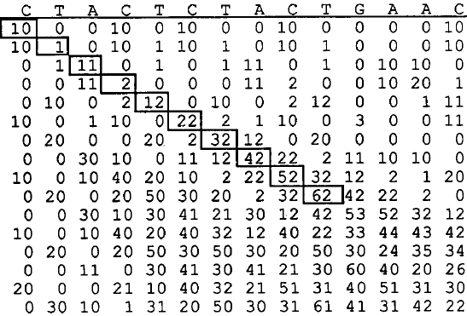
H s(a,a)=1 s(a,b)=-0.9 w_{k} =-2k multiplied by 10

Slide 9
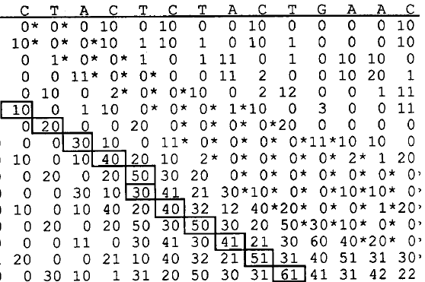
H*

Slide 10
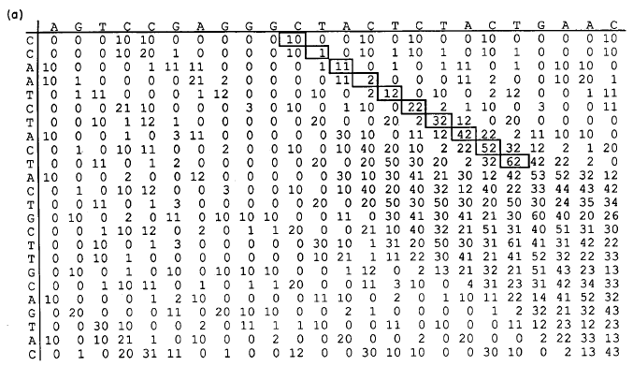
H

Slide 11
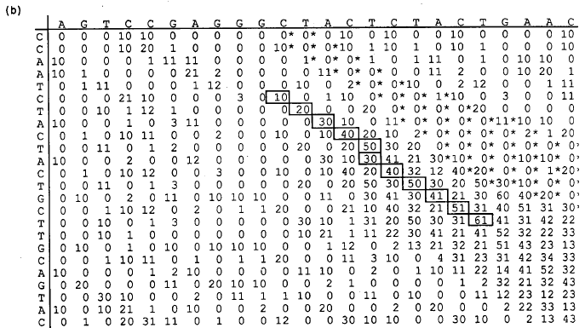
H*

