Slide 1
A faster algorithm for finding shortest substring matches of a regular expression
Hiroaki Yamamoto
Information Processing Letters 143 (2019) P56~P60
Presenter: Jing-Ping Chan
Date: Nov. 03, 2020
Notes:
Journal of Internet Technology 網際網路技術學刊 2009

Slide 2
Abstract
Consider a regular expression r of length m and a text string T of length n over an alphabet Ʃ. Then, the RE shortest substring search problem is to find all shortest substrings of T matching r. The previous algorithm proposed by Clarke and Cormack uses an ε-free nondeterministic finite automaton (NFA) and runs in O(ksn) time and O(s) space, where k is the maximum number of outgoing transitions for any state and symbol, and s is the number of states. Generally, an ε-free NFA obtained from a regular expression has s = O(m) and k = O(m); thus the algorithm takes O(m²n) time and O(m) space. We propose a faster algorithm that runs in O(mn) time and O(m) space. The proposed algorithm is based on a Thompson automaton which is an NFA with ε-transitions.
Notes:
Ʃ = sigma
Ε = epsilon

Slide 3
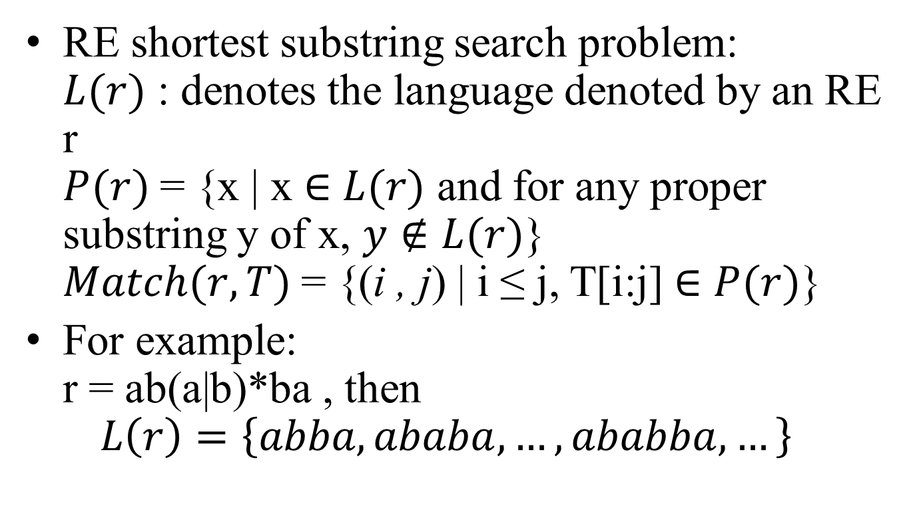
Introduction
RE shortest substring search problem: $L(r)$ : denotes the language denoted by an RE r $P(r)$= {x | x ∈ $L(r)$ and for any proper substring y of x, $y∉L(r)$} $Match(r, T)$= {(i , j) | i ≤ j, T[i:j] ∈ $P(r)$}
For example: r = ab(a|b)*ba , then $L\left(r\right)=\left\{abba,ababa,…,ababba,…\right\}$

Slide 4
RE shortest substring search problem
R = ab(a|b)*ba , T = aababaaaabaaaba
Substring matching r : T[2:6] = ababa T[2:11] = ababaaaaba T[2:15] = ababaaaabaaaba T[4:11] = abaaaaba T[4:15] = abaaaabaaaba T[9:15] = abaaaba

Slide 5
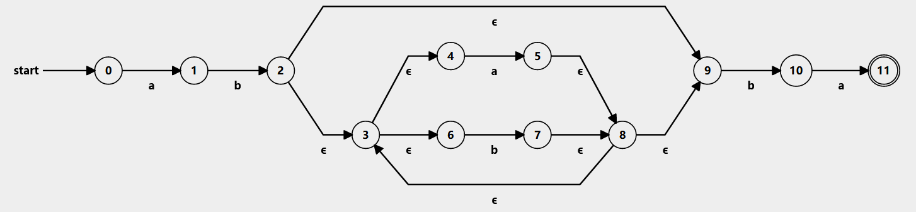

RE shortest substring search problem
R = ab(a|b)*ba , T = aababaaaabaaaba
$Match(r,T)$ : T[2:6] = ababa T[4:11] = abaaaaba T[9:15] = abaaaba

Slide 6
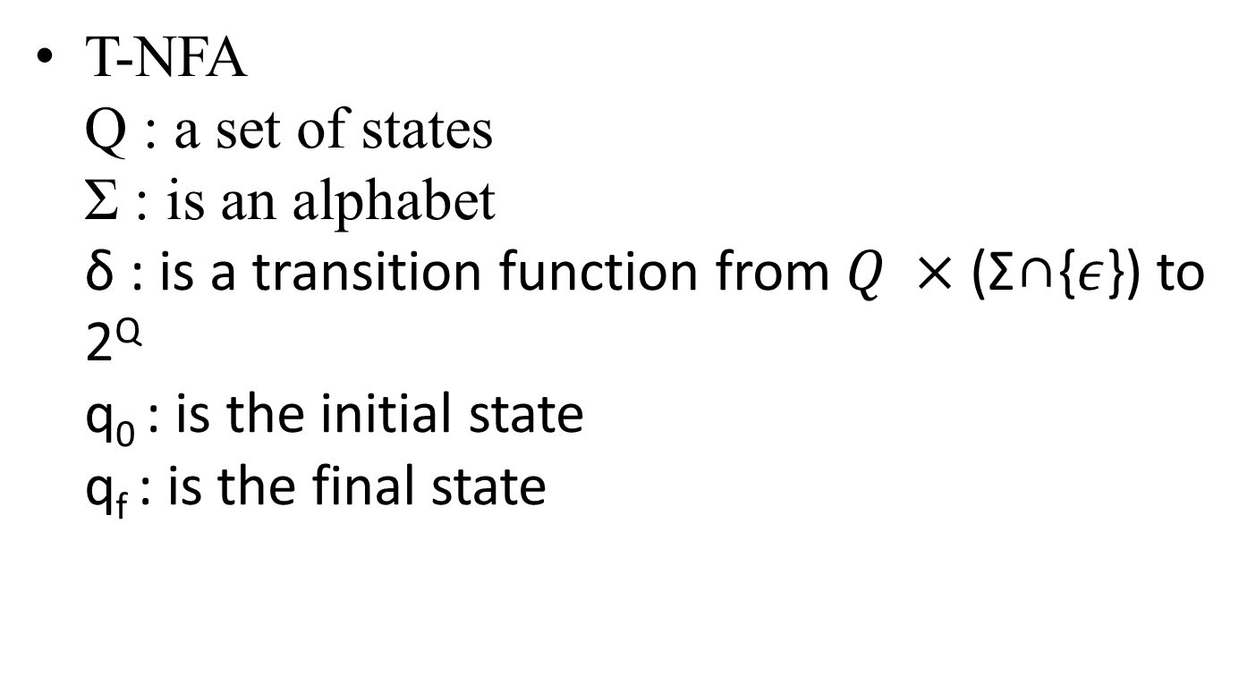
RE shortest substring search problem
T-NFA Q : a set of states Ʃ : is an alphabet δ : is a transition function from $Q ×$ (Ʃ∩{$ε$}) to 2^{Q} q₀ : is the initial state q_{f} : is the final state

Slide 7


RE shortest substring search problem
Construction of Thompson automaton for a regular expression. R = $ε$

Slide 8

RE shortest substring search problem
Construction of Thompson automaton for a regular expression. R = a

Slide 9
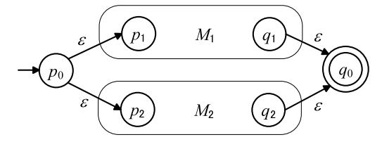
RE shortest substring search problem
Construction of Thompson automaton for a regular expression. R = M₁ | M₂

Slide 10
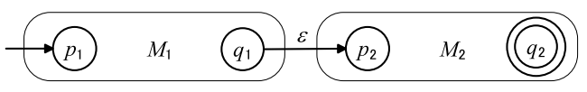
RE shortest substring search problem
Construction of Thompson automaton for a regular expression. R = M₁M₂

Slide 11
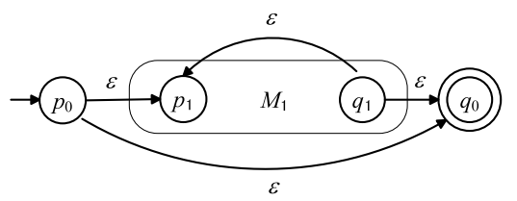
RE shortest substring search problem
Construction of Thompson automaton for a regular expression. R = M₁*

Slide 12
RE shortest substring search problem
R = ab(a|b)*ba

Slide 13

RE shortest substring search problem
$S−state$:{0,1,2,5,7,10,11}
$ε−state$:{3,4,6,8,9}

Slide 14
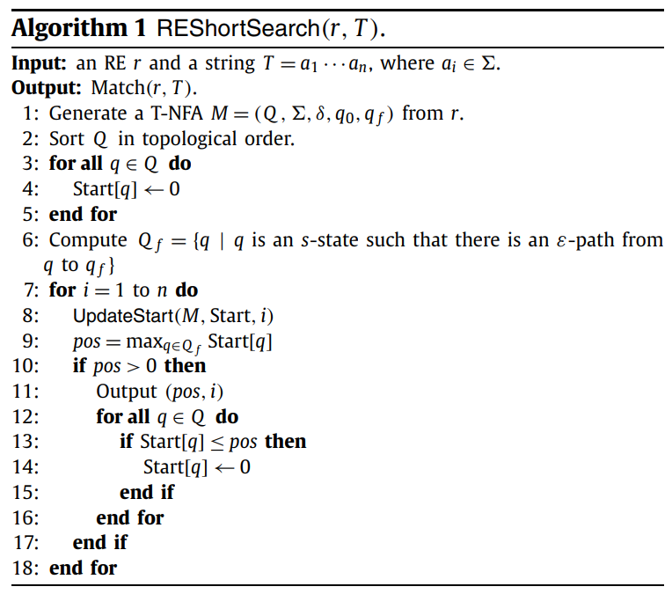
RE shortest substring search problem

Slide 15
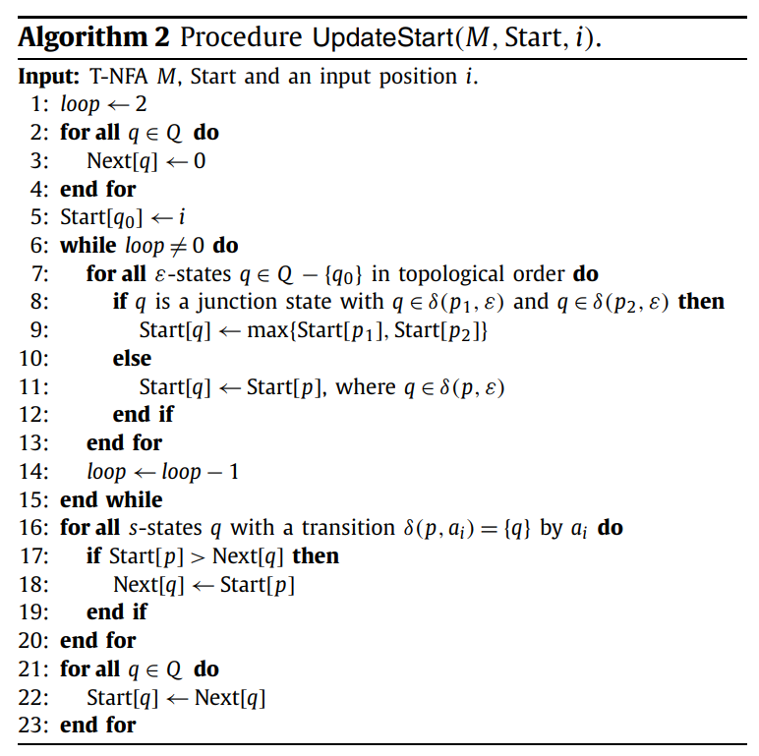
RE shortest substring search problem

Slide 16
RE shortest substring search problem
Q | Start
i | 0
1 | 0
2 | 0
3 | 0
4 | 0
5 | 0
6 | 0
7 | 0
8 | 0
9 | 0
10 | 0
11 | 0
T = aababaaaabaaaba
Output:
0
0
0
0
0
0
2
3
4
5
8
3
4
9
6
7
9
6

Slide 17
RE shortest substring search problem
Q | Start
i | 1
1 | 1
2 | 0
3 | 0
4 | 0
5 | 0
6 | 0
7 | 0
8 | 0
9 | 0
10 | 0
11 | 0
T = aababaaaabaaaba
Output:
1
0
0
0
0
0
2
3
4
5
8
3
4
9
6
7
9
6

Slide 18
RE shortest substring search problem
Q | Start
i | 2
1 | 2
2 | 0
3 | 0
4 | 0
5 | 0
6 | 0
7 | 0
8 | 0
9 | 0
10 | 0
11 | 0
T = aababaaaabaaaba
Output:
2
0
0
0
0
0
2
3
4
5
8
3
4
9
6
7
9
6

Slide 19
RE shortest substring search problem
Q | Start
i | 3
1 | 0
2 | 2
3 | 0
4 | 0
5 | 0
6 | 0
7 | 0
8 | 0
9 | 0
10 | 0
11 | 0
T = aababaaaabaaaba
Output:
3
0
0
0
0
0
2
3
4
5
8
3
4
9
6
7
9
6

Slide 20
RE shortest substring search problem
Q | Start
i | 4
1 | 4
2 | 0
3 | 0
4 | 0
5 | 2
6 | 0
7 | 0
8 | 0
9 | 0
10 | 0
11 | 0
T = aababaaaabaaaba
Output:
4
2
2
2
2
0
2
3
4
5
8
3
4
9
6
7
9
6

Slide 21
RE shortest substring search problem
Q | Start
i | 5
1 | 0
2 | 4
3 | 0
4 | 0
5 | 0
6 | 0
7 | 2
8 | 0
9 | 0
10 | 2
11 | 0
T = aababaaaabaaaba
Output:
5
2
2
2
2
2
2
3
4
5
8
3
4
9
6
7
9
6

Slide 22
RE shortest substring search problem
Q | Start
i | 6
1 | 6
2 | 0
3 | 0
4 | 0
5 | 4
6 | 0
7 | 0
8 | 0
9 | 0
10 | 0
11 | 2
T = aababaaaabaaaba
Output: (2,6)
6
4
4
4
4
4
2
3
4
5
8
3
4
9
6
7
9
6

Slide 23
RE shortest substring search problem
Q | Start
i | 7
1 | 7
2 | 0
3 | 0
4 | 0
5 | 4
6 | 0
7 | 0
8 | 0
9 | 0
10 | 0
11 | 0
T = aababaaaabaaaba
Output: (2,6)
7
4
4
4
4
4
2
3
4
5
8
3
4
9
6
7
9
6

Slide 24
RE shortest substring search problem
Q | Start
i | 8
1 | 8
2 | 0
3 | 0
4 | 0
5 | 4
6 | 0
7 | 0
8 | 0
9 | 0
10 | 0
11 | 0
T = aababaaaabaaaba
Output: (2,6)
8
4
4
4
4
4
2
3
4
5
8
3
4
9
6
7
9
6

Slide 25
RE shortest substring search problem
Q | Start
i | 9
1 | 9
2 | 0
3 | 0
4 | 0
5 | 4
6 | 0
7 | 0
8 | 0
9 | 0
10 | 0
11 | 0
T = aababaaaabaaaba
Output: (2,6)
9
4
4
4
4
4
2
3
4
5
8
3
4
9
6
7
9
6

Slide 26
RE shortest substring search problem
Q | Start
i | 10
1 | 0
2 | 9
3 | 0
4 | 0
5 | 0
6 | 0
7 | 4
8 | 0
9 | 0
10 | 4
11 | 0
T = aababaaaabaaaba
Output: (2,6)
10
4
4
4
4
4
2
3
4
5
8
3
4
9
6
7
9
6

Slide 27
RE shortest substring search problem
Q | Start
i | 11
1 | 11
2 | 0
3 | 0
4 | 0
5 | 9
6 | 0
7 | 0
8 | 0
9 | 0
10 | 0
11 | 4
T = aababaaaabaaaba
Output: (2,6)
(4,11)
11
9
9
9
9
4
2
3
4
5
8
3
4
9
6
7
9
6

Slide 28
RE shortest substring search problem
Q | Start
i | 12
1 | 12
2 | 0
3 | 0
4 | 0
5 | 9
6 | 0
7 | 0
8 | 0
9 | 0
10 | 0
11 | 0
T = aababaaaabaaaba
Output: (2,6)
(4,11)
12
9
9
9
9
9
2
3
4
5
8
3
4
9
6
7
9
6

Slide 29
RE shortest substring search problem
Q | Start
i | 13
1 | 13
2 | 0
3 | 0
4 | 0
5 | 9
6 | 0
7 | 0
8 | 0
9 | 0
10 | 0
11 | 0
T = aababaaaabaaaba
Output: (2,6)
(4,11)
13
9
9
9
9
9
2
3
4
5
8
3
4
9
6
7
9
6

Slide 30
RE shortest substring search problem
Q | Start
i | 14
1 | 0
2 | 13
3 | 0
4 | 0
5 | 0
6 | 0
7 | 9
8 | 0
9 | 0
10 | 9
11 | 0
T = aababaaaabaaaba
Output: (2,6)
(4,11)
14
9
9
9
9
9
2
3
4
5
8
3
4
9
6
7
9
6

Slide 31
RE shortest substring search problem
Q | Start
i | 15
1 | 15
2 | 0
3 | 0
4 | 0
5 | 13
6 | 0
7 | 0
8 | 0
9 | 0
10 | 0
11 | 9
T = aababaaaabaaaba
Output: (2,6)
(4,11)
(9,15)
15
13
13
13
13
9
2
3
4
5
8
3
4
9
6
7
9
6

Slide 32
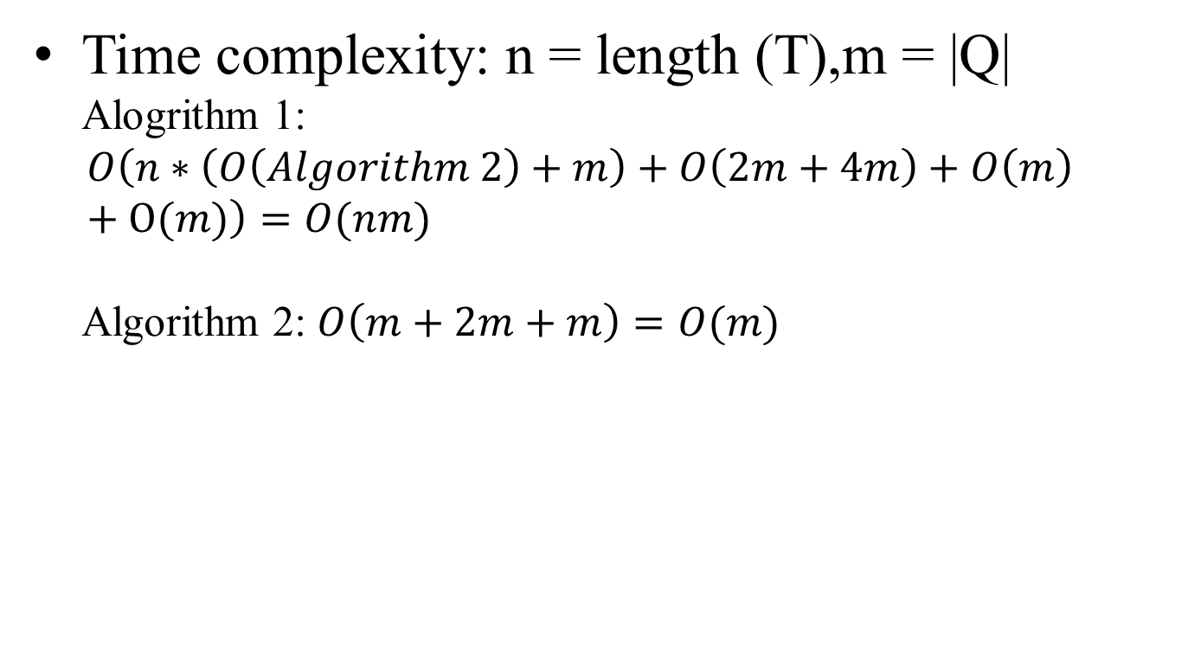
RE shortest substring search problem
Time complexity: n = length (T),m = |Q| Alogrithm 1: $O\left(n∗\left(O\left(Algorithm 2\right)+m\right)+O\left(2m+4m\right)+O\left(m\right)+O(m)\right)=O(nm)$ Algorithm 2: $O\left(m+2m+m\right)=O(m)$
Notes:
Algo.1: O(m) = regular expression轉換成NFA的時間
O(2m + 4m) = topological sort 的時間(topological sort 的time complexity = |V| + |E|)

