Slide 1
Semi-local longest common subsequences in subquadratic time
Alexander Tiskin, Journal of Discrete Algorithms, Volume 6, Issue 4, Pages 570–581, 2008.
Presenter: Shao-Xuan Lee
Date: Nov. 10, 2020

Slide 2
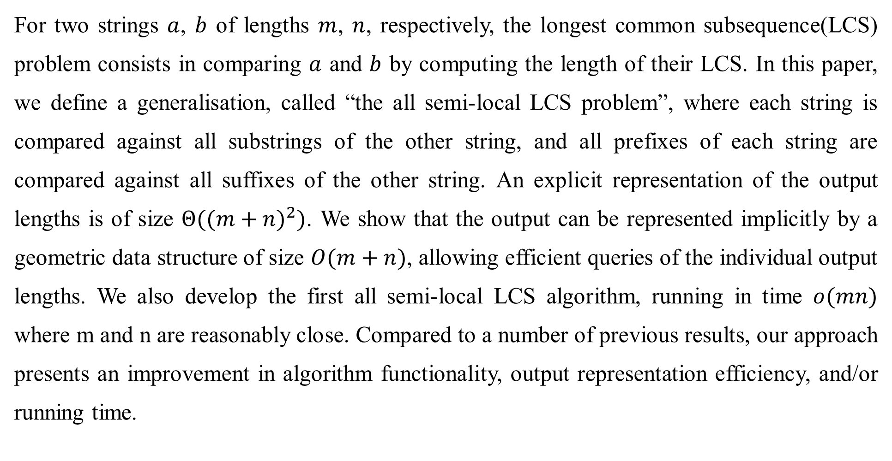
Abstract
For two strings $a$, $b$ of lengths $m$, $n$, respectively, the longest common subsequence(LCS) problem consists in comparing $a$ and $b$ by computing the length of their LCS. In this paper, we define a generalisation, called “the all semi-local LCS problem”, where each string is compared against all substrings of the other string, and all prefixes of each string are compared against all suffixes of the other string. An explicit representation of the output lengths is of size $Θ({(m+n)}^{2})$. We show that the output can be represented implicitly by a geometric data structure of size $O(m+n)$, allowing efficient queries of the individual output lengths. We also develop the first all semi-local LCS algorithm, running in time $o(mn)$ where m and n are reasonably close. Compared to a number of previous results, our approach presents an improvement in algorithm functionality, output representation efficiency, and/or running time.

Slide 3
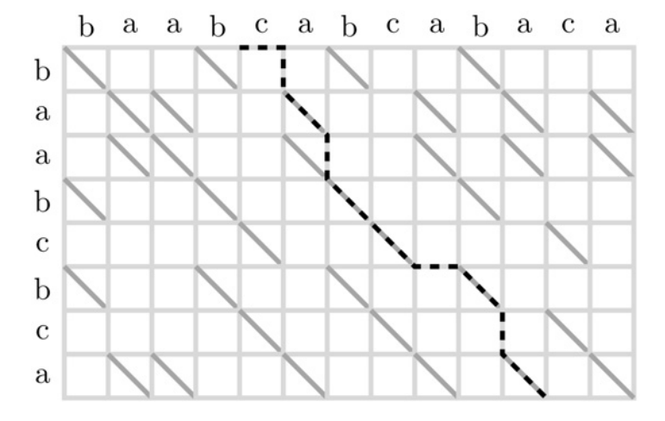
Semi-local LCS problem
Alignment Directed Acyclic Graph(DAG)

Slide 4
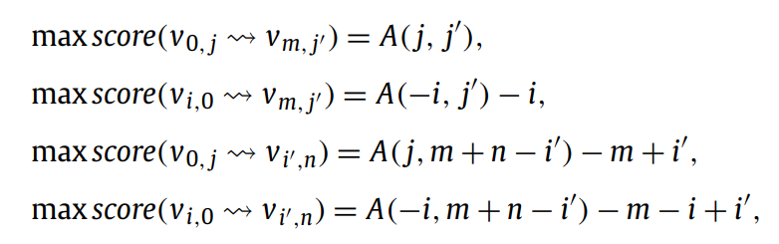
Semi-local LCS problem
…
…

Slide 5
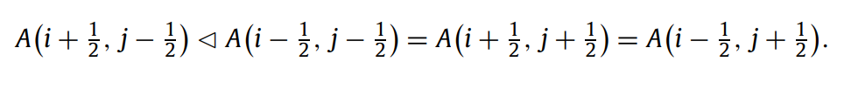
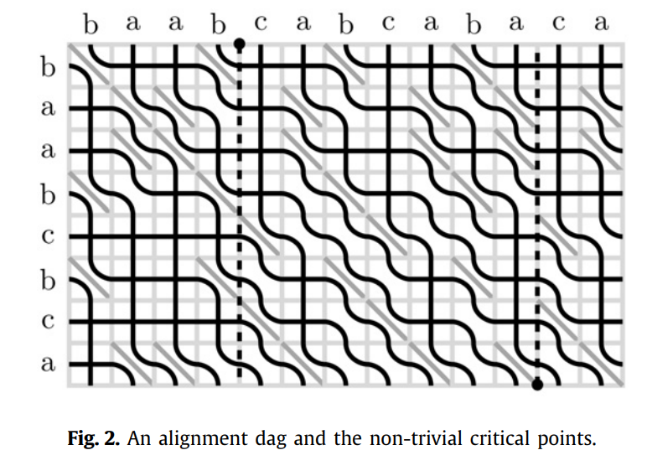
A-critical point

Slide 6
A-critical point

Slide 7

A-critical point
11 – 4 – 2 = 5
LCS = a b c b a

Slide 8
A-critical point
11 – 2 – 3 = 6
LCS = a a b c b a
(b a b c b a)

Slide 9
Algorithm
Divide and conquer

Slide 10
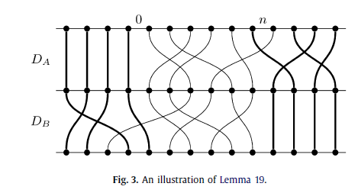

Algorithm
Divide and conquer
Time Complexity : $O\left(M+n^{1.5}\right)$

Slide 11

Conclusions
Time Complexity : $O\left(\frac{mn}{{(log\left(m+n\right))}^{\frac{1}{2}}}\right)$

