Slide 1
Shuffled Frog-leaping Algorithm: A Memetic Metaheuristic for Discrete Optimization
Muzaffar Eusuff, Kevin Lansey and Fayzul Pasha
Engineering Optimization, Vol. 38, No. 2, pp. 129-154, 2006
Presenter : Tz-Hsu Lee
Date : Dec. 29, 2020.
Notes:
journal

Slide 2
Abstract(1/3)
A memetic meta-heuristic called the shuffled frog-leaping algorithm (SFLA) has been developed for solving combinatorial optimization problems. The SFLA is a population-based cooperative search metaphor inspired by natural memetics. The algorithm contains elements of local search and global information exchange. The SFLA consists of a set of interacting virtual population of frogs partitioned into different memeplexes. The virtual frogs act as hosts or carriers of memes where a meme is a unit of cultural evolution. The algorithm performs simultaneously an independent local search in each memeplex. The local search is completed using a particle swarm optimization-like method adapted for discrete problems but emphasizing a local search.

Slide 3
Abstract(2/3)
To ensure global exploration, the virtual frogs are periodically shuffled and reorganized into new memplexes in a technique similar to that used in the shuffled complex evolution algorithm. In addition, to provide the opportunity for random generation of improved information, random virtual frogs are generated and substituted in the population. The algorithm has been tested on several test functions that present difficulties common to many global optimization problems. The effectiveness and suitability of this algorithm have also been demonstrated by applying it to a groundwater model calibration problem and a water distribution system design problem.

Slide 4
Abstract(3/3)
Compared with a genetic algorithm, the experimental results in terms of the likelihood of convergence to a global optimal solution and the solution speed suggest that the SFLA can be an effective tool for solving combinatorial optimization problems.

Slide 5
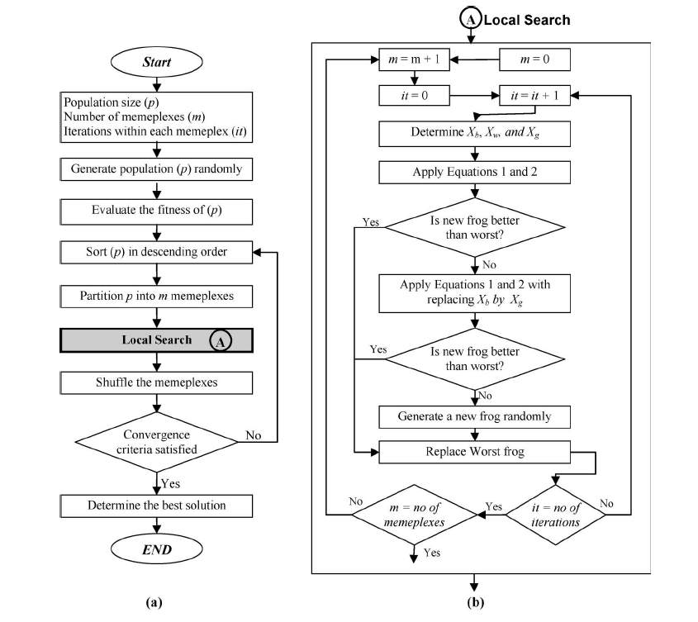

Shuffled Frog-leaping Algorithm(SFLA)(1/5)

Slide 6
Meme
Meme is a contagious information pattern that replicates by parasitically infecting human and/or animal minds and altering their behavior, which causes them to propagate the pattern.
Examples of memes are songs, ideas, catch phrases, clothes fashions and ways of making pots or of building arches.
Memes propagate themselves in the meme pool by leaping from brain to brain via a process that, in the broad sense, can be called imitation.
Notes:
An idea or information pattern is not a meme until it causes someone to replicate it or to repeat it to someone else.

Slide 7
Comparison of Memes and Genes
Memes :
Increased communicability among the hosts.
Can be transmitted between any two individuals.
Can be transmitted in the space of minutes.
Can take over a meme from a single individual is almost unlimited.
Spreading is much faster, can be improved by the person.
Genes :
For sexual reproducibility.
Can only be transmitted from parents or parent.
Transmitted between generations.
Restricted by the rather small number of offspring from a single parent.
Notes:
An idea or information pattern is not a meme until it causes someone to replicate it or to repeat it to someone else.

Slide 8
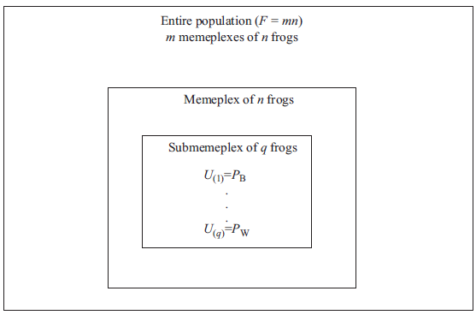
Shuffled Frog-leaping Algorithm(SFLA)(2/5)

Slide 9

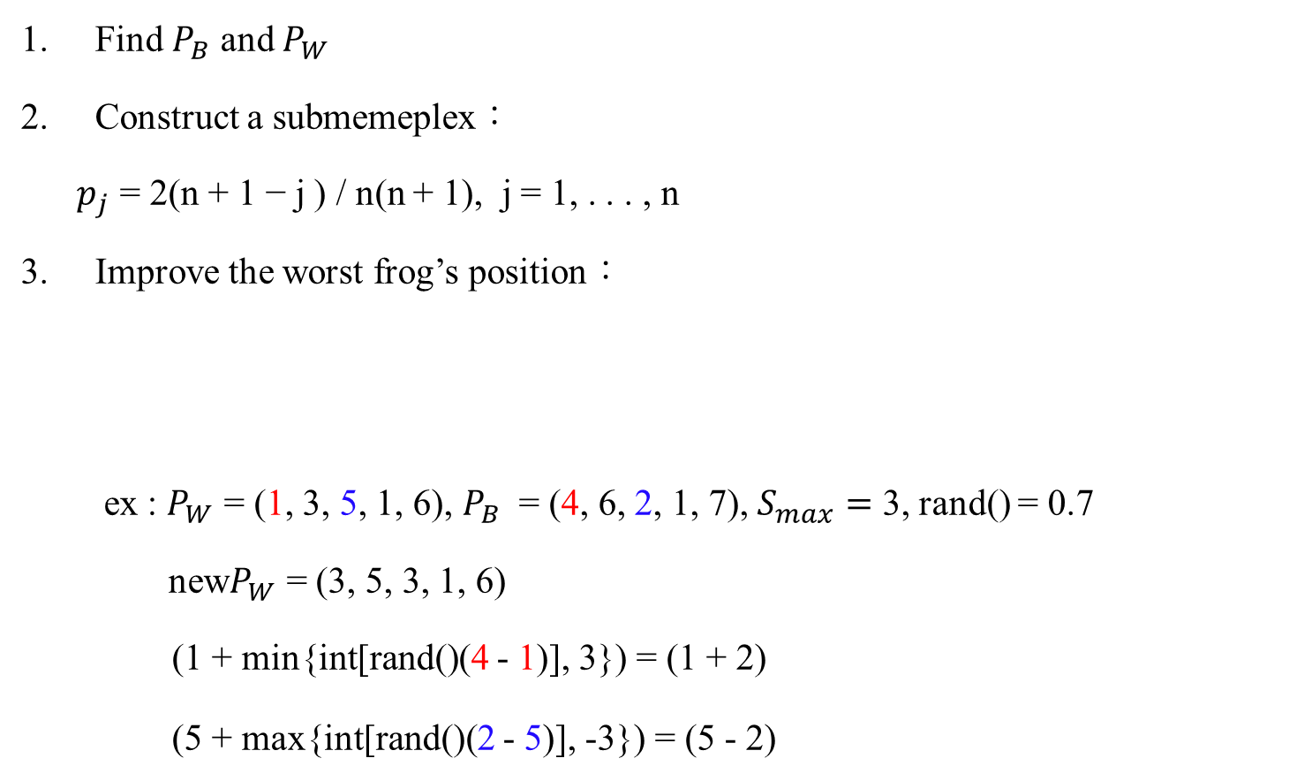
Shuffled Frog-leaping Algorithm(SFLA)(3/5)
Find $P_{B}$ and $P_{W}$
Construct a submemeplex：
$p_{j}$ = 2(n + 1 − j ) / n(n + 1), j = 1, . . . , n
Improve the worst frog’s position：
ex : $P_{W}$ = (1, 3, 5, 1, 6), $P_{B}$ = (4, 6, 2, 1, 7), $S_{max}=$ 3, rand() = 0.7
new$P_{W}$ = (3, 5, 3, 1, 6)
(1 + min{int[rand()(4 - 1)], 3}) = (1 + 2)
(5 + max{int[rand()(2 - 5)], -3}) = (5 - 2)

Slide 10


Shuffled Frog-leaping Algorithm(SFLA)(4/5)
if new$P_{W}$not better than $P_{W} :$
if new$P_{W}$still not better than $P_{W} :$
random a new frog to replace $P_{W}$
Update $P_{B}$ and $P_{W}$
Repeat N times for every memeplex
Shuffle memeplexes：
sort frogs and partition frogs into memeplexes again
Notes:
If there are too few frogs in each memeplex, the advantage of the local memetic evolution strategy is lost.
when too few frogs are selected in a submemeplex, the information exchange is slow, resulting in longer solution times
If N is small, the memeplexes will be shuffled frequently, reducing idea exchange on the local scale.
On the other hand, if N is large, each memeplex will be shrunk into a local optimum

Slide 11
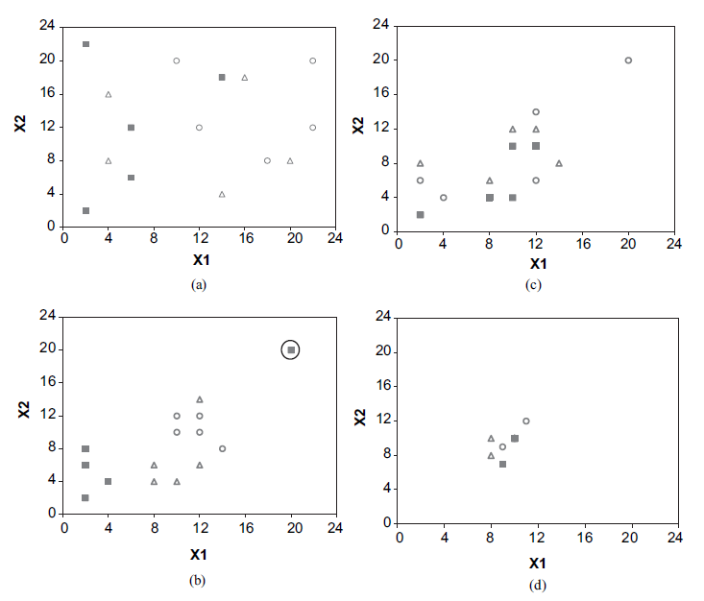
Shuffled Frog-leaping Algorithm(SFLA)(5/5)
Notes:
If there are too few frogs in each memeplex, the advantage of the local memetic evolution strategy is lost.
when too few frogs are selected in a submemeplex, the information exchange is slow, resulting in longer solution times
If N is small, the memeplexes will be shuffled frequently, reducing idea exchange on the local scale.
On the other hand, if N is large, each memeplex will be shrunk into a local optimum

Slide 12
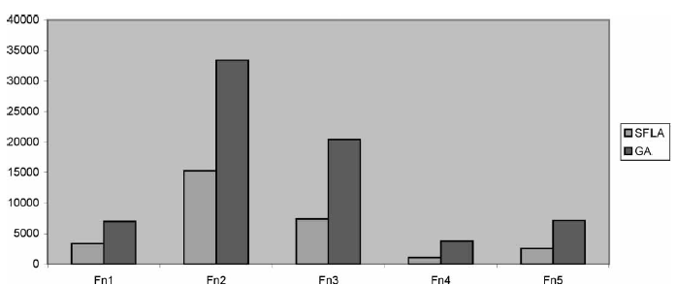
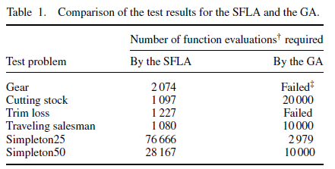
Results (1/3)
Notes:
20 runs

Slide 13
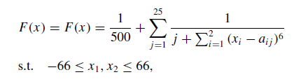
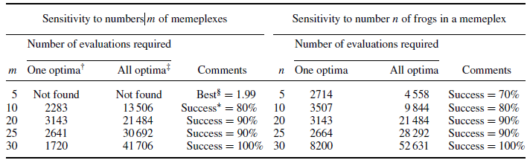
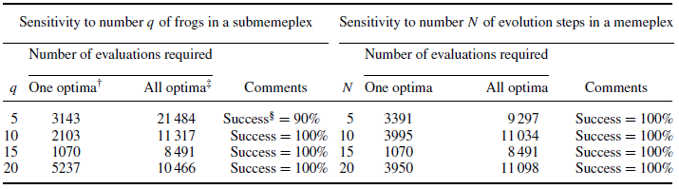
Results (2/3)
Notes:
One optima indicates the event when at least one frog is infected by the global optimal idea.
All optima indicate the event when all the frogs are infected by the global optimal idea.
The global optimal (0.998) was not found; rather the local best was determined.
The success rate was measured on the basis of the number of global optimal solutions found in ten runs.
m = 20, n = 20, q = 5,N = 15 and Smax = 45%
m = 20, n = 20, q = 15,N = 15 and Smax = 45%

Slide 14
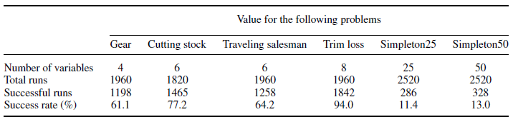
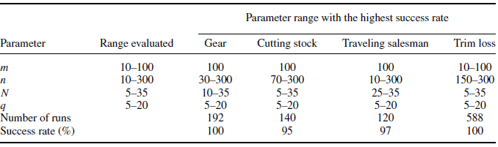
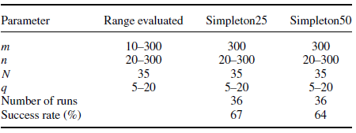
Results (3/3)

