Slide 1
Longest Common Subsequence Using Chemical Reaction Optimization
l
Md. Rafiqul Islam, Zarrin Tasnim Asha and Rezoana Ahmed
Proceedings of International Conference on Electrical Information and Communication Technology (EICT 2015), Khulna, Bangladesh
Presenter: Jue -Jun Wu
Date: Dec. 29th , 2020
Notes:
電氣信息與通信技術
孟加拉國的一所公立工程大學

Slide 2
Abstract(1/2)
Longest Common Subsequence (LCS) is a well-known optimization problem. It is the problem to find out a longest subsequence of each member of a given set of sequences. It is an NP-hard problem and has applications in data compression, FPGA circuit minimization and bioinformatics. Chemical Reaction Optimization (CRO) is a new meta-heuristic method that is being widely used in solving optimization problem.

Slide 3
Abstract(2/2)
In this paper we have proposed an efficient Chemical Reaction Optimization technique to solve Longest Common Subsequence problem. The design strategies of elementary operators and correction method are shown to solve the problem. The proposed method is compared with two other methods and the experimental results show that it takes less execution time than that of others.
Notes:
人工化學反應優化算法(ACROA)是一種模擬化學反應過程的元啟發式算法,它把化學反應中的對象、狀態、過程和事件設計成一種計算方法;把反應中焓和熵的能量變化設計成目標函數,通過求目標函數的最優組合來實現問題的求解。所以提出一種混合人工化學反應優化算法求解0-1背包問題。該方法首先把化學反應分成單分子和雙分子兩種反應類型,并對這兩種類型中的不同化學反應進行二進制編碼;其次,為了獲得問題的最優解,引入一個貪婪策略的修正算子來修正反應過程的隨機選擇所產生的非可行解,并通過局部和全局搜索來獲得問題的最優求解。實驗結果證明ACROA算法的性能明顯優于GA算法和QEA算法,該算法在解決背包問題等有很大的優勢。

Slide 4
Chemical Reaction Optimization (CRO) is a simple and powerful
meta-heuristic which is showing excellent performance in solving
optimization problem.
CRO mimics the interactions of molecules in chemical reactions to search for the global optimum .
In this paper we have designed an algorithm to find LCS based on the concept of CRO. The proposed method, dynamic programming algorithm for LCS given in and fast dynamic programming method have been implemented and compared the results to show the performances.
Notes:
Mimics-模仿 moleculesz-分子

Slide 5
CRO simulates four types of chemical reactions.
Elementary reactions are on-wall ineffective collision,
decomposition, inter-molecular ineffective collision and synthesis.
At the end of each iteration , we have to check stopping criteria.
Here the potential energy value of the newly obtained molecule(s) is
compared with the original molecules.
The new molecules will be accepted when the new values can
satisfy the energy conservation conditions.
Otherwise, the new molecules are discarded.
Notes:
CRO模擬四種類型的化學反應。四種類型
基本反應是壁上無效的碰撞，
分解，分子間無效碰撞和合成。
初始化，迭代和最後階段
在每次迭代的最後，我們必須檢查 停止標準。節能

Slide 6
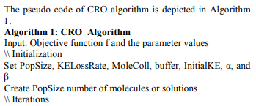
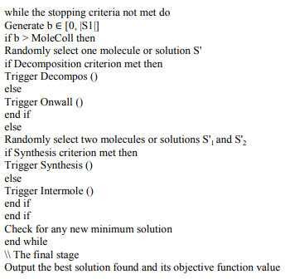
S1 (first sequence) of length n
S2 (second sequence) of length m, where m ≤ n
S1 = “GCCCTAGCG”.
S2 = “GGCACTA”.
LCS = ”GCAC”.
Notes:
CRO是最新的優化算法之一， 受化學反應過程啟發。在CRO中 分子（M）是代表 優化問題的解決方案。分子由CRO控制和操縱。 分子具有勢能（PE），動能（KE），命中數和代表溶液的其他特徵。 CRO模擬四種類型的化學反應。四種類型 基本反應是壁上無效的碰撞， 分解，分子間無效碰撞和 合成。在CRO過程中，總能量仍然存在 常數，這意味著CRO需要節約能源。
在 迭代階段，四個反應中有一個基本反應 在每次迭代中發生。在這裡，我們必須確定 無論發生單分子還是雙分子反應。 反應類型是通過比較隨機 對MoleColl的數字t [0，1]。如果t> MoleColl，將會有 單分子反應。否則會發生雙分子反應 發生。在每次迭代的最後，我們必須檢查 停止標準。在這裡，新能源的勢能值 將獲得的分子與原始分子進行比較。 當新值可以 滿足節能要求

Slide 7
S1: | G | C | C | C | T | A | G | C | G
 | 0 | 1 | 2 | 3 | 4 | 5 | 6 | 7 | 8
Solution Generation(生成解)
Take length m=|S2|.
Generate m random numbers from 0 to n =|S1|.
Sort the numbers to get a solution sequence.
Generate |S2| random numbers k ∈ [0, n]:
S2: | G | G | C | A | C | T | A
 | 0 | 1 | 2 | 3 | 4 | 5 | 6
R: | 8 | 2 | 0 | 8 | 6 | 4 | 7
S: | 0 | 2 | 4 | 6 | 7 | 8 | 8
S: | G | C | T | G | C | G | G

Slide 8
R: | 8 | 2 | 0 | 8 | 6 | 4 | 7
S: | 0 | 2 | 4 | 6 | 7 | 8 | 8
B. On-wall Ineffective Collision
It changes the solution structure of one solution.
Solution S is transformed to S’.
S' = C(S), where C(S) is a correction operator that corrects new solution structure.
S’: | 0 | 2 | 4 | 1 | 7 | 8 | 8
S: | 0 | 1 | 2 | 4 | 7 | 8 | 8
G | C | C | T | C | G | G

Slide 9
C. Decomposition
Generates two solutions from one solution and the solution will different from the original one.
Assume that the operator creates two solutions S'1 and S'2 from solution S,
S → S'1 ∪ S'2
Firstly, S is copied to generate S'1 and S’2.
Secondly, for n/2 positions in solutions S'1 and S'2 are changed randomly.
The function C (S) is invoked to make the output solution valid.
S: | 0 | 2 | 4 | 6 | 7 | 8 | 8
S1’: | 0 | 2 | 3 | 0 | 7 | 8 | 1
S2’: | 0 | 0 | 4 | 1 | 7 | 5 | 8
S1’: | 0 | 0 | 1 | 2 | 3 | 7 | 8
S2’: | 0 | 0 | 1 | 4 | 5 | 7 | 8

Slide 10
S1’: | 0 | 1 | 4 | 6 | 7 | 7 | 8
S1: | 0 | 2 | 4 | 6 | 7 | 8 | 8
D. Inter-molecular Ineffective Collision
It changes the solution structure.
The molecularity remains unchanged before and after the process.
Suppose that in an inter-molecular ineffective collision, the solution
structure S1 is transformed to S'1 and S2 is transformed to S'2.
It can be defined as follows: S1 ∪ S2 → S'1 ∪ S’2 .
Then the new solution structure is generated as S' = C (S) .
S2: | 0 | 1 | 4 | 4 | 7 | 7 | 8
S2’: | 0 | 2 | 4 | 4 | 7 | 8 | 8
Notes:
分子（假設二）在處理前後保持不變。 假設在分子間無效碰撞中，解決方案
結構S1轉換為S'1，S2轉換為S'2。

Slide 11
S1’: | 0 | 2 | 4 | 5 | 6 | 8 | 8
S2’: | 0 | 0 | 2 | 4 | 7 | 7 | 8
E. Synthesis Operator
Synthesis takes two molecules as the inputs and combines
them to generate a new molecule.
We take two existing solution S'1 and S’2.
Generate a new solution S from them.
S'1 ∪ S'2 → S
This new solution S is the longest common subsequence
S: | 0 | 0 | 2 | 5 | 7 | 8 | 8
Notes:
合成以兩個分子為輸入並結合
我們採取兩個現有解決方案S'1和S'2。 產生一個新的解S

Slide 12
G | C | C | C | T | A | G | C | G
0 | 1 | 2 | 3 | 4 | 5 | 6 | 7 | 8
S: | 0 | 1 | 4 | 7 | 7 | 8 | 8
F. Correction Method
Input is solution: S
Compare the position S[i] of S1 with the character in position, I of S2.
1 . Same character (character matching) in S2 and in S1, then we copy
the value of S[i] to output vector, S'[i].
2 . If different character is found (no character matching) then we do forward searching in S1 starting at the position S[i] +1 to the position S[i+1]-1.
If matches with the character in position, i of S2, the value of j (which is the index value of S1) is saved to S'[i].
3 . In case, there is no character matching in forward searching and also in backward searching the value of S[i] to be copied in S'[i].
S1: | G | C | C | G | C | A | G | C | G
G | G | C | A | C | T | A
0 | 1 | 2 | 3 | 4 | 5 | 6
S2: | G | G | C | A | C | T | A
S’: | 0 | 3 | 4 | 5 | 7 | 8 | 8
Notes:
校正方法
將S1的位置S [i]中的字符與該字符進行比較在S2的i位置，
因此，我們在S1中進行正向搜索。
這裡S [i] +1 = 2和S [i + 1] -1 = 3，
S的值 若沒有改變則 保留S的 若大於i+1則最大的位置8

Slide 13
Simulation Results
DNA:{A,T,C,G}
Si= rand [A, G, C, T]
Length of the string is n
Parameters as initialize :
Pop Size = 10 , Collision Rate = 0.2 , Loss Rate = 0.1 ,
Buffer = 0 , KE = 1000, Decomposition Threshold (α) = 15000 , Systhesis Threshold (β) =10 etc.
The decomposition condition and synthesis condition respectively effect by the value of decomposition threshold and systhesis threshold.
Notes:
仿真結果
我們將建議的CRO方法與動態LCS進行比較[2]和Fast Dynamic LCS [3]算法來展示它們表演。
分解條件與合成條件分別受分解值影響閾值和置換閾值。

Slide 14
Test Environment
The test environment is set up on a personal computer with
Core i5 CPU at 2.50 GHz CPU, 4G RAM, running on Windows 8.
System.currentTimeMillis() method was used for obtained the time measurement.
Using Java programming language and the process of coding,
Eclipse IDE is used.
*During the experiment, we see that 50 runs for each of the chosen values is not sufficient for longest String which length is bigger than 1000 or more.
Notes:
在選擇的值中
比較了50次跑步，最長的順序是已選擇。在實驗過程中，我們發現對於每個選定的值，要進行50次運行就不足以使最長的String
長度大於1000或更大。那我們需要增加
運行次數，

Slide 15
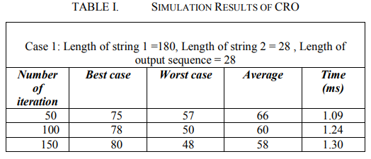

Slide 16
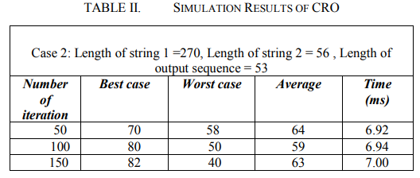

Slide 17
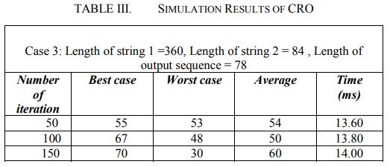

Slide 18
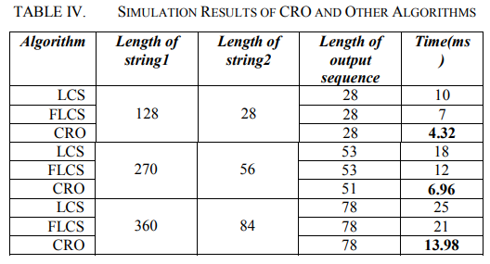
Notes:
We have compared proposed CRO based method with Dynamic LCS [2] and Fast Dynamic LCS [3]

Slide 19
Conclution
It proposed an algorithm to solve longest common subsequence problem based on the concept of CRO. Our main target is to reduce the time complexity of LCS problem and generate an optimal solution.
We have compared proposed CRO based method with Dynamic LCS and Fast Dynamic LCS and found that our proposed algorithm has superior performance when compared for all proposed test instances. It reduces the execution time.
Notes:
在本文中我們的主要目標是減少LCS問題的時間複雜度並產生最優解。
我們比較了建議的基於CRO的方法::使用動態LCS [2]和快速動態LCS [3]並發現
我們提出的算法在比較所有建議的測試實例。它減少了執行時間處理時間。
這裡我們使用了兩個不同的字符串長度。將來，我們將設計一種CRO算法來查找LCS用於多個字符串。

Slide 20
Thanks for listening.

