Slide 1
Authorship Attribution
Patrick Juola
March 2008
Foundations and Trends in Information Retrieval, Vol.1, No.3, pp.233-334
Present: Chia-Lin Chen
Date: Sept. 15th, 2020
Notes:
Duquesne University, 美國賓州
1

Slide 2
Abstract(1/2)
Authorship attribution, the science of inferring characteristics of the author from the characteristics of documents written by that author, is a problem with a long history and a wide range of application. Recent work in“non-traditional” authorship attribution demonstrates the practicality of automatically analyzing documents based on authorial style, but the state of the art is confusing. Analyses are difficult to apply, little is known about type or rate of errors, and few “best practices” are available.

Slide 3
Abstract(2/2)
In part because of this confusion, the field has perhaps had less uptake and general acceptance than is its due. This review surveys the history and present state of the discipline, presenting some comparative results when available. It shows, first, that the discipline is quite successful, even in difficult cases involving small documents in unfamiliar and less studied languages; it further analyzes the types of analysis and features used and tries to determine characteristics of well-performing systems, finally formulating these in a set of recommendations for best practices.

Slide 4
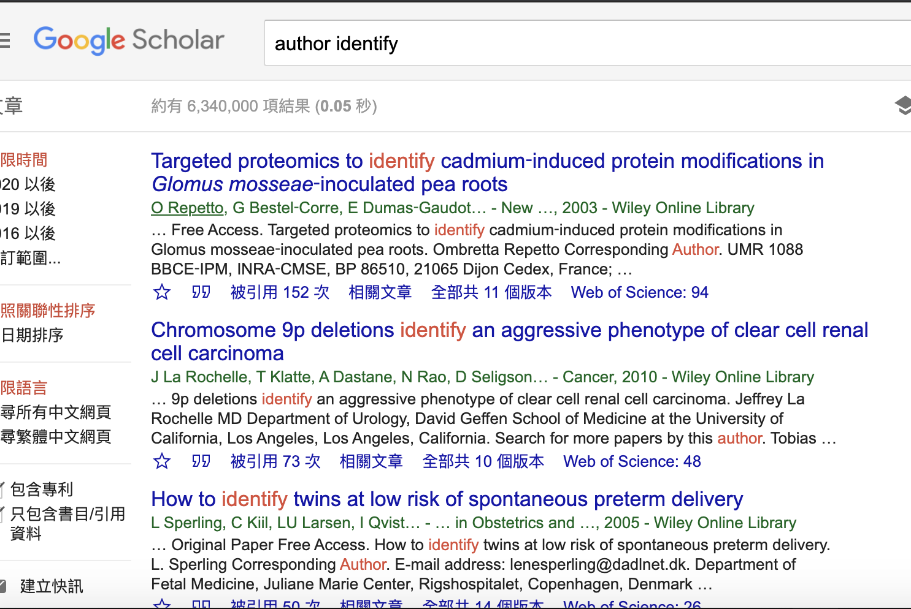
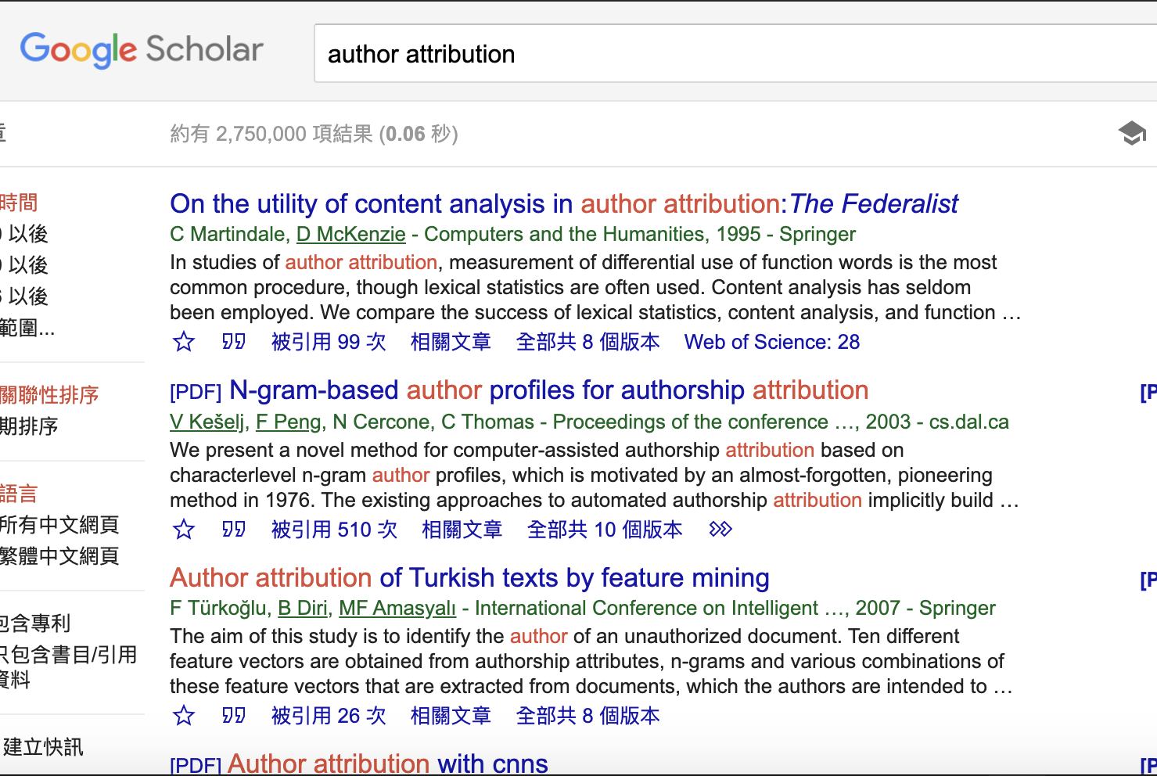
Keywords— author identify v.s. author attribution (partial covered) (fully covered)

Slide 5
Context of the book(1/6)
Chapter1: Introduction
Chapter2: Background and History
Chapter3: Linguistic and Mathematical Background
Chapter4: Linguistic Feature
Chapter5: Attributional Analysis
Chapter6: Empirical Testing
Chapter7: Other Applications of Authorship Attribution
Chapter8: Special Problems of Linguistic Forensics
Chapter9: Recommendations

Slide 6
Context of the book(2/6)
Chapter1: Introduction
2004, Michael Scheuer ”Imperial Hubris: Why the West is Losing the War on Terror”
2003 Michael Scheuer “Through Our Enemies’ Eyes”
Chapter2: Background and History
Three problem set:
Closet class: give an example to classify which one of author
Open class: tell if any, tell who wrote it
Third class: does the document singly or multiply written? Was the writer naïve English speaker(color/colour)? A man/woman?
Method: vocabulary frequency, weighted frequency, cum, mulative
Notes:
第二本作者疑似是Michael美國CIA的幹員，作者認為如果這本書是他寫的，那這本書信譽度大增。

Slide 7
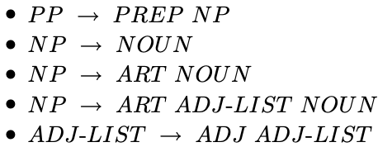
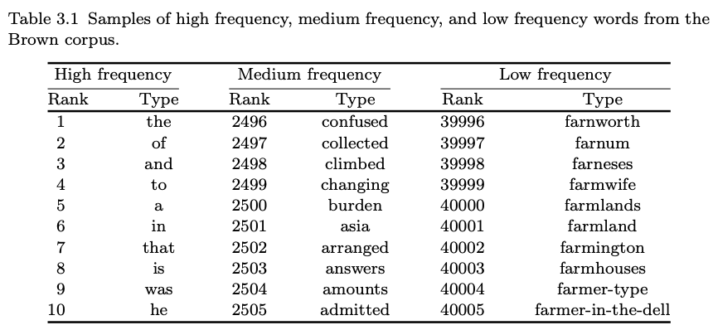
Context of the book(3/6)
Chapter3: Linguistic and Mathematical Background
Language replacement:
(PP)in Monday morning->on Monday
(NP)the monkey->monkey(NOUN)
(NP)the monkey->Naughty monkey(ART NOUN)
Entropy, Cross entropy
Matrices, Vector Space, PCA, LDA
Notes:
名詞片語可用

Slide 8


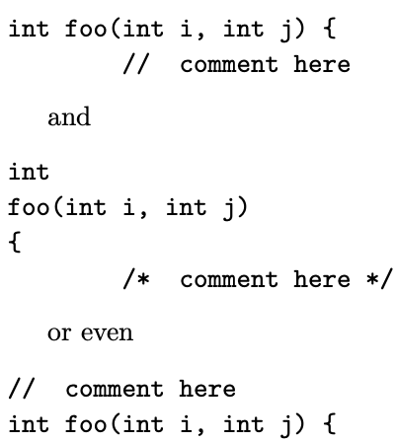
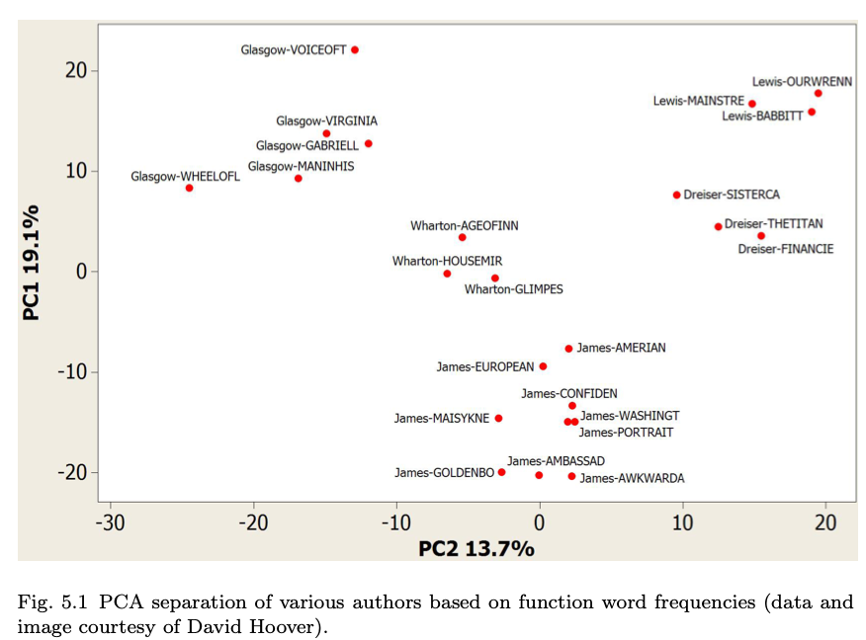
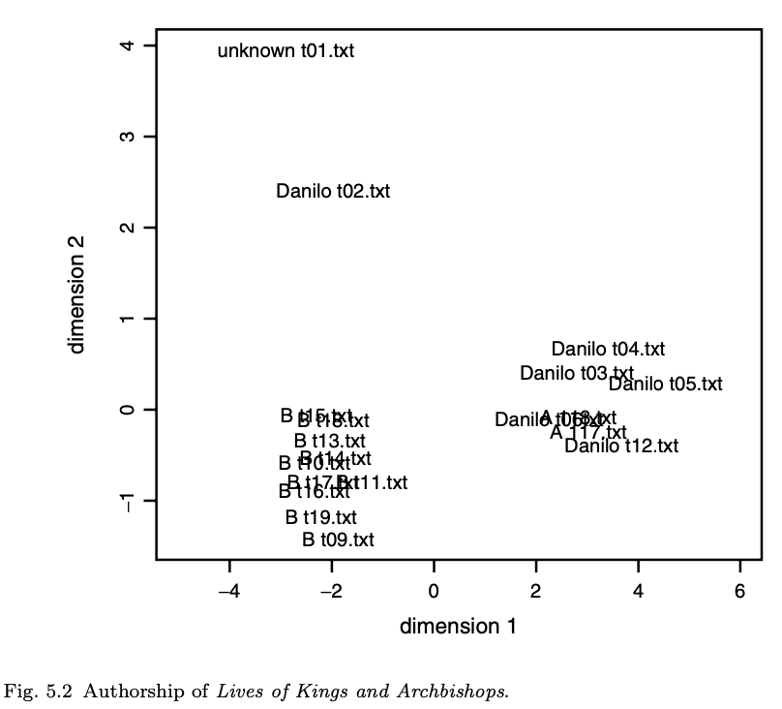
Context of the book(4/6)
Chapter4: Linguistic Feature
Vocabulary to integer numbers
N-gram: e.g. danc( 4-gram ): dance, dancing, dancer
Chapter5: Attributional Analysis
Notes:
2-gram公式
N-gram公式
Code style不同的例子
第五章例子-詞頻的PCA,三維降成二維

Slide 9
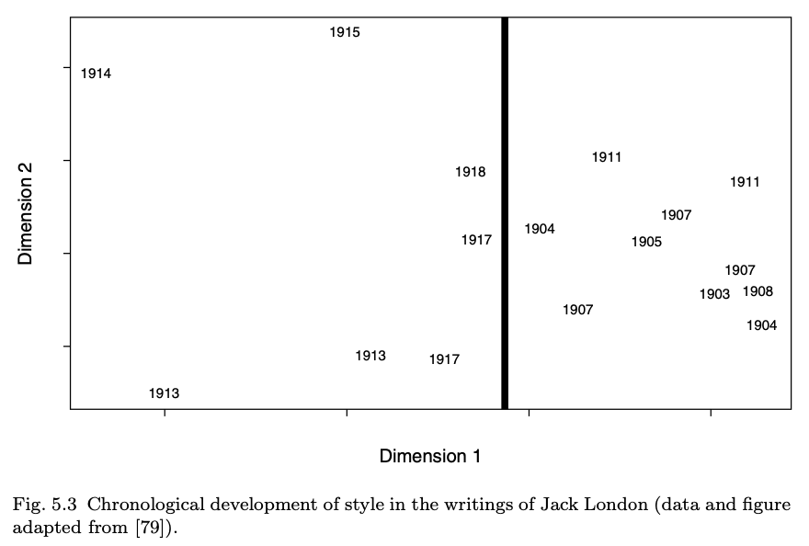
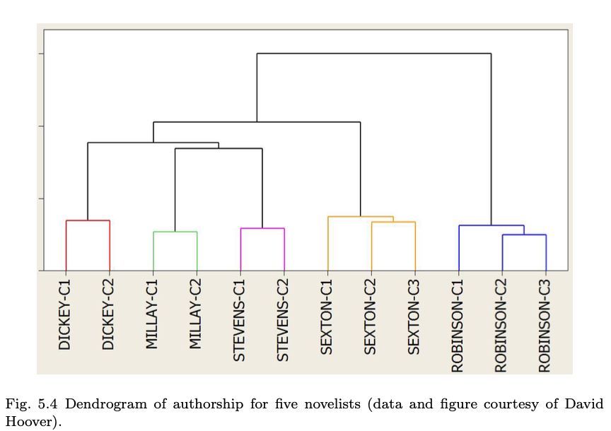
Context of the book(5/6)
Chapter5: Attributional Analysis
Notes:
Example of
Cluster
Supervised

Slide 10
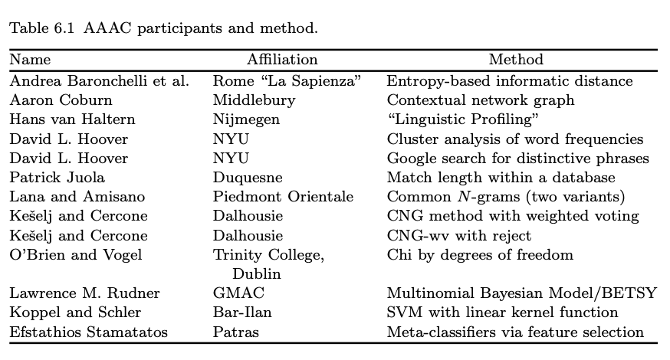
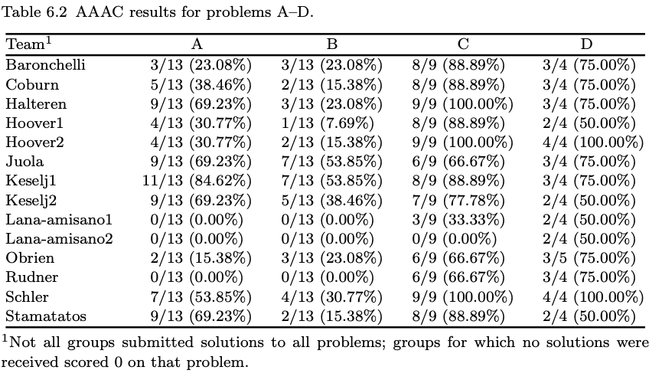
Context of the book(6/6)
Chapter6: Empirical Testing

Slide 11
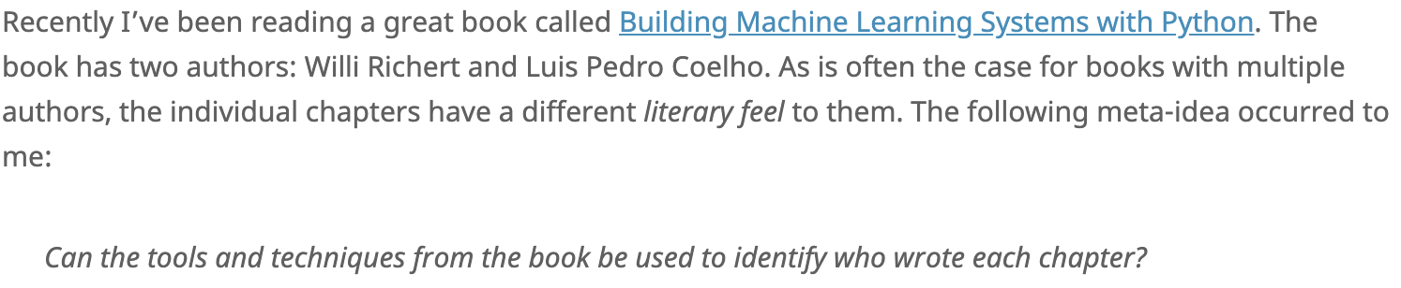
Extend application (1/3)
Detect Unknown Author by learning Author1/Author2.
(http://www.aicbt.com/authorship-attribution/online-software/)
( Randomly choose CNN author, correct; Unfortunately it cannot read Chinese. )

Slide 12
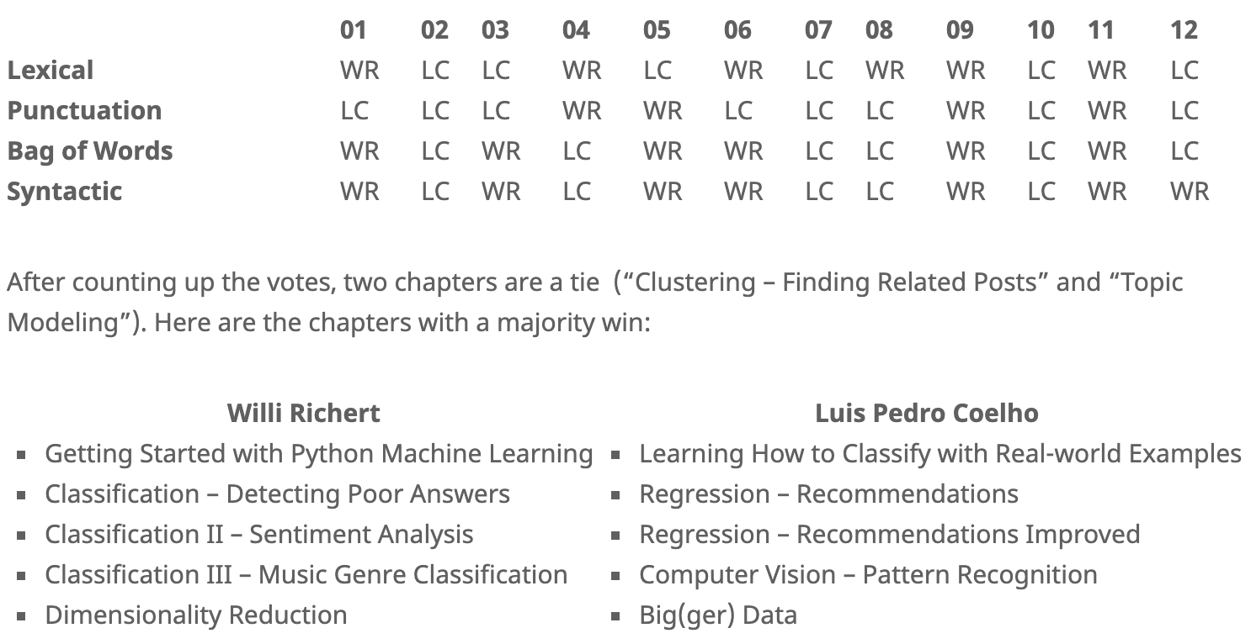
Extend application (2/3)

Slide 13
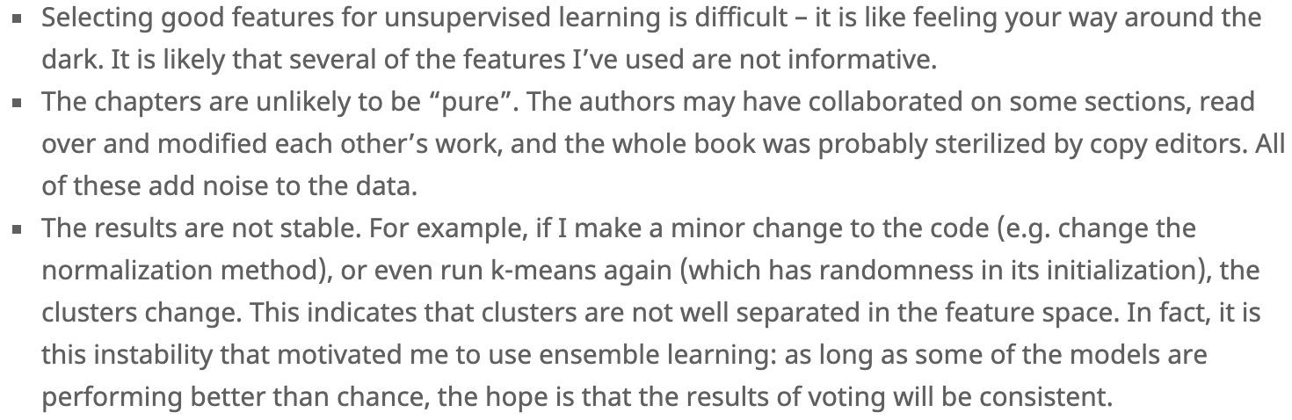
Extend application (3/3)

Slide 14
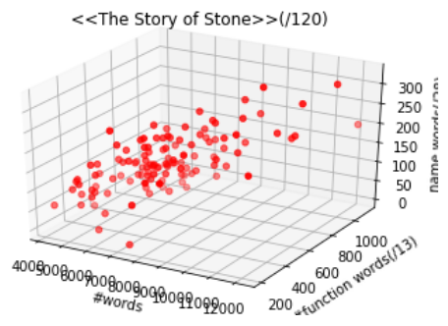
My thesis (1/3)--#words, #function words(13), #names(28) in each ariticle(120)

Slide 15
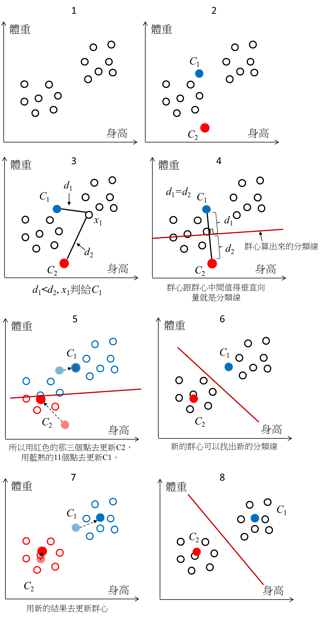
My thesis (2/3)—Clustering, k-means(k=2)
start
Start
Randomly choose 2 points
as 2 centers of gravity
Update gravity table and
decide who is new 2 centers
( If 1 or 2 or 3 )
1. Distances of points to 2 centers
are the same
2. Reach MAX_ITER
3. Distances of points to 2 centers are
same as the last iteration
Yes
End
No
Notes:
最靠近重心者當重心,loop看是否為真正重心

Slide 16
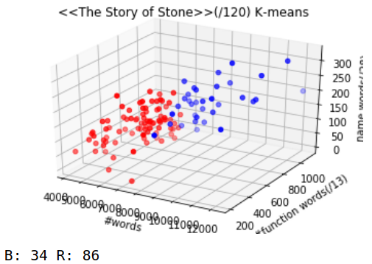
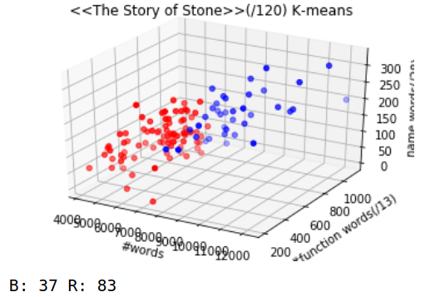
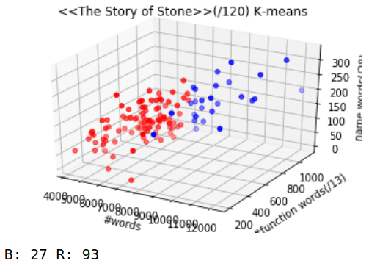
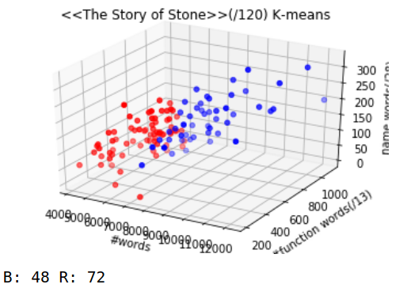
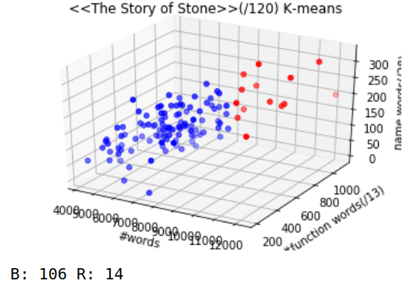
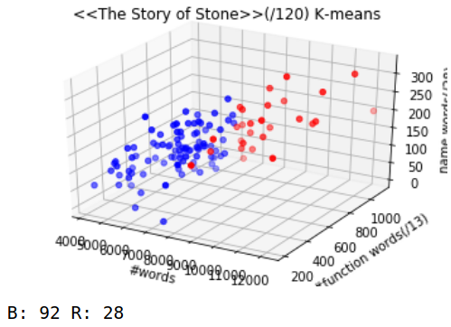
My thesis (3/3)--K-means(K=2)

Slide 17
Thank you!

