Slide 1
Resequencing a Set of Strings Based on a Target String
Chih-En Kuo · Yue-Li Wang · Jia-Jie Liu · Ming-Tat Ko
Algorithmica, Vol. 72, No. 2, pp. 430-449, 2015.
Presenter: Shao-Xuan Lee
Date: Sep. 15, 2020

Slide 2
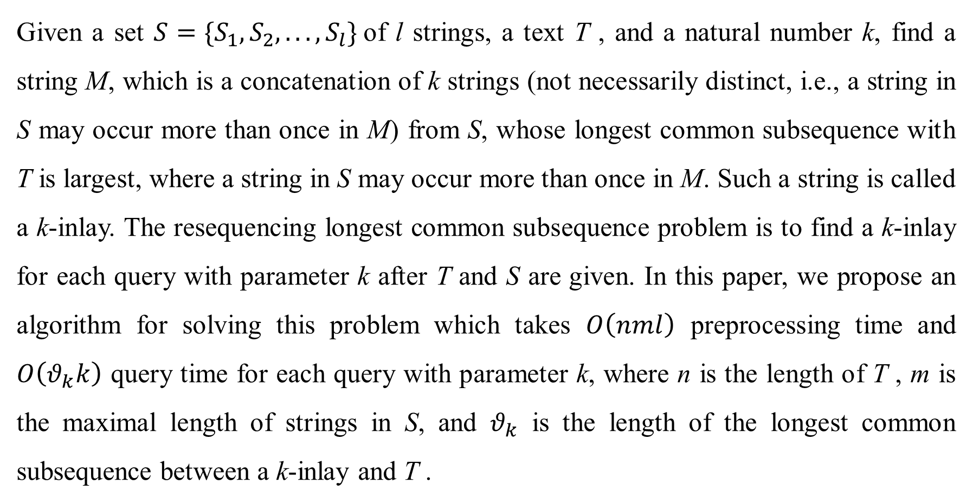
Abstract
Given a set $S=\{S_{1},S_{2}, . . . ,S_{l}\}$of l strings, a text T , and a natural number k, find a string M, which is a concatenation of k strings (not necessarily distinct, i.e., a string in S may occur more than once in M) from S, whose longest common subsequence with T is largest, where a string in S may occur more than once in M. Such a string is called a k-inlay. The resequencing longest common subsequence problem is to find a k-inlay for each query with parameter k after T and S are given. In this paper, we propose an algorithm for solving this problem which takes $O\left(nml\right)$ preprocessing time and $O\left(θ_{k}k\right)$ query time for each query with parameter k, where n is the length of T , m is the maximal length of strings in S, and $θ_{k}$ is the length of the longest common subsequence between a k-inlay and T .

Slide 3

Mosaic LCS problem (Resequencing LCS problem)
$S=\{agc, act, aatg, ttcg\}$
$T$ = $agactagtc$
$k$ = 4
$M$ = $agcactagcttcg$
LCS of $M$ and $T$ is $θ_{k}=9$

Slide 4
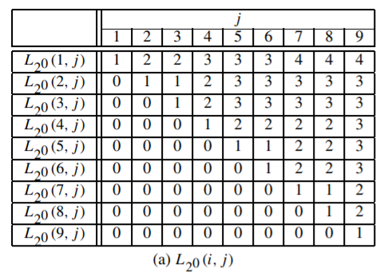
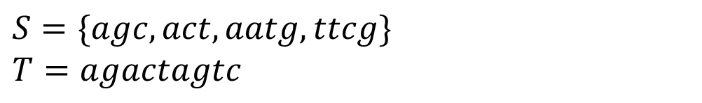
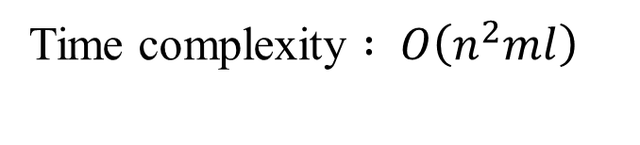
Algorithm Formosa1
Huang, K.S., Yang, C.B., Tseng, K.T., Peng, Y.H., Ann, H.Y., Dynamic programming algorithms for the mosaic longest common subsequence problem. (2007)
$$S=\{agc, act, aatg, ttcg\}$$
$$T=agactagtc$$
Time complexity $: O\left(n^{2}ml\right)$

Slide 5
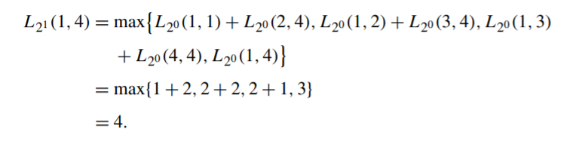
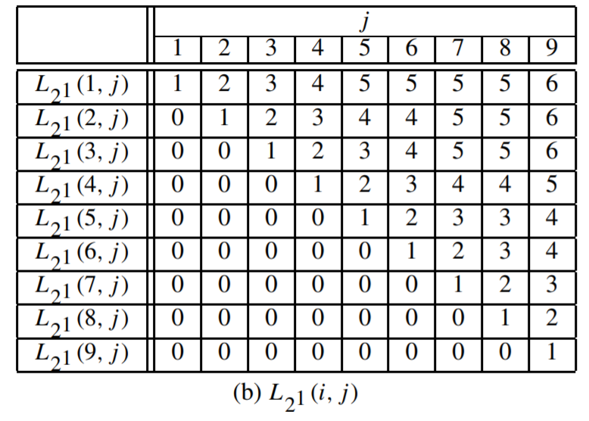
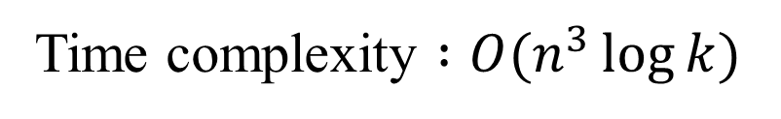
Time complexity $:O(n^{3}\log{k})$

Slide 6
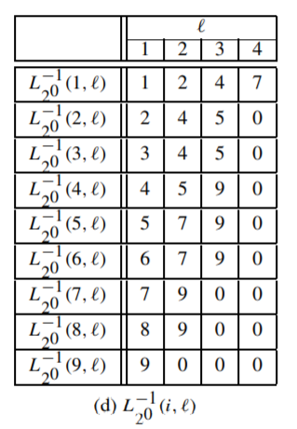
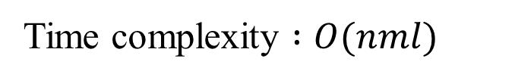
Algorithm mosaic1
Alves, C.E.R., Cáceres, E.N., Song, S.W., An all-substrings common subsequence algorithm (2008)
Time complexity $:O(nml)$

Slide 7
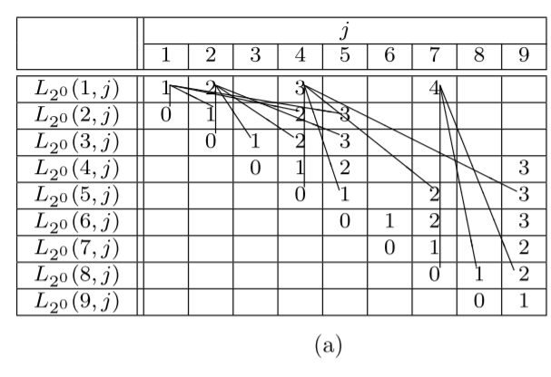
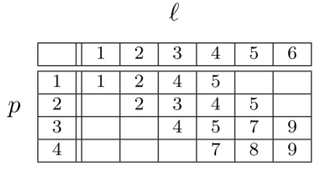
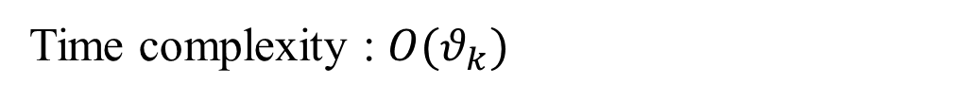
Time complexity : $O(θ_{k})$
1 | 2 | 3 | 4 | 5 | 9

Slide 8
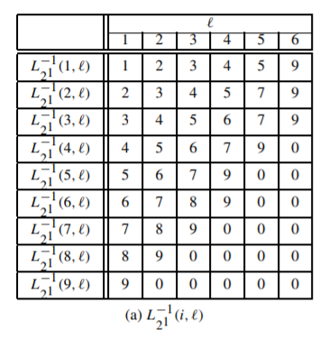


$$O(nθ_{k})$$
Time complexity : $O(nθ_{k}\log{k})$

Slide 9
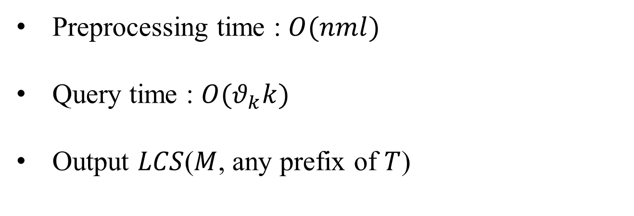
Algorithm mosaic2
Preprocessing time : $O(nml)$
Query time : $O(θ_{k}k)$
Output $LCS$($M$, any prefix of $T$)

Slide 10
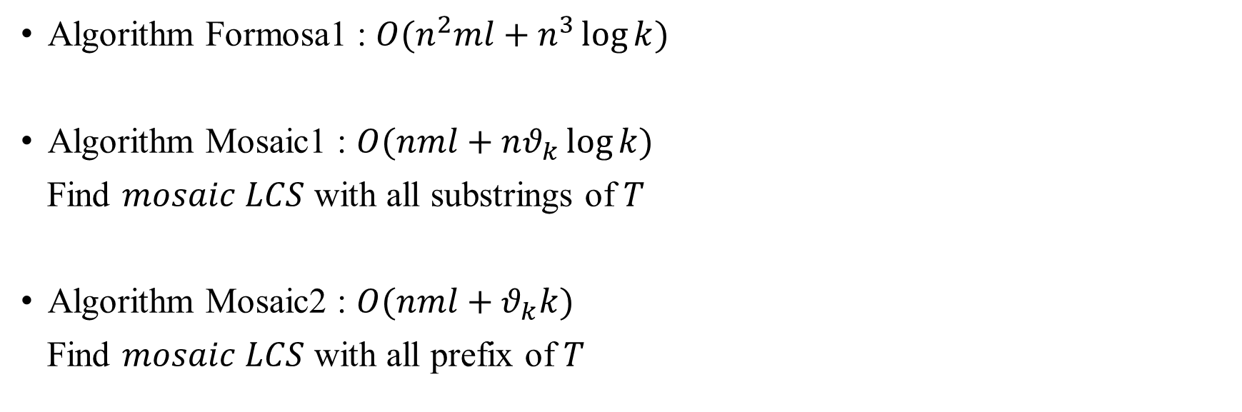
Conclusion
Algorithm Formosa1 : $O(n^{2}ml+n^{3}\log{k})$
Algorithm Mosaic1 : $O(nml+nθ_{k}\log{k})$
Find $mosaic$ $LCS$ with all substrings of $T$
Algorithm Mosaic2 : $O(nml+θ_{k}k)$
Find $mosaic$ $LCS$ with all prefix of $T$

