Slide 1
A Parallel Pairwise Local Sequence Alignment Algorithm
Sanghamitra Bandyopadhyay and Ramkrishna Mitra
IEEE TRANSACTIONS ON NANOBIOSCIENCE,
VOL. 8, NO. 2, JUNE 2009, pp. 139-146
Presenter: Shin-Cheng Lin
Date: Sept. 15 2020

Slide 2
Abstract(1/2)
Researchers are compelled to use heuristic-based pairwise sequence alignment tools instead of Smith–Waterman (SW) algorithm due to space and time constraints, thereby losing significant amount of sensitivity. Parallelization is a possible solution, though, till date, the parallelization is restricted to database searching through database fragmentation. In this paper, the power of a cluster computer is utilized for developing a parallel algorithm, RPAlign, involving, first, the detection of regions that are potentially alignable, followed by their actual alignment.

Slide 3
Abstract(2/2)
RPAlign is found to reduce the timing requirement by a factor of upto 9 and 99 when used with the basic local alignment search tool (BLAST) and SW, respectively, while keeping the sensitivity similar to the corresponding method. For distantly related sequences, which remain undetected by BLAST, RPAlign with SW can be used. Again, for megabase-scale sequences, when SW becomes computationally intractable, the proposed method can still align them reasonably fast with high sensitivity.

Slide 4
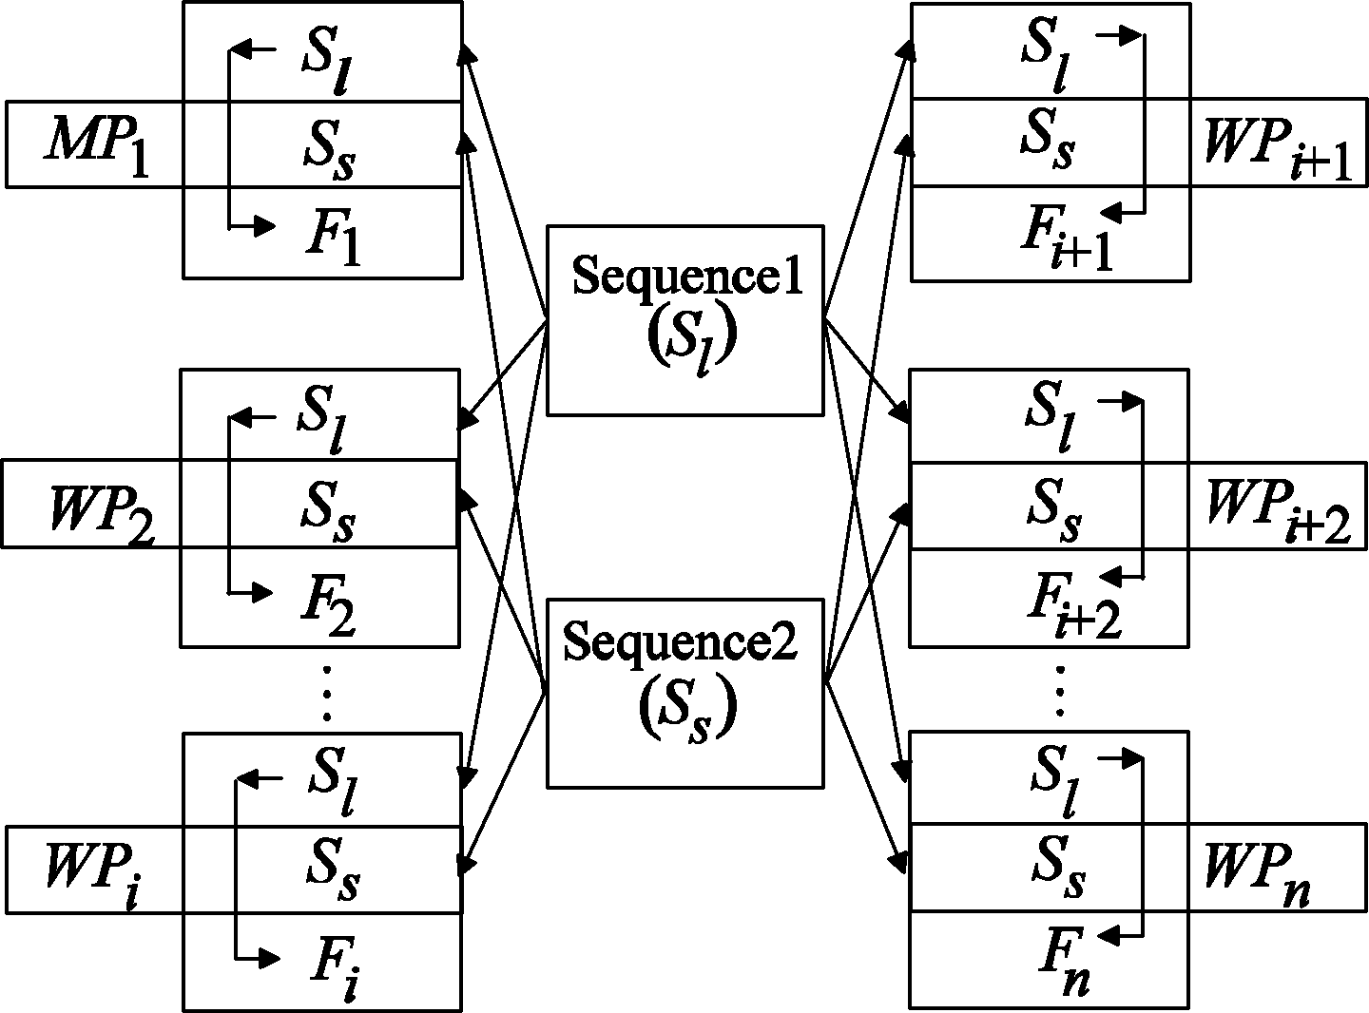
|S_{l}|＞|S_{s}|
1 master processor(MP)
(n-1) worker processors

Slide 5
S_{l} =ATCGATCGA
S_{s} =ATCGAT
3 processor
Overlapping window w=2
|F_{i}|= |S_{l}|/n+w
F₁ =ATCGA
F₂ =GATCG
F₃ =CGA

Slide 6
S_{s} =ATCGAT
F₁ =ATCGA
F_{ij} , j=1,2,…,|F_{i}| － w ＋ 1
F₁₁ =AT
F₁₂ =TC
S_{sk} , k=1,2,…,┌|S_{s}|/w┐
f_{e}(F_{ij}) or f_{e}(S_{sk}) is the frequencies of each type of element
e = 1, 2, . . . , 5 for DNA ( A,T,C,G,N(unknow) )
e = 1,2,...,20 for protein

Slide 7


Composite score (CS)
Protein:
Mat_Score can use BLOSUM62 or BLOSUM50
DNA:

Slide 8
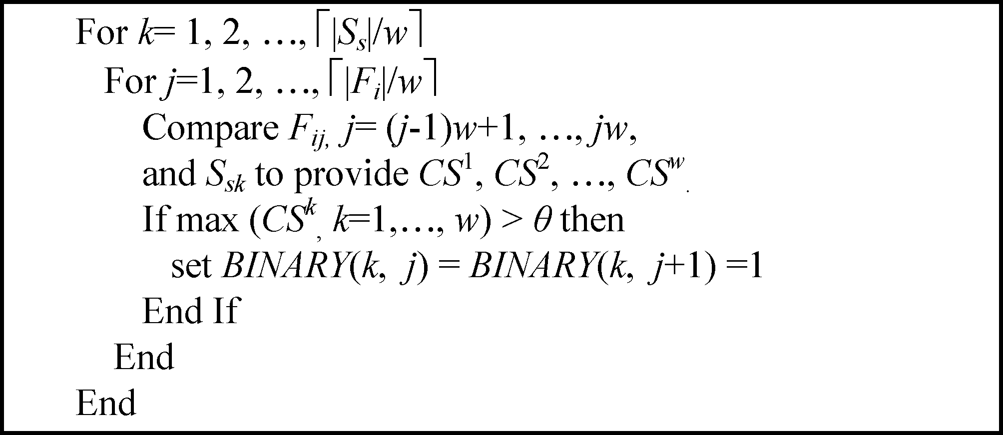
BINARY Matrix
(┌|S_{s}|/w┐) × (┌|F_{i}|/w┐)

Slide 9
BINARY Matrix
F₁ =ATCGA
S_{s} =ATCGAT
When k=1, j=1
F₁₁ =AT , f_{e}(F₁₁)=[1,1,0,0,0]
F₁₂ =TC , f_{e}(F₁₂)=[0,1,1,0,0]
S_{s1} =AT , f_{e}(S_{s1})=[1,1,0,0,0]
CS^{l} =CS(F_{11,} S_{s1})=2
CS² =CS(F_{12,} S_{s1})=1
[CS^{l} ,CS²] =[2,1]
MAX([CS^{l} ,CS²] )=2

Slide 10
BINARY Matrix
F₁ =ATCGA
S_{s} =ATCGAT
MAX ([CS^{l} ,CS²] )=2
A threshold θ
If MAX ([CS^{l} ,CS²]) > θ ,BINARY(k,j)=BINARY(k,j+1)=1

Slide 11
Merging and Redistribution
Transmit BINARY Matrice to the MP
The matrices are collated side by side to make the RPA_DETECTION matrix.
Diagonals that are strings of all 1’s are The positions of the RPAs
Redistribute RPAs to each node to align by BLAST or by SW

Slide 12
Parameters
Overlapping window length w is min(|S_{l}| /40, 25 000) for DNA in general
And for protein sequences of length >3 kb, w = 500 is recommended.
Threshold θ , θ/w≒0.9

Slide 13
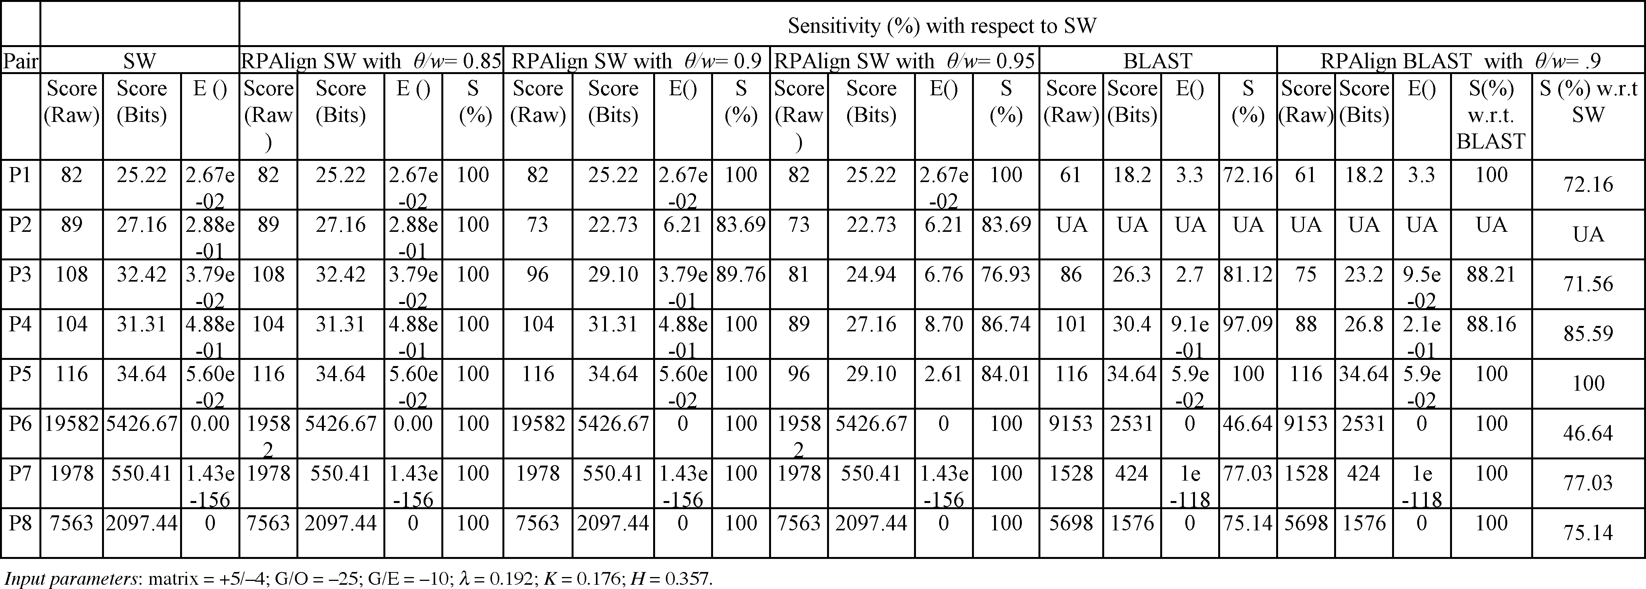
Result
E() : the expected frequency of chance occurrence of the RPA having similarity score S (or higher).
G/O,G/E : gap penalty
K, λ : Karlin–Altschul parameters(parameters of BLAST)

Slide 14
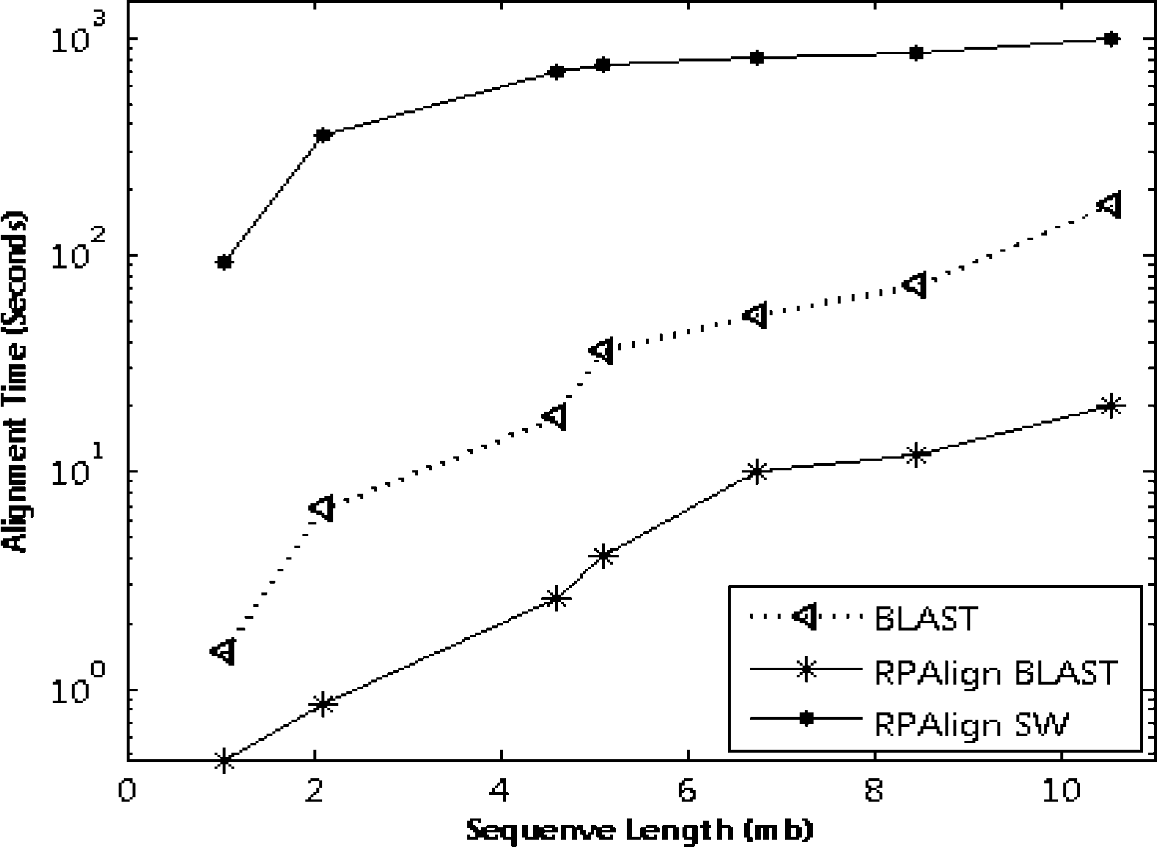
Timing Analysis

