Slide 1
Fast Algorithms For the Constrained Longest Increasing Subsequence Problems
I-Hsuan Yang and Yi-Ching Chen
The 25th Workshop on Combinatorial Mathematics and Computation Theory
April 25-26 2008, Pages 226 - 231
Presenter：Yu-Cheng Chang
Date：Sept. 22, 2020
Notes:
25屆組數研討會: http://par.cse.nsysu.edu.tw/~algo/paper/paper_list08.htm
I-Hsuan Yang : 也是 LCIS O(mn) time & space 的作者
台灣大學

Slide 2
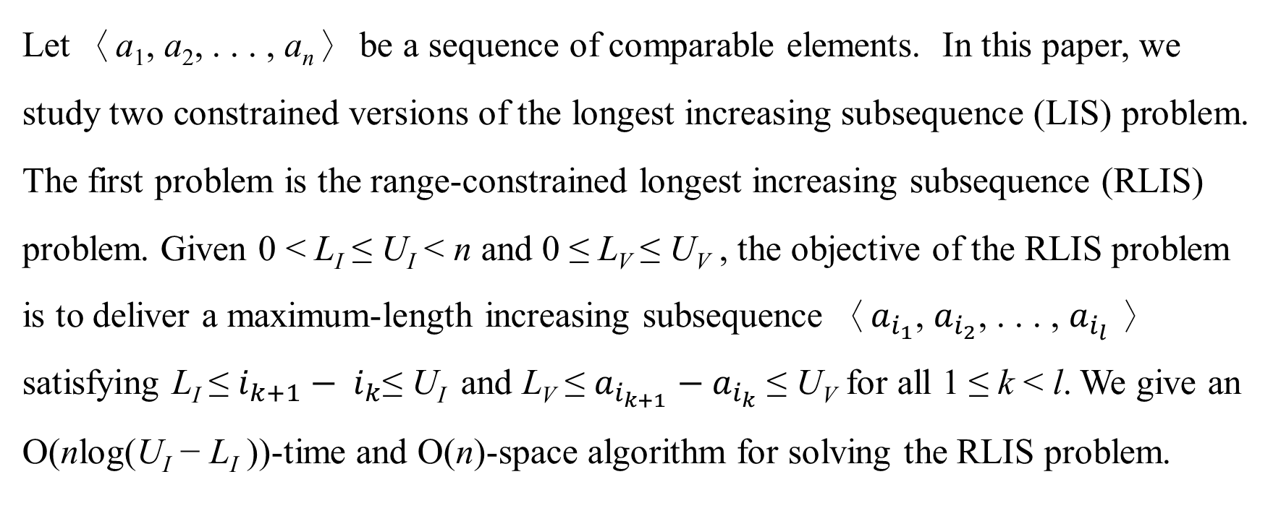
Abstract(1/2)
Let 〈a₁, a₂, . . . , a_{n}〉 be a sequence of comparable elements. In this paper, we study two constrained versions of the longest increasing subsequence (LIS) problem. The first problem is the range-constrained longest increasing subsequence (RLIS) problem. Given 0 < L_{I} ≤ U_{I} < n and 0 ≤ L_{V} ≤ U_{V} , the objective of the RLIS problem is to deliver a maximum-length increasing subsequence 〈$a_{i_{1}}$, $a_{i_{2}}$, . . . , $a_{i_{l}}$〉 satisfying L_{I} ≤ $i_{k+1}− i_{k}$≤ U_{I} and L_{V} ≤ $a_{i_{k+1}}−a_{i_{k}}$ ≤ U_{V} for all 1 ≤ k < l. We give an O(nlog(U_{I} − L_{I} ))-time and O(n)-space algorithm for solving the RLIS problem.

Slide 3
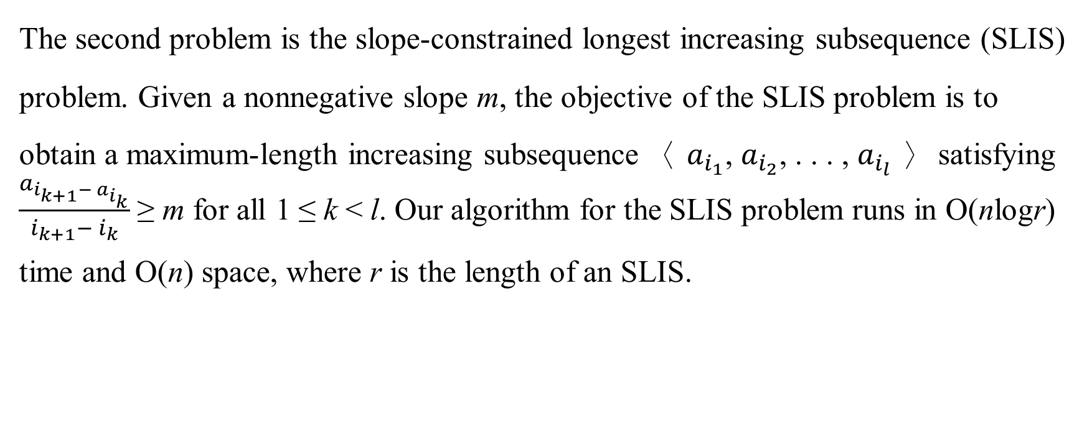
Abstract(2/2)
The second problem is the slope-constrained longest increasing subsequence (SLIS) problem. Given a nonnegative slope m, the objective of the SLIS problem is to obtain a maximum-length increasing subsequence 〈 $a_{i_{1}}$, $a_{i_{2}}$, . . . , $a_{i_{l}}$〉 satisfying $\frac{a_{i_{k+1}− a_{i_{k}}}}{i_{k+1}− i_{k}}$≥ m for all 1 ≤ k < l. Our algorithm for the SLIS problem runs in O(nlogr) time and O(n) space, where r is the length of an SLIS.

Slide 4
LIS
4
2
2 | 12
2 | 6
2 | 5
2 | 5 | 9
2 | 3 | 9
2 | 3 | 9 | 15
2 | 3 | 9 | 15
2 | 3 | 5 | 15
2 | 3 | 5 | 7
2 | 3 | 5 | 7 | 20
2 | 3 | 5 | 7 | 19
A = {4 , 2 , 12 , 6 , 5 , 9 , 3 , 15 , 2 , 5 , 7 , 20 , 19 }
LIS(A) = {{2 , 3 , 5 , 7 , 19} , {2 , 3 , 5 , 7 , 20}}
Time Complexity：
O(nlogn) → O(nlogk), k is the length of LIS
O(nloglogn) with van Emde Boas Tree

Slide 5
Range-constrained Longest Increasing Subsequence (RLIS)
A = { 4 , 2 , 12 , 6 , 5 , 9 , 3 , 15 , 2 , 5 , 7 , 20 , 19 }
Bound of index = [L_{I} , U_{I}] = [2,5]
Bound of value = [L_{V} , U_{V}] = [3,10]
RLIS(A,L_{I},U_{I},L_{V},U_{V}) = {{ 2 , 6 , 9 , 15 , 20 }, { 2 , 6 , 9 , 15 , 19 },…}

Slide 6
Range-constrained Longest Increasing Subsequence (RLIS)
i | 1 | 2 | 3 | 4 | 5 | 6 | 7 | 8 | 9 | 10 | 11 | 12 | 13
A | 4 | 2 | 12 | 6 | 5 | 9 | 3 | 15 | 2 | 5 | 7 | 20 | 19
Rank | 1
S
AVL Tree：
Insert、Delete、Query are O(logn)-time
Bound of index = [2,5]
Bound of value = [3,10]

Slide 7
Range-constrained Longest Increasing Subsequence (RLIS)
i | 1 | 2 | 3 | 4 | 5 | 6 | 7 | 8 | 9 | 10 | 11 | 12 | 13
A | 4 | 2 | 12 | 6 | 5 | 9 | 3 | 15 | 2 | 5 | 7 | 20 | 19
Rank | 1 | 1
S
Bound of index = [2,5]
Bound of value = [3,10]

Slide 8
Range-constrained Longest Increasing Subsequence (RLIS)
i | 1 | 2 | 3 | 4 | 5 | 6 | 7 | 8 | 9 | 10 | 11 | 12 | 13
A | 4 | 2 | 12 | 6 | 5 | 9 | 3 | 15 | 2 | 5 | 7 | 20 | 19
Rank | 1 | 1 | 2
S | (4,1)
Bound of index = [2,5]
Bound of value = [3,10]
[12 – U_{V} , 12 – L_{V}]
= [ 12 – 10 , 12 – 3 ]
= [ 2 , 9 ]

Slide 9
Range-constrained Longest Increasing Subsequence (RLIS)
i | 1 | 2 | 3 | 4 | 5 | 6 | 7 | 8 | 9 | 10 | 11 | 12 | 13
A | 4 | 2 | 12 | 6 | 5 | 9 | 3 | 15 | 2 | 5 | 7 | 20 | 19
Rank | 1 | 1 | 2 | 2
S | (4,1) | (2,1)
Bound of index = [2,5]
Bound of value = [3,10]
[6 – U_{V} , 6 – L_{V}]
= [ 6 – 10 , 6 – 3 ]
= [ -4 , 3 ]

Slide 10
Range-constrained Longest Increasing Subsequence (RLIS)
i | 1 | 2 | 3 | 4 | 5 | 6 | 7 | 8 | 9 | 10 | 11 | 12 | 13
A | 4 | 2 | 12 | 6 | 5 | 9 | 3 | 15 | 2 | 5 | 7 | 20 | 19
Rank | 1 | 1 | 2 | 2 | 2 | 3 | 1
S | (4,1) | (2,1) | (12,2) | (6,2) | (5,2)
Bound of index = [2,5]
Bound of value = [3,10]
[3 – U_{V} , 3 – L_{V}]
= [ 3 – 10 , 3 – 3 ]
= [ -7 , 0 ]

Slide 11
Range-constrained Longest Increasing Subsequence (RLIS)
i | 1 | 2 | 3 | 4 | 5 | 6 | 7 | 8 | 9 | 10 | 11 | 12 | 13
A | 4 | 2 | 12 | 6 | 5 | 9 | 3 | 15 | 2 | 5 | 7 | 20 | 19
Rank | 1 | 1 | 2 | 2 | 2 | 3 | 1 | 4
S |  | (2,1) | (12,2) | (6,2) | (5,2) | (9,3)
Bound of index = [2,5]
Bound of value = [3,10]
[15 – U_{V} , 15 – L_{V}]
= [ 15 – 10 , 15 – 3 ]
= [ 5 , 12 ]

Slide 12
Range-constrained Longest Increasing Subsequence (RLIS)
i | 1 | 2 | 3 | 4 | 5 | 6 | 7 | 8 | 9 | 10 | 11 | 12 | 13
A | 4 | 2 | 12 | 6 | 5 | 9 | 3 | 15 | 2 | 5 | 7 | 20 | 19
Rank | 1 | 1 | 2 | 2 | 2 | 3 | 1 | 4 | 1 | 1 | 2 | 5 | 5
S |  |  |  |  |  |  |  | (15,4) | (2,1) | (5,1) | (7,2)
RLIS(A) = {{ 2 , 6 , 9 , 15 , 20 }, { 2 , 6 , 9 , 15 , 19 },…}
Complexity:
O(nlog(U_{I} – L_{I}))-time
O(|S|+n)-space = O(n)-space
Bound of index = [2,5]
Bound of value = [3,10]

Slide 13
Slope-constrained Longest Increasing Subsequence (SLIS)
A = { 4 , 2 , 12 , 6 , 5 , 9 , 3 , 15 , 2 , 5 , 7 , 20 , 19 }
m = 2
SLIS(A,m) = {2 , 5 , 7 , 19}

Slide 14
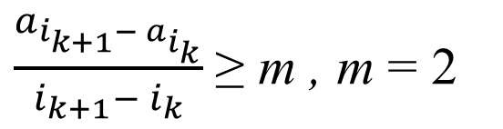
Slope-constrained Longest Increasing Subsequence (SLIS)
i | 1 | 2 | 3 | 4 | 5 | 6 | 7 | 8 | 9 | 10 | 11 | 12 | 13
A | 4 | 2 | 12 | 6 | 5 | 9 | 3 | 15 | 2 | 5 | 7 | 20 | 19
R1 | 4
Critical Point(s):
最後一個insert進來的元素
$\frac{a_{i_{k+1}− a_{i_{k}}}}{i_{k+1}− i_{k}}$≥ m , m = 2

Slide 15
Slope-constrained Longest Increasing Subsequence (SLIS)
i | 1 | 2 | 3 | 4 | 5 | 6 | 7 | 8 | 9 | 10 | 11 | 12 | 13
A | 4 | 2 | 12 | 6 | 5 | 9 | 3 | 15 | 2 | 5 | 7 | 20 | 19
R1 | 4 | 2
Critical Point(s):
最後一個insert進來的元素
$\frac{a_{i_{k+1}− a_{i_{k}}}}{i_{k+1}− i_{k}}$≥ m , m = 2

Slide 16
Slope-constrained Longest Increasing Subsequence (SLIS)
i | 1 | 2 | 3 | 4 | 5 | 6 | 7 | 8 | 9 | 10 | 11 | 12 | 13
A | 4 | 2 | 12 | 6 | 5 | 9 | 3 | 15 | 2 | 5 | 7 | 20 | 19
R1 | 4 | 2
R2 | 12
Critical Point(s)
$\frac{a_{i_{k+1}− a_{i_{k}}}}{i_{k+1}− i_{k}}$≥ m , m = 2

Slide 17
Slope-constrained Longest Increasing Subsequence (SLIS)
i | 1 | 2 | 3 | 4 | 5 | 6 | 7 | 8 | 9 | 10 | 11 | 12 | 13
A | 4 | 2 | 12 | 6 | 5 | 9 | 3 | 15 | 2 | 5 | 7 | 20 | 19
R1 | 4 | 2
R2 | 12 | 6
Critical Points
$\frac{a_{i_{k+1}− a_{i_{k}}}}{i_{k+1}− i_{k}}$≥ m , m = 2

Slide 18
Slope-constrained Longest Increasing Subsequence (SLIS)
i | 1 | 2 | 3 | 4 | 5 | 6 | 7 | 8 | 9 | 10 | 11 | 12 | 13
A | 4 | 2 | 12 | 6 | 5 | 9 | 3 | 15 | 2 | 5 | 7 | 20 | 19
R1 | 4 | 2 | 5 | 3 | 2
R2 | 12 | 6 | 9 | 5
R3 | 15 | 7
R4 | 20 | 19
$\frac{a_{i_{k+1}− a_{i_{k}}}}{i_{k+1}− i_{k}}$≥ m , m = 2

Slide 19
Critical point (proof)
y
i | 1 | 2 | 3
A | 4 | 2 | 12
R1 | 4 | 2
R2 | 12
x
z
因為 x dominates y, 故 m_{xy} ≥ m
假設 z 無法 dominate y, 則 m_{zy} < m
因為 m_{xy} 是 m_{xz} , m_{zy} 的 convex combination
故 m_{xz} ≥ m, 這代表 x dominates z，z 的 Rank 會比 x 大，明顯矛盾
故 z 可以 dominates y, m_{zy} ≥ m
所以只要記錄 Critical points 即可完成SLIS，且具遞移性。
如 R1 dominates R2，R2 dominates R3，可得 R1 dominates R3。
Notes:
Convex Combination: https://zh.wikipedia.org/wiki/%E5%87%B8%E7%BB%84%E5%90%88 (WIKI)
在凸包內，的任何點，可以由頂點組合而成 (係數都是分數，但係數和是1)

Slide 20
SLIS
i | A | Rank
1 | 4 | 4
2 | 2 | 2
3 | 12 | 2 | 12
4 | 6 | 2 | 6
5 | 5 | 5 | 6
6 | 9 | 5 | 9
7 | 3 | 3 | 9
8 | 15 | 3 | 9 | 15
9 | 2 | 2 | 9 | 15
10 | 5 | 2 | 5 | 15
11 | 7 | 2 | 5 | 7
12 | 20 | 2 | 5 | 7 | 20
13 | 19 | 2 | 5 | 7 | 19
A = { 4 , 2 , 12 , 6 , 5 , 9 , 3 , 15 , 2 , 5 , 7 , 20 , 19 }
m = 2
SLIS(A,m) = { 2 , 5 , 7 , 19}
Complexity:
O(nlogr)-time, r is the output size
O(n)-space

