Slide 1
conLSH: Context based Locality Sensitive Hashing for mapping of noisy SMRT reads
Angana Chakraborty, Sanghamitra Bandyopadhyay
Computational Biology and Chemistry
Volume 85, April 2020, 107206
Presenter: Yuan-Hsiu Tsai
Date: Sept. 22, 2020

Slide 2
Abstract(1/2)
Single Molecule Real-Time (SMRT) sequencing is a recent advancement of Next Gen technology developed by Pacific Bio (PacBio). It comes with an explosion of long and noisy reads demanding cutting edge research to get most out of it. To deal with the high error probability of SMRT data, a novel contextual Locality Sensitive Hashing (conLSH) based algorithm is proposed in this article, which can effectively align the noisy SMRT reads to the reference genome. Here, sequences are hashed together based not only on their closeness, but also on similarity of context. The algorithm has space requirement, where n is the number of sequences in the corpus and ρ is a constant.

Slide 3
Abstract(2/2)
The indexing time and querying time are bounded by
and respectively, where P₂ > 0, is a probability value. This algorithm is particularly useful for retrieving similar sequences, a widely used task in biology. The proposed conLSH based aligner is compared with rHAT, popularly used for aligning SMRT reads, and is found to comprehensively beat it in speed as well as in memory requirements. In particular, it takes approximately 24.2% less processing time, while saving about 70.3% in peak memory requirement for H.sapiens PacBio dataset.

Slide 4
Introduction- LSH
S = ACBCBAB
I = 1234567 (index)
We have a function F to index the char of S
F(1) = F(6) = the position of ‘A’ in LSH Table
So, after do this, we can get same char index fast.

Slide 5
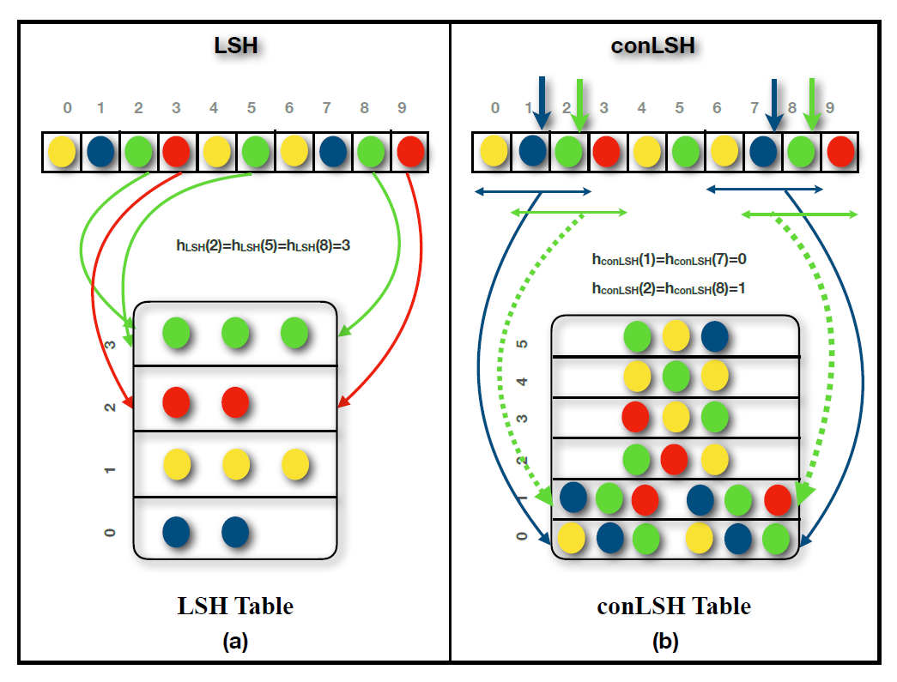

Slide 6
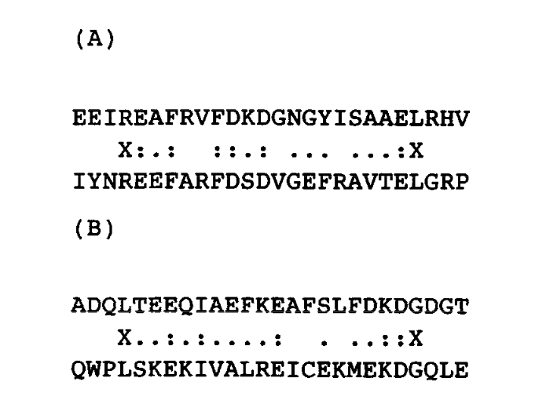
FASTA 選取方式

Slide 7
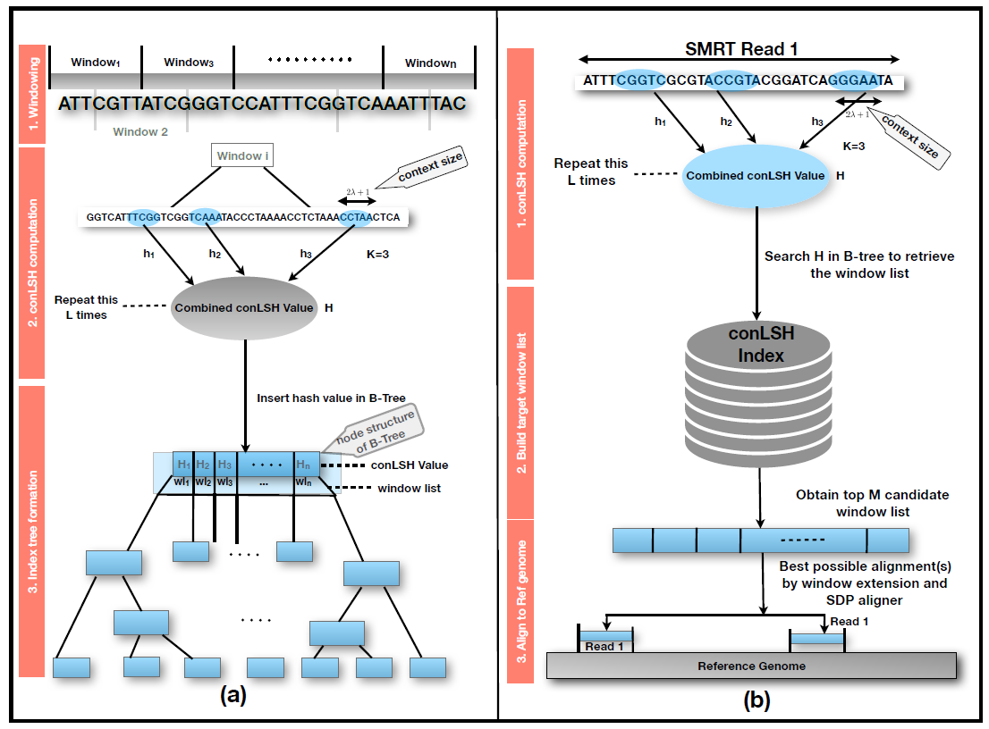

Slide 8
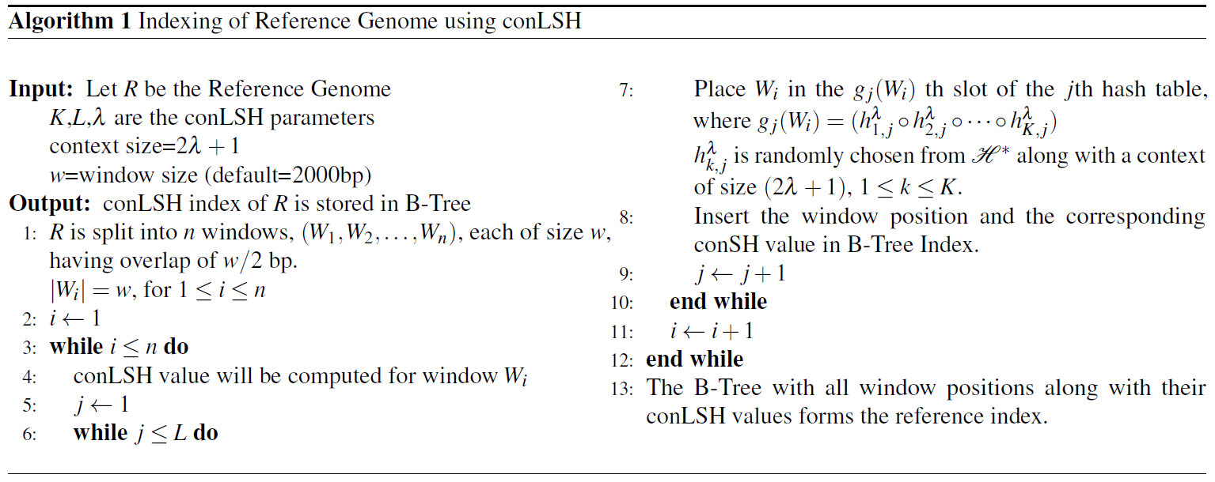

Slide 9
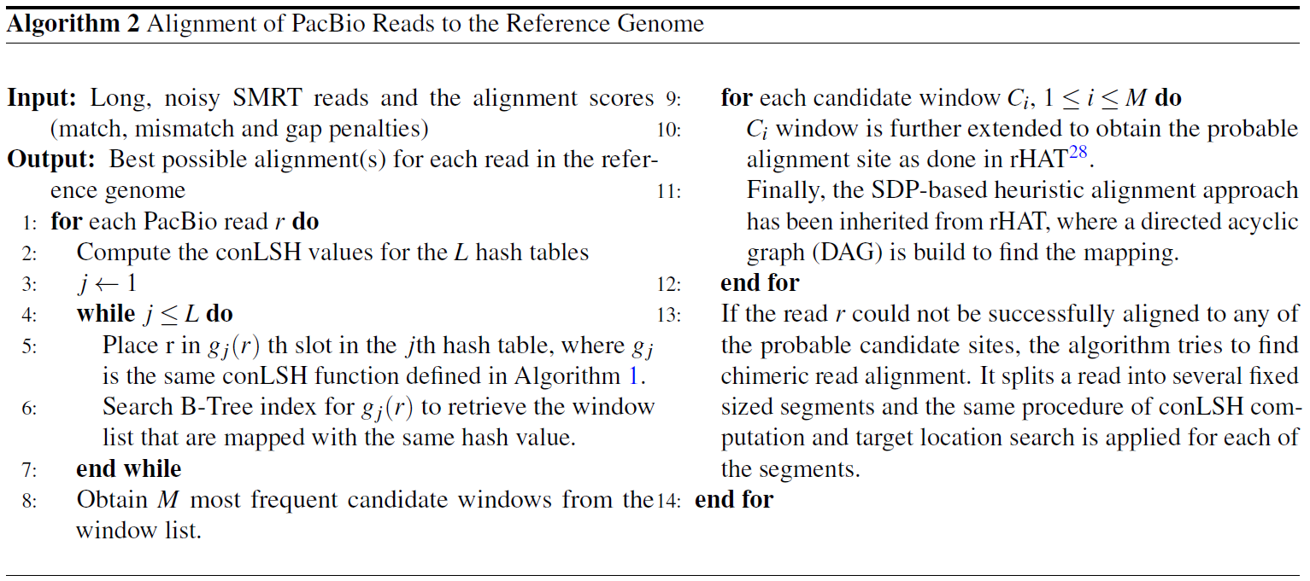

Slide 10
Function /Dataset | conLSH | rHAT1 | rHAT2 | BWA
E.coli | 1.38 (MB) | 290 | 4317 | 9.7
 | 0.01 (S) | 4 | 49 | 8.7
H.sapiens | 724.32 | 11755.34 | 15806.77 | 4523
 | 49 | 785 | 1166 | 3904
A.thaliana | 29.87 | 742.84 | 4770.16 | 209
 | 1 | 35 | 115 | 114.7
S.cerevisiae | 3.03 | 316.91 | 4343.47 | 21.3
 | 0.01 | 3 | 50 | 10.16
O.sativa | 93.18 | 1744.08 | 5804 | 652.4
 | 7 | 122 | 253 | 543.3

Slide 11
Experiment
Method | Time Taken (Sec) | % of Reads Aligned | Peak Memory Footprint
rHAT1 (13) | 210839 | 99.8 | 14562
rHAT2 (15) | 667280 | 100 | 15746
conLSH | 159888 | 99.8 | 4327
BLASR(BWT) | 724304 | 99.7 | 8100
BLASR(SA) | 848602 | 99.8 | 14700
BWA-MEM | 372782 | 99.7 | 5200
BWA-SW | 1145150 | 99.76 | 7100

Slide 12
Function /Dataset | Method | Time Taken(Sec) | % of Reads Aligned | Peak Memory Footprint (MB)
E.coli_sim | rHAT1 | 6 | 94.8 | 294
 | rHAT2 | 59 | 100 | 4225
 | conLSH | 15 | 100 | 85
S.cerevisiae_sim | rHAT1 | 9 | 100 | 326
 | rHAT2 | 85 | 100 | 4259
 | conLSH | 45 | 100 | 156
A.thaliana_sim | rHAT1 | 89 | 100 | 849
 | rHAT2 | 372 | 100 | 4781
 | conLSH | 337 | 99.9 | 574
D.melanogaster_sim | rHAT1 | 139 | 100 | 1054
 | rHAT2 | 223 | 98 | 4987
 | conLSH | 395 | 99 | 705

Slide 13
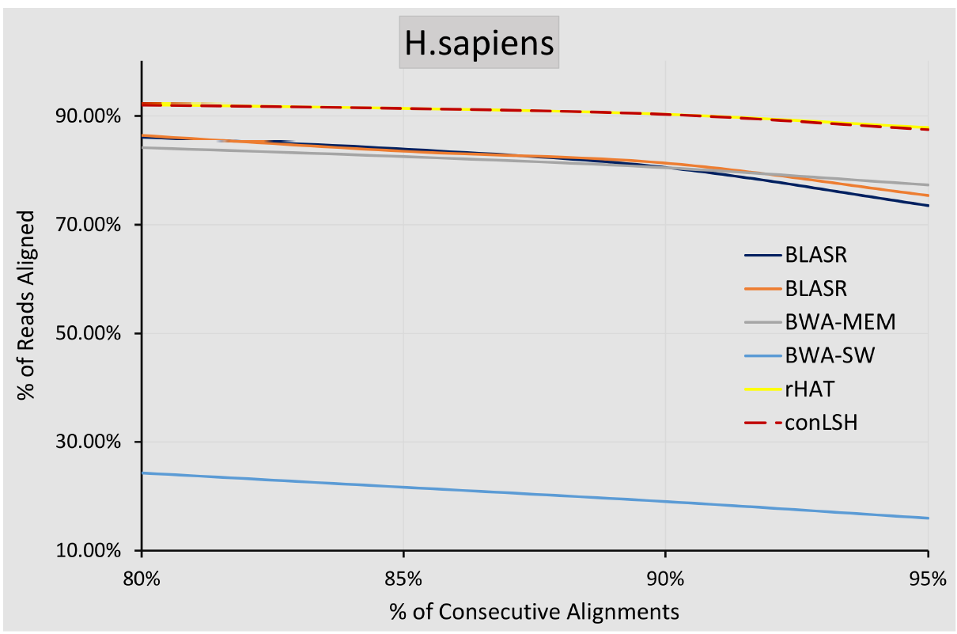
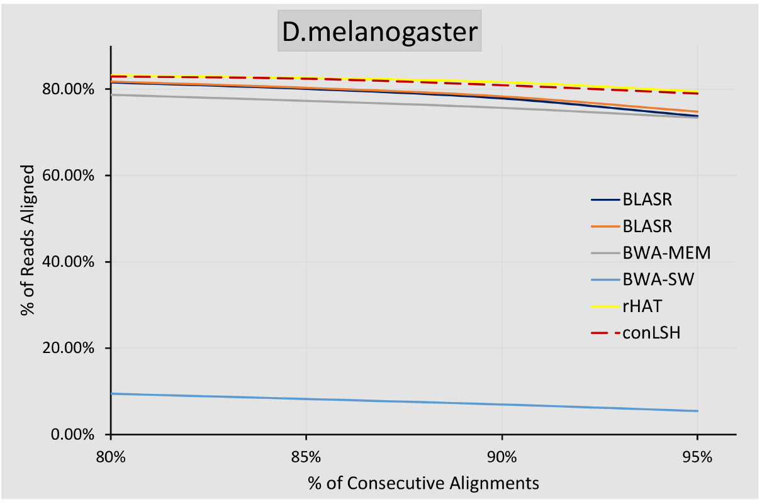

Slide 14
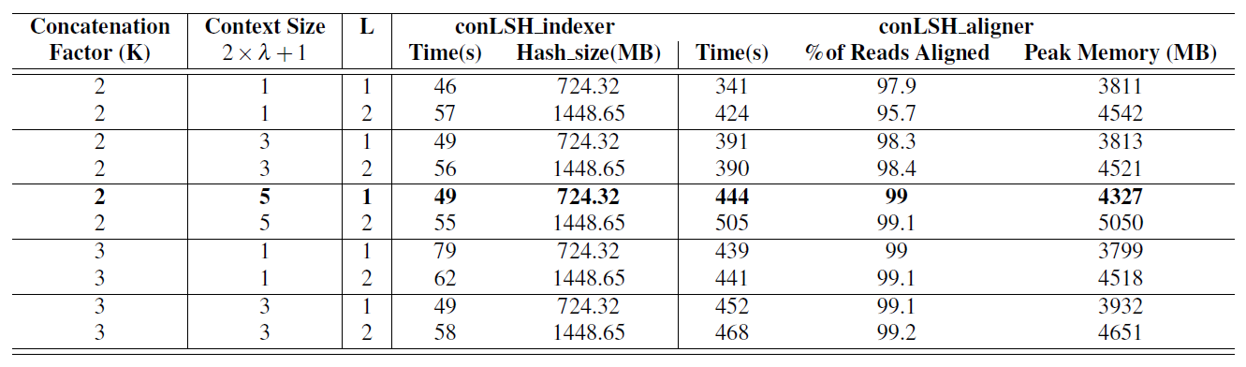
Experiment

