Slide 1
Faster Algorithms for Computing Longest Common Increasing Subsequences
Martin Kutz, Gerth Stølting Brodal, Kanela Kaligosi, Irit Katriel
Journal of Discrete Algorithms 9 (2011) 314–325
Presenter：Yu-Cheng Chang
Date：Nov. 17, 2020

Slide 2
Abstract
We present algorithms for finding a longest common increasing subsequence of two or more input sequences. For two sequences of lengths n and m, where m ≥ n, we present an algorithm with an output-dependent expected running time of O((m+nl)loglog σ + Sort) and O(m) space, where l is the length of an LCIS, σ is the size of the alphabet, and Sort is the time to sort each input sequence. For k ≥ 3 length-n sequences we present an algorithm which improves the previous best bound by more than a factor k for many inputs. In both cases, our algorithms are conceptually quite simple but rely on existing sophisticated data structures. Finally, we introduce the problem of longest common weakly-increasing (or non-decreasing) subsequences (LCWIS), for which we present an O(min{m+nlogn, mloglogm})-time algorithm for the 3-letter alphabet case. For the extensively studied longest common subsequence problem, comparable speedups have not been achieved for small alphabets.

Slide 3
Longest Common Increasing Subsequence (LCIS)
A = {1, 5, 4, 7, 2, 5, 8, 4, 2}
B = {4, 5, 1, 4, 8, 2}
LCIS(A,B) = {1,4,8}
n ≤ m
Author | Time complexity
Yang et al. [1] | O(mn)
Chan et al. [2] | O(min{rlogl, ml + r)loglogm + Sort(m))
This | O((m + nl)loglog σ + Sort(m))
[1] I.-H. Yang, C.-P. Huang, K.-M. Chao, A fast algorithm for computing a longest common increasing subsequence, Information Processing Letters 93 (5) (2005) 249–253.
[2] W.-T. Chan, Y. Zhang, S.P.Y. Fung, D. Ye, H. Zhu, Efficient algorithms for finding a longest common increasing subsequence, Journal of Combinatorial Optimization 13 (3) (2007) 277–288.

Slide 4
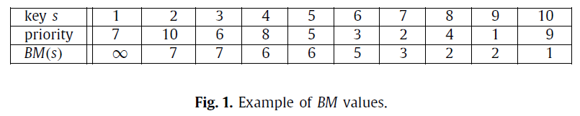
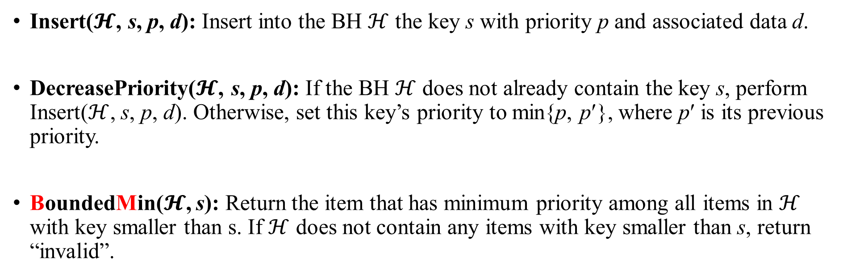
Bounded Heap
Index
Value
Insert($𝓗$, s, p, d): Insert into the BH $ℋ$ the key s with priority p and associated data d.
DecreasePriority($𝓗$, s, p, d): If the BH $ℋ$ does not already contain the key s, perform Insert($ℋ$, s, p, d). Otherwise, set this key’s priority to min{p, p′}, where p′ is its previous priority.
BoundedMin($𝓗$, s): Return the item that has minimum priority among all items in $ℋ$ with key smaller than s. If $ℋ$ does not contain any items with key smaller than s, return “invalid”.

Slide 5
Longest Common Increasing Subsequence (LCIS)
 | a₁ | a₂ | a₃ | a₄ | a₅
A | 5 | 2 | 3 | 4 | 6
 | b₁ | b₂ | b₃ | b₄ | b₅ | b₆ | b₇ | b₈
B | 4 | 2 | 4 | 5 | 7 | 6 | 1 | 3
preprocessing
 | a₁ | a₂ | a₃ | a₄ | a₅
A | 5 | 2 | 3 | 4 | 6
 | b₁ | b₂ | b₃ | b₄ | b₅ | b₆
B | 4 | 2 | 4 | 5 | 6 | 3
L_{i}[j] = k
i : LCIS長度
j : a_{j}
k : a_{j} 出現在B，最小的index
Occ | 2 | 3 | 4 | 5 | 6
 | 2 | 6 | 1 | 4 | 5
 |  |  | 3
 | 1 | 2 | 3 | 4 | 5
L₁ | 4 | 2 | 6 | 1 | 5

Slide 6


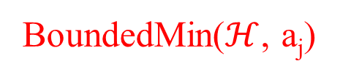
LCIS
 | a₁ | a₂ | a₃ | a₄ | a₅
A | 5 | 2 | 3 | 4 | 6
 | b₁ | b₂ | b₃ | b₄ | b₅ | b₆
B | 4 | 2 | 4 | 5 | 6 | 3
BoundedMin($ℋ$, a_{j})
DecreasePriority($ℋ$, a_{j}, L_{i-1}[j], d)
 | L₁[j]
1 | 4
2 | 2
3 | 6
4 | 1
5 | 5
$$ℋ$$
a_{j} | 2 | 3 | 4 | 5 | 6
L_{i-1}[j]
 | L₂[j]
1 | ∞
2 | ∞
3 | ∞
4 | ∞
5 | ∞
4
a_{j} | 2 | 3 | 4 | 5 | 6
L_{i-1}[j] | 2 |  |  | 4
6
a_{j} | 2 | 3 | 4 | 5 | 6
L_{i-1}[j] | 2 |  |  | 4
3
6
5
a_{j} | 2 | 3 | 4 | 5 | 6
L_{i-1}[j] | 2 | 6 | 1 | 4
Occ | 2 | 3 | 4 | 5 | 6
 | 2 | 6 | 1 | 4 | 5
 |  |  | 3
a_{j} | 2 | 3 | 4 | 5 | 6
L_{i-1}[j] | 2 | 6 | 1 | 4 | 5

Slide 7
LCIS
 | a₁ | a₂ | a₃ | a₄ | a₅
A | 5 | 2 | 3 | 4 | 6
 | b₁ | b₂ | b₃ | b₄ | b₅ | b₆
B | 4 | 2 | 4 | 5 | 6 | 3
 | L₂[j]
1 | ∞
2 | ∞
3 | 6
4 | 3
5 | 5
$$ℋ$$
a_{j} | 2 | 3 | 4 | 5 | 6
L_{i-1}[j]
 | L₃[j]
1 | ∞
2 | ∞
3 | ∞
4 | ∞
5 | ∞
a_{j} | 2 | 3 | 4 | 5 | 6
L_{i-1}[j]
a_{j} | 2 | 3 | 4 | 5 | 6
L_{i-1}[j] |  | 6
5
a_{j} | 2 | 3 | 4 | 5 | 6
L_{i-1}[j] |  | 6 | 3
Occ | 2 | 3 | 4 | 5 | 6
 | 2 | 6 | 1 | 4 | 5
 |  |  | 3
a_{j} | 2 | 3 | 4 | 5 | 6
L_{i-1}[j] |  | 6 | 3 |  | 5

Slide 8
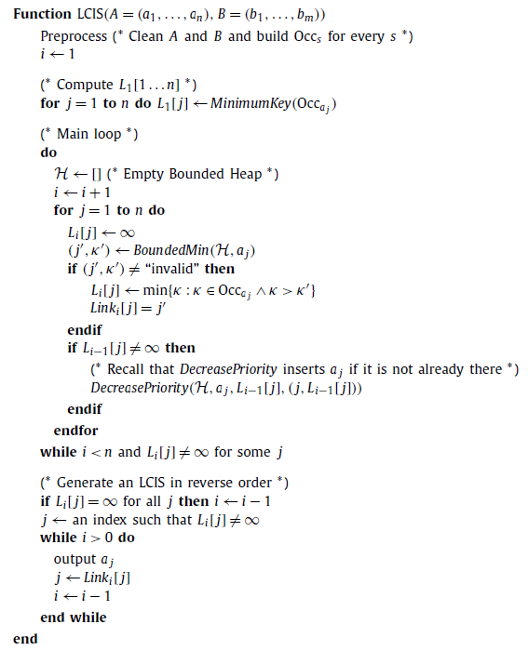
LCIS
O(m) + Sort(m)
O(nlloglogσ)
Occ | 2 | 3 | 4 | 5 | 6
 | 2 | 6 | 1 | 4 | 5
 |  |  | 3
Naïve: O(σm)
y-fast: O(mloglogσ)
Time complexity:
O((m + nl)loglog σ + Sort(m))
Space complexity:
O(m) with Hirschberg
O(l)

Slide 9
Longest Common Weakly-increasing Subsequence (LCWIS)
A = { a, b, a, c, a, b, b, d, a }
B = { d, c, a, a, b, c, a, b, b, a }
LCWIS(A,B) = { a, a, a, b, b }
use the LCIS algorithm: O((m + nl)loglog σ + Sort(m))
two special cases of LCWIS:
2-letter: O(m)
3-letter: O(min{m + nlogn, mloglogm })

Slide 10
LCWIS － Preprocessing O(m)
Alphabet Σ = {α, β, γ}, α < β < γ
Num_{A,α} , Num_{A,β} , … , Num_{B,γ} ：到 i 以前(含)有幾個 α, β, γ
Pos_{A,α} , Pos_{A,β} , … , Pos_{B,γ} ：第 i 個 α, β, γ 出現的位置
i | 1 | 2 | 3 | 4 | 5 | 6 | 7 | 8 | 9 | 10
A | β | α | α | β | α | α | β | β | α | β
B | α | β | α | α | β | β | β | β | γ | α
Num_{A,α} | 0 | 1 | 2 | 2 | 3 | 4 | 4 | 4 | 5 | 5
Pos_{A,α} | 2 | 3 | 5 | 6 | 9

Slide 11
LCWIS － 2-letter
Num_{A,α}[n]
Num_{A,α}[PosA,α[2]]
i | 1 | 2 | 3 | 4 | 5 | 6 | 7 | 8 | 9 | 10
A | β | α | α | β | α | α | β | β | α | β
B | α | β | α | α | β | β | β | β | α | α
α^{i}β* 只要知道 α 就能得到對應的 β 數量：
min(Num_{A,α}[n] - Num_{A,α}[Pos_{A,α}[i]] , Num_{B,α}[m] - Num_{B,α}[Pos_{B,α}[i]])
i = 1，min( 5 – 1 , 5 – 0) = 4：αββββ
i = 2，min( 5 – 1 , 5 – 1) = 4：ααββββ
…

Slide 12
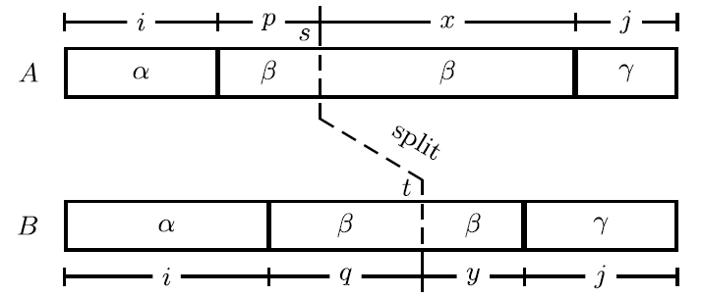
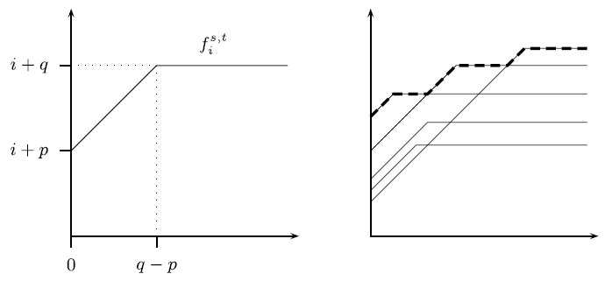

LCWIS － 3-letter (m + nlogn)
α^{i}β*γ^{j}：
透過 α β 可以得到關係圖$f_{i}^{s,t}$並根據$f_{i}^{s,t}與$ γ^{j} 得到答案
z = |x – y|：
Split point 後面多了幾個 β 可以給prefix 使用
z
z

Slide 13
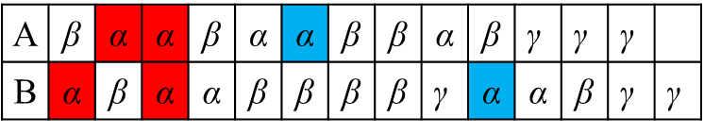
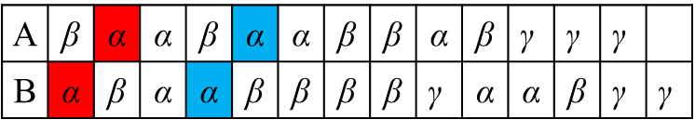
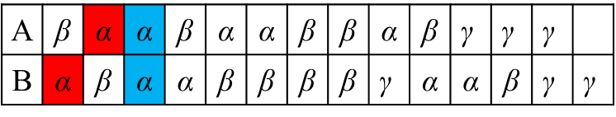
LCWIS － 3-letter (m + nlogn)
A | β | α | α | β | α | α | β | β | α | β | $$\text{γ}$$ | $$\text{γ}$$ | $$\text{γ}$$
B | α | β | α | α | β | β | β | β | $$\text{γ}$$ | α | α | β | $$\text{γ}$$ | $$\text{γ}$$
i + q
A | β | α | α | β | α | α | β | β | α | β | $$\text{γ}$$ | $$\text{γ}$$ | $$\text{γ}$$
B | α | β | α | α | β | β | β | β | $$\text{γ}$$ | α | α | β | $$\text{γ}$$ | $$\text{γ}$$
i + p
….
i
p
x
j
q － p
A | β | α | α | β | α | α | β | β | α | β | $$\text{γ}$$ | $$\text{γ}$$ | $$\text{γ}$$
B | α | β | α | α | β | β | β | β | $$\text{γ}$$ | α | α | β | $$\text{γ}$$ | $$\text{γ}$$
i
q
y
j
all
….

Slide 14
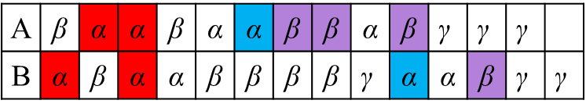
LCWIS － 3-letter (m + nlogn)
A | β | α | α | β | α | α | β | β | α | β | $$\text{γ}$$ | $$\text{γ}$$ | $$\text{γ}$$
B | α | β | α | α | β | β | β | β | $$\text{γ}$$ | α | α | β | $$\text{γ}$$ | $$\text{γ}$$
i + q
A | β | α | α | β | α | α | β | β | α | β | $$\text{γ}$$ | $$\text{γ}$$ | $$\text{γ}$$
B | α | β | α | α | β | β | β | β | $$\text{γ}$$ | α | α | β | $$\text{γ}$$ | $$\text{γ}$$
i + p
….
i
p
x
j
q － p
A | β | α | α | β | α | α | β | β | α | β | $$\text{γ}$$ | $$\text{γ}$$ | $$\text{γ}$$
B | α | β | α | α | β | β | β | β | $$\text{γ}$$ | α | α | β | $$\text{γ}$$ | $$\text{γ}$$
i
q
y
j
all
….

Slide 15
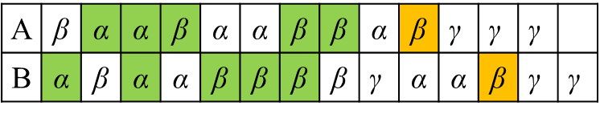
LCWIS － 3-letter (m + nlogn)
A | β | α | α | β | α | α | β | β | α | β | $$\text{γ}$$ | $$\text{γ}$$ | $$\text{γ}$$
B | α | β | α | α | β | β | β | β | $$\text{γ}$$ | α | α | β | $$\text{γ}$$ | $$\text{γ}$$
i + q
A | β | α | α | β | α | α | β | β | α | β | $$\text{γ}$$ | $$\text{γ}$$ | $$\text{γ}$$
B | α | β | α | α | β | β | β | β | $$\text{γ}$$ | α | α | β | $$\text{γ}$$ | $$\text{γ}$$
i + p
….
i
p
x
j
q － p
A | β | α | α | β | α | α | β | β | α | β | $$\text{γ}$$ | $$\text{γ}$$ | $$\text{γ}$$
B | α | β | α | α | β | β | β | β | $$\text{γ}$$ | α | α | β | $$\text{γ}$$ | $$\text{γ}$$
i
q
y
j
all
….

Slide 16
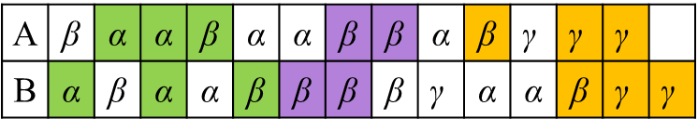
LCWIS － 3-letter (m + nlogn)
A | β | α | α | β | α | α | β | β | α | β | $$\text{γ}$$ | $$\text{γ}$$ | $$\text{γ}$$
B | α | β | α | α | β | β | β | β | $$\text{γ}$$ | α | α | β | $$\text{γ}$$ | $$\text{γ}$$
i + q
A | β | α | α | β | α | α | β | β | α | β | $$\text{γ}$$ | $$\text{γ}$$ | $$\text{γ}$$
B | α | β | α | α | β | β | β | β | $$\text{γ}$$ | α | α | β | $$\text{γ}$$ | $$\text{γ}$$
i + p
….
i
p
x
j
q － p
A | β | α | α | β | α | α | β | β | α | β | $$\text{γ}$$ | $$\text{γ}$$ | $$\text{γ}$$
B | α | β | α | α | β | β | β | β | $$\text{γ}$$ | α | α | β | $$\text{γ}$$ | $$\text{γ}$$
i
q
y
j
all
….

Slide 17
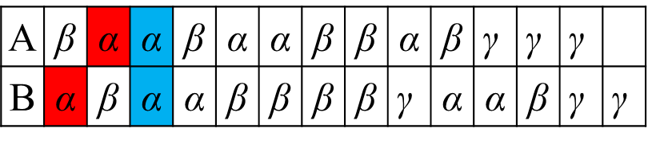
LCWIS － 3-letter (m + nlogn)
Naïve time complexity： O(m + n²)
The key observation behind our O(nlogn)-time algorithm is that the naive approach stores multiple copies of the same information in different split diagrams.
Hierarchy of splits： O(m + nlogn)
 | 001 | 010 | 011 | 100 | 101
i | 1 | 2 | 3 | 4 | 5
u | 2 | 3 | 5 | 6 | 9
v | 1 | 3 | 4 | 10 | 11
level | 0 | 1 | 0 | 2 | 0
A | β | α | α | β | α | α | β | β | α | β | $$\text{γ}$$ | $$\text{γ}$$ | $$\text{γ}$$
B | α | β | α | α | β | β | β | β | $$\text{γ}$$ | α | α | β | $$\text{γ}$$ | $$\text{γ}$$

Slide 18
Hierarchy of splits
 | 0001 | 0010 | 0011 | 0100 | 0101 | 0110 | 0111 | 1000 | 1001 | 1010
i | 1 | 2 | 3 | 4 | 5 | 6 | 7 | 8 | 9 | 10
u | 2 | 3 | 5 | 6 | 9 | * | * | * | * | *
v | 1 | 3 | 4 | 10 | 11 | * | * | * | * | *
level | 0 | 1 | 0 | 2 | 0 | 1 | 0 | 3 | 0 | 1
This scheme has the nice property that between any two splits on the same level there lies another split on a higher level.
Our algorithm will use this property to ensure that for any LCWIS L, there exists at least one split diagram into which we insert the α information of L and from which we read off the γ part of L.

Slide 19
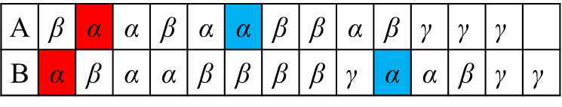
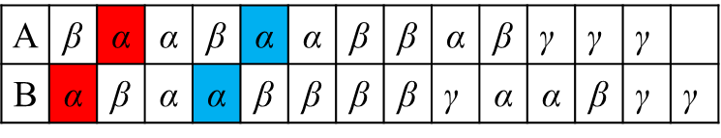
LCWIS － 3-letter (m + nlogn)
D’₀
A | β | α | α | β | α | α | β | β | α | β | $$\text{γ}$$ | $$\text{γ}$$ | $$\text{γ}$$
B | α | β | α | α | β | β | β | β | $$\text{γ}$$ | α | α | β | $$\text{γ}$$ | $$\text{γ}$$
D₁
A | β | α | α | β | α | α | β | β | α | β | $$\text{γ}$$ | $$\text{γ}$$ | $$\text{γ}$$
B | α | β | α | α | β | β | β | β | $$\text{γ}$$ | α | α | β | $$\text{γ}$$ | $$\text{γ}$$
A | β | α | α | β | α | α | β | β | α | β | $$\text{γ}$$ | $$\text{γ}$$ | $$\text{γ}$$
B | α | β | α | α | β | β | β | β | $$\text{γ}$$ | α | α | β | $$\text{γ}$$ | $$\text{γ}$$
D₂
i | 1 | 2 | 3 | 4 | 5
u | 2 | 3 | 5 | 6 | 9
v | 1 | 3 | 4 | 10 | 11
level | 0 | 1 | 0 | 2 | 0

Slide 20
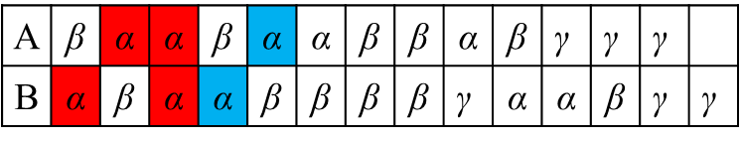
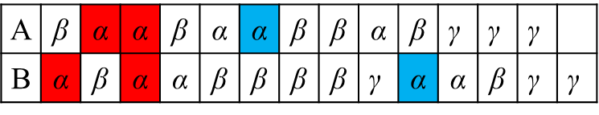
LCWIS － 3-letter (m + nlogn)
D’₀
A | β | α | α | β | α | α | β | β | α | β | $$\text{γ}$$ | $$\text{γ}$$ | $$\text{γ}$$
B | α | β | α | α | β | β | β | β | $$\text{γ}$$ | α | α | β | $$\text{γ}$$ | $$\text{γ}$$
D₁
A | β | α | α | β | α | α | β | β | α | β | $$\text{γ}$$ | $$\text{γ}$$ | $$\text{γ}$$
B | α | β | α | α | β | β | β | β | $$\text{γ}$$ | α | α | β | $$\text{γ}$$ | $$\text{γ}$$
D’₂
i | 1 | 2 | 3 | 4 | 5
u | 2 | 3 | 5 | 6 | 9
v | 1 | 3 | 4 | 10 | 11
level | 0 | 1 | 0 | 2 | 0

Slide 21
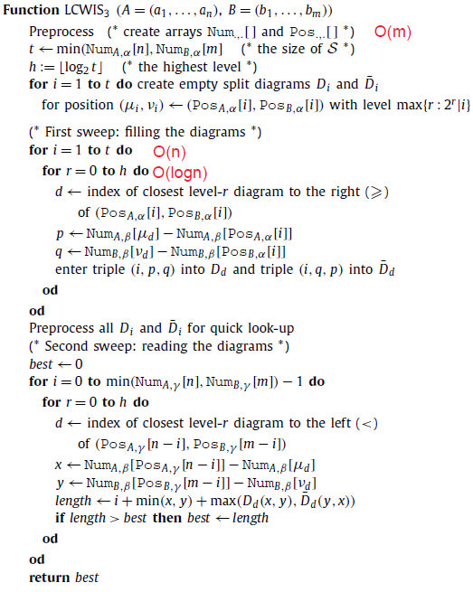
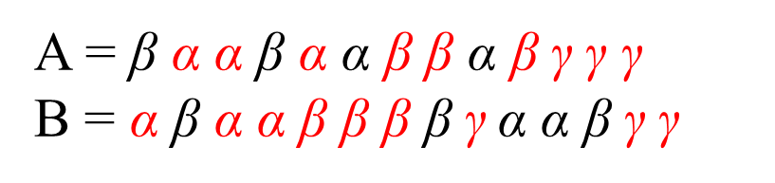

LCWIS － 3-letter (m + nlogn)
建立 split diagrams：O(nlogn)
D₀、D’₀
D₁、D’₁
…
D_{logn}、D’_{logn}
用$f_{i}^{s,t}與$ γ^{j} 得到答案
A = β α α β α α β β α β $\text{γ}$ $\text{γ}$ $\text{γ}$
B = α β α α β β β β$\text{γ}$α α β $\text{γ}$ $\text{γ}$

Slide 22
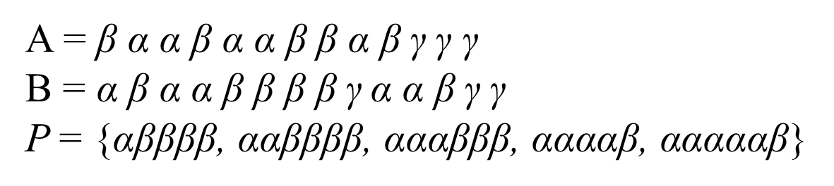
LCWIS － 3-letter (mloglogm)
This algorithm is based on a new approach to the 2-letter case. In particular, we show how to solve the 2-letter case in an online manner, where one symbol of a sequence is revealed at a time.
A = β α α β α α β β α β $\text{γ}$ $\text{γ}$ $\text{γ}$
B = α β α α β β β β$\text{γ}$α α β $\text{γ}$ $\text{γ}$
P = {αββββ, ααββββ, αααβββ, ααααβ, αααααβ}
A = β α α β
B = α β
P = {αβ}
A = β α α β
B = α β α
P = {αβ, αα}
A = β α α
B = α β
P = {α}
A = β
B = α
P = {}
A = β α
B = α
P = {α}
Naïve : each time we consider a β we may spend Θ(n) time

Slide 23
LCWIS － 3-letter – 2-letter procedure
α∗β∗γ^{k} :
透過 L_{A}、EX_{A}、L_{B}、EX_{B}、Num_{A,*}、Num_{B,*}、Pos_{A,*}、Pos_{B,*}、P
一邊 insert、delete 決定 LCWIS
l(i) = i + Num_{B,β}[b] – Num_{B,β}[Pos_{B,α}[i]]
= i + Num_{A,β}[a] – Num_{A,β}[Pos_{A,α}[i]] ，主要看誰的 β 比較多
Num_{A,β}[a] – Num_{A,β}[Pos_{A,α}[4]] = 5
ex_{A}(4) = 2
A = α β α β β β α α β α β α β β β
B = β α β β α β β β α α β α α α β β
Num_{B,β}[b] – Num_{B,β}[Pos_{B,α}[4]] = 3

Slide 24
LCWIS － 3-letter – 2-letter procedure
L_{A}(L_{B})：maximum priority queue keeps CWISs with ex_{A(B)}(i) > 0, whose elements are (key, data) pairs.
Priority(value)： k(i) = i – Num_{B,β}[Pos_{B,α}[i]] + m (L_{A})
k(i) = i – Num_{A,β}[Pos_{A,α}[i]] + n (L_{B})
l(i) = i + Num_{B,β}[b] - Num_{B,β}[Pos_{B,α}[i]]
= k(i) + Num_{B,β}[b] – m
EX_{A}(EX_{B})：minimum priority queue keeps the same CWISs in L_{A(B)}, but with priority their excess.
Priority(value)： Num_{B,β}[Pos_{B,α}[i]] – Num_{A,β}[Pos_{A,α}[i]] + m (EX_{A})
Num_{A,β}[Pos_{A,α}[i]] – Num_{B,β}[Pos_{B,α}[i]] + n (EX_{B})

Slide 25
LCWIS － 3-letter – 2-letter procedure
L_{A} | α (15) | αα (14) | αααα (13) | ααα (12)
EX_{A} | α (1) | αα (2) | ααα (2) | αααα (2)
L_{B}
EX_{B}
Num_{A,β}[a] – Num_{A,β}[Pos_{A,α}[1]] = 9
ex_{A}(1) = 1
A = α β α β β β α α β α β α β β β
B = β α β β α β β β α α β α α α β β
Num_{B,β}[b] – Num_{B,β}[Pos_{B,α}[1]] = 9 – 1 = 8

Slide 26
LCWIS － 3-letter – 2-letter procedure
L_{A} | α (15) | αα (14) | αααα (13) | ααα (12)
EX_{A} | α (0) | αα (1) | ααα (1) | αααα (1)
L_{B}
EX_{B}
Num_{A,β}[a] – Num_{A,β}[Pos_{A,α}[1]] = 9
ex_{A}(1) = 1 – 1 = 0
A = α β α β β β α α β α β α β β β
B = β α β β α β β β α α β α α α β β β
Num_{B,β}[b] – Num_{B,β}[Pos_{B,α}[1]] = 8 + 1 = 9

Slide 27
LCWIS － 3-letter – 2-letter procedure
L_{A} | α (15) | αα (14) | αααα (13) | ααα (12)
EX_{A} | α (-1) | αα (0) | ααα (0) | αααα (0)
L_{B} | α (15)
EX_{B} | α (1)
L_{A} | α (15) | αα (14) | αααα (13) | ααα (12)
EX_{A} | α (-1) | αα (0) | ααα (0) | αααα (0)
L_{B}
EX_{B}
Num_{A,β}[a] – Num_{A,β}[Pos_{A,α}[1]] = 9
ex_{A}(1) = 0 – 1 = -1
A = α β α β β β α α β α β α β β β
B = β α β β α β β β α α β α α α β β β β
Num_{B,β}[b] – Num_{B,β}[Pos_{B,α}[1]] = 9 + 1 = 10

Slide 28
LCWIS － 3-letter (mloglogm)
α∗β∗γ^{k} :
preprocessing：O(m)
Num_{A,*}、Num_{B,*}、Pos_{A,*}、Pos_{B,*}
2-letter procedure： O((m + n)loglogm)
L_{A}、EX_{A}、L_{B}、EX_{B}、P
Total time complexity：O(mloglogm)

Slide 29
Multiple LCIS (MLCIS)
Author | Time complexity
Chan et al. [1] | O(min(kr², kr logσ log^{k-1}r) + kSort(n))
This | O(rlog^{k-1}rloglogr)
use a data structure by Gabow et al. [2]
A query takes O(log^{k−1}nloglogn) time and the total time for at most n activations is O(nlog^{k−1}nloglogn). The data structure requires O(nlog^{k−1}n) preprocessing time and space.
[1] W.-T. Chan, Y. Zhang, S.P.Y. Fung, D. Ye, H. Zhu, Efficient algorithms for finding a longest common increasing subsequence, Journal of Combinatorial Optimization 13 (3) (2007) 277–288.
[2] H.N. Gabow, J.L. Bentley, R.E. Tarjan, Scaling and related techniques for geometry problems, in: Proceedings of the Sixteenth Annual ACM Symposium on Theory of Computing (STOC ’84), ACM Press, 1984, pp. 135–143

Slide 30
Summary
n ≤ m
the length of LCIS is bounded by σ, it is not clear how this fact should carry over to LCWIS, where the output size need not relate to σ at all.
Algorithm | Time complexity
LCIS | O((m + nl)loglog σ + Sort(m))
LCWIS | O((m + nl)loglog σ + Sort(m))
LCWIS (2-letter) | O(m)
LCWIS (3-letter) | O(min{m + nlogn , mloglogm})
MLCS | O(rlog^{k-1}rloglogr)

