Slide 1
Moth-Flame Optimization Algorithm : A Novel Nature-inspired Heuristic Paradigm
Seyedali Mirjalili
Knowledge-based System, 2015, Vol. 89, pp. 228-249.
Presenter : Tz-Hsu Lee
Date : Nov. 24, 2020.

Slide 2
Abstract(1/2)
In this paper a novel nature-inspired optimization paradigm is proposed called Moth-Flame Optimization (MFO) algorithm. The main inspiration of this optimizer is the navigation method of moths in nature called transverse orientation. Moths fly in night by maintaining a fixed angle with respect to the moon, a very effective mechanism for travelling in a straight line for long distances. However, these fancy insects are trapped in a useless/deadly spiral path around artificial lights. This paper mathematically models this behaviour to perform optimization. The MFO algorithm is compared with other well-known nature-inspired algorithms on 29 benchmark and 7 real engineering problems. The statistical results on the benchmark functions show that this algorithm is able to provide very promising and competitive results.

Slide 3
Abstract(1/2)
Additionally, the results of the real problems demonstrate the merits of this algorithm in solving challenging problems with constrained and unknown search spaces. The paper also considers the application of the proposed algorithm in the field of marine propeller design to further investigate its effectiveness in practice.

Slide 4
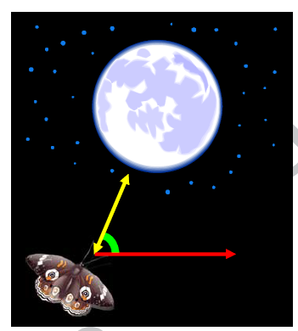
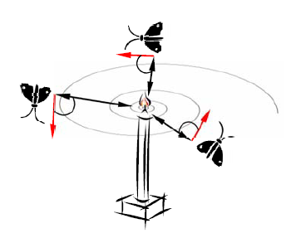

Inspiration

Slide 5
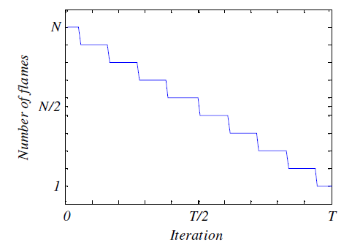

Flame
Flame = Sort(moth)

Slide 6
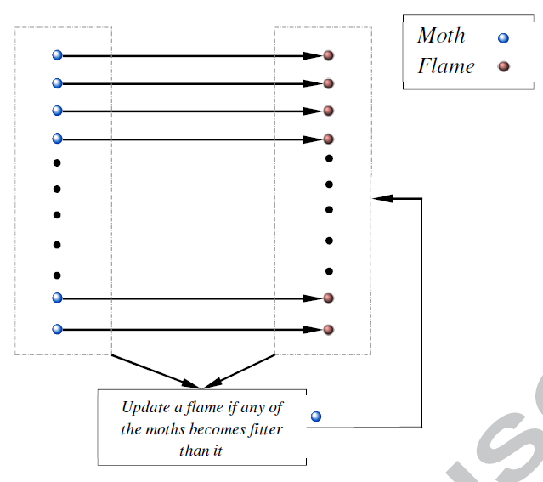
Move (1/2)
Moth move to the Flame.

Slide 7

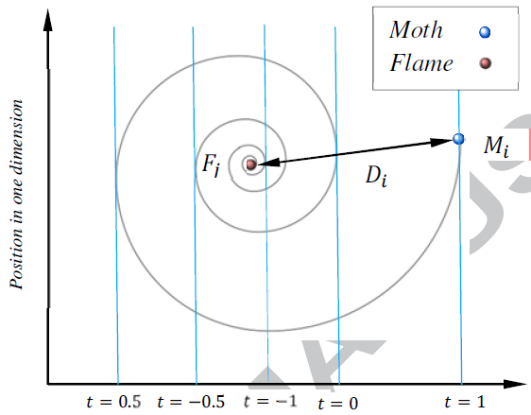
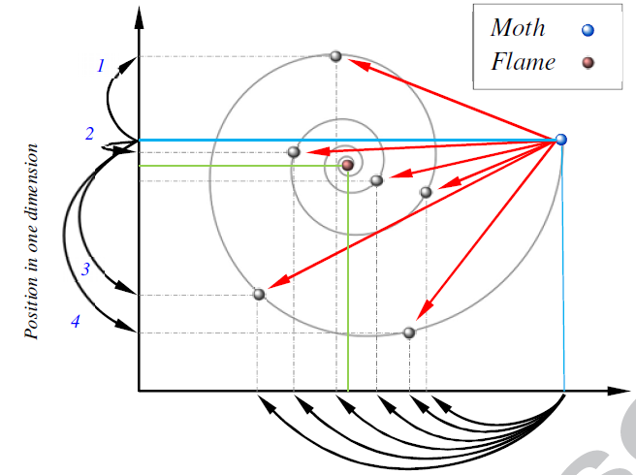
Move (2/2)
b : constant
t : random number in [r, 1]
r : [-1, -2]

Slide 8
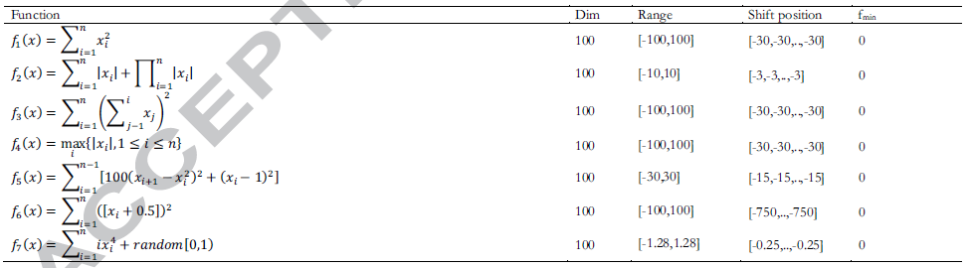
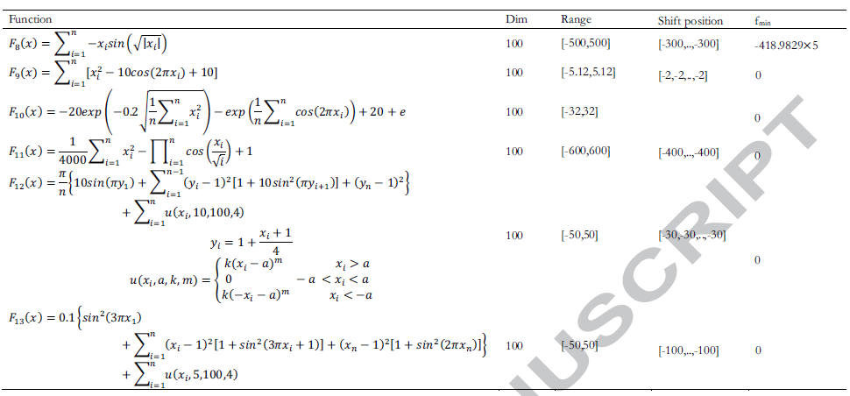
Results (1/4)

Slide 9

Results (2/4)

Slide 10
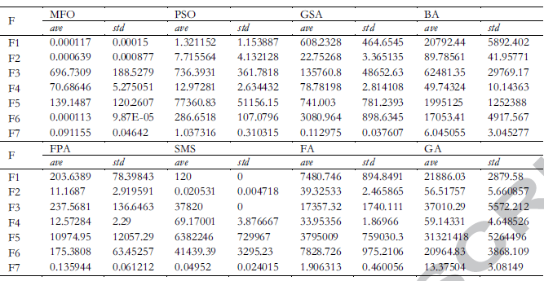
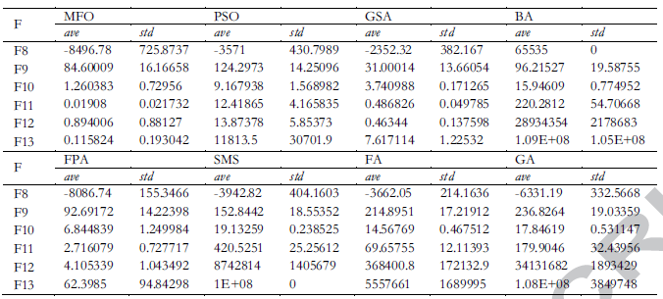
Results (3/4)

Slide 11
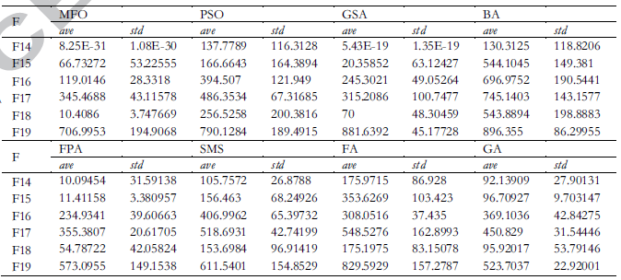
Results (4/4)

