Slide 1
An Efficient Parallel Algorithm for Longest Common Subsequence Problem on GPUs
Jiaoyun Yang, Yun Xu, Yi Shang
Proceedings of the World Congress on Engineering 2010 Vol I WCE 2010, June 30 - July 2, 2010, London, U.K.
Presenter: Shin-Cheng Lin
Date: Nov. 24, 2020

Slide 2
Abstract(1/3)
Sequence alignment is an important problem in computational biology and finding the longest common subsequence (LCS) of multiple biological sequences is an essential and effective technique in sequence alignment. A major computational approach for solving the LCS problem is dynamic programming.

Slide 3
Abstract(2/3)
Several dynamic programming methods have been proposed to have reduced time and space complexity. As databases of biological sequences become larger, parallel algorithms become increasingly important to tackle large size problems. In the meantime, general-purpose computing on graphics processing units (GPGPU) has emerged as a promising technology for cost-effective high performance computing.
Notes:
3

Slide 4
Abstract(3/3)
In this paper, we develop an efficient parallel algorithm on GPUs for the LCS problem. We propose a new technique that changes the data dependency in the score table used by dynamic programming algorithms to enable higher degrees of parallelism. The algorithm takes advantage of the large number of processing units and the unique memory-accessing properties of GPUs to achieve high performance.
Notes:
4

Slide 5
Based on Smith-Waterman algorithm
Change the data dependence for parallelization

Slide 6
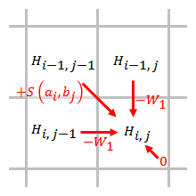
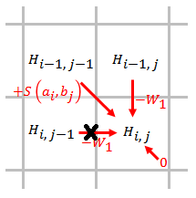

Slide 7
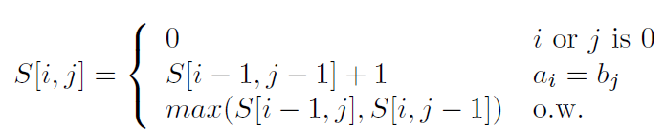
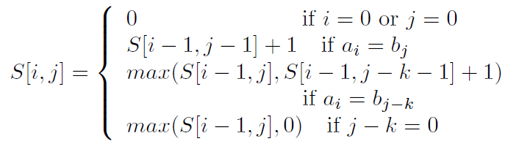

Slide 8
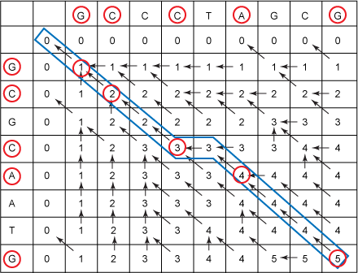

Slide 9
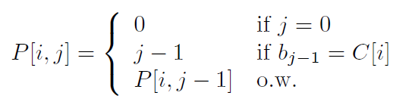
A table P of size l*(m + 1)
l is the size of the finite alphabet
m is the length of sequence B
C[1 … l] :the finite alphabet
P[i, j] :the maximum number before j that makes b_{p[i;j]} = C[i].

Slide 10
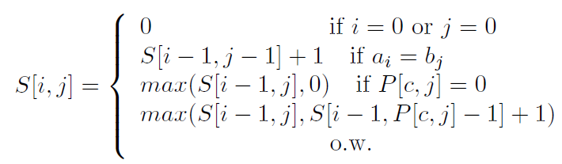
Replace j - k with P[c: j]

Slide 11
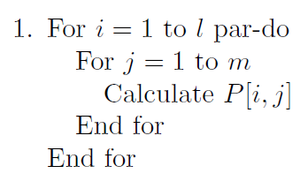
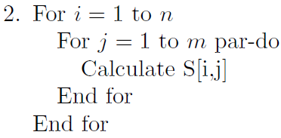
in step 1, l is the size of the alphabet and is usually smaller than the length of the sequences.
Step 1 takes O(m) time using l processors
Step 2 takes O(n) time using m processors
time complexity is O(max(m,n)) using max(m,n) processors.

Slide 12
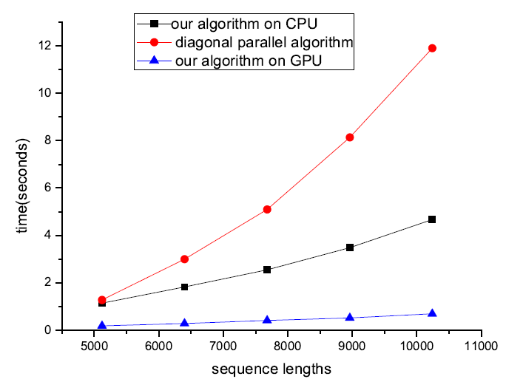
random gene sequences (alphabet size 4) of lengths from 5120 to 10240.

