Slide 1
Fast Optimal Alignment
James W.Fickett
Nucleic Acids Research, Volume 12, Issue 1, Part 1,
11 January 1984, Pages 175–179
Presenter: Yuan-Hsiu Tsai
Date: Nov. 24, 2020
Notes:
ISTA: Information Science, Technology and Applications -- https://dl.acm.org/conference/ista
Kuwait Kuwait 科威特 的 科威特城

Slide 2
Abstract(1/2)
We show how to speed up sequence alignment algorithms of the type Introduced by Needleman and Wunsch (and generalized by Sellers and research-articles). Faster alignment algorithms have been introduced, but always at the cost of possibly getting sub-optimal alignments. Our modification results in the optimal alignment still being found, often In 1/10 the usual time.

Slide 3
Abstract(2/2)
What we do is reorder the computation of the usual alignment matrix so that the optimal alignment is ordinarily found when only a small fraction of the matrix is filled. The number of matrix elements which have to be computed is related to the distance between the sequences being aligned; the better the optimal alignment, the faster the algorithm runs.

Slide 4
Introduction
DNA = {A,T,C,G}
RNA = {A,U,C,G}
Protein = {A,R,N,D,C,Q,E,G,H,I,L,K,M,F,P,S,T,W,Y,V,B,Z,X}

Slide 5
Introduction – DP formula
where Score is score matrix, g is gap penalty.

Slide 6
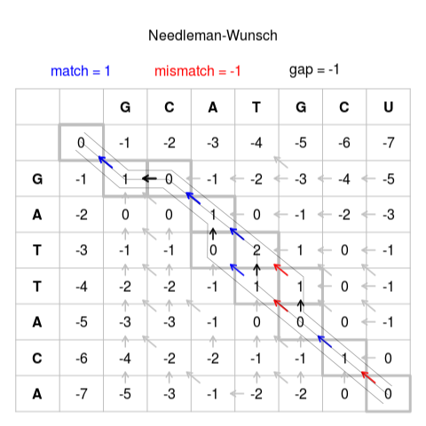
Introduction – Optimal algorithm

Slide 7
Algorithm
Match : 0
Mismatch : 1
Gap : 2
 |  | A | C | G | A | C
 | 0 | 2 | 4 | 6 | 8 | 10
A | 2 | 0 | 2 | 4 | 6 | 8
C | 4 | 2 | 0 | 2 | 4 | 6
A | 6 | 4 | 2 | 1 | 2 | 4
G | 8 | 6 | 4 | 2 | 2 | 3
C | 10 | 8 | 6 | 4 | 3 | 2

Slide 8
Algorithm
Match : 0
Mismatch : 1
Gap : 2
D = 0
 |  | A | C | G | A | C
 | 0
A
C
A
G
C

Slide 9
Algorithm
Match : 0
Mismatch : 1
Gap : 2
D = 0
 |  | A | C | G | A | C
 | 0 | 2
A | 2 | 0
C
A
G
C

Slide 10
Algorithm
Match : 0
Mismatch : 1
Gap : 2
D = 0
 |  | A | C | G | A | C
 | 0 | 2
A | 2 | 0 | 2
C |  | 2 | 0
A
G
C

Slide 11
Algorithm
Match : 0
Mismatch : 1
Gap : 2
D = 0
 |  | A | C | G | A | C
 | 0 | 2
A | 2 | 0 | 2
C |  | 2 | 0 | 2
A |  |  | 2 | 1
G
C

Slide 12
Algorithm
Match : 0
Mismatch : 1
Gap : 2
D = 0 → 1
 |  | A | C | G | A | C
 | 0 | 2
A | 2 | 0 | 2
C |  | 2 | 0 | 2
A |  |  | 2 | 1
G
C

Slide 13
Algorithm
Match : 0
Mismatch : 1
Gap : 2
D = 1
 |  | A | C | G | A | C
 | 0 | 2
A | 2 | 0 | 2
C |  | 2 | 0 | 2
A |  |  | 2 | 1 | 3
G |  |  |  | 3 | 2
C

Slide 14
Algorithm
Match : 0
Mismatch : 1
Gap : 2
D = 1 → 2
 |  | A | C | G | A | C
 | 0 | 2
A | 2 | 0 | 2
C |  | 2 | 0 | 2
A |  |  | 2 | 1 | 3
G |  |  |  | 3 | 2
C

Slide 15
Algorithm
Match : 0
Mismatch : 1
Gap : 2
D = 2
 |  | A | C | G | A | C
 | 0 | 2
A | 2 | 0 | 2
C |  | 2 | 0 | 2
A |  |  | 2 | 1 | 3
G |  |  |  | 3 | 2
C

Slide 16
Algorithm
Match : 0
Mismatch : 1
Gap : 2
D = 2
 |  | A | C | G | A | C
 | 0 | 2 | 4
A | 2 | 0 | 2 | 4
C | 4 | 2 | 0 | 2 | 4
A |  | 4 | 2 | 1 | 2
G |  |  | 4 | 2 | 2 | 4
C |  |  |  |  | 4 | 2

Slide 17
Algorithm
Match : 0
Mismatch : 1
Gap : 2
D = 2
 |  | A | C | G | A | C
 | 0 | 2 | 4
A | 2 | 0 | 2 | 4
C | 4 | 2 | 0 | 2 | 4
A |  | 4 | 2 | 1 | 2
G |  |  | 4 | 2 | 2 | 3
C |  |  |  |  | 4 | 2

Slide 18
Algorithm
Match : 0
Mismatch : 1
Gap : 2
D = 2
 |  | A | C | G | A | C
 | 0 | 2 | 4
A | 2 | 0 | 2 | 4
C | 4 | 2 | 0 | 2 | 4
A |  | 4 | 2 | 1 | 2 | 4
G |  |  | 4 | 2 | 2 | 3
C |  |  |  | 4 | 3 | 2
Since final score = D
So , stop.

Slide 19
Conclusion
If the similarity is more than 95%, the space used is less than 1/10.

Slide 20
A Fast Pruning Algorithm for Optimal Sequence Alignment
Aaron Davidson
Proceedings 2nd Annual IEEE International Symposium
on Bioinformatics and Bioengineering
4-6 Nov. 2001, Bethesda, MD, USA, USA
Presenter: Yuan-Hsiu Tsai
Date: Nov. 24, 2020
Notes:
貝塞斯達(Bethesda)是位於美國馬里蘭州蒙哥馬利縣(MD)的一個未成建制的自然聚居區

Slide 21
Abstract(1/2)
Sequence alignment is an important operation in computational biology. Both dynamic programming and A* heuristic search algorithms for optimal sequence alignment are discussed and evaluated Presented here are two new algorithms for optimal pairwise sequence alignment which outperform traditional methods on very large problem instances (hundreds of thousands of characters, for example). The technique combines the benefits of dynamic programming and A* heuristic search, with a minimal amount of additional overhead.

Slide 22
Abstract(2/2)
The dynamic programming matrix is traversed along antidiagonals, bounding the computation to exclude portions of the matrix that cannot contain optimal paths. An admissible heuristic assists in pruning away unnecessary areas of the matrix, while preserving optimal solutions for any given scoring function. Since memory requirements are a major concern for large sequence alignment problems, it is shown how the standard algorithm (requiring quadratic space) can be reformulated as a divide and conquer algorithm (requiring only linear space, at the cost of some recomputation).

Slide 23
Introduction
Optimal alignment algorithm
Dynamic programming
Hirschberg`s algorithm

Slide 24
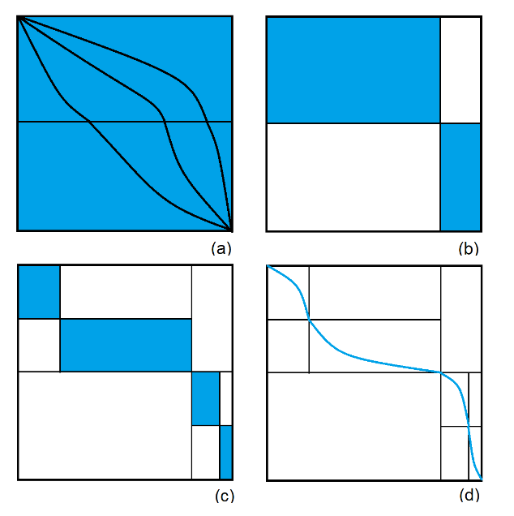
Introduction – Hirschberg

Slide 25
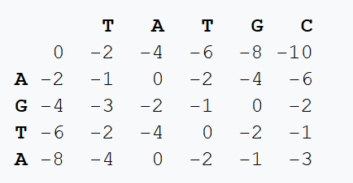
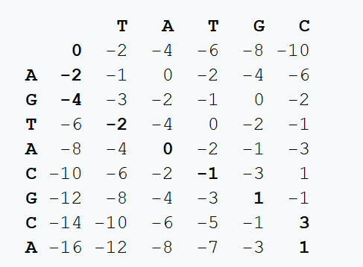
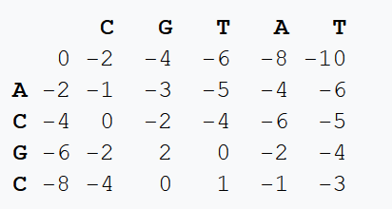
Hirschberg algorithm
這個序列是inversion的

Slide 26
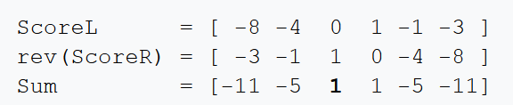
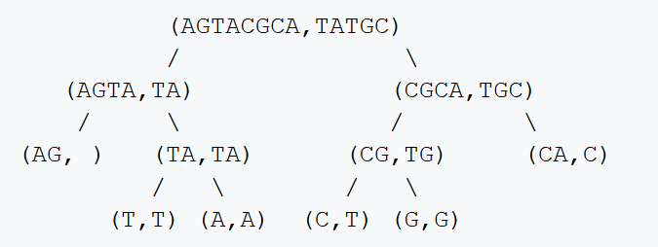
Hirschberg algorithm
得出切點在第2個字母位置

Slide 27
Introduction
Heuristic algorithm
A*
IDA* (Iterative Deepening A*)
DCFA (Divide and Conquer Frontier A*)

Slide 28
An example for A* algorithm
Find the shortest path with A* algorithm.
Stop iff the selected node is also a goal node.
引用自 楊昌彪老師 演算法設計與分析 第五章 pp.35-41

Slide 29
Step 1:
引用自 楊昌彪老師 演算法設計與分析 第五章 pp.35-41

Slide 30
Step 2: Expand node A.
5
引用自 楊昌彪老師 演算法設計與分析 第五章 pp.35-41

Slide 31
Step 3: Expand node C.
引用自 楊昌彪老師 演算法設計與分析 第五章 pp.35-41

Slide 32
Step 4: Expand node D.
引用自 楊昌彪老師 演算法設計與分析 第五章 pp.35-41

Slide 33
Step 5: Expand node B.
引用自 楊昌彪老師 演算法設計與分析 第五章 pp.35-41

Slide 34
Step 6: Expand node F.
Node I is a goal node. Thus, the final solution has been obtained.
引用自 楊昌彪老師 演算法設計與分析 第五章 pp.35-41

Slide 35
Introduction
Heuristic algorithm
A*
IDA* (Iterative Deepening A*)
DCFA (Divide and Conquer Frontier A*)

Slide 36
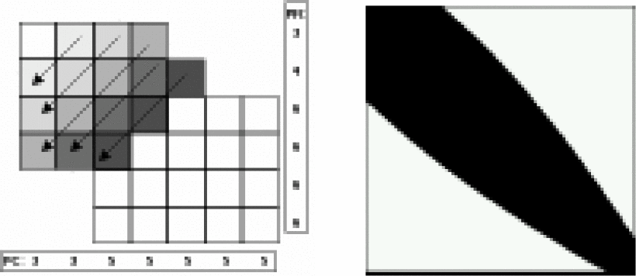
Introduction
Linear Bounded Diagonal Alignment
(LBD-Align)

Slide 37
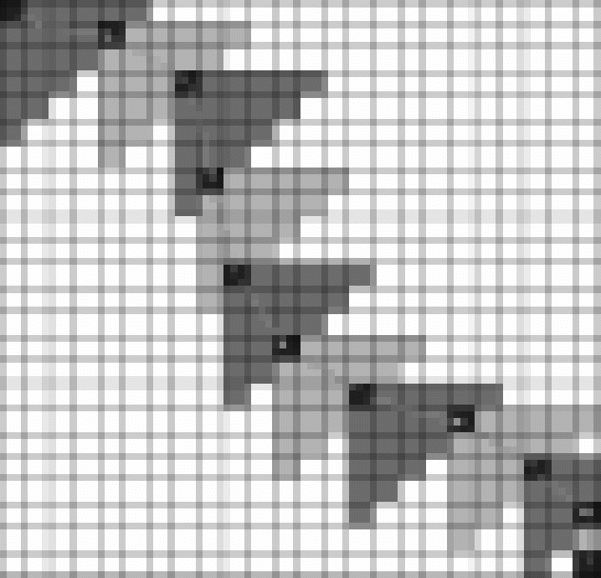
Algorithm
How to compute bound (heuristic)
Lower bound
Diagonal heuristic
Greedy headlight
Upper bound
Compute the best score of remaining characters

Slide 38
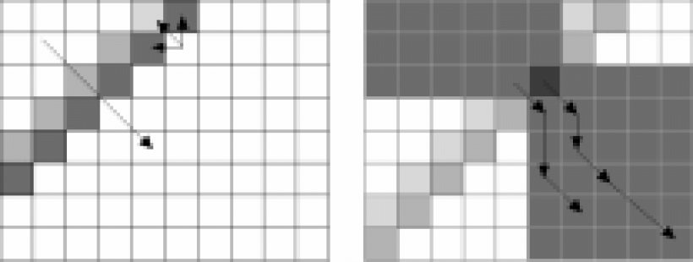
Algorithm – DCLBD-Align
Divide and Conquer Linear Bounded Diagonal Alignment

Slide 39
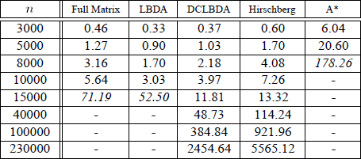
Experiments

Slide 40

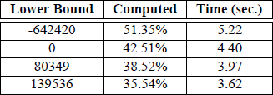

Experiments
Black : optimal lower bound search region
Gray : diagonal lower bound search region
Left : no gap extension
Right : have gap extension

