Slide 1
Linear-Size Suffix Tries
Maxime Crochemore, Chiara Epifanio, Roberto Grossi, Filippo Mignosi
Theoretical Computer Science
Volume 638, 25 July 2016, Pages 171-178
Presenter：Yu-Cheng Chang
Date：Dec. 23, 2020

Slide 2
Abstract (1/2)
Suffix trees are highly regarded data structures for text indexing and string algorithms [MCreight 76, Weiner 73]. For any given string w of length n = |w|, a suffix tree for w takes O(n) nodes and links. It is often presented as a compacted version of a suffix trie for w, where the latter is the trie (or digital search tree) built on the suffixes of w. Here the compaction process replaces each maximal chain of unary nodes with a single arc. For this, the suffix tree requires that the labels of its arcs are substrings encoded as pointers to w (or equivalent information).

Slide 3
Abstract (2/2)
On the contrary, the arcs of the suffix trie are labeled by single symbols but there can be Θ(n²) nodes and links for suffix tries in the worst case because of their unary nodes. It is an interesting question if the suffix trie can be stored using O(n) nodes. We present the linear-size suffix trie, which guarantees O(n) nodes. We use a new technique for reducing the number of unary nodes to O(n), that stems from some results on antidictionaries. For instance, by using the linear-size suffix trie, we are able to check whether a pattern p of length m = |p| occurs in w in O(mlog|Σ|) time and we can find the longest common substring of two strings w₁ and w₂ in O((|w₁| + |w₂|)log |Σ|) time for an alphabet Σ.

Slide 4
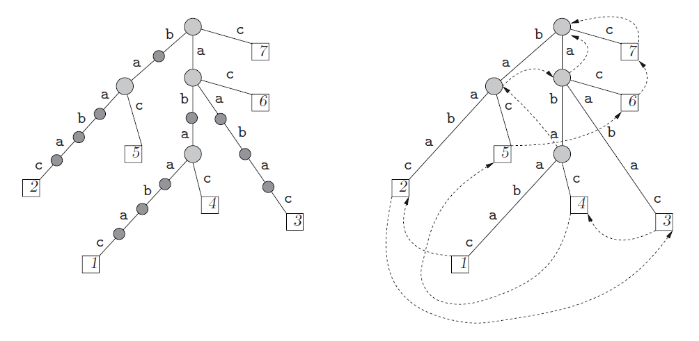
Suffix Trie vs. Suffix Tree
w = abaabac
suffix trie of w : ST(w) Θ(n²) nodes
suffix tree of w : S(w) O(n) nodes worst case: 2n Construct: O(n) with Ukkonen's algorithm
(1) suffix trie
(2) suffix tree

Slide 5
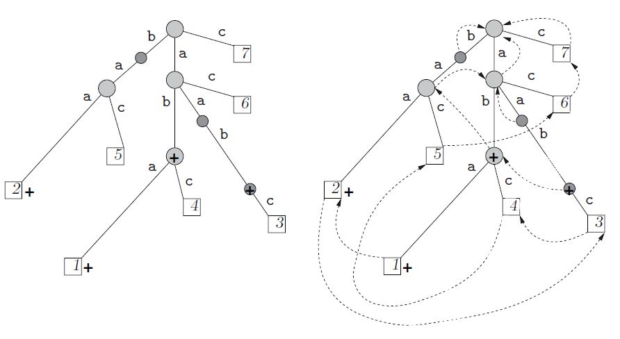
Linear-size Suffix Trie (LST)
w = abaabac
The LST can be built in O(n) time from the suffix tree, and checking whether a pattern p of length m = |p| occurs as a substring in w takes O(m) time, by traversing a small part of the LST.
LST
LST with suffix links

Slide 6
Linear-size Suffix Trie (LST) － Build (?)
w = abaabac
The set of nodes of LST(w) is made up of all the nodes that appear also in the suffix tree S(w), plus some nodes that appear only in the suffix trie ST(w). Namely, these nodes are selected in the suffix trie ST(w) according to the following criterion.
The nodes that appear also in the suffix tree S(w)
The nodes v such that their suffix link s(v) is a node appearing also in S(w).
ST
S
LST

Slide 7
Linear-size Suffix Trie (LST) － Build (?)
w = abaabac
The nodes that appear also in the suffix tree S(w)
The nodes v such that their suffix link s(v) is a node appearing also in S(w).
ST
S
LST

Slide 8
Linear-size Suffix Trie (LST) － Build (?)
w = abaabac
The nodes that appear also in the suffix tree S(w)
The nodes v such that their suffix link s(v) is a node appearing also in S(w).
ST
S
LST
+
Notes:
+ sign: 在ST中，其之間的 substring 長度 > 1

Slide 9
Linear-size Suffix Trie (LST) － Build (?)
w = abaabac
The nodes that appear also in the suffix tree S(w)
The nodes v such that their suffix link s(v) is a node appearing also in S(w).
ST
S
LST
+

Slide 10
Linear-size Suffix Trie (LST) － Build (?)
w = abaabac
The nodes that appear also in the suffix tree S(w)
The nodes v such that their suffix link s(v) is a node appearing also in S(w).
ST
S
LST
+

Slide 11
Linear-size Suffix Trie (LST) － Build
The construction of LST(w) can be easily done in linear time by a simple post-processing after the corresponding suffix tree construction is given. Indeed, one can make a bottom-up traversal of S(w), and for each arc(u,v) consider the path (not necessarily a single arc) in the suffix tree between s(u) and s(v). With a standard skip-and-count technique on this path, one can then infer which are the nodes of type 2 between u and v.
suffix tree

Slide 12
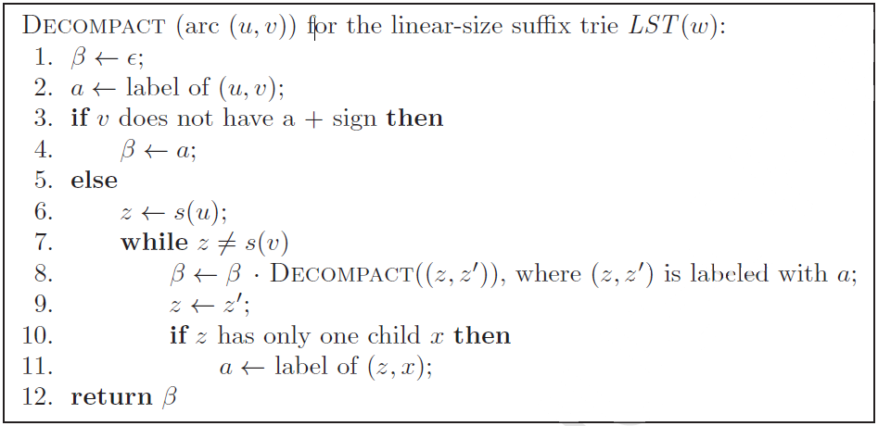
Decompact
?
LST with suffix links
Notes:
被省略掉的，其實都隱含在 suffix tree 內，透過 recursive 可以將隱含在裡面的 suffix 挖出來，沿著 suffix link 去找

Slide 13
Decompact
β = null
β
LST with suffix links
Notes:
被省略掉的，其實都隱含在 suffix tree 內，透過 recursive 可以將隱含在裡面的 suffix 挖出來，沿著 suffix link 去找

Slide 14
Decompact
β = null
LST with suffix links
Notes:
被省略掉的，其實都隱含在 suffix tree 內，透過 recursive 可以將隱含在裡面的 suffix 挖出來，沿著 suffix link 去找

Slide 15
Decompact
β = a．#
LST with suffix links
Notes:
被省略掉的，其實都隱含在 suffix tree 內，透過 recursive 可以將隱含在裡面的 suffix 挖出來，沿著 suffix link 去找

Slide 16
Decompact
β = a．#
LST with suffix links
Notes:
被省略掉的，其實都隱含在 suffix tree 內，透過 recursive 可以將隱含在裡面的 suffix 挖出來，沿著 suffix link 去找

Slide 17
Decompact
β = a．#
LST with suffix links
Notes:
被省略掉的，其實都隱含在 suffix tree 內，透過 recursive 可以將隱含在裡面的 suffix 挖出來，沿著 suffix link 去找

Slide 18
Decompact
β = a．#
LST with suffix links
Notes:
被省略掉的，其實都隱含在 suffix tree 內，透過 recursive 可以將隱含在裡面的 suffix 挖出來，沿著 suffix link 去找

Slide 19
Decompact
β = a．#
β = a．(b．a)．#
LST with suffix links
Notes:
被省略掉的，其實都隱含在 suffix tree 內，透過 recursive 可以將隱含在裡面的 suffix 挖出來，沿著 suffix link 去找

Slide 20
Decompact
β = a．#
β = a．ba．#
LST with suffix links
Notes:
被省略掉的，其實都隱含在 suffix tree 內，透過 recursive 可以將隱含在裡面的 suffix 挖出來，沿著 suffix link 去找

Slide 21
Decompact
β = a．#
β = a．ba ．#
β = a．ba ．c
β = abac
LST with suffix links
Notes:
被省略掉的，其實都隱含在 suffix tree 內，透過 recursive 可以將隱含在裡面的 suffix 挖出來，沿著 suffix link 去找

Slide 22
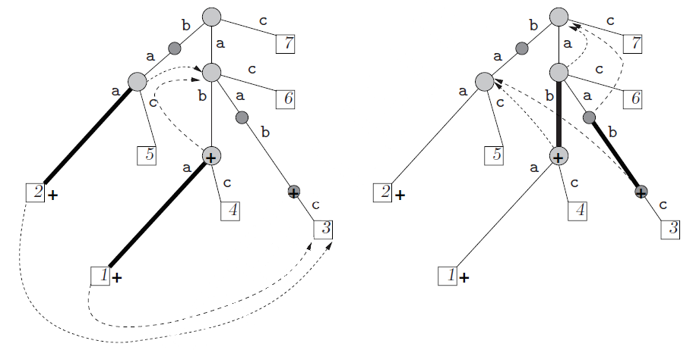
FastDecompact － s(u,v)、s^{k}(x)
s(u,v) as the pair of vertices s^{k}(u) and s^{k}(v), where s^{k}(x) indicates the traversal of k suffix links starting from x, and k is the smallest integer such that s^{k}(u) is no more the parent of s^{k}(v).
s¹(u) / s²(u)
u
u
v
s¹(v) / s²(v)
v

Slide 23
FastDecompact － s(u,v)、s^{k}(x)
s(u,v) as the pair of vertices s^{k}(u) and s^{k}(v), where s^{k}(x) indicates the traversal of k suffix links starting from x, and k is the smallest integer such that s^{k}(u) is no more the parent of s^{k}(v).
s¹(u) / s²(u)
s¹(v) / s²(v)
u
u
v
v

Slide 24
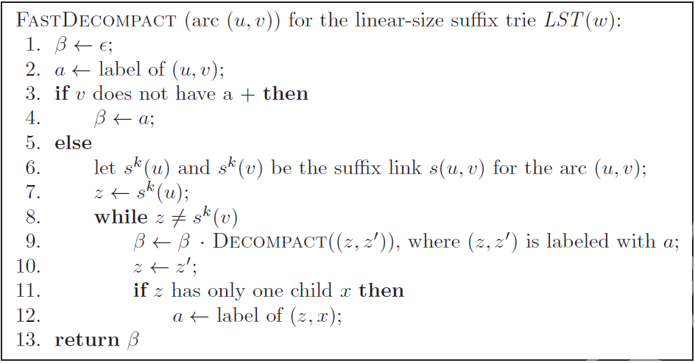
FastDecompact

Slide 25
Decompact
FastDecompact
β
2 steps
1 step
Notes:
被省略掉的，其實都隱含在 suffix tree 內，透過 recursive 可以將隱含在裡面的 suffix 挖出來，沿著 suffix link 去找

Slide 26
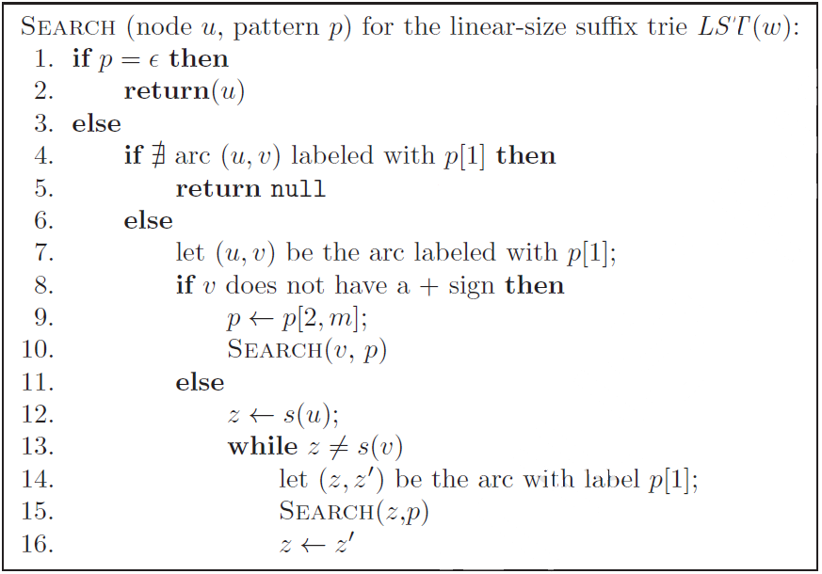
Search
Same notion as decompact

Slide 27
Theorem 1
Let Σ be any alphabet and w be a string over Σ of length n = |w|. The total size of LST(w) is O(n) space.
The number of arcs and their labeling symbols
The number of suffix links for nodes
The number of suffix links for arcs
All above take O(n) space

Slide 28
Theorem 2
Given the linear-size suffix trie LST(w), reconstructing the substring of an arc of length l takes O(l) time and, consequently, finding if a pattern p of length m occurs in w takes O(m) time. For an arbitrary alphabet Σ, this cost is multiplied by a factor of log|Σ|.

Slide 29
Longest Common Substring (LCS)
A = xabxa
B = babxba
LCS(A,B) = abx
w = xabxa#₁babxa#₂
O(|A| + |B|)
with suffix tree
a
b
#₂
x
#₁
#₁
#₂
12
5
a
ba#₂
a
x
4
11
bx
9
ba#₂
bxba#₂
a#₁
a#₁
#₁
#₂
bxa#₁
ba#₂
1
7
3
0
6
10
2
8

Slide 30
Conclusion
We think that linear-size suffix tries have the potential to be used in the place of standard suffix trees in all applications because their underlying trees structures and the suffix links are close enough.
We further think that for large enough text generated by a memoryless source, the search for patterns generated by the same source can also be done in average linear time without using suffix links on the arcs whose ending node has a + sign.

