Slide 1
On pattern matching with k mismatches and few don’t cares
Marius Nicolae, Sanguthevar Rajasekaran
Information Processing Letters 118 (2017) P78~P82
Presenter: Jing-Ping Jan
Date: Dec. 23, 2020
Notes:
Journal of Internet Technology 網際網路技術學刊 2009

Slide 2
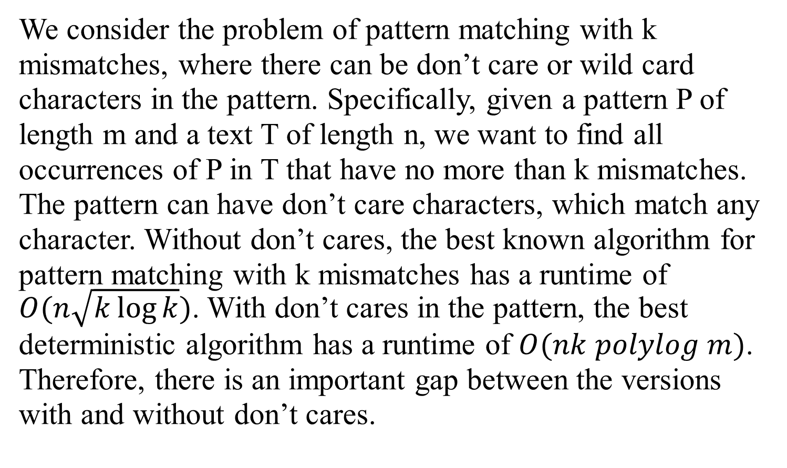
Abstract
We consider the problem of pattern matching with k mismatches, where there can be don’t care or wild card characters in the pattern. Specifically, given a pattern P of length m and a text T of length n, we want to find all occurrences of P in T that have no more than k mismatches. The pattern can have don’t care characters, which match any character. Without don’t cares, the best known algorithm for pattern matching with k mismatches has a runtime of $O(n\sqrt{k\log{k}})$. With don’t cares in the pattern, the best deterministic algorithm has a runtime of $O(nk polylog m)$. Therefore, there is an important gap between the versions with and without don’t cares.
Notes:
Ʃ = sigma
Ε = epsilon

Slide 3
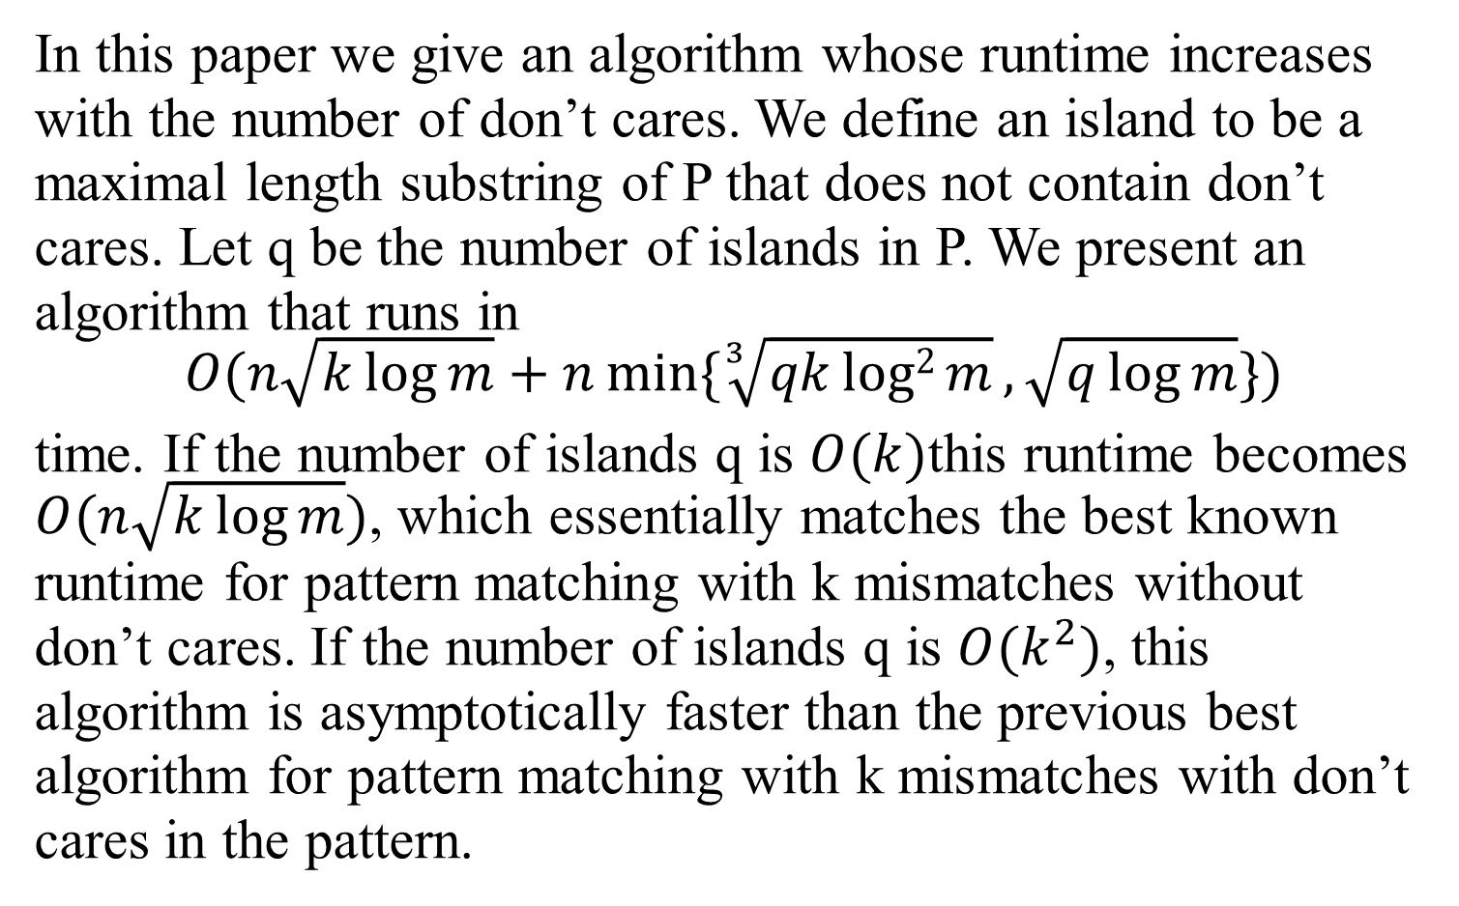
Abstract
In this paper we give an algorithm whose runtime increases with the number of don’t cares. We define an island to be a maximal length substring of P that does not contain don’t cares. Let q be the number of islands in P. We present an algorithm that runs in
$$O(n\sqrt{k\log{m}}+n\min{\{\sqrt[3]{qklog2{m}},\sqrt{q\log{m}}\}})$$
time. If the number of islands q is $O(k)$this runtime becomes $O(n\sqrt{k\log{m}})$, which essentially matches the best known runtime for pattern matching with k mismatches without don’t cares. If the number of islands q is $O(k^{2})$, this algorithm is asymptotically faster than the previous best algorithm for pattern matching with k mismatches with don’t cares in the pattern.
Notes:
Ʃ = sigma
Ε = epsilon
$\sqrt[3]{x}$ = cube root of x

Slide 4
Introduction
T = tcctgtgcat = t₁t₂…t_{n}
P = tac.g
Ti = t_{i}t_{i+1}…t_{i+m-1}

Slide 5
Introduction
Pattern matching with mismatches T = tcctgtgcat P = tac.g
 | t | c | c | t | g | t | g | c | a | t | distance
T1 | t | a | c | . | g |  |  |  |  |  | 1
T2 |  | t | a | c | . | g |  |  |  |  | 4
T3 |  |  | t | a | c | . | g |  |  |  | 3
T4 |  |  |  | t | a | c | . | g |  |  | 3
T5 |  |  |  |  | t | a | c | . | g |  | 4
T6 |  |  |  |  |  | t | a | c | . | g | 2

Slide 6
Introduction
Pattern matching with k mismatches T = tcctgtgcat P = tac.g k = 2
 | t | c | c | t | g | t | g | c | a | t | distance
T1 | t | a | c | . | g |  |  |  |  |  | 1
T6 |  |  |  |  |  | t | a | c | . | g | 2

Slide 7
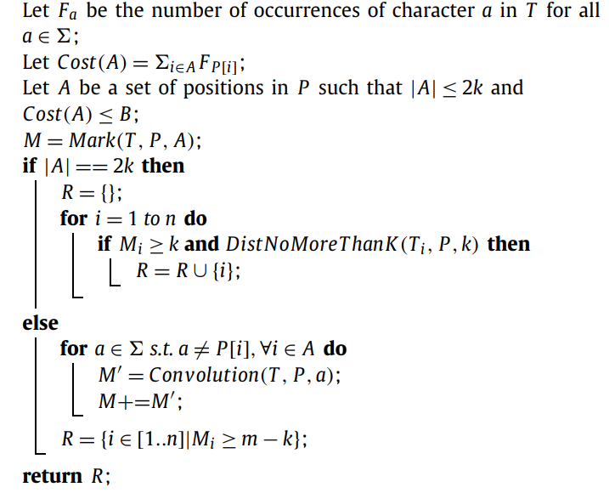
K-Mismatches with Wild Cards - |A| < 2k
Notes:
|A| <= 2k Cost(A) <= b

Slide 8
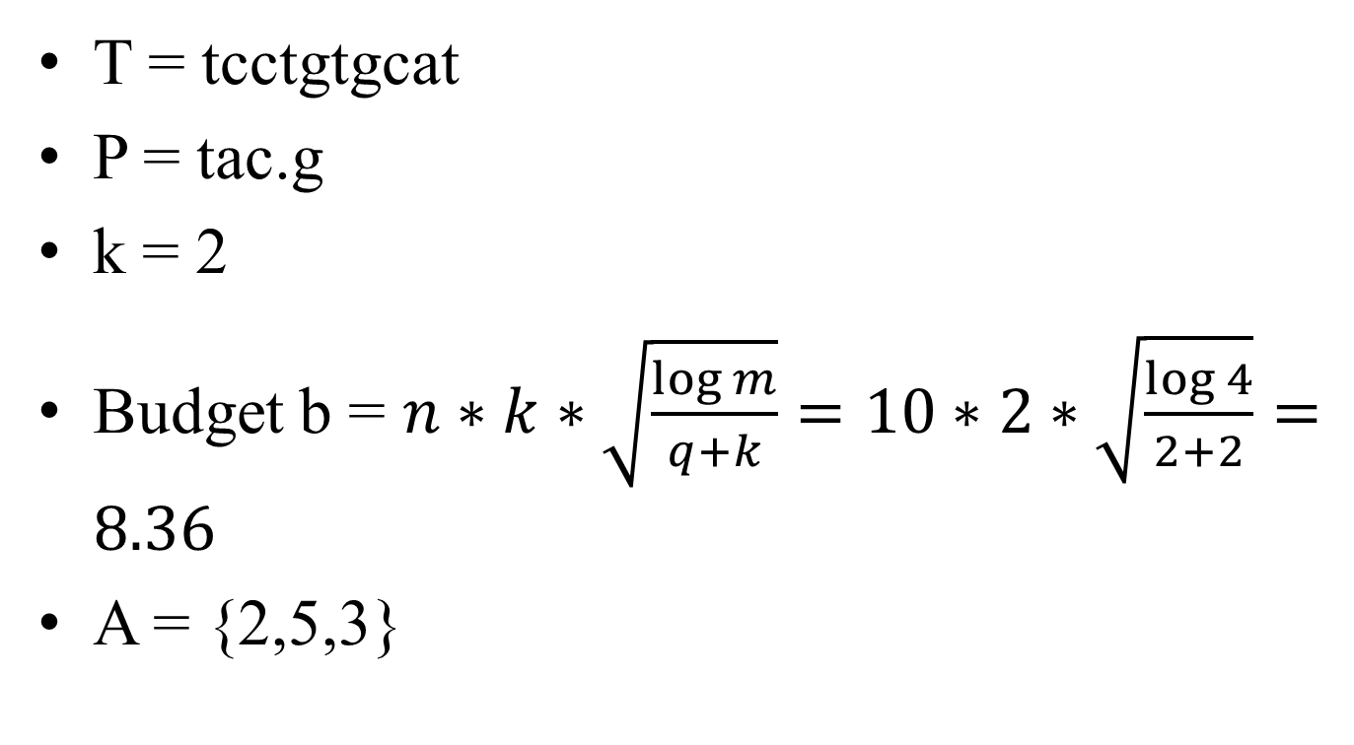
K-Mismatches with Wild Cards - |A| < 2k
 | F_{i}
I = t | 4
I = a | 1
I = c | 3
I = g | 2
T = tcctgtgcat
P = tac.g
k = 2
Budget b = $n∗k∗\sqrt{\frac{\log{m}}{q+k}}=10∗2∗\sqrt{\frac{\log{4}}{2+2}}=8.36$
A = {2,5,3}
Notes:
|A| <= 2k Cost(A) <= b

Slide 9
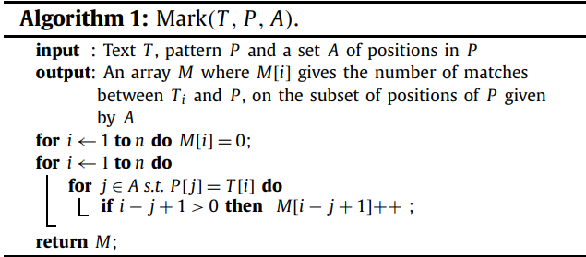
K-Mismatches with Wild Cards - |A| < 2k
Mark(T,P,A) T = tcctgtgcat P = tac.g A = {2,5,3}
M₁ | M₂ | M₃ | M₄ | M₅ | M₆ | M₇ | M₈ | M₉ | M₁₀
0 | 0 | 0 | 0 | 0 | 0 | 0 | 0 | 0 | 0
Notes:
|A| <= 2k Cost(A) <= b
M[i] = T_{i} 中等於P_{x⊆A}的個數

Slide 10
K-Mismatches with Wild Cards - |A| < 2k
Mark(T,P,A) T = tcctgtgcat P = tac.g A = {2,5,3}
M₁ | M₂ | M₃ | M₄ | M₅ | M₆ | M₇ | M₈ | M₉ | M₁₀
0 | 0 | 0 | 0 | 0 | 0 | 0 | 0 | 0 | 0
Notes:
|A| <= 2k Cost(A) <= b
M[i] = T_{i} 中等於P_{x⊆A}的個數

Slide 11
K-Mismatches with Wild Cards - |A| < 2k
Mark(T,P,A) T = tcctgtgcat P = tac.g A = {2,5,3}
M₁ | M₂ | M₃ | M₄ | M₅ | M₆ | M₇ | M₈ | M₉ | M₁₀
0 | 0 | 0 | 0 | 0 | 0 | 0 | 0 | 0 | 0
Notes:
|A| <= 2k Cost(A) <= b
M[i] = T_{i} 中等於P_{x⊆A}的個數

Slide 12
K-Mismatches with Wild Cards - |A| < 2k
Mark(T,P,A) T = tcctgtgcat P = tac.g A = {2,5,3}
M₁ | M₂ | M₃ | M₄ | M₅ | M₆ | M₇ | M₈ | M₉ | M₁₀
1 | 0 | 0 | 0 | 0 | 0 | 0 | 0 | 0 | 0
Notes:
|A| <= 2k Cost(A) <= b
M[i] = T_{i} 中等於P_{x⊆A}的個數

Slide 13
K-Mismatches with Wild Cards - |A| < 2k
Mark(T,P,A) T = tcctgtgcat P = tac.g A = {2,5,3}
M₁ | M₂ | M₃ | M₄ | M₅ | M₆ | M₇ | M₈ | M₉ | M₁₀
1 | 0 | 0 | 0 | 0 | 0 | 0 | 0 | 0 | 0
Notes:
|A| <= 2k Cost(A) <= b
M[i] = T_{i} 中等於P_{x⊆A}的個數

Slide 14
K-Mismatches with Wild Cards - |A| < 2k
Mark(T,P,A) T = tcctgtgcat P = tac.g A = {2,5,3}
M₁ | M₂ | M₃ | M₄ | M₅ | M₆ | M₇ | M₈ | M₉ | M₁₀
2 | 0 | 0 | 0 | 0 | 0 | 0 | 0 | 0 | 0
Notes:
|A| <= 2k Cost(A) <= b
M[i] = T_{i} 中等於P_{x⊆A}的個數

Slide 15
K-Mismatches with Wild Cards - |A| < 2k
Mark(T,P,A) T = tcctgtgcat P = tac.g A = {2,5,3}
M₁ | M₂ | M₃ | M₄ | M₅ | M₆ | M₇ | M₈ | M₉ | M₁₀
2 | 0 | 0 | 0 | 0 | 0 | 0 | 0 | 0 | 0
Notes:
|A| <= 2k Cost(A) <= b
M[i] = T_{i} 中等於P_{x⊆A}的個數

Slide 16
K-Mismatches with Wild Cards - |A| < 2k
Mark(T,P,A) T = tcctgtgcat P = tac.g A = {2,5,3}
M₁ | M₂ | M₃ | M₄ | M₅ | M₆ | M₇ | M₈ | M₉ | M₁₀
2 | 0 | 1 | 0 | 0 | 0 | 0 | 0 | 0 | 0
Notes:
|A| <= 2k Cost(A) <= b
M[i] = T_{i} 中等於P_{x⊆A}的個數

Slide 17
K-Mismatches with Wild Cards - |A| < 2k
Mark(T,P,A) T = tcctgtgcat P = tac.g A = {2,5,3}
M₁ | M₂ | M₃ | M₄ | M₅ | M₆ | M₇ | M₈ | M₉ | M₁₀
2 | 0 | 1 | 0 | 0 | 1 | 0 | 0 | 0 | 0
Notes:
|A| <= 2k Cost(A) <= b
M[i] = T_{i} 中等於P_{x⊆A}的個數

Slide 18
K-Mismatches with Wild Cards - |A| < 2k
Mark(T,P,A) T = tcctgtgcat P = tac.g A = {2,5,3}
M₁ | M₂ | M₃ | M₄ | M₅ | M₆ | M₇ | M₈ | M₉ | M₁₀
2 | 0 | 1 | 0 | 0 | 1 | 0 | 1 | 0 | 0
Notes:
|A| <= 2k Cost(A) <= b
M[i] = T_{i} 中等於P_{x⊆A}的個數

Slide 19
K-Mismatches with Wild Cards - |A| < 2k
Mark(T,P,A) T = tcctgtgcat P = tac.g A = {2,5,3}
M₁ | M₂ | M₃ | M₄ | M₅ | M₆ | M₇ | M₈ | M₉ | M₁₀
2 | 0 | 1 | 0 | 0 | 1 | 0 | 1 | 0 | 0
Notes:
|A| <= 2k Cost(A) <= b
M[i] = T_{i} 中等於P_{x⊆A}的個數

Slide 20
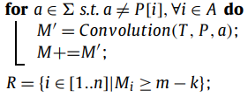
K-Mismatches with Wild Cards - |A| < 2k
Mark(T,P,A) T = tcctgtgcat P = tac.g A = {2,5,3} =>{a,g,c}
M₁ | M₂ | M₃ | M₄ | M₅ | M₆ | M₇ | M₈ | M₉ | M₁₀
2 | 0 | 1 | 0 | 0 | 1 | 0 | 1 | 0 | 0
M’₁ | M’₂ | M’₃ | M’₄ | M’₅ | M’₆ | M’₇ | M’₈ | M’₉ | M’₁₀
6 | 1 | 3 | 2 | 1 | 4 | 0 | 1 | 0 | 0
Notes:
Convolution(T,P,a):

Slide 21
K-Mismatches with Wild Cards - |A| < 2k
Mark(T,P,A) T = tcctgtgcat P = tac.g A = {2,5,3} =>{a,g,c}
R = {1,6}
M’₁ | M’₂ | M’₃ | M’₄ | M’₅ | M’₆ | M’₇ | M’₈ | M’₉ | M’₁₀
6 | 1 | 3 | 2 | 1 | 4 | 0 | 1 | 0 | 0
Notes:
Convolution(T,P,a):
m是P的長度

Slide 22

K-Mismatches with Wild Cards - |A| = 2k
 | F_{i}
I = t | 4
I = a | 1
I = c | 3
I = g | 2
I = b | 0
T = tcctgtgcat
P = acbg
k = 2
Budget b = $6.91$
A = {3,1,4,2}
Notes:
|A| <= 2k Cost(A) <= b

Slide 23
K-Mismatches with Wild Cards - |A| = 2k
Mark(T,P,A) T = tcctgtgcat P = acbg A = {3,1,4,2}
M₁ | M₂ | M₃ | M₄ | M₅ | M₆ | M₇ | M₈ | M₉ | M₁₀
0 | 0 | 0 | 0 | 0 | 0 | 0 | 0 | 0 | 0
Notes:
|A| <= 2k Cost(A) <= b
M[i] = T_{i} 中等於P_{x⊆A}的個數

Slide 24
K-Mismatches with Wild Cards - |A| = 2k
Mark(T,P,A) T = tcctgtgcat P = acbg A = {3,1,4,2}
M₁ | M₂ | M₃ | M₄ | M₅ | M₆ | M₇ | M₈ | M₉ | M₁₀
0 | 0 | 0 | 0 | 0 | 0 | 0 | 0 | 0 | 0
Notes:
|A| <= 2k Cost(A) <= b
M[i] = T_{i} 中等於P_{x⊆A}的個數

Slide 25
K-Mismatches with Wild Cards - |A| = 2k
Mark(T,P,A) T = tcctgtgcat P = acbg A = {3,1,4,2}
M₁ | M₂ | M₃ | M₄ | M₅ | M₆ | M₇ | M₈ | M₉ | M₁₀
1 | 0 | 0 | 0 | 0 | 0 | 0 | 0 | 0 | 0
Notes:
|A| <= 2k Cost(A) <= b
M[i] = T_{i} 中等於P_{x⊆A}的個數

Slide 26
K-Mismatches with Wild Cards - |A| = 2k
Mark(T,P,A) T = tcctgtgcat P = acbg A = {3,1,4,2}
M₁ | M₂ | M₃ | M₄ | M₅ | M₆ | M₇ | M₈ | M₉ | M₁₀
1 | 1 | 0 | 0 | 0 | 0 | 0 | 0 | 0 | 0
Notes:
|A| <= 2k Cost(A) <= b
M[i] = T_{i} 中等於P_{x⊆A}的個數

Slide 27
K-Mismatches with Wild Cards - |A| = 2k
Mark(T,P,A) T = tcctgtgcat P = acbg A = {3,1,4,2}
M₁ | M₂ | M₃ | M₄ | M₅ | M₆ | M₇ | M₈ | M₉ | M₁₀
1 | 1 | 0 | 0 | 0 | 0 | 0 | 0 | 0 | 0
Notes:
|A| <= 2k Cost(A) <= b
M[i] = T_{i} 中等於P_{x⊆A}的個數

Slide 28
K-Mismatches with Wild Cards - |A| = 2k
Mark(T,P,A) T = tcctgtgcat P = acbg A = {3,1,4,2}
M₁ | M₂ | M₃ | M₄ | M₅ | M₆ | M₇ | M₈ | M₉ | M₁₀
1 | 2 | 0 | 0 | 0 | 0 | 0 | 0 | 0 | 0
Notes:
|A| <= 2k Cost(A) <= b
M[i] = T_{i} 中等於P_{x⊆A}的個數

Slide 29
K-Mismatches with Wild Cards - |A| = 2k
Mark(T,P,A) T = tcctgtgcat P = acbg A = {3,1,4,2}
M₁ | M₂ | M₃ | M₄ | M₅ | M₆ | M₇ | M₈ | M₉ | M₁₀
1 | 2 | 0 | 0 | 0 | 0 | 0 | 0 | 0 | 0
Notes:
|A| <= 2k Cost(A) <= b
M[i] = T_{i} 中等於P_{x⊆A}的個數

Slide 30
K-Mismatches with Wild Cards - |A| = 2k
Mark(T,P,A) T = tcctgtgcat P = acbg A = {3,1,4,2}
M₁ | M₂ | M₃ | M₄ | M₅ | M₆ | M₇ | M₈ | M₉ | M₁₀
1 | 2 | 0 | 1 | 0 | 0 | 0 | 0 | 0 | 0
Notes:
|A| <= 2k Cost(A) <= b
M[i] = T_{i} 中等於P_{x⊆A}的個數

Slide 31
K-Mismatches with Wild Cards - |A| = 2k
Mark(T,P,A) T = tcctgtgcat P = acbg A = {3,1,4,2}
M₁ | M₂ | M₃ | M₄ | M₅ | M₆ | M₇ | M₈ | M₉ | M₁₀
1 | 2 | 0 | 1 | 0 | 0 | 1 | 0 | 0 | 0
Notes:
|A| <= 2k Cost(A) <= b
M[i] = T_{i} 中等於P_{x⊆A}的個數

Slide 32
K-Mismatches with Wild Cards - |A| = 2k
Mark(T,P,A) T = tcctgtgcat P = acbg A = {3,1,4,2}
M₁ | M₂ | M₃ | M₄ | M₅ | M₆ | M₇ | M₈ | M₉ | M₁₀
1 | 2 | 0 | 1 | 0 | 0 | 1 | 0 | 1 | 0
Notes:
|A| <= 2k Cost(A) <= b
M[i] = T_{i} 中等於P_{x⊆A}的個數

Slide 33
K-Mismatches with Wild Cards - |A| = 2k
Mark(T,P,A) T = tcctgtgcat P = acbg A = {3,1,4,2}
M₁ | M₂ | M₃ | M₄ | M₅ | M₆ | M₇ | M₈ | M₉ | M₁₀
1 | 2 | 0 | 1 | 0 | 0 | 1 | 0 | 1 | 0
Notes:
|A| <= 2k Cost(A) <= b
M[i] = T_{i} 中等於P_{x⊆A}的個數

Slide 34
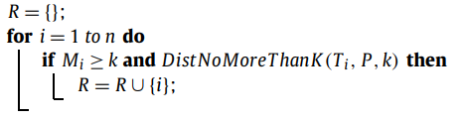
K-Mismatches with Wild Cards - |A| = 2k
Mark(T,P,A) T = tcctgtgcat P = acbg A = {3,1,4,2}
M₁ | M₂ | M₃ | M₄ | M₅ | M₆ | M₇ | M₈ | M₉ | M₁₀
1 | 2 | 0 | 1 | 0 | 0 | 1 | 0 | 1 | 0
Notes:
Convolution(T,P,a):

Slide 35
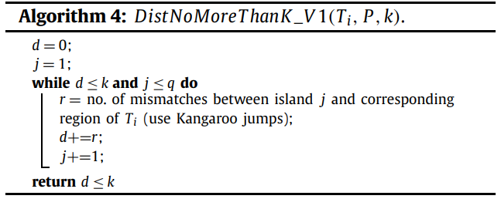
K-Mismatches with Wild Cards - |A| = 2k
Mark(T,P,A) T = tcctgtgcat P = acbg A = {3,1,4,2}
R = {2}
M₁ | M₂ | M₃ | M₄ | M₅ | M₆ | M₇ | M₈ | M₉ | M₁₀
1 | 2 | 0 | 1 | 0 | 0 | 1 | 0 | 1 | 0
Notes:
Distance No More Than K是算出每個ISLAND中mismatch的個數總和
Kangaroo : LCA能算出第一個mismatch的位置
LCA = Lowest common ancestor
這個例子只有一個island
所以就是全部的 P 跟 T_{i} 比，算出mismatch的個數

Slide 36

Conclusions
Time complexity: $O(n\sqrt{k\log{m}}+n\min{\{\sqrt[3]{qklog2{m}},\sqrt{q\log{m}}\}})$
If q is $O(k)$ this runtime become: $O(n\sqrt{k\log{m}})$
Notes:
Distance No More Than K是算出每個ISLAND中mismatch的個數總和
Kangaroo : LCA能算出第一個mismatch的位置
LCA = Lowest common ancestor
這個例子只有一個island
所以就是全部的 P 跟 T_{i} 比，算出mismatch的個數

Slide 37
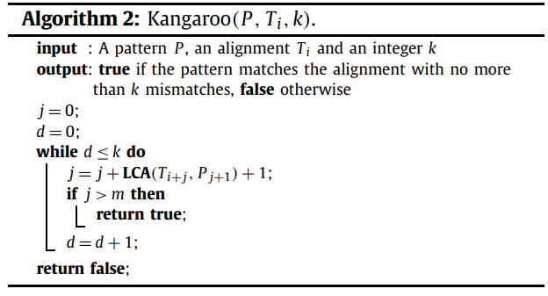
Kangaroo algorithm
Notes:
Distance No More Than K是算出每個ISLAND中mismatch的個數總和
Kangaroo : LCA能算出第一個mismatch的位置
LCA = Lowest common ancestor
這個例子只有一個island
所以就是全部的 P 跟 T_{i} 比，算出mismatch的個數

