Slide 1
A fast parallel algorithm for finding the longest common sequence of multiple biosequences
Yixin Chen, Andrew Wan & Wei Liu
BMC Bioinformatics, volume 7, Supplement 4, 2006
Presenter: Yuan-Hsiu Tsai
Date: Dec. 23, 2020
Notes:
ISTA: Information Science, Technology and Applications -- https://dl.acm.org/conference/ista
Kuwait Kuwait 科威特 的 科威特城

Slide 2
Abstract(1/4)
Background
Searching for the longest common sequence (LCS) of multiple biosequences is one of the most fundamental tasks in bioinformatics. In this paper, we present a parallel algorithm named FAST_LCS to speedup the computation for finding LCS.

Slide 3
Abstract(2/4)
Results
A fast parallel algorithm for LCS is presented. The algorithm first constructs a novel successor table to obtain all the identical pairs and their levels. It then obtains the LCS by tracing back from the identical character pairs at the last level. Effective pruning techniques are developed to significantly reduce the computational complexity. Experimental results on gene sequences in the tigr database show that our algorithm is optimal and much more efficient than other leading LCS algorithms.

Slide 4
Abstract(3/4)
Conclusion
We have developed one of the fastest parallel LCS algorithms on an MPP parallel computing model. For two sequences X and Y with lengths n and m, respectively, the memory required is max{4*(n+1)+4*(m+1), L}, where L is the number of identical character pairs. The time complexity is O(L) for sequential execution, and O(|LCS(X, Y)|) for parallel execution, where |LCS(X, Y)| is the length of the LCS of X and Y.

Slide 5
Abstract(4/4)
Conclusion
For n sequences X₁, X₂, ..., X _{n} , the time complexity is O(L) for sequential execution, and O(|LCS(X₁, X₂, ..., X _{n} )|) for parallel execution. Experimental results support our analysis by showing significant improvement of the proposed method over other leading LCS algorithms.

Slide 6
Introduction
Successor table
S1 = ATCCCA
 |  | A 0 | T 1 | C 2 | C 3 | C 4 | A 5
A | 1 | 6 | 6 | 6 | 6 | 6 | --
T | 2 | 2 | -- | -- | -- | -- | --
C | 3 | 3 | 3 | 4 | 5 | -- | --
G | -- | -- | -- | -- | -- | -- | --

Slide 7
Algorithm
Give two sequence X, Y
Step1: Create Successor of X, Y
Step2: Find all match pairs
Step3: Do parallel algorithm until find answer

Slide 8
Algorithm
S1 = ATCCCA
S2 = CAATTC
Level 1
A
(1,2)
T
(2,4)
--
(0,0)
C
(3,1)
G
(--,--)

Slide 9
Algorithm
Level 3
Level 2
A
(6,3)
A
(x,y)
S1 = ATCCCA
S2 = CAATTC
T
(2,4)
.
.
.
Level 1
C
(3,6)
A
(1,2)
.
.
.
G
(--,--)
T
(2,4)
--
(0,0)
.
.
.
C
(3,1)
.
.
.
G
(--,--)
G
(x,y)
G
(--,--)

Slide 10
Algorithm
Pruning
Level 1
A
(1,2)
T
(2,4)
--
(0,0)
C
(3,1)
G
(--,--)

Slide 11
Algorithm – Multiple alignment
S1 = ATCCCA
S2 = CAATTC
S3 = ACTCTG
Level 1
A
(1,2,1)
T
(2,4,3)
--
(0,0,0)
C
(3,1,4)
G
(--,--,6)

Slide 12
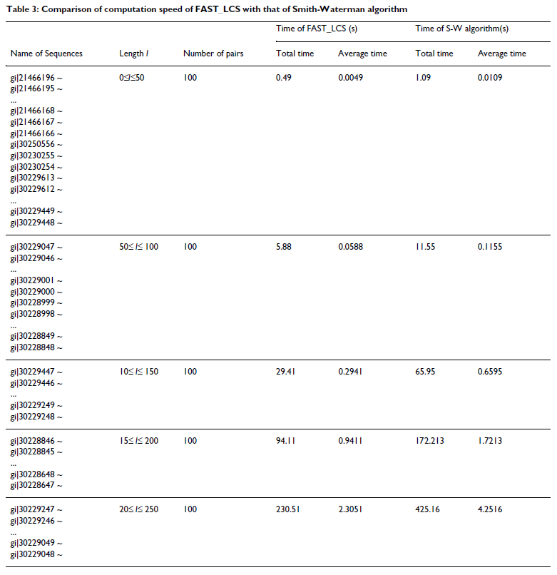
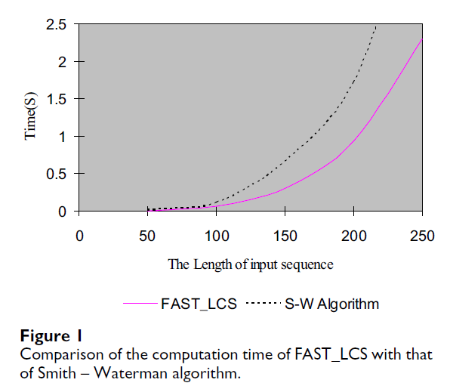
Experiment

Slide 13
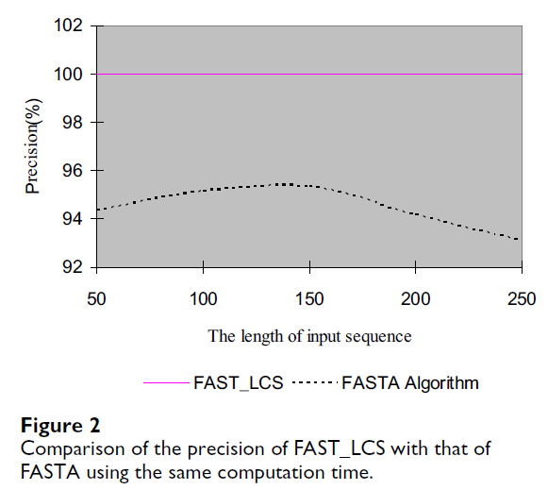
Experiment

Slide 14
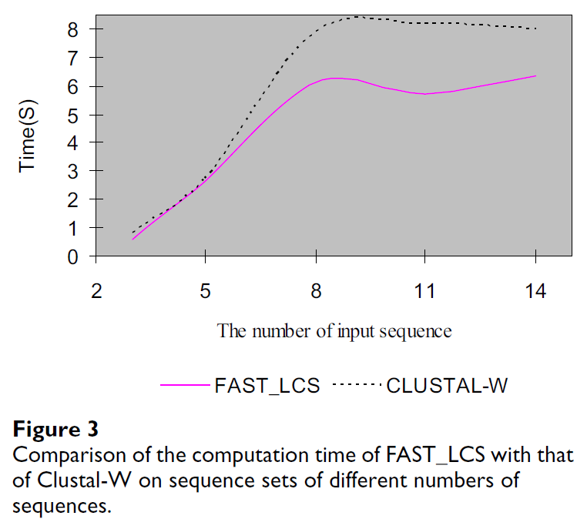
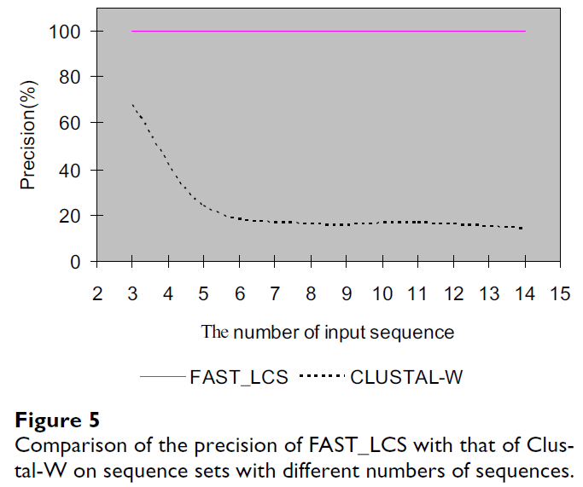
Experiment

Slide 15
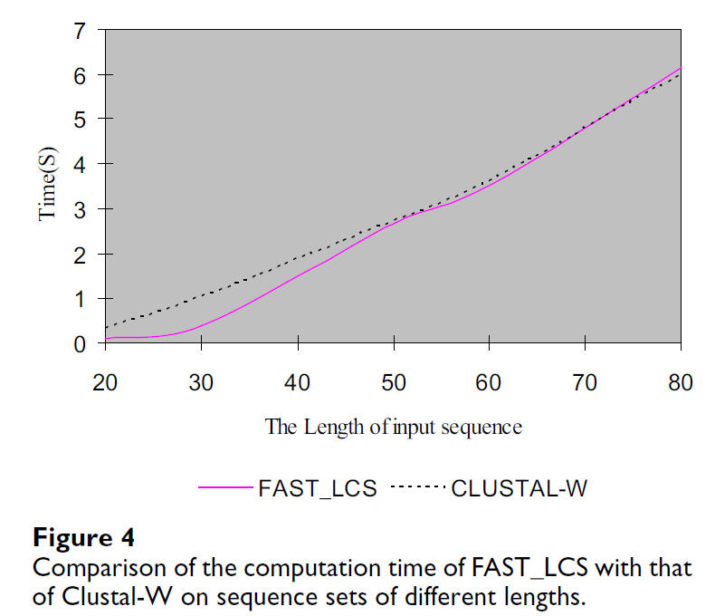
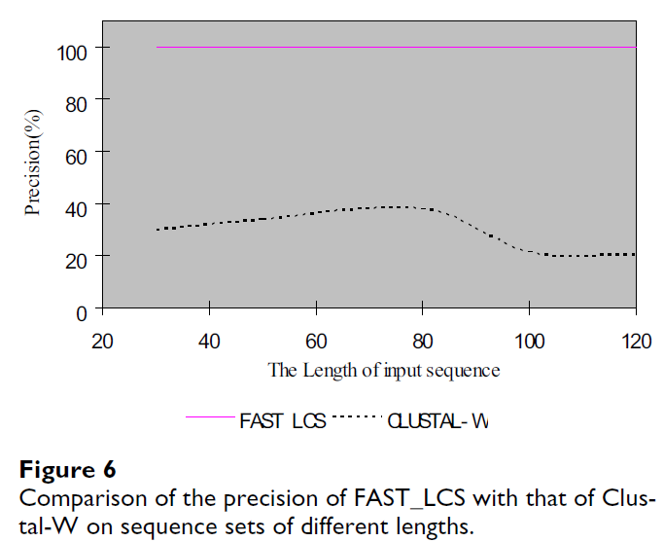
Experiment

Slide 16
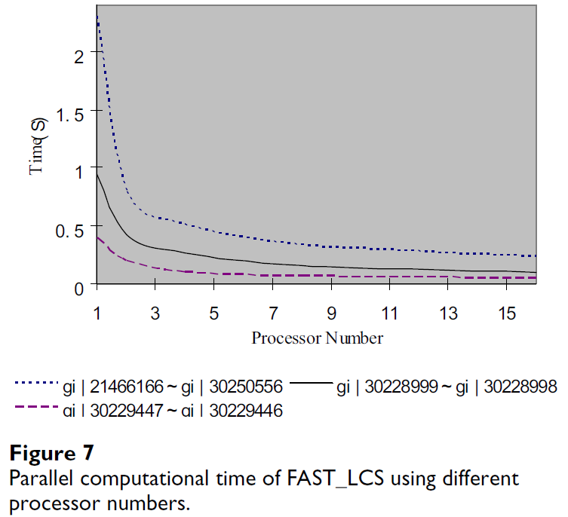
Experiment

