Slide 1
Dynamic Time Warping Averaging of Time Series Allows Faster and More Accurate Classification
Francois Petitjean, Germain Forestier, Geoffrey I. Webb,
Ann E. Nicholson, Yanping Chen and Eamonn Keogh
Proceeding of 2014 IEEE International Conference on Data Mining, India
Presenter : Shu-Kai, Hung
Date : 2017/2/21

Slide 2
Abstract(1/2)
Recent years have seen significant progress in improving both the efficiency and effectiveness of time series classification. However, because the best solution is typically the Nearest Neighbor algorithm with the relatively expensive Dynamic Time Warping as the distance measure, successful deployments on resource constrained devices remain elusive. Moreover, the recent explosion of interest in wearable devices, which typically have limited computational resources, has created a growing need for very efficient classification algorithms.

Slide 3
Abstract(2/2)
A commonly used technique to glean the benefits of the Nearest Neighbor algorithm, without inheriting its undesirable time complexity, is to use the Nearest Centroid algorithm. However, because of the unique properties of (most) time series data, the centroid typically does not resemble any of the instances, an unintuitive and underappreciated fact. In this work we show that we can exploit a recent result to allow meaningful averaging of “warped” times series, and that this result allows us to create ultra-efficient Nearest “Centroid” classifiers that are at least as accurate as their more lethargic Nearest Neighbor cousins.

Slide 4

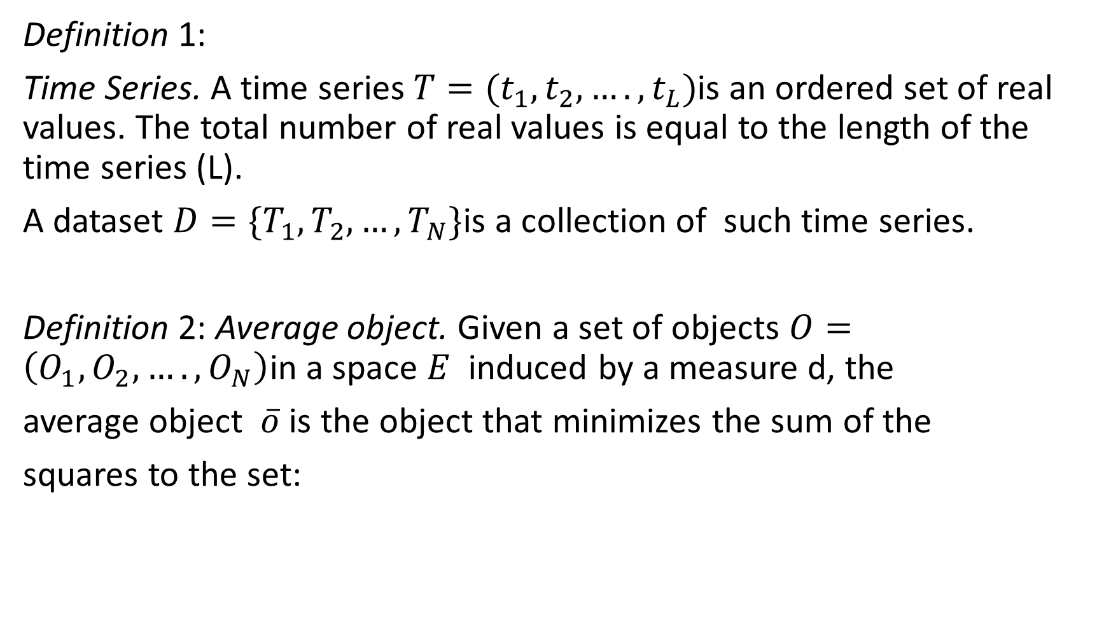
Definition 1:
Time Series. A time series $T=(t_{1},t_{2},….,t_{L})$is an ordered set of real values. The total number of real values is equal to the length of the time series (L).
A dataset $D=\{T_{1},T_{2},…,T_{N}\}$is a collection of such time series.
Definition 2: Average object. Given a set of objects $O=\left(O_{1},O_{2},….,O_{N}\right)$in a space $E$ induced by a measure d, the
average object $\overline{o}$ is the object that minimizes the sum of the
squares to the set:

Slide 5
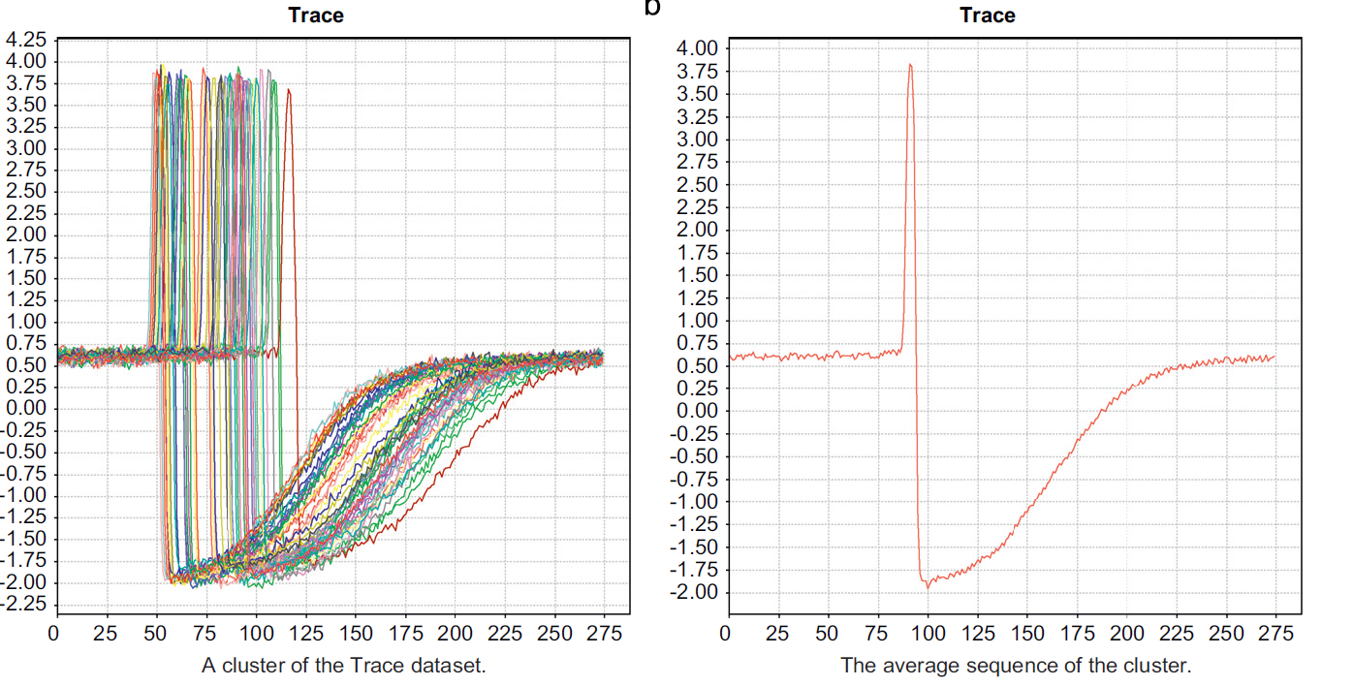

Slide 6
DTW Barycenter Averaging (DBA)
Compute multiple series averaging with DTW

Slide 7
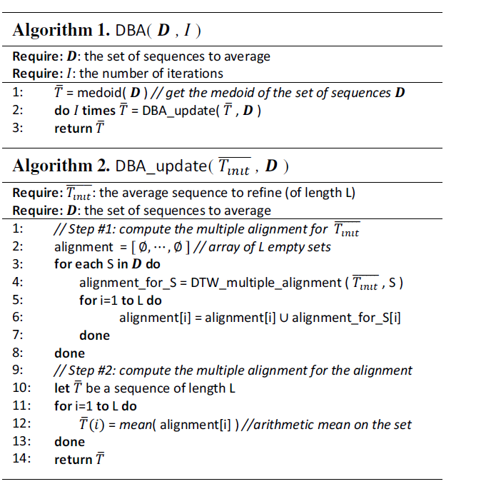
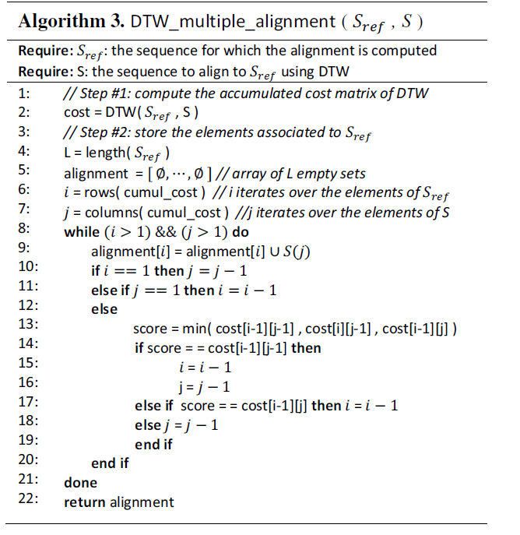

Slide 8

$\overline{T}=D_{i}$(隨機選,選到$D_{2}$)
$D_{1}=\left(1,3,4,5\right)$
$D_{2}=\left(2,1,3,2\right)$
$D_{3}=(1,4,3,1)$
Alignment2 = $\text{\{}∅,∅\text{,} ∅\text{,}∅\text{\}}$
$\text{Alignment}\text{3 = \{}∅,∅\text{,} ∅\text{,}\{3\}\text{\}}$
 | 1 | 3 | 4 | 3
2 | 1 | 1 | 4 | 1
1 | 0 | 4 | 9 | 4
3 | 4 | 0 | 1 | 1
2 | 1 | 1 | 4 | 1

Slide 9

$\overline{T}=D_{i}$
$D_{1}=\left(1,3,4,5\right)$
$D_{2}=\left(2,1,3,2\right)$
$D_{3}=(1,4,3,1)$
Alignment2 = $\text{\{}∅,∅\text{,} ∅\text{,}∅\text{\}}$
$\text{Alignment}\text{3 = \{}∅,∅\text{,} \{4\}\text{,}\{3\}\text{\}}$
 | 1 | 3 | 4 | 3
2 | 1 | 1 | 4 | 1
1 | 0 | 4 | 9 | 4
3 | 4 | 0 | 1 | 1
2 | 1 | 1 | 4 | 1

Slide 10

$\overline{T}=D_{i}$
$D_{1}=\left(1,3,4,5\right)$
$D_{2}=\left(2,1,3,2\right)$
$D_{3}=(1,4,3,1)$
Alignment2 = $\text{\{}∅,∅\text{,} ∅\text{,}∅\text{\}}$
$\text{Alignment}\text{3 = \{}∅,∅\text{,} \{3,4\}\text{,}\{3\}\text{\}}$
 | 1 | 3 | 4 | 3
2 | 1 | 1 | 4 | 1
1 | 0 | 4 | 9 | 4
3 | 4 | 0 | 1 | 1
2 | 1 | 1 | 4 | 1

Slide 11

$\overline{T}=D_{i}$
$D_{1}=\left(1,3,4,5\right)$
$D_{2}=\left(2,1,3,2\right)$
$D_{3}=(1,4,3,1)$
Alignment2 = $\text{\{}∅,∅\text{,} ∅\text{,}∅\text{\}}$
$\text{Alignment}\text{3 = \{}∅,\{1\}\text{,} \{3,4\}\text{,}\{3\}\text{\}}$
 | 1 | 3 | 4 | 3
2 | 1 | 1 | 4 | 1
1 | 0 | 4 | 9 | 4
3 | 4 | 0 | 1 | 1
2 | 1 | 1 | 4 | 1

Slide 12
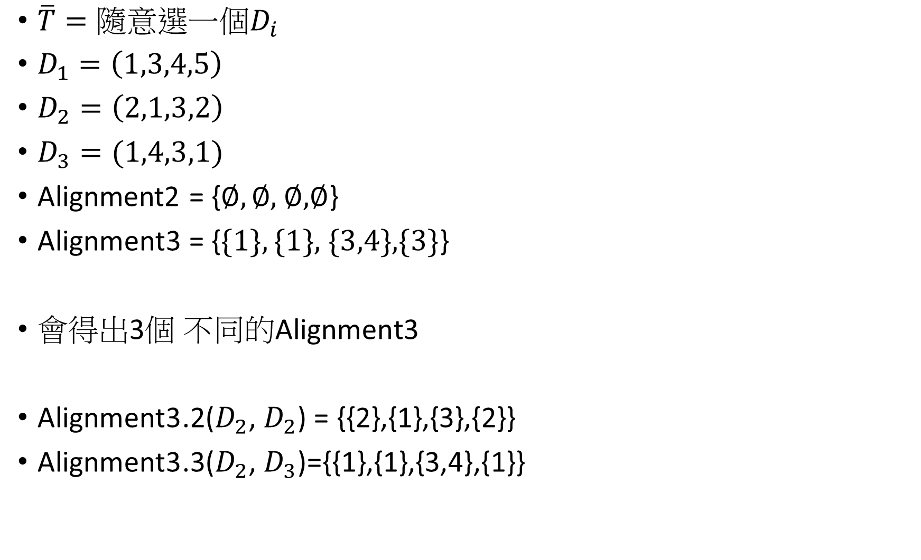
$\overline{T}={隨意選一個D}_{i}$
$D_{1}=\left(1,3,4,5\right)$
$D_{2}=\left(2,1,3,2\right)$
$D_{3}=(1,4,3,1)$
Alignment2 = $\text{\{}∅,∅\text{,} ∅\text{,}∅\text{\}}$
$\text{Alignment}\text{3 = \{}\{1\},\{1\}\text{,} \{3,4\}\text{,}\{3\}\text{\}}$
會得出3個 不同的$\text{Alignment}\text{3}$
$\text{Alignment}\text{3}$.2($D_{2}$, $D_{2}$) = {{2},{1},{3},{2}}
$\text{Alignment}\text{3}$.3($D_{2}$, $D_{3}$)={{1},{1},{3,4},{1}}
 | 1 | 3 | 4 | 3
2 | 1 | 1 | 4 | 1
1 | 0 | 4 | 9 | 4
3 | 4 | 0 | 1 | 1
2 | 1 | 1 | 4 | 1

Slide 13

Alignment2 =$\text{Alignment}3∪\text{Alignment}\text{3.2}$ $∪\text{Alignment}\text{3.3}$
Alignment2 = {{1,2},{1},{3,4},{1,2,3}}
$\overline{T}=$ {{1.5},{1},{3.5},{2}}

Slide 14
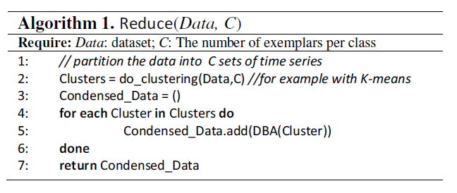
Reduce
Reducing the data cardinality
Reducing the data dimensionality
Reducing the number of objects the nearest neighbor
algorithm(DBA)

Slide 15

Experiment
Data Drop{X} : numerosity reduction
Simple Rank (SR) : using leave-one-out 1-NNclassification
k-medoids (找中位數)
K-Means(找平均值)

Slide 16
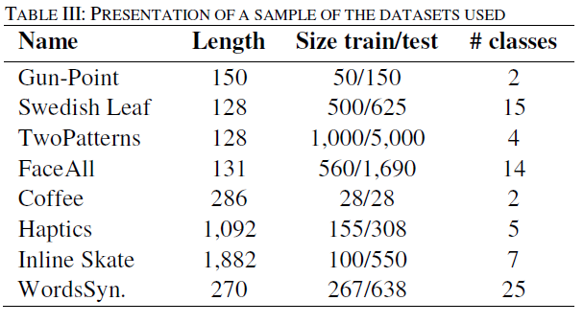

Slide 17
