Slide 1
Computing Research Repository (CoRR), 2012 Andy Nguyen
Solving Cyclic Longest Common Subsequence in Quadratic Time
Presenter：Wei-Hao Fu
Date：2017/ 03/ 31
Notes:
1

Slide 2
Abstract
We present a practical algorithm for the cyclic longest common subsequence (CLCS) problem that runs in O(mn) time, where m and n are the lengths of the two input strings. While this is not necessarily an asymptotic improvement over the existing record, it is far simpler to understand and to implement.

Slide 3
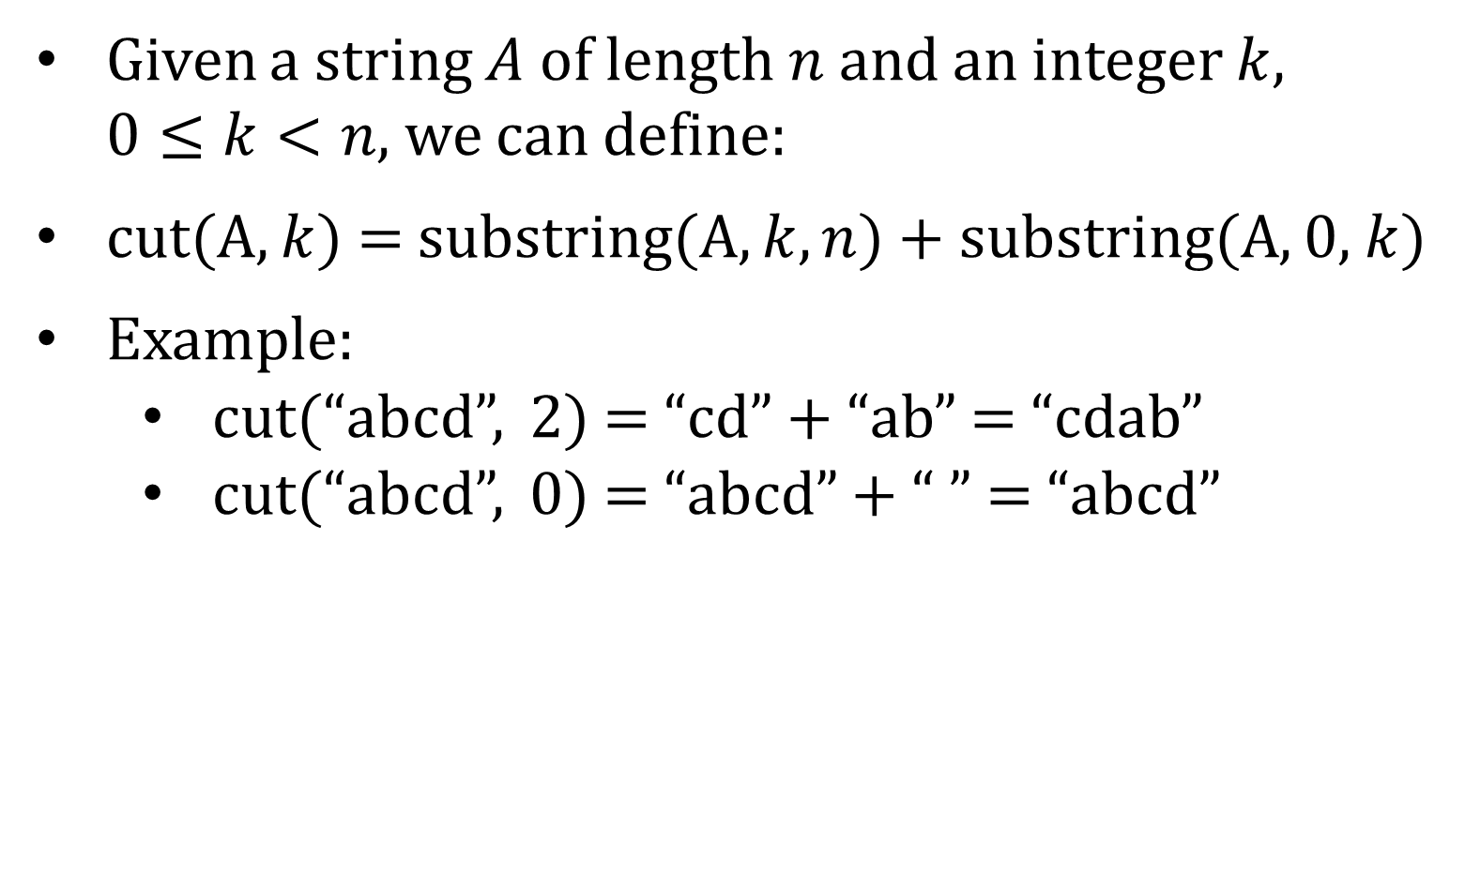
Cyclic LCS (CLCS) (1/2)
Given a string $A$ of length $n$ and an integer $k$, $0≤k<n,$ we can define:
cut(A, $k$) = substring(A, $k, n$) + substring(A, 0, $k$)
Example:
cut(“abcd”, 2) = “cd” + “ab” = “cdab”
cut(“abcd”, 0) = “abcd” + “ ” = “abcd”

Slide 4

Cyclic LCS (CLCS) (2/2)
CLCS(A, B) = LCS(cut(A, i), cut(B, j)), for some integers i and j. → $O\left(m^{2}n^{2}\right)$
CLCS(A, B) = LCS(cut(A, i), B), for some integers i. → $O(m^{2}n)$

Slide 5
Algorithm
 |  | A | B | A | B | B
 | 0 | 0 | 0 | 0 | 0 | 0
B | 0 | 0 | 1 | 1 | 1 | 1
B | 0 | 0 | 1 | 1 | 2 | 2
A | 0 | 1 | 1 | 2 | 2 | 2
A | 0 | 1 | 1 | 2 | 2 | 2
P = “BBAA”
Q = “ABABB”

Slide 6
Algorithm
 |  | A | B | A | B | B
 | 0 | 0 | 0 | 0 | 0 | 0
B | 0 | 0 | 1 | 1 | 1 | 1
B | 0 | 0 | 1 | 1 | 2 | 2
A | 0 | 1 | 1 | 2 | 2 | 2
A | 0 | 1 | 1 | 2 | 2 | 2
P = “BBAA”
Q = “ABABB”

Slide 7
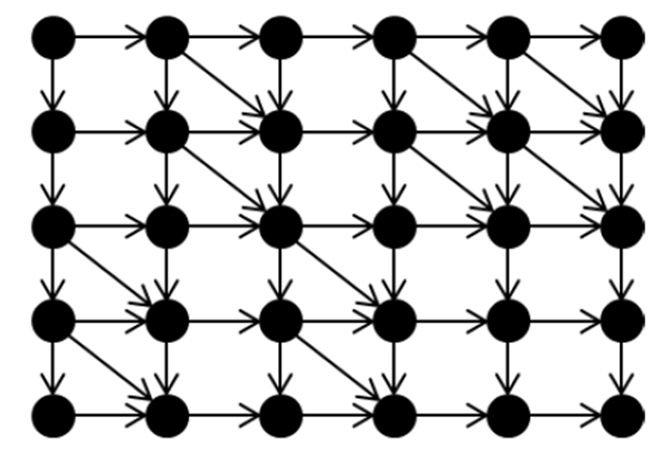
Algorithm
 |  | A | B | A | B | B
 | 0 | 0 | 0 | 0 | 0 | 0
B | 0 | 0 | 1 | 1 | 1 | 1
B | 0 | 0 | 1 | 1 | 2 | 2
A | 0 | 1 | 1 | 2 | 2 | 2
A | 0 | 1 | 1 | 2 | 2 | 2
P = “BBAA”
Q = “ABABB”

Slide 8
Algorithm
 |  | A | B | A | B | B
 | 0 | 0 | 0 | 0 | 0 | 0
B | 0 | 0 | 1 | 1 | 1 | 1
B | 0 | 0 | 1 | 1 | 2 | 2
A | 0 | 1 | 1 | 2 | 2 | 2
A | 0 | 1 | 1 | 2 | 2 | 2
B | 0 | 1 | 2 | 2 | 3 | 3
B | 0 | 1 | 2 | 2 | 3 | 4
A | 0 | 1 | 2 | 3 | 3 | 4
A | 0 | 1 | 2 | 3 | 3 | 4

Slide 9
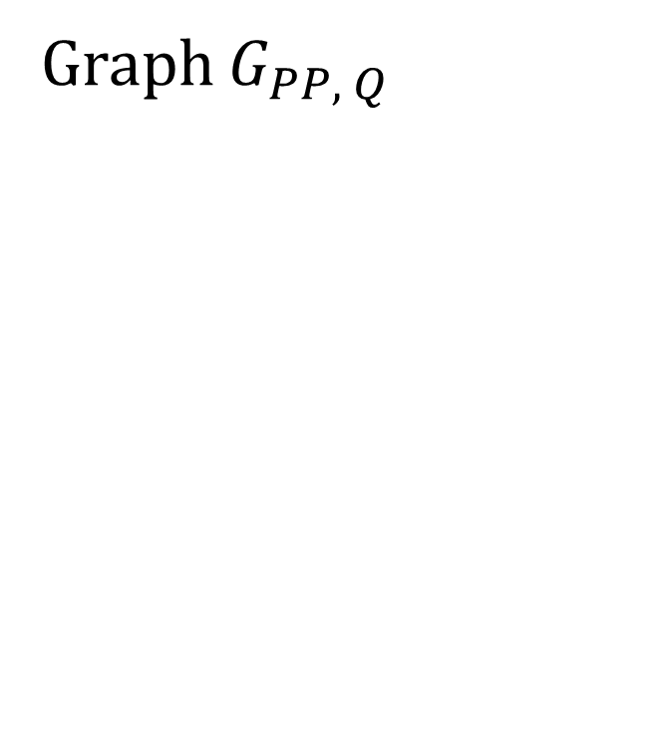
Algorithm
 |  | A | B | A | B | B
 | 0 | 0 | 0 | 0 | 0 | 0
B | 0 | 0 | 1 | 1 | 1 | 1
B | 0 | 0 | 1 | 1 | 2 | 2
A | 0 | 1 | 1 | 2 | 2 | 2
A | 0 | 1 | 1 | 2 | 2 | 2
B | 0 | 1 | 2 | 2 | 3 | 3
B | 0 | 1 | 2 | 2 | 3 | 4
A | 0 | 1 | 2 | 3 | 3 | 4
A | 0 | 1 | 2 | 3 | 3 | 4
Graph $G_{PP, Q}$

Slide 10
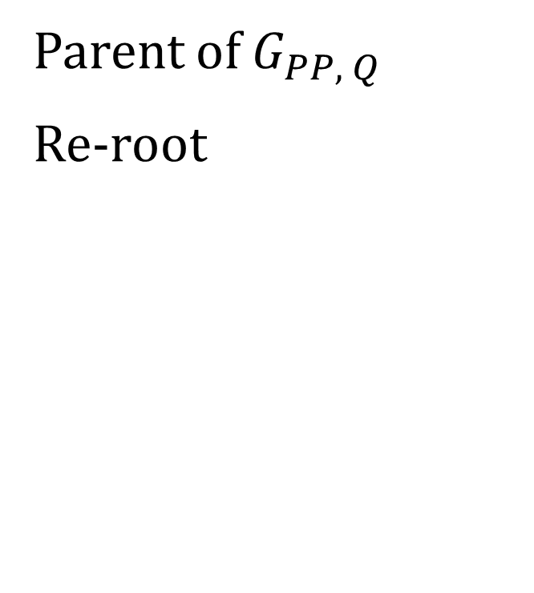
Algorithm
 |  | A | B | A | B | B
B
B
A
A
B
B
A
A
Parent of $G_{PP, Q}$
Re-root

Slide 11
Algorithm
 |  | A | B | A | B | B
B
B
A
A
B
B
A
A
Initial

Slide 12
Algorithm
 |  | A | B | A | B | B
B
B
A
A
B
B
A
A
Step 1

Slide 13
Algorithm
 |  | A | B | A | B | B
B
B
A
A
B
B
A
A
Step 1

Slide 14
Algorithm
 |  | A | B | A | B | B
B
B
A
A
B
B
A
A
Step 1

Slide 15
Algorithm
 |  | A | B | A | B | B
B
B
A
A
B
B
A
A
Step 1

Slide 16
Algorithm
 |  | A | B | A | B | B
B
B
A
A
B
B
A
A
Step 1

Slide 17
Algorithm
 |  | A | B | A | B | B
B
B
A
A
B
B
A
A
Step 2

Slide 18
Algorithm
 |  | A | B | A | B | B
B
B
A
A
B
B
A
A
Step 2

Slide 19
Algorithm
 |  | A | B | A | B | B
B
B
A
A
B
B
A
A
Step 2

Slide 20
Algorithm
 |  | A | B | A | B | B
B
B
A
A
B
B
A
A
Step 2

Slide 21
Algorithm
 |  | A | B | A | B | B
B
B
A
A
B
B
A
A
Step 2

Slide 22
Algorithm
 |  | A | B | A | B | B
B
B
A
A
B
B
A
A
Step 3

Slide 23
Algorithm
 |  | A | B | A | B | B
B
B
A
A
B
B
A
A
Step 3

Slide 24
Algorithm
 |  | A | B | A | B | B
B
B
A
A
B
B
A
A
Step 3

Slide 25
Algorithm
 |  | A | B | A | B | B
B
B
A
A
B
B
A
A
Step 3

Slide 26
Algorithm
 |  | A | B | A | B | B
B
B
A
A
B
B
A
A
Step 3

Slide 27
Algorithm
 |  | A | B | A | B | B
B
B
A
A
B
B
A
A
Step 3

Slide 28
Algorithm
 |  | A | B | A | B | B
B
B
A
A
B
B
A
A
Step 3

Slide 29
Algorithm
 |  | A | B | A | B | B
B
B
A
A
B
B
A
A
Final

