Slide 1
Stock Price Prediction Using Reinforcement Learning
Jae Won Lee
Proceeding of International Society for Industrial Ecology, Leiden Netherlands, 2001.
IEEE International Symposium on, Volume 1
Presentor: Shih-Jhan Huang
Date: 2017/3/31

Slide 2
Abstract(1/2)
Recently, numerous investigations for stock price prediction and portfolio management using machine learning have been trying to develop efficient mechanical trading systems. But these systems have a limitation in that they are mainly based on the supervised learning which is not so adequate for learning problems with long-term goals and delayed rewards. This paper proposes a method of applying reinforcement learning, suitable for modeling and learning various kinds of interactions in real situations, to the problem of stock price prediction.

Slide 3
Abstract(2/2)
The stock price prediction problem is considered as Markov process which can be optimized by reinforcement learning based algorithm. TD(0), a reinforcement learning algorithm which learns only from experiences, is adopted and function approximation by artificial neural network is performed to learn the values of states each of which corresponds to a stock price trend at a given time. An experimental result based on the Korean stock market is presented to evaluate the performance of the proposed method.

Slide 4
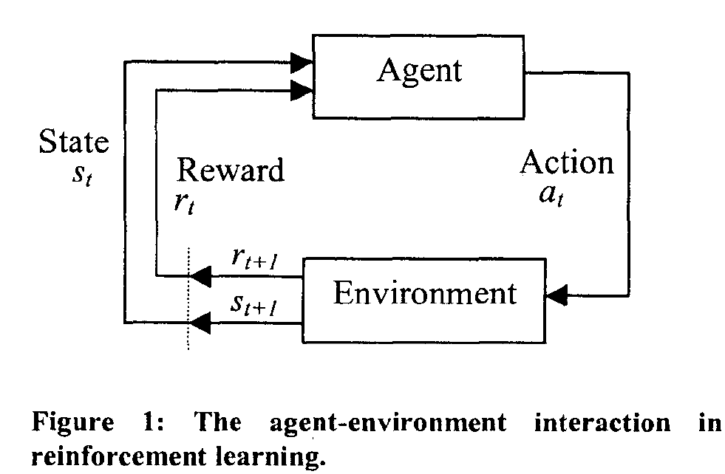
Reinforcement Learning
r_{t+1} = r(s_{t}, a_{t})
s_{t+1} = δ(s_{t}, a_{t})
r(s_{t}, a_{t})、δ(s_{t}, a_{t}) depend only on the current state and action, not on earlier states or actions.

Slide 5
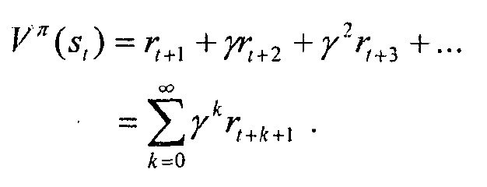
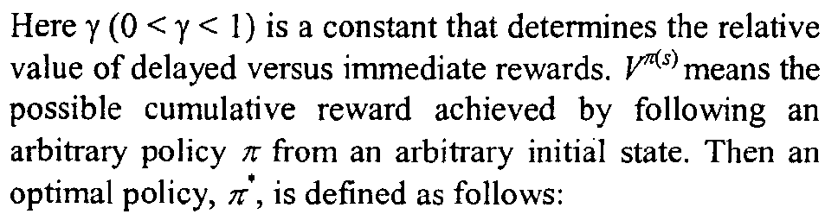
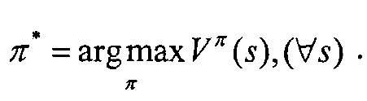
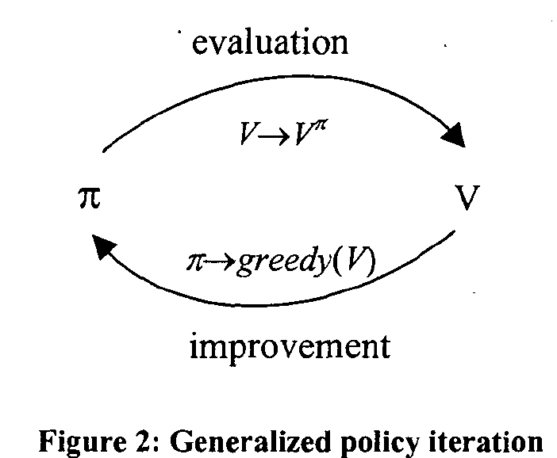

Slide 6
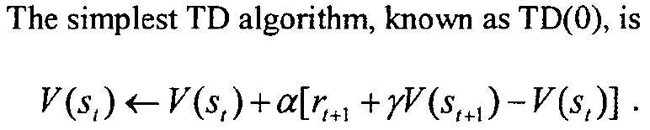
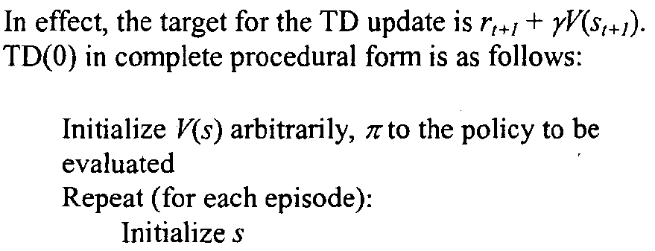
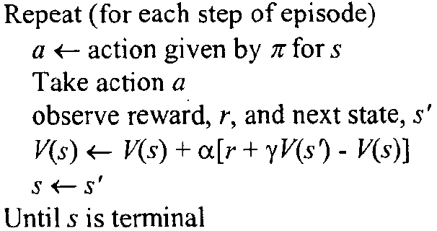
Temporal-difference (TD) Algorithm
If ϒ = 0:
only the immediate reward.
the price rate of change of the next day, is reflected to the values.
y close to 0 is suitable for short-term prediction.
if ϒ = 1:
all the rewards after the state are treated equally regardless of the temporal distance from that state
y close to 1 is suitable for long-term prediction.

Slide 7
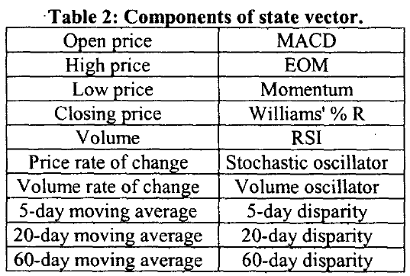
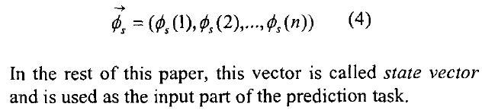
State

Slide 8
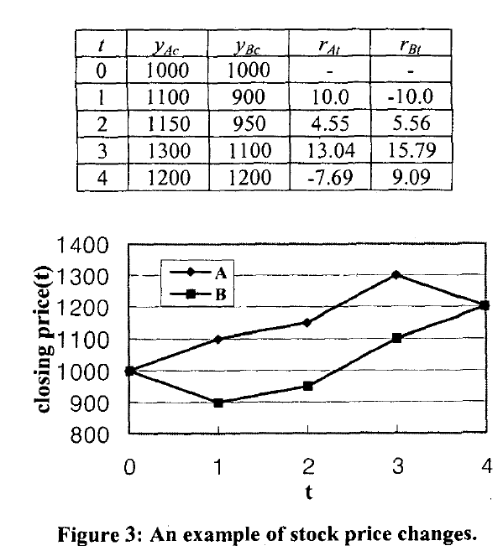
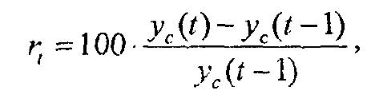
Reward

Slide 9
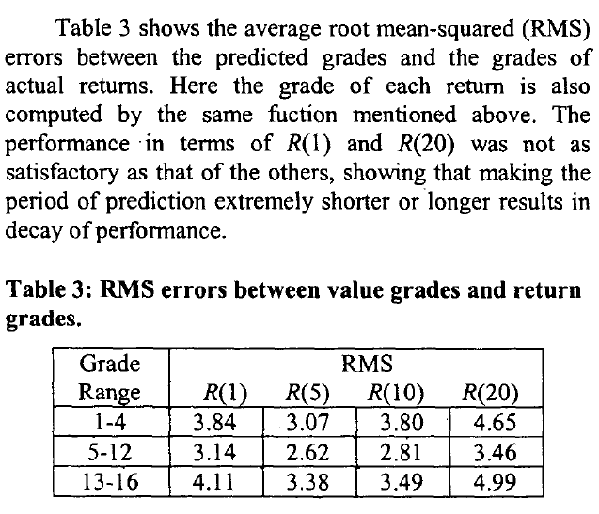
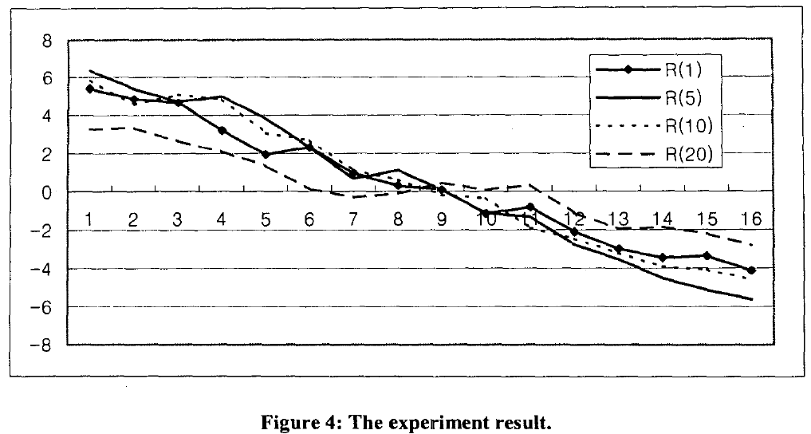
Experimental Result
?

