Slide 1
Longest common substrings with k mismatches
Tomas Flouri, Emanuele Giaquinta, Kassian Kobert,
Esko Ukkonen
Information Processing Letters
Volume 115, Issues 6–8, June–August 2015, Pages 643–647
Presenter: Shou-Fu Lo
Date:2017/03/31

Slide 2
Abstract
The longest common substring with k-mismatches problem is to ﬁnd, given two strings S₁ and S₂, a longest substring A₁ of S₁ and A₂ of S₂ such that the Hamming distance between A₁ and A₂ is ≤ k. We introduce a practical O (nm) time and O (1) space solution for this problem, where n and m are the lengths of S₁ and S₂, respectively. This algorithm can also be used to compute the matching statistics with k-mismatches of S₁ and S₂ in O (nm) time and O (m) space. Moreover, we also present a theoretical solution for the k = 1 case which runs in O (n log m) time, assuming m ≤ n, and uses O (m) space, improving over the existing O (nm) time and O (m) space bound of Babenko and Starikovskaya [1].

Slide 3
Longest common substrings with k mismatches (k-LCF)
find a pair of strings S₁[i₁ ... i₁ + m− 1] and S₂[i₂ ... i₂ + m − 1] such that S₁[i₁ ... i₁ + m − 1] and S₂[i₂ ... i₂ + m− 1] differ in at most k positions and the string length m is maximized.
(i.e., |{i₁ ≤ pos ≤ i₁ + m −1 : S₁[pos] = S₂[pos+(i₂ − i₁)]}| ≤ k)
k=2
S₁ = b a f a d a
S₂ = a b c d a a

Slide 4
Longest common substrings with k mismatches
The idea is to iterate over the φ matrix diagonal-wise and compute, for a ﬁxed(i, j) ∈ {(0, 0), (0, 1), . . . , (0, m − 1)} ∪{(1, 0), (2, 0), . . . , (n − 1, 0)}, the values φ (i + p, j + p), for 0 ≤ p < min(n − i, m − j), i.e., the diagonal starting at (i, j).
k=2
S₁ = b a f a d a
S₂ = a b c d a a
(i, j) | (0, 1) | (1, 2) | (2, 3) | (3, 4) | (4, 5)
p | 0 | 1 | 2 | 3 | 4
start | 0 | 0 | 0 | 0 | 2
queue | empty | 1 | 1->2 | 1->2 | 2->4
maxlength | 1 | 2 | 3 | 4 | 4

Slide 5
Longest common substrings with k mismatches
O (nm) time and O (k) space, as the queue contains at most k elements at any iteration.

Slide 6
Longest common substrings with 1 mismatches
Given a string S, a pair of substrings ((p₁, q₁), (p₂, q₂)) of S is a repeated pair if S[p₁..q₁] =S[p₂..q₂]. A repeated pair ((p₁, q₁), (p₂, q₂)) is left-maximal (right-maximal) if S[p₁ − 1] ≠ S[p₂ − 1] (S[q₁ + 1] ≠ S[q₂ + 1]).
S = x x a b c x y a b c y x

Slide 7
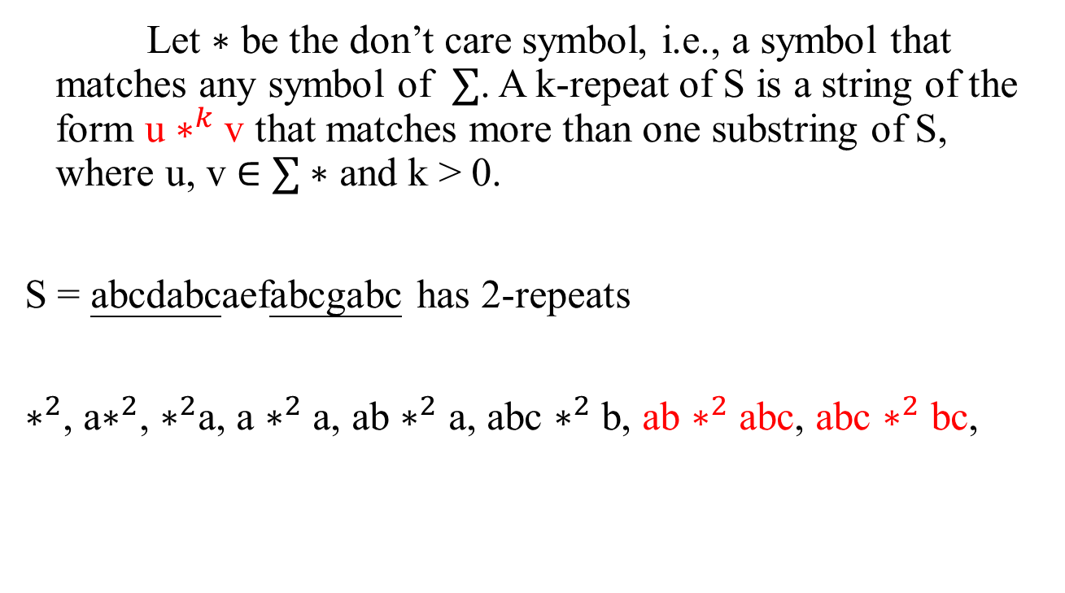
The longest k-repeats problem
Let ∗ be the don’t care symbol, i.e., a symbol that matches any symbol of $∑$. A k-repeat of S is a string of the form u $∗^{k}$v that matches more than one substring of S, where u, v ∈ $∑$∗ and k > 0.
S = abcdabcaefabcgabc has 2-repeats
$∗^{2}$, a$∗^{2}$, $∗^{2}$a, a $∗^{2}$ a, ab $∗^{2}$ a, abc $∗^{2}$ b, ab $∗^{2}$ abc, abc $∗^{2}$ bc,
Longest repeats with a block of k don’t cares
Maxime Crochemore, Costas S. Iliopoulos, Manal Mohamed, Marie-France Sagot
Theoretical Computer Science 362 (2006) 248 – 254

Slide 8

The longest k-repeats problem
In fact, all right-maximal repeats in x are represented naturally by the suffix tree of S.
Similarly, all left-maximal repeats of x are represented by the suffix tree of $\overset{⃖}{S}.$
Longest repeats with a block of k don’t cares
Maxime Crochemore, Costas S. Iliopoulos, Manal Mohamed, Marie-France Sagot
Theoretical Computer Science 362 (2006) 248 – 254

Slide 9
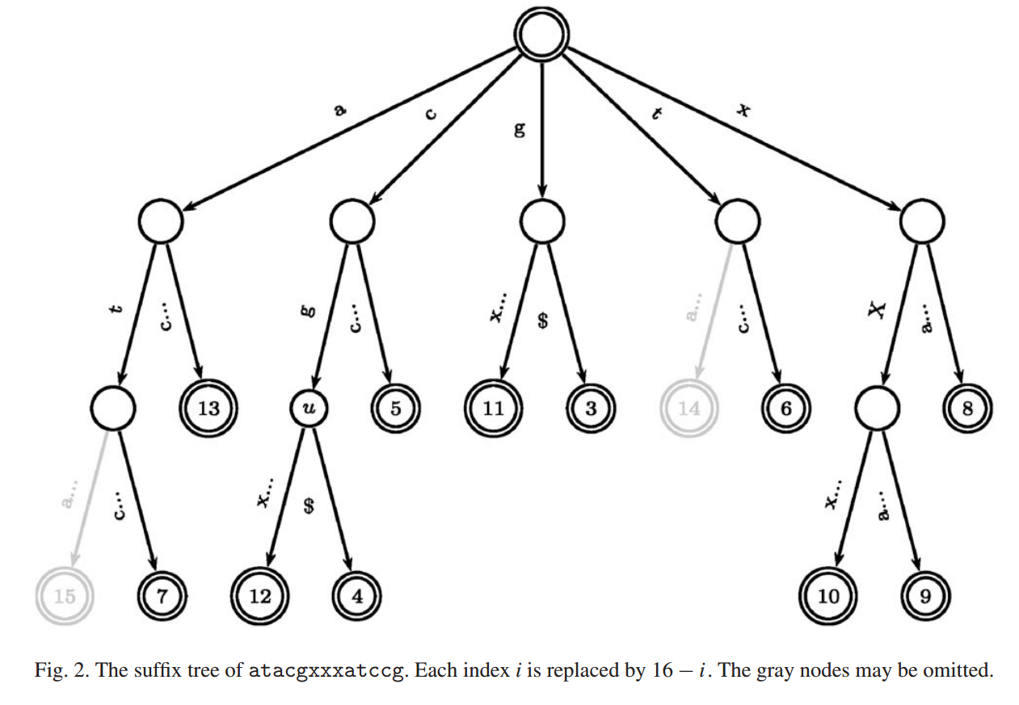
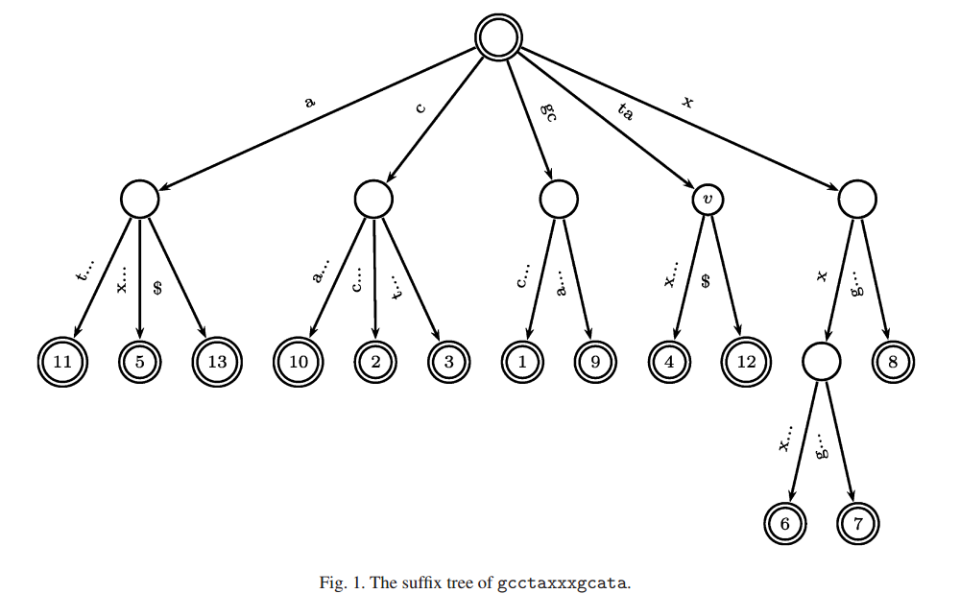
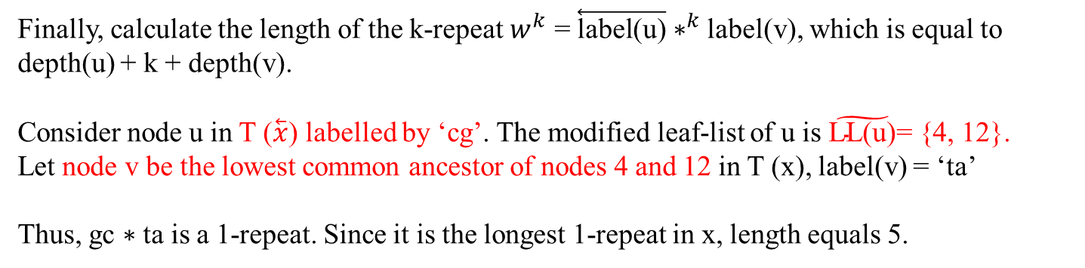
The longest k-repeats problem
If k = 1 and S = gcctaxxxgcata
Finally, calculate the length of the k-repeat $w^{k}$ = $\overset{⃖}{\text{label}\text{(}\text{u}\text{)}}$ $∗^{k}$ label(v), which is equal to depth(u) + k + depth(v).
Consider node u in T ($\overset{⃖}{x}\text{)}$ labelled by ‘cg’. The modified leaf-list of u is $\tilde{\text{LL}\text{(}\text{u}\text{)}}$= {4, 12}.
Let node v be the lowest common ancestor of nodes 4 and 12 in T (x), label(v) = ‘ta’
Thus, gc ∗ ta is a 1-repeat. Since it is the longest 1-repeat in x, length equals 5.

Slide 10
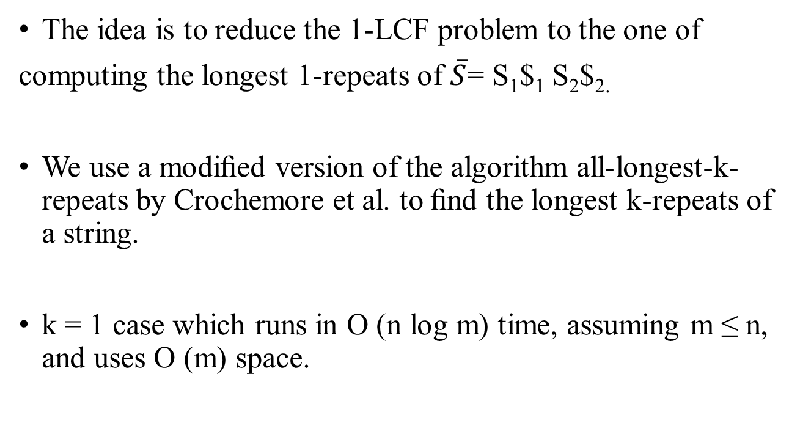
Longest common substrings with 1 mismatches
The idea is to reduce the 1-LCF problem to the one of
computing the longest 1-repeats of $\overline{S}$= S₁$₁ S₂$_{2.}
We use a modiﬁed version of the algorithm all-longest-k-repeats by Crochemore et al. to ﬁnd the longest k-repeats of a string.
k = 1 case which runs in O (n log m) time, assuming m ≤ n, and uses O (m) space.

