Slide 1
A Latent Source Model for Nonparametric Time Series Classification
George H. Chen, Stanislav Nikolov, Devavrat Shah
Proceedings of Neural Information Processing Systems (NIPS), Harrah’s and Harvey’s, Lake Tahoe, USA, December, 2013
Presenter : Bo-Xian Chen
Date : 2017/4/11

Slide 2
Abstract(1/2)
For classifying time series, a nearest-neighbor approach is widely used in practice with performance often competitive with or better than more elaborate methods such as neural networks, decision trees, and support vector machines. We develop theoretical justification for the effectiveness of nearest-neighbor-like classification of time series. Our guiding hypothesis is that in many applications, such as forecasting which topics will become trends on Twitter, there aren’t actually that many prototypical time series to begin with, relative to the number of time series we have access to, e.g., topics become trends on Twitter only in a few distinct manners whereas we can collect massive amounts of Twitter data.

Slide 3
Abstract(2/2)
To operationalize this hypothesis, we propose a latent source model for time series, which naturally leads to a “weighted majority voting” classification rule that can be approximated by a nearest-neighbor classifier. We establish nonasymptotic performance guarantees of both weighted majority voting and nearest-neighbor classification under our model accounting for how much of the time series we observe and the model complexity. Experimental results on synthetic data show weighted majority voting achieving the same misclassification rate as nearest-neighbor classification while observing less of the time series. We then use weighted majority to forecast which news topics on Twitter become trends, where we are able to detect such “trending topics” in advance of Twitter 79% of the time, with a mean early advantage of 1 hour and 26 minutes, a true positive rate of 95%, and a false positive rate of 4%.

Slide 4
Procedure
Method :
Nearest-Neighbor Classification
Weighted Majority Voting
Maximum a posteriori (MAP)
Goal :
Predicting whether a topic is going to be a trend before it is actually declared to be a trend by Twitter (“trend” or “not trend”). That is , given a time series s, we want to classify it as having either +1(“trend”) or -1(“not trend”).

Slide 5
A Latent Source Model
E.g.

Slide 6
A Latent Source Model
E.g.
臺北市大運

Slide 7
A Latent Source Model
E.g.
臺北市大運 → 柯P跌倒

Slide 8
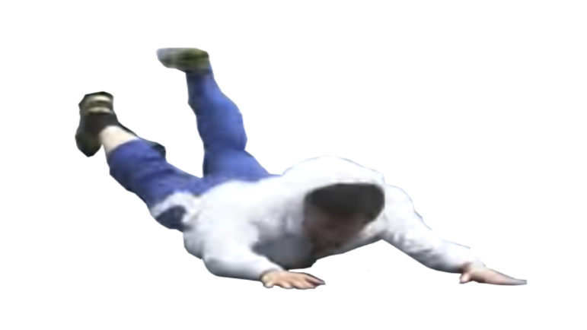
A Latent Source Model
E.g.
臺北市大運 → 柯P跌倒

Slide 9
A Latent Source Model
E.g.
臺北市大運 → 柯P跌倒
動物朋友→

Slide 10
A Latent Source Model
E.g.
臺北市大運 → 柯P跌倒
動物朋友→ 哇，是個擅長___的朋友呢!

Slide 11
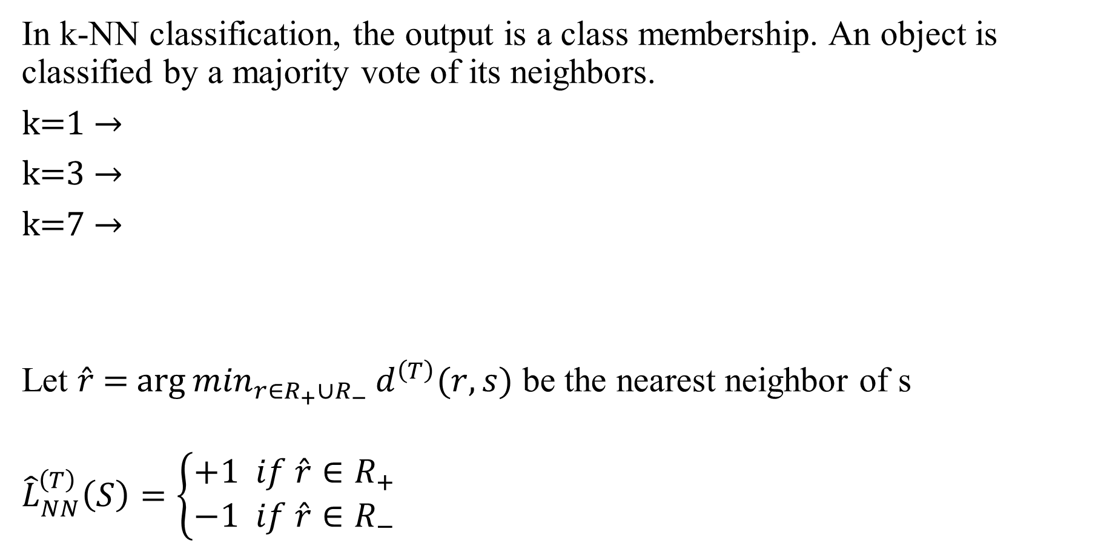
Nearest-neighbor classifier
In k-NN classification, the output is a class membership. An object is classified by a majority vote of its neighbors.
k=1 →
k=3 →
k=7 →
Let $\hat{r}$ = ${\arg{min}}_{r∈R_{+}∪R_{−}}d^{\left(T\right)}(r,s)$ be the nearest neighbor of s
$${\hat{L}}_{NN}^{\left(T\right)}\left(S\right)=\left\{\begin{aligned}+1 if \hat{r}∈R_{+} \\ −1 if \hat{r}∈R_{−}\end{aligned}\right.$$
?

Slide 12
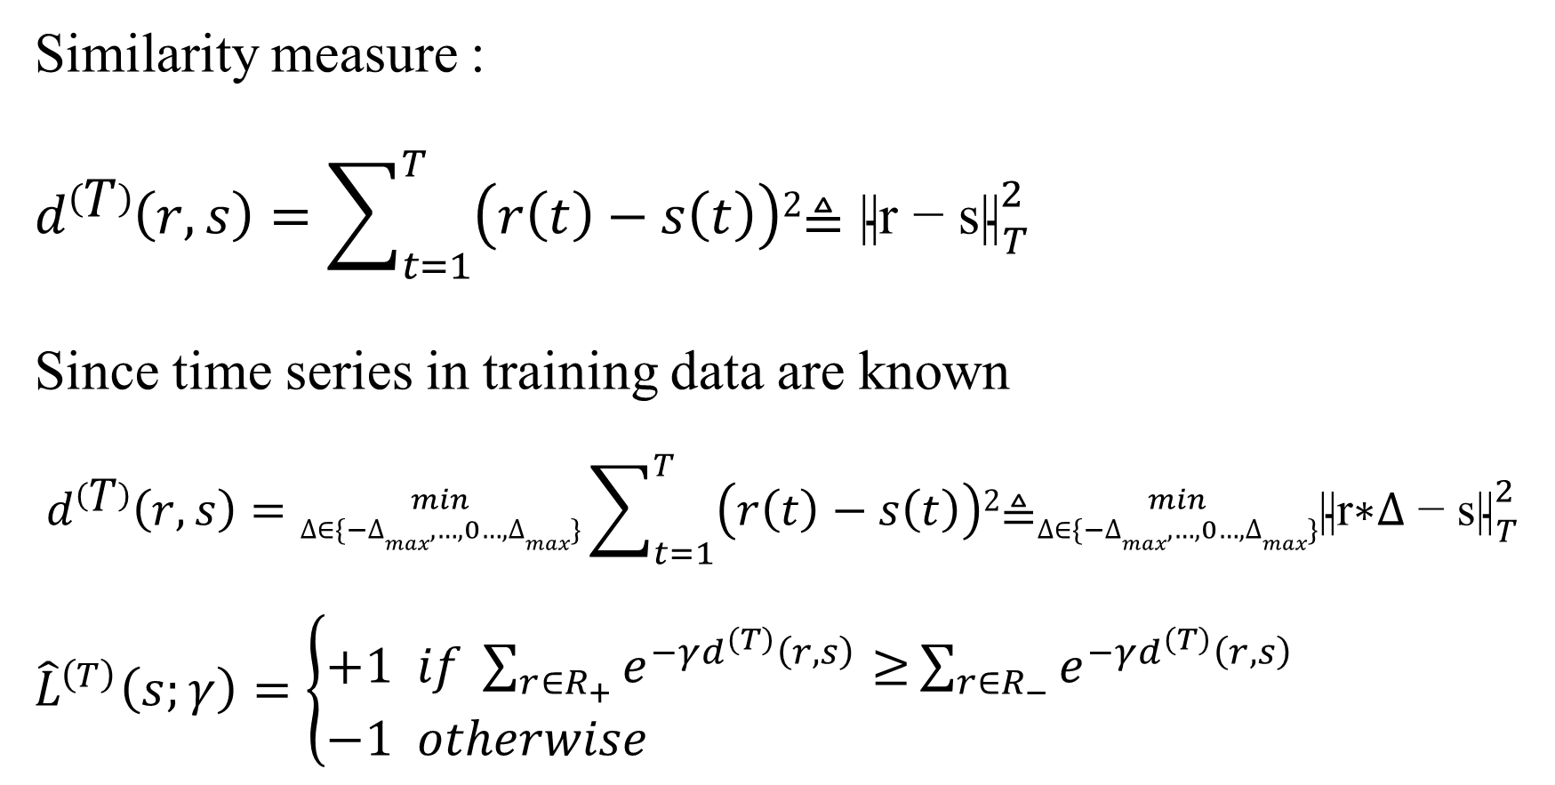
Weighted Majority Voting
+1
Similarity measure :
$$d\left(T\right)\left(r, s\right)=\sum_{t=1}^{T}{\left(r\left(t\right)−s\left(t\right)\right)2\text{≜ }{\text{||}\text{r}\text{ − }\text{s}\text{||}}_{T}^{2} }$$
Since time series in training data are known
$$d\left(T\right)\left(r, s\right)={min \atop ∆∈\{−∆max,…,0…,∆max\}}\sum_{t=1}^{T}{\left(r\left(t\right)−s\left(t\right)\right)2\text{≜}{min \atop ∆∈\{−∆max,…,0…,∆max\}}{\text{||}\text{r}\text{∗}∆\text{ − }\text{s}\text{||}}_{T}^{2} }$$
${\hat{L}}^{\left(T\right)}\left(s;γ\right)=\left\{\begin{aligned}&+1 if \sum_{r∈R_{+}}{e^{−γd^{\left(T\right)}\left(r,s\right)}≥}\sum_{r∈R_{−}}{e^{−γd^{\left(T\right)}\left(r,s\right)}} \\ &−1 otherwise\end{aligned}\right.$
-1
?

Slide 13
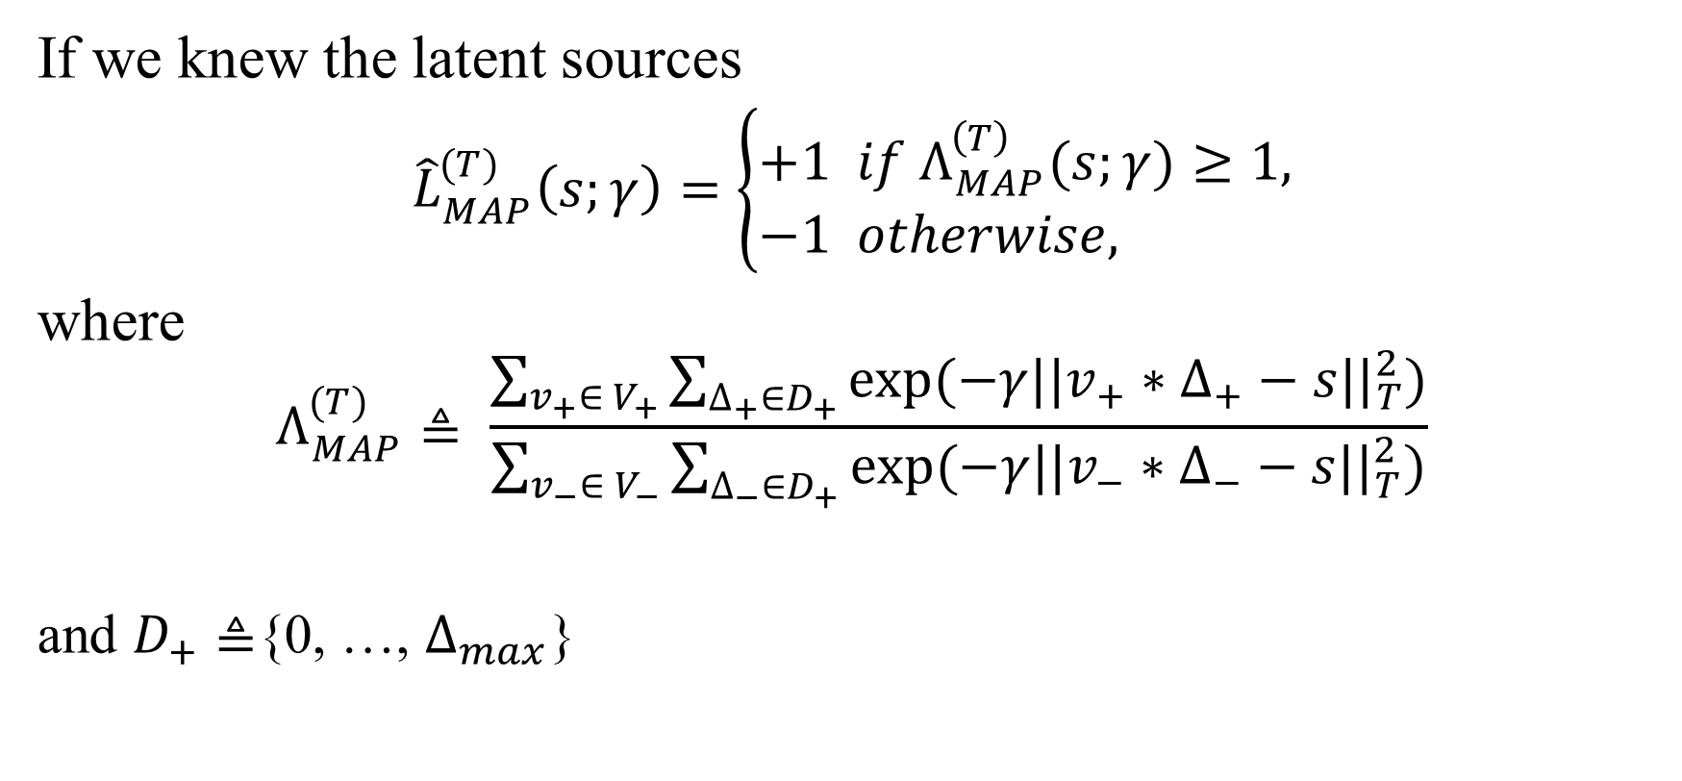
Maximum a posteriori (MAP)
If we knew the latent sources
${\hat{L}}_{MAP}^{(T)}\left(s;γ\right)=\left\{\begin{aligned}&+1 if Λ_{MAP}^{\left(T\right)}(s;γ)≥1, \\ &−1 otherwise,\end{aligned}\right.$
where
$$Λ_{MAP}^{(T)}≜ \frac{\sum_{v_{+}∈ V_{+}}{\sum_{∆_{+}∈D_{+}}{exp⁡(−γ||v_{+}∗∆_{+}−s{||}_{T}^{2})}}}{\sum_{v_{−}∈ V_{−}}{\sum_{∆_{−}∈D_{+}}{exp⁡(−γ||v_{−}∗∆_{−}−s{||}_{T}^{2}}})}$$
and $D_{+}≜${0, …, $∆_{max}$}

Slide 14
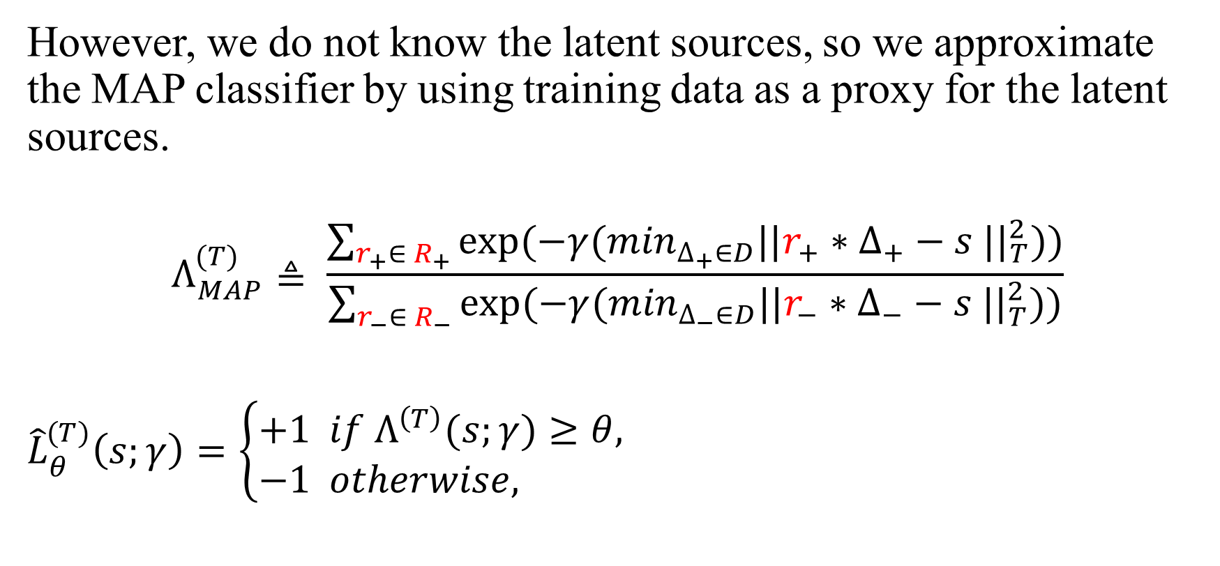
Maximum a posteriori (MAP)
However, we do not know the latent sources, so we approximate the MAP classifier by using training data as a proxy for the latent sources.
$$Λ_{MAP}^{(T)}≜ \frac{\sum_{r_{+}∈ R_{+}}{exp⁡(−γ(\min_{∆_{+}∈D}||r_{+}∗∆_{+}−s {||}_{T}^{2}))}}{\sum_{r_{−}∈ R_{−}}{exp⁡(−γ(\min_{∆_{−}∈D}||r_{−}∗∆_{−}−s {||}_{T}^{2}))}}$$
${\hat{L}}_{θ}^{(T)}\left(s;γ\right)=\left\{\begin{aligned}&+1 if Λ^{\left(T\right)}(s;γ)≥θ, \\ &−1 otherwise,\end{aligned}\right.$

Slide 15
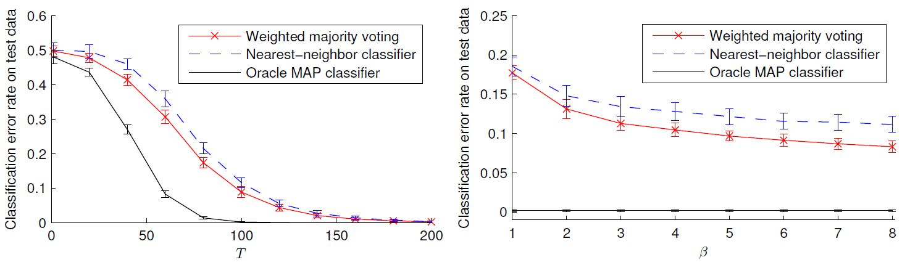


Results on Synthetic Data
n =$β$mlogm where$β$ =8
Classification error rate at T = 100 vs. $β$

Slide 16
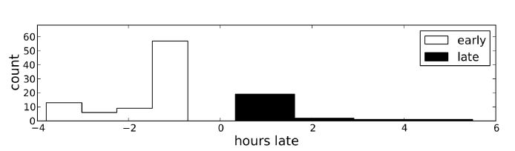
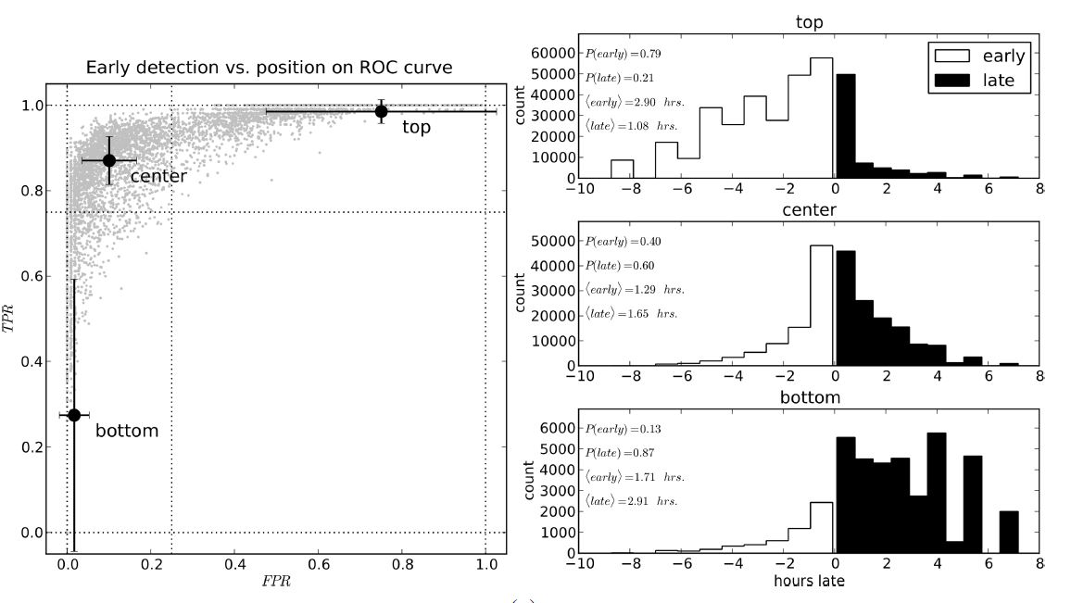
Results on Twitter data
Weighted majority voting
95% TPR
4% FPR
Notes:
TPR：在所有實際為陽性的樣本中，被正確地判斷為陽性之比率。
TPR=TP/(TP+FN)}
FPR：在所有實際為陰性的樣本中，被錯誤地判斷為陽性之比率。
FPR=FP/(FP+TN)}

Slide 19
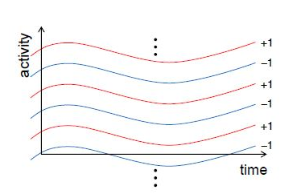
Latent Source Model
V denotes all latent sources with label, i.e.
V₊ ⊂ V : +1
V₋ ⊂ V : +1

