Slide 1
CLUSTAL W: improving the sensitivity of progressive multiple sequence alignment through sequence weighting, position-specific gap penalties and weight matrix choice
Julie D. Thompson
Desmond G. Higgins
Toby J. Gibson
Nucleic Acids Research, 1994, Vol. 22, No. 22 4673-4680
Presenter: Hsiu-Chieh Hung
Date: 2017/4/11

Slide 2
Abstract
The sensitivity of the commonly used progressive multiple sequence alignment method has been greatly improved for the alignment of divergent protein sequences. Firstly, individual weights are assigned to each sequence in a partial alignment in order to down-weight near-duplicate sequences and up-weight the most divergent ones. Secondly, amino acid substitution matrices are varied at different alignment stages according to the divergence of the sequences to be aligned. Thirdly, residue-specific gap penalties and locally reduced gap penalties in hydrophilic regions encourage new gaps in potential loop regions rather than regular secondary structure. Fourthly, positions in early alignments where gaps have been opened receive locally reduced gap penalties to encourage the opening up of new gaps at these positions. These modifications are incorporated into a new program, CLUSTAL W which is freely available.

Slide 3
Pairwise Alignment
 | A | B | C | D
A | - | 17 | 21 | 27
B |  | - | 12 | 18
C |  |  | - | 14
D |  |  |  | -

Slide 4









Neighbor-joining
 | A | B | C | D
A | - | 17 | 21 | 27
B |  | - | 12 | 18
C |  |  | - | 14
D |  |  |  | -
$u_{1}$ = (17+21+27) / (n-2) = 32.5
$u_{2}$ = (17+12+18) / (n-2) = 23.5
$u_{3}$ = (21+12+14) / (n-2) = 23.5
$u_{4}$ = (27+18+14) / (n-2) = 29.5
$$v_{i}=0.5∗D_{ij}+0.5∗(u_{i}−u_{j})$$
C
D
$$v_{j}=0.5∗D_{ij}+0.5∗(u_{j}−u_{i})$$
 | A | B | C | D
A | - | -39 | -35 | -35
B |  | - | -35 | -35
C |  |  | - | -39
D |  |  |  | -
$$v_{i}$$
$$v_{j}$$
X
$$D_{ij} − u_{i} − u_{j}$$

Slide 5
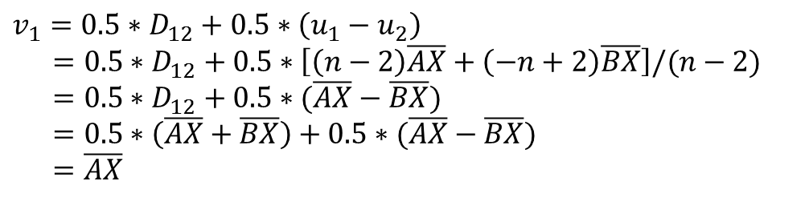




Neighbor-joining
$$v_{i}=0.5∗D_{ij}+0.5∗(u_{i}−u_{j})$$
$$v_{j}=0.5∗D_{ij}+0.5∗(u_{j}−u_{i})$$
$$u_{1}=\left[\left(n−1\right)\overline{AX}+\overline{BX}+\left(n−2\right)\overline{XY}+\overline{CY}+\overline{DY}\right]/(n−2)$$
$$u_{2}=\left[\left(n−1\right)\overline{BX}+\overline{AX}+\left(n−2\right)\overline{XY}+\overline{CY}+\overline{DY}\right]/(n−2)$$
A
C
$$v_{1}$$
$$v_{1}=0.5∗D_{12}+0.5∗\left(u_{1}−u_{2}\right)$$
$$=0.5∗D_{12}+0.5∗\left[\left(n−2\right)\overline{AX}+\left(−n+2\right)\overline{BX}\right]/(n−2)$$
$$=0.5∗D_{12}+0.5∗(\overline{AX}−\overline{BX})$$
$$=0.5∗\left(\overline{AX}+\overline{BX}\right)+0.5∗(\overline{AX}−\overline{BX})$$
$$=\overline{AX}$$
X
Y
$$v_{2}$$
B
D

Slide 6

Neighbor-joining
 | A | B | C | D
A | - | 17 | 21 | 27
B |  | - | 12 | 18
C |  |  | - | 14
D |  |  |  | -
$u_{1}$ = (17+21+27) / (n-2) = 32.5
$u_{2}$ = (17+12+18) / (n-2) = 23.5
$u_{3}$ = (21+12+14) / (n-2) = 23.5
$u_{4}$ = (27+18+14) / (n-2) = 29.5
$$v_{i}=0.5∗D_{ij}+0.5∗(u_{i}−u_{j})$$
C
D
$$v_{j}=0.5∗D_{ij}+0.5∗(u_{j}−u_{i})$$
 | A | B | C | D
A | - | -39 | -35 | -35
B |  | - | -35 | -35
C |  |  | - | -39
D |  |  |  | -
4
10
X
$$v_{3}=0.5∗D_{34}+0.5∗\left(u_{3}−u_{4}\right)=4$$
$$v_{4}=0.5∗D_{34}+0.5∗\left(u_{4}−u_{3}\right)=10$$
$$D_{ij} − u_{i} − u_{j}$$

Slide 7


Neighbor-joining
 | A | B | C | D
A | - | 17 | 21 | 27
B |  | - | 12 | 18
C |  |  | - | 14
D |  |  |  | -
C
D
4
10
X
 | A | B | X
A | - | 17 | 17
B |  | - | 8
X |  |  | -
$${D_{XA}=(D}_{CA}+D_{DA}−D_{CD})/2=17$$
$${D_{XB}=(D}_{CB}+D_{DB}−D_{CD})/2=8$$

Slide 8



Neighbor-joining
 | A | B | X
A | - | 17 | 17
B |  | - | 8
X |  |  | -
$u_{1}$ = (17+17) / (n-2) = 34
$u_{2}$ = (17+8) / (n-2) = 25
$u_{3}$ = (17+8) / (n-2) = 25
C
D
A
B
 | A | B | X
A | - | -42 | -28
B |  | - | -28
X |  |  | -
4
10
13
4
X
Y

Slide 9

Neighbor-joining
 | A | B | X
A | - | 17 | 17
B |  | - | 8
X |  |  | -
C
D
A
B
4
10
13
4
X
Y
 | X | Y
X | - | 4
Y |  | -
$${D_{YX}=(D}_{AX}+D_{BX}−D_{AB})/2=4$$

Slide 10
Neighbor-joining
 | X | Y
X | - | 4
Y |  | -
C
D
A
B
4
10
13
4
X
Y
4

Slide 11
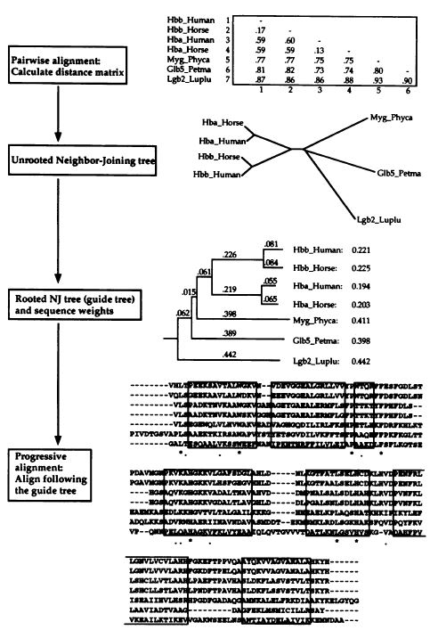
Pairwise alignment
Neighbor-joining
Guide tree : mid-point method
Progressive alignment

Slide 12
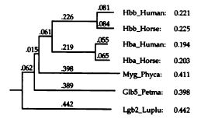
Guide Tree : mid-point method
The most divergent sequence gets highest weight.

Slide 13
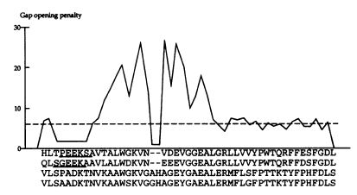
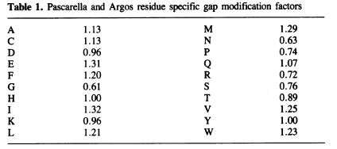
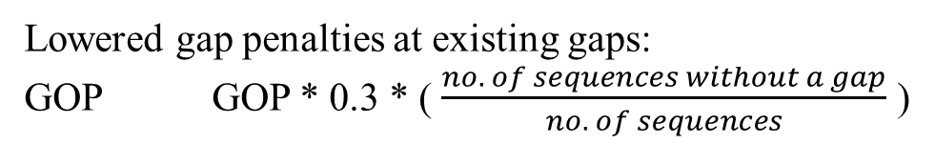
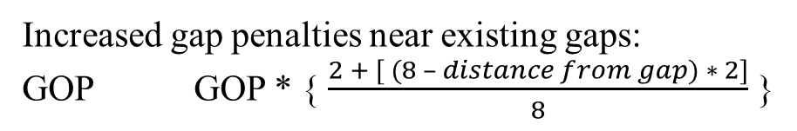
Progressive Alignment
Lowered gap penalties at existing gaps:
GOP GOP * 0.3 * ( $\frac{no. of sequences without a gap}{no. of sequences}$ )
Increased gap penalties near existing gaps:
GOP GOP * { $\frac{2 + [ (8 – distance from gap) ∗ 2]}{8}$ }
Reduced gap penalties in hydrophilic stretches:
GOP GOP * 1/3

