Slide 1
String Matching with Inversions and Translocations in Linear Average Time (most of the time)
Grabowski, Szymon, Simone Faro, and Emanuele Giaquinta.
Information Processing Letters 111.11 (2011): 516-520.
Presenter : Shie-Yan Lee
2017/4/11

Slide 2
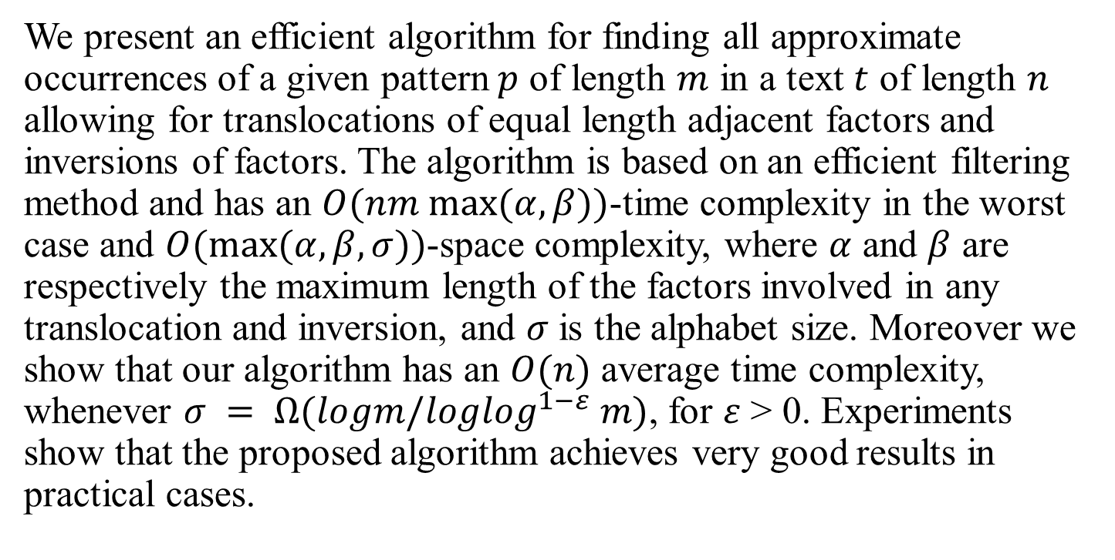
Abstract
We present an efficient algorithm for finding all approximate occurrences of a given pattern $p$ of length $m$ in a text $t$ of length $n$ allowing for translocations of equal length adjacent factors and inversions of factors. The algorithm is based on an efficient filtering method and has an $O(nm max⁡(α, β))$-time complexity in the worst case and $O(max⁡(α,β,σ))$-space complexity, where $α$ and $β$ are respectively the maximum length of the factors involved in any translocation and inversion, and $σ$ is the alphabet size. Moreover we show that our algorithm has an $O(n)$ average time complexity, whenever $σ = Ω(logm/log\log^{1−ε} m)$, for $ε$ > 0. Experiments show that the proposed algorithm achieves very good results in practical cases.

Slide 3



String matching with inversions and translocations problem
pattern $p$
$$m$$
text $t$
$$n$$

Slide 4



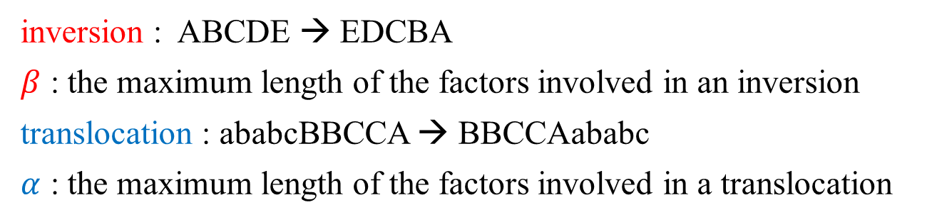


String matching with inversions and translocations problem
$$p$$
$$ABCAAB$$
$$s_{1}$$
$$s_{2}$$
$$t$$
$$ABCACABBAACBBACAAABCBBACBACBACBAC$$
$$ABCACABBAACBBACAAABCBBACBACBACBAC$$
$$ABCACABBAACBBACAAABCBBACBACBACBAC$$
inversion : ABCDE → EDCBA
$β$ : the maximum length of the factors involved in an inversion
translocation : ababcBBCCA → BBCCAababc
$α$ : the maximum length of the factors involved in a translocation

Slide 5
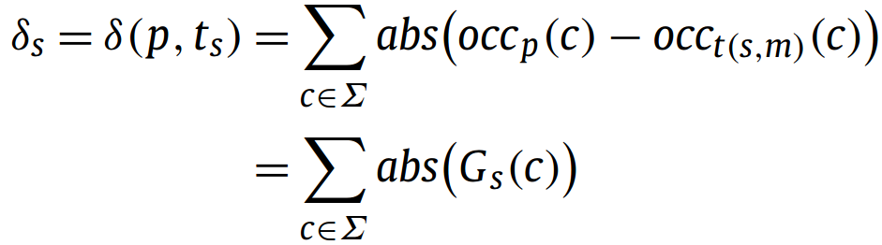





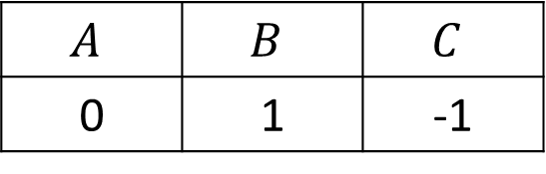
Distance value
$$p$$
$$ABCAAB$$
$$s_{1}$$
$$t$$
$$ABCACABBAACBBACAAABCBBACBACBACBAC$$
$$A$$ | $$B$$ | $$C$$
0 | 1 | -1
$$δ_{s_{1} }=\left|0\right|+\left|1\right|+\left|−1\right|=2$$

Slide 6


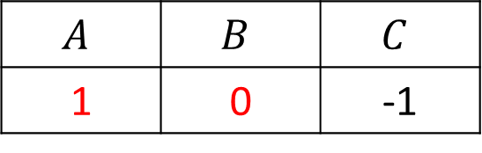


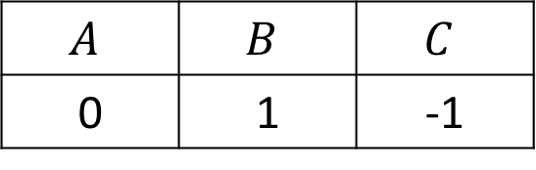
Distance value
$$p$$
$$ABCAAB$$
$$s_{2}$$
$$t$$
$$ABCACABBAACBBACAAABCBBACBACBACBAC$$
$$A$$ | $$B$$ | $$C$$
1 | 0 | -1
$$A$$ | $$B$$ | $$C$$
0 | 1 | -1
$$δ_{s_{2} }=δ_{s_{1} }−\left|G_{s_{1}}\left[A\right]\right|−\left|G_{s_{1}}\left[B\right]\right|+\left|G_{s_{2}}\left[A\right]\right|+\left|G_{s_{2}}\left[B\right]\right|$$

Slide 7









Verification
$$p$$
$$ABCAAB$$
$$s$$
$$t$$
$$ABCACABBAACBBACAAABCBBACBACBACBAC$$
$$δ_{s }=0$$
?
$$p$$
$$ABCAAB$$
$$t_{s}$$
$$AAABCB$$

Slide 8





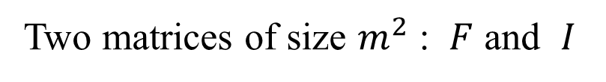









Verification based on dynamic programming
Two matrices of size $m^{2}$ : $F$ and $I$
$$F\left[i,j\right]=3$$
$$i$$
$$j$$
$$p$$
ABC
$$t_{s}$$
ABC
$$k$$
$$k$$
$$I\left[i,j\right]=3$$
$$i$$
$$j$$
$$p$$
ABC
$$t_{s}$$
CBA
$$k$$
$$k$$

Slide 9
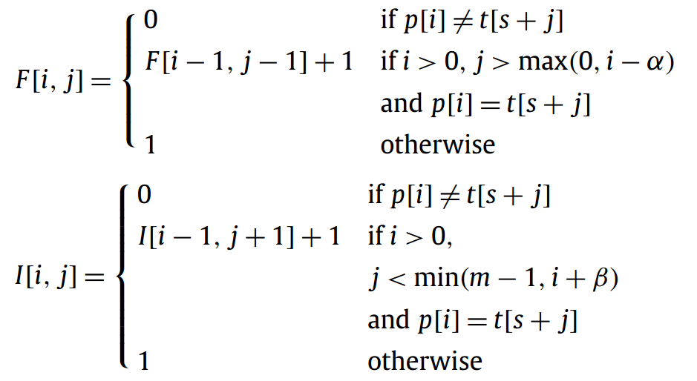
Verification based on dynamic programming
Two matrices of size $m^{2}$ : $F$ and $I$

Slide 10
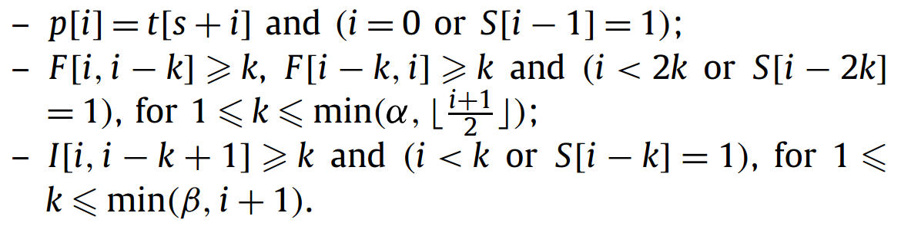

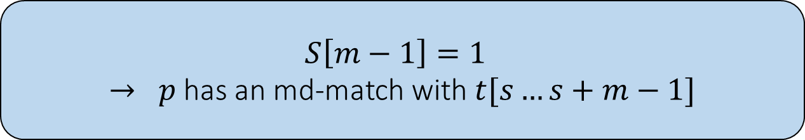

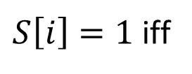
Verification based on dynamic programming
A vector $S [0…m]$, from 0 to $m$, set
$S\left[i\right]=1$iff
$O(m$max⁡($α,β$)$)$
$$S\left[m−1\right]=1$$
$→ p$has an md-match with $t[s…s+m−1]$

Slide 11



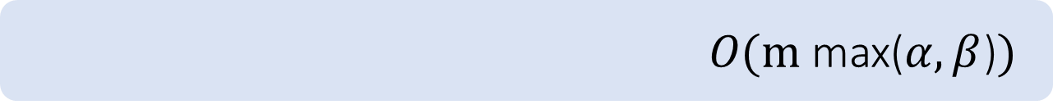


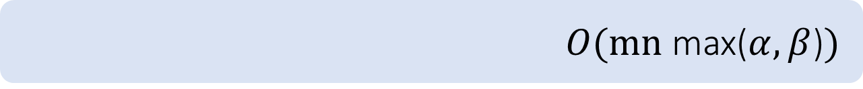



Time Complexity
$$p$$
$$ABCAAB$$
$$s$$
$$t$$
$$ABCACABBAACBBACAAABCBBACBACBACBAC$$
$$δ_{s }=0$$
$O(m$max⁡($α,β$)$)$
$$VERIFY(p,m,t,s,α,β)$$
$O(mn$max⁡($α,β$)$)$
$$(n−m) ∗ VERIFY(p,m,t,s,α,β)$$
$$O(n)$$
$$average case$$

Slide 12
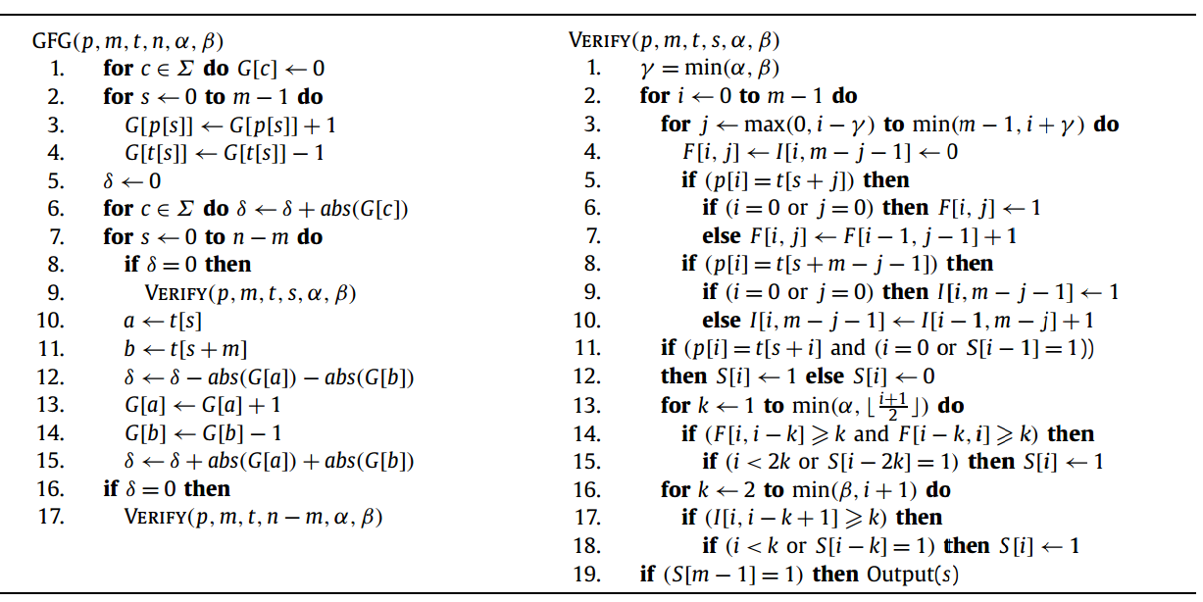
Time Complexity

Slide 13
Time Complexity

