Slide 1
In Proceedings of the International World Wide Web Conference (WWW’07). 141–150. Manku, G. S., Jain, A., and Sarma, A. D. (2007)
Detecting Near-Duplicates for Web Crawling
Presenter：Jyun-Hao Lai
Date：2017 / 04 / 25
Notes:
1

Slide 2
Abstract
Near-duplicate web documents are abundant. Two such documents differ from each other in a very small portion that displays advertisements, for example. Such differences are irrelevant for web search. So the quality of a web crawler increases if it can assess whether a newly crawled web page is a near-duplicate of a previously crawled web page or not. In the course of developing a near-duplicate detection system for a multi-billion page repository, we make two research contributions. First, we demonstrate that Charikar's fingerprinting technique is appropriate for this goal. Second, we present an algorithmic technique for identifying existing f-bit fingerprints that differ from a given fingerprint in at most k bit-positions, for small k. Our technique is useful for both online queries and batch queries. Experimental evaluation over real data confirms the practicality of our design.

Slide 3
Algorithm: Simhash Technique
1.Convert web-page or documents to set of features
use tf-idf techniques
give a weight to each feature
2.Hash each feature word into a f-bit value
3.Have a f-dimensional vector：dimension values start at 0
4.Update f-dimensional vector with weight of feature
if i-th bit of hash value is zero -> subtract i-th vector value by weight of feature
if i-th bit of hash value is one -> add the weight of the feature to the i-th vector value
5.Vector will have positive and negative components
Sign (+/-) of each component are bits for the fingerprint
(feature word, weight)

Slide 4
Algorithm: Simhash Technique
Example：「Simhash Technique」
Two features
(“Simhash”, weight = 2)
(“Technique”, weight = 4)
Hash features to 4-bits
“Simhash” -> 1101
“Technique” -> 0110
論文中無詳細說明hash函數

Slide 5
Algorithm: Simhash Technique
Start vector with all zeroes
Apply “Simhash” feature (weight = 2)
0
0
0
0
0
0
0
0
1
1
0
1
2
2
-2
2
feature’s f-bit value

Slide 6
Algorithm: Simhash Technique
Start vector with all zeroes
Apply “Technique” feature (weight =4 )
0
0
0
0
0
0
0
0
0
1
1
0
-4
4
4
-4
feature’s f-bit value

Slide 7
Algorithm: Simhash Technique
Final vector
2
2
-2
2
-4
4
4
-4
-2
6
2
-2
Sign of vector values is -,+,+,-
Final 4-bit fingerprint = 0110

Slide 8
Algorithm: Simhash Technique
Given f-bit fingerprint (F) find all fingerprints in a given collection which differ by at most k-bit positions.
1.Create tables containing the fingerprints： each table has a permutation (π) and a small integer (p) associated with it
2.Store tables in main-memory of a set of machines ： find all permutated fingerprints whose top pi bits match the top pi bits of πi(F)

Slide 9
Algorithm: Simhash Technique
fingerprint
1100 0101
1111 1111
0101 1100
0111 1110
1111 1110
0000 0001
1111 0101
1101 0010
Example：
F = 0100 1101
K = 3
Have a collection of 8 fingerprints
Create two tables

Slide 10
p = 3; π = Swap last four bits with first four bits
0101 1100
1111 1111
1100 0101
1110 0111
fingerprint
1100 0101
1111 1111
0101 1100
0111 1110
1111 1110
0000 0001
1111 0101
1101 0010
p = 3; π = Move last two bits to the front
1011 1111
0100 1000
0111 1101
1011 0100

Slide 11
p = 3; π = Swap last four bits with first four bits
0101 1100
1111 1111
1100 0101
1110 0111
p = 3; π = Swap last four bits with first four bits
0101 1100
1100 0101
1110 0111
1111 1111
Sort

Slide 12
p = 3; π = Move last two bits to the front
1011 1111
0100 1000
0111 1101
1011 0100
p = 3; π = Move last two bits to the front
0100 1000
0111 1101
1011 0100
1011 1111
Sort

Slide 13
F = 0100 1101
π(F) = 1101 0100
π(F) =0101 0011
p = 3; π = Swap last four bits with first four bits
0101 1100
1100 0101
1110 0111
1111 1111
p = 3; π = Move last two bits to the front
0100 1000
0111 1101
1011 0100
1011 1111
Match

Slide 14
Hamming Distance
With k =3, only fingerprint in first table is a near-duplicate of the F fingerprint
π(F) = 1101 0100
π(F) =0101 0011
p = 3; π = Swap last four bits with first four bits
0101 1100
1100 0101
1110 0111
1111 1111
p = 3; π = Move last two bits to the front
0100 1000
0111 1101
1011 0100
1011 1111
fingerprint
1101 0100
1100 0101
fingerprint
0101 0011
0100 1000
Hamming distance = 2
Hamming distance = 4

Slide 15

64-bit
fingerprint
分成
4段(16-bit)
0 | 0 | 0 | … | 0 | 0 | 0 | … | 0 | 0 | 0 | … | 0 | 0 | 0
0
1
0
:
:
1
0
1
0 | 0 | 0 | … | 0 | 0 | 0 | … | 0 | 0 | 0 | … | 0 | 0 | 1
0 | 1 | 0 | … | 1 | 1 | 0 | … | 0 | 1 | 1 | … | 1 | 0 | 1
0 | 0 | 0 | … | 0 | 0 | 0 | … | 0 | 0 | 0 | … | 0 | 1 | 0
: : :
0 | 1 | 0 | … | 1 | 1 | 0 | … | 0 | 1 | 1 | … | 1 | 0 | 1
0 | 1 | 0 | … | 1 | 1 | 0 | … | 0 | 1 | 1 | … | 1 | 0 | 1
1 | 1 | 1 | … | 1 | 1 | 1 | … | 1 | 1 | 1 | … | 1 | 1 | 0
0 | 1 | 0 | … | 1 | 1 | 0 | … | 0 | 1 | 1 | … | 1 | 0 | 1
1 | 1 | 1 | … | 1 | 1 | 1 | … | 1 | 1 | 1 | … | 1 | 1 | 1

Slide 16
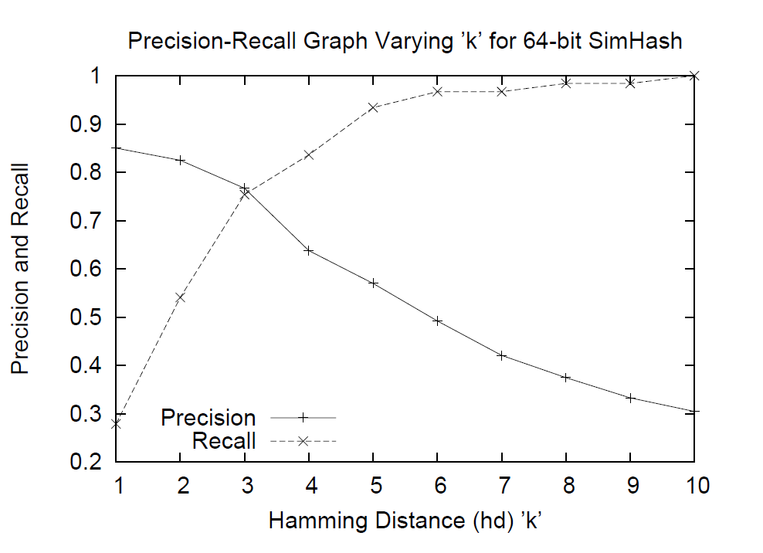
Experimental results
when choosing k=3,
precision and recall ≒ 0.75

