Slide 1
An Enhanced Support Vector Machine for Faster Time Series Classification
Thapanan Janyalikit, Phongsakorn Sathianwiriyakhun, Haemwaan Sivaraks and Chotirat Ann Ratanamahatana
Asian Conference on Intelligent Information
and Database Systems (ACIIDS), Vietnam, March, 2016
Presenter : Bo-Xian Chen
Date : 2017/5/9

Slide 2
Abstract(1/2)
As time series have become a prevalent type of data, various data mining tasks are often performed to extract useful knowledge, including time series classification, a more commonly performed task. Recently, a support vector machine (SVM), one of the most powerful classifiers for general classification tasks, has been applied to time series classification as it has been shown to outperform one nearest neighbor in various domains. Recently, Dynamic Time Warping (DTW) distance measure has been used as a feature for SVM classifier. However, its main drawback is its exceedingly high time complexity in DTW computation, which degrades the SVM’s performance.

Slide 3
Abstract(2/2)
In this paper, we propose an enhanced SVM that utilizes a DTW’s fast lower bound function as its feature to mitigate the problem. The experiment results on 47 UCR time series data mining datasets demonstrate that our proposed work can speed up the classification process by a large margin while maintaining high accuracies comparing with the state-of-the-art approach.

Slide 4
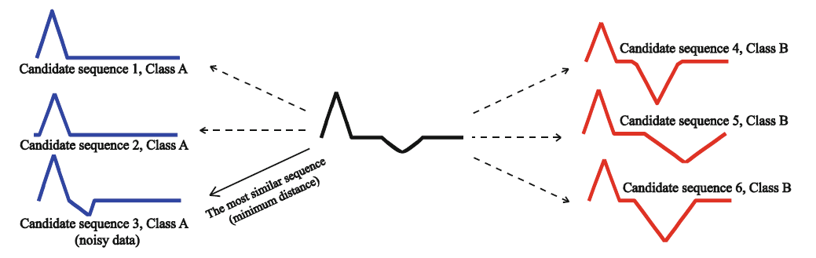
Time Series Classification
1NN-DTW ( one nearest neighbor with Dynamic Time warping )
Pros :
effective in time series classification
Cons:
high computational time - O(n²)
Subject to the influence of noise

Slide 5
Countermeasure
LCS
Variation of edit distance
…Cons : High computational cost
SVM

Slide 6
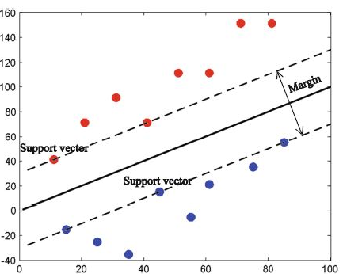
SVM(1/2)
Pros : ignore misleading noisy data point
How?
Construct a hyperplane to separate the data
Situation 1 :
If data can be linearly separated

Slide 7
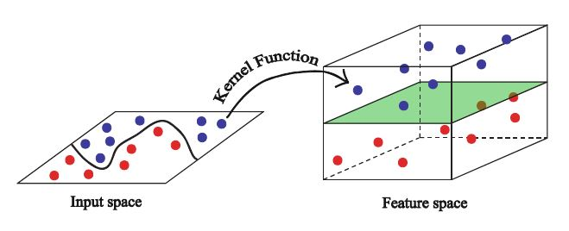
SVM(2/2)
Situation 2 :
Otherwise, a kernel function is applied to map the input space higher that

Slide 8
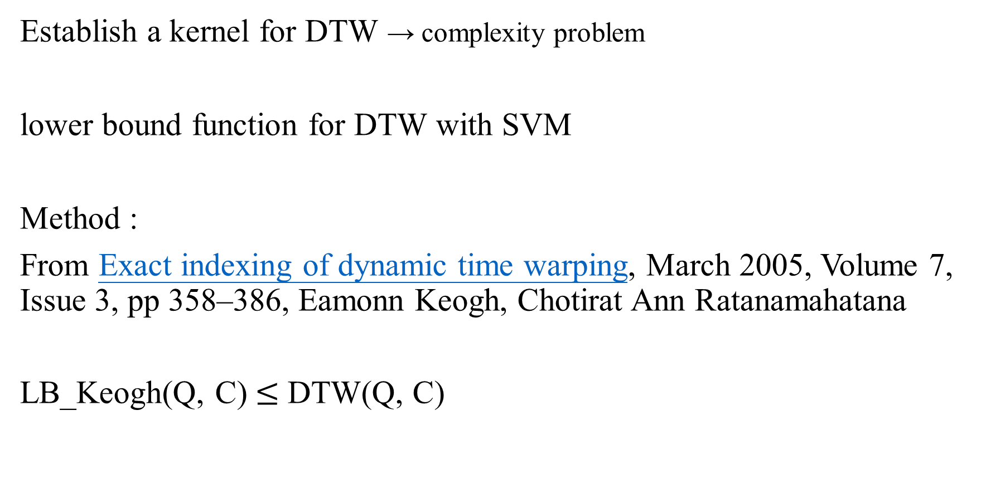
DTW with SVM
Establish a kernel for DTW → complexity problem
lower bound function for DTW with SVM
Method :
From Exact indexing of dynamic time warping, March 2005, Volume 7, Issue 3, pp 358–386, Eamonn Keogh, Chotirat Ann Ratanamahatana
LB_Keogh(Q, C) $≤$ DTW(Q, C)

Slide 9
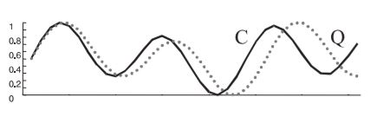
Dynamic Time Warping(DTW)
A similarity measure for time series data.
Given two time series sequences, Q and C of length m and n, we want
to find the minimum of cumulative distance.
Q = {q₁, q₂, q₃,…, q_{i},…, q_{m}}
C = {c₁, c₂, c₃,…, c_{j},…, c_{n}}

Slide 10
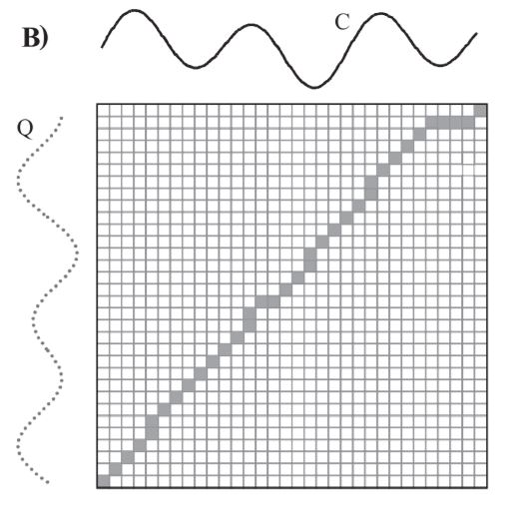
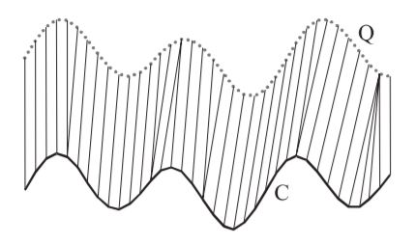

Dynamic Time Warping(DTW)
DTW distance from (1, 1) to (m, n)
$γ\left(i, j\right)=d\left(qi, cj\right)+min⁡\{γ\left(i−1, j\right),γ\left(i−1, j−1\right),γ\left(i, j−1\right)\}$

Slide 11
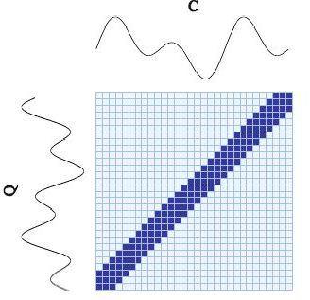

Global Constraint
Prevent unreasonable warping → increases the accuracy
Sakoe-Chiba constraint :
$$γ\left(i, j\right)=d\left(qi, cj\right)+\min\left\{γ\left(i−1, j\right),γ\left(i−1, j−1\right),γ\left(i, j−1\right)\right\};$$
$$i−r≤j≤i+r$$

Slide 12
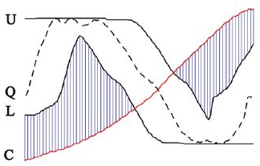

Lower Bound of DTW
U_{i} = max (q_{i-r} : q_{i+r})
L_{i} = min (q_{i-r} : q_{i+r})
$LB_Keogh\left(Q, C\right)$ = $\sum{\left\{\begin{aligned}&\left(Ui −Ci\right)2, if ci>Ui \\ &\left(Li −Ci\right)2, if ci<Li \\ &0, otherwise\end{aligned}\right.}$
LB_Keogh(Q, C) $≤$ DTW(Q, C)

Slide 13
LB_Keogh Feature Construction
LB_Keogh with global constraint
Given a training dataset C with k time series sequences,
LB_Keogh_Feature(Q)=
{LB_Keogh(Q,C₁), LB_Keogh(Q,C₂), …, LB_Keogh(Q,C_{k})}
SVM + LB_Keogh with global constraint
10-fold cross validation
Input : UCR Time Series 47 benchmark datasets

Slide 14
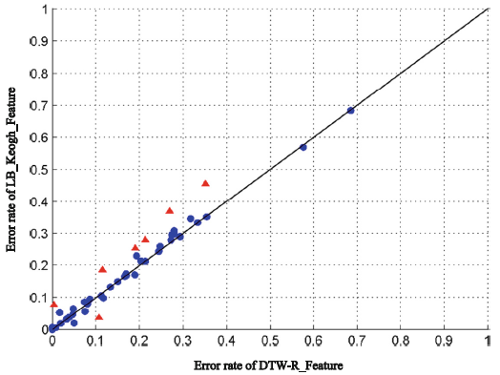
Experiment Results(1/3)
Error rate between Keogh_Feature with DTW-R_Feature

Slide 15
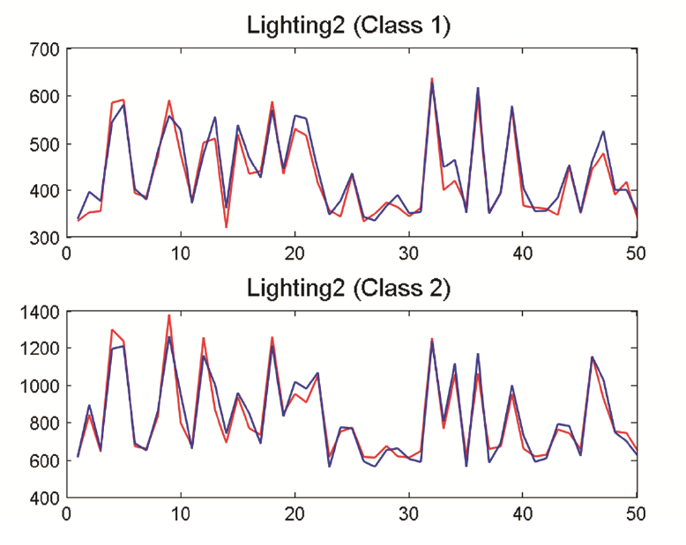
Experiment Results(2/3)

Slide 16
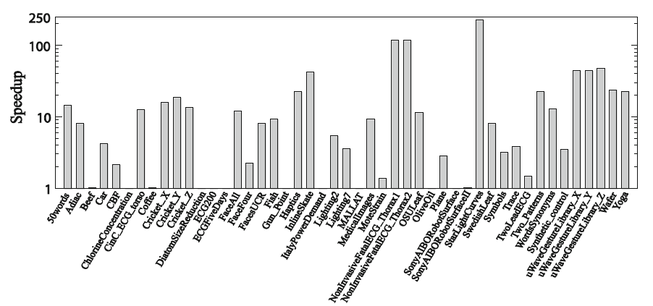
Experiment Results(3/3)

