Slide 1
Procedia Computer Science, 2015, Y.H. Sharath Kumar, N. Vinay Kumar and D.S. Guru
Delaunay Triangulation on Skeleton of Flowers for Classification
Presenter：Wei-Hao Fu
Date：2017/ 05/ 09
Notes:
1

Slide 2
Abstract (1/2)
In this work, we propose a Triangle based approach to classify flower images. Initially, flowers are segmented using whorl based region merging segmentation. Skeleton of a flower is obtained from the segmented flower using a skeleton pruning method. The Delaunay triangulation is obtained from the endpoints and junction points detected on the skeleton.

Slide 3
Abstract (2/2)
The length and angle features are extracted from the obtained Delaunay triangles and then are aggregated to represent in the form of interval-valued type data. A suitable classifier has been explored for the purpose of classification. To corroborate the efficacy of the proposed method, an experiment is conducted on our own data set of 30 classes of flowers, containing 3000 samples.

Slide 4
Algorithm (1/10)
Segmentation
Skeleton pruning
Triangular representation of skeleton
Feature extraction
Classification

Slide 5
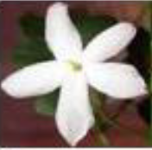
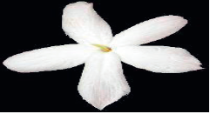
Algorithm (2/10)
Segmentation:
The flowers are segmented using whorl based region merging segmentation proposed in “Classification of Flowers: A Symbolic Approach”

Slide 6


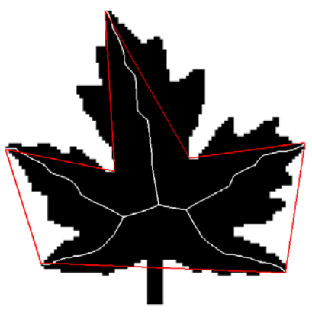
Algorithm (3/10)
Skeleton pruning:
The Discrete Curve Evolution (DCE) is used to simplify the polygons obtained from un-pruned flower skeleton image.
Reference: Skeleton Pruning by Contour Partitioning with Discrete Curve Evolution

Slide 7
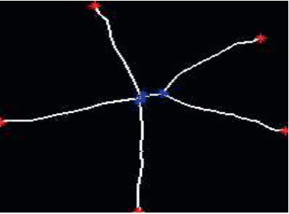
Algorithm (4/10)
Triangular representation of skeleton:
For the skeleton flower we find the endpoints and junction points. Using the detected points we generate the triangles.

Slide 8
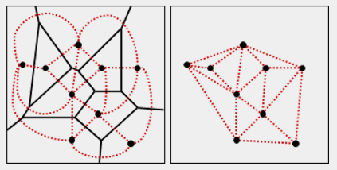
Algorithm (5/10)
Triangular representation of skeleton:
We use the method called Delaunay Triangulation to generate the triangles.
Voronoi diagram → Delaunay Triangulation
Reference: http://www.csie.ntnu.edu.tw/~u91029/Triangulation.html

Slide 9
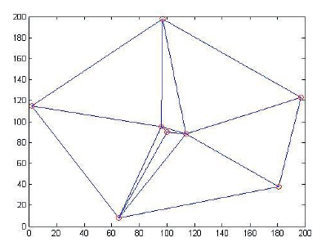
Algorithm (6/10)
Triangular representation of skeleton:
Finally, we can get a set of triangles for a flower.
1
7
8
9
6
2
3
4
5

Slide 10
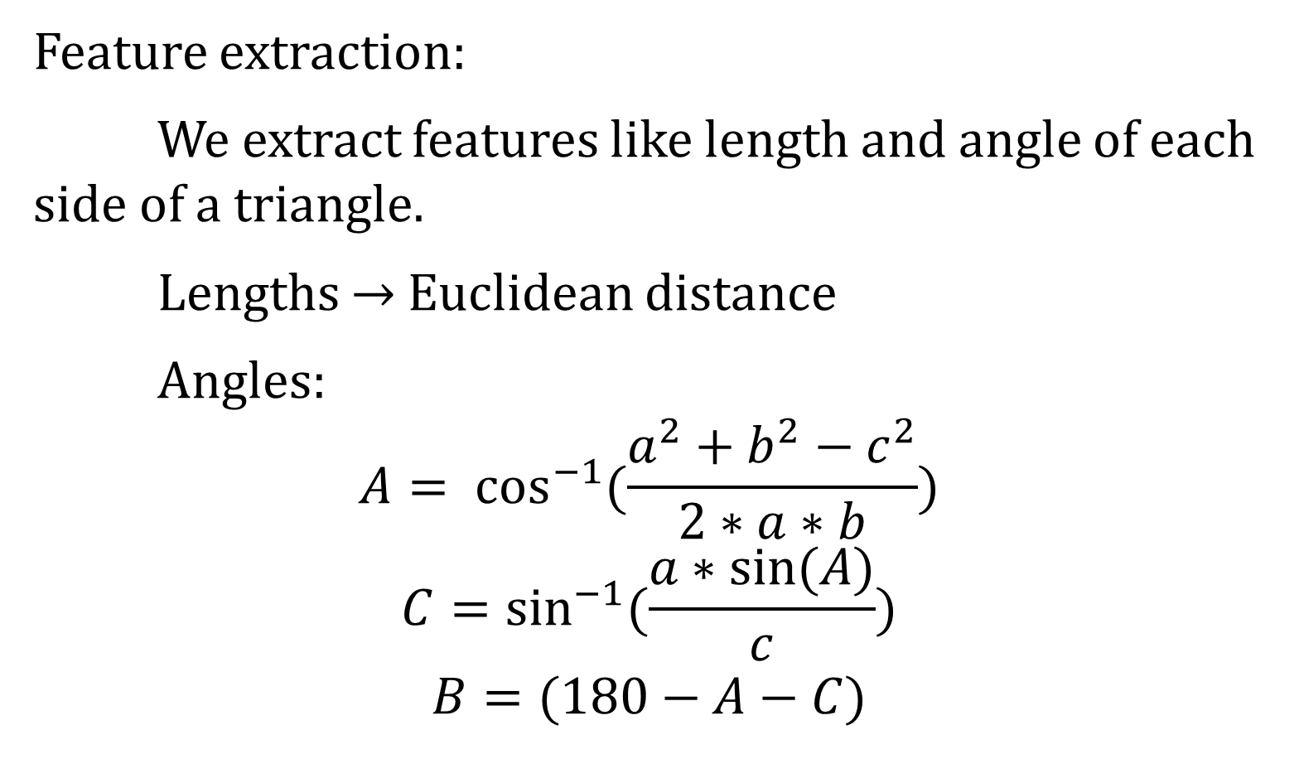
Algorithm (7/10)
Feature extraction:
We extract features like length and angle of each side of a triangle.
Lengths → Euclidean distance
Angles:
$$A= \cos^{−1}{(\frac{a^{2}+b^{2}−c^{2}}{2∗a∗b}})$$
$$C=\sin^{−1}{(\frac{a∗\sin{(A)}}{c})}$$
$$B=(180−A−C)$$
A
c
b
B
a
C

Slide 11
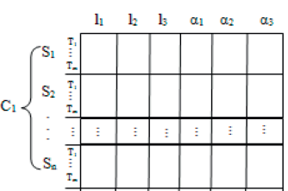
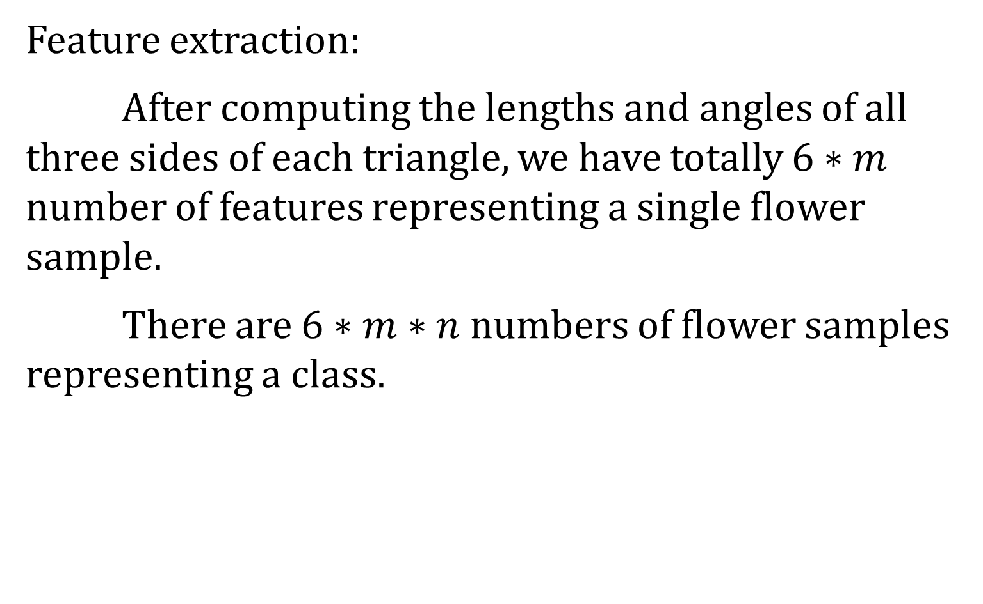
Algorithm (8/10)
Feature extraction:
After computing the lengths and angles of all three sides of each triangle, we have totally $6∗m$ number of features representing a single flower sample.
There are $6∗m∗n$ numbers of flower samples representing a class.

Slide 12







Algorithm (9/10)
Feature extraction:
Then we find the minimum and maximum feature values respectively, obtained from all the $m$ triangles of a sample image.
$$l1$$
$$l2$$
$$l3$$
$$a1$$
$$a2$$
$$a3$$
T1
T2
$$\left[l_{1}^{−}, l_{1}^{+}\right]$$ | $$\left[l_{2}^{−}, l_{2}^{+}\right]$$ | $$\left[l_{3}^{−}, l_{3}^{+}\right]$$ | $$\left[a_{1}^{−}, a_{1}^{+}\right]$$ | $$\left[a_{2}^{−}, a_{2}^{+}\right]$$ | $$\left[a_{3}^{−}, a_{3}^{+}\right]$$
T3
T4

Slide 13
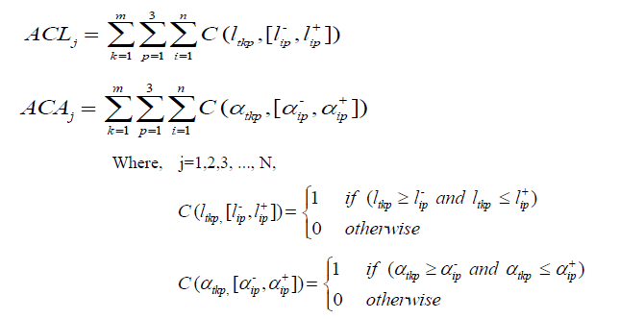
Algorithm (10/10)
Classification:
We adopt the symbolic classifier with a slight modification for classifying the flowers. We can call this classification as voting based classifier.

Slide 14
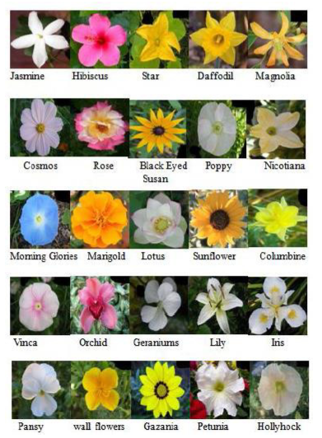
Experimental Result (1/2)
Dataset: 30 flower classes and total 3000 images

Slide 15
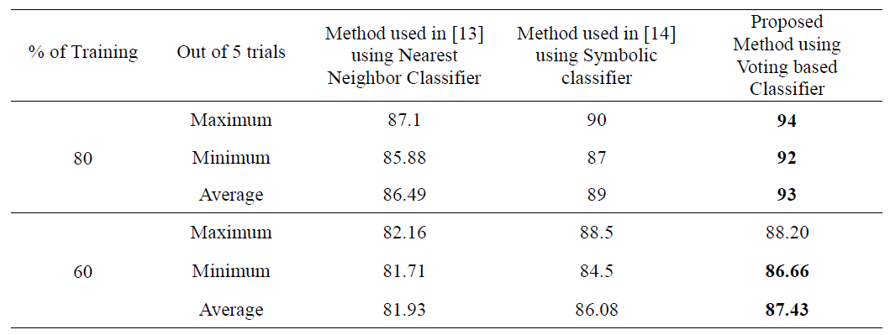
Experimental Result (2/2)

