Slide 1
Computing a Near-Maximum Independent Set in Linear Time by Reducing-Peeling
Lijun Chang, Wei Li, Wenjie Zhang
University of New South Wales, Australia
SIGMOD ’17, May 14-19, 2017, Chicago, Illinois, USA.
Presenter: Guan-Ting Chen
Date: 13, Oct. 2021

Slide 2
Abstract
This paper studies the problem of eﬃciently computing a maximum independent set from a large graph, a fundamental problem in graph analysis. Due to the hardness results of computing an exact maximum independent set or an approximate maximum independent set with accuracy guarantee, the existing algorithms resort to heuristic techniques for approximately computing a maximum independent set with good performance in practice but no accuracy guarantee theoretically. Observing that the existing techniques have various limits, in this paper, we aim to develop eﬃcient algorithms (with linear or near-linear time complexity) that can generate a high-quality (large-size) independent set from a graph in practice.

Slide 3
Abstract (cont.)
In particular, firstly we develop a Reducing-Peeling framework which iteratively reduces the graph size by applying reduction rules on vertices with very low degrees (Reducing) and temporarily removing the vertex with the highest degree (Peeling) if the reduction rules cannot be applied. Secondly, based on our framework we design two baseline algorithms, BDOne and BDTwo, by utilizing the existing reduction rules for handling degree-one and degree-two vertices, respectively. Both algorithms can generate higher-quality (larger-size) independent sets than the existing algorithms. Thirdly, we propose a linear-time algorithm, LinearTime, and a near-linear time algorithm, NearLinear, by designing new reduction rules and developing techniques for eﬃciently and incrementally applying reduction rules.

Slide 4
Abstract (cont.)
In practice, LinearTime takes similar time and space to BDOne but computes a higher quality independent set, similar in size to that of an independent set generated by BDTwo. Moreover, in practice NearLinear has a good chance to generate a maximum independent set and it often generates near-maximum independent sets. Fourthly, we extend our techniques to accelerate the existing iterated local search algorithms. Extensive empirical studies show that all our algorithms output much larger independent sets than the existing linear-time algorithms while having a similar running time, as well as achieve signiﬁcant speedup against the existing iterated local search algorithms.

Slide 5
Reducing-Peeling Framework
Reducing
Exact reduction rule
Peeling
Inexact reduction rule
Temporarily removes the highest-degree vertex
As few as possible

Slide 6
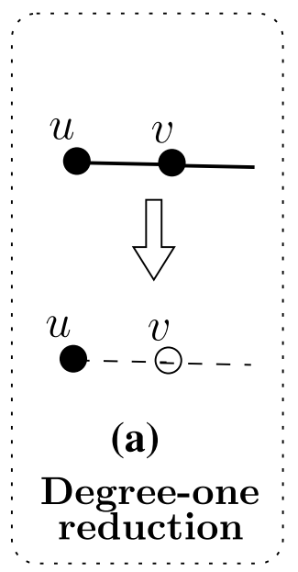
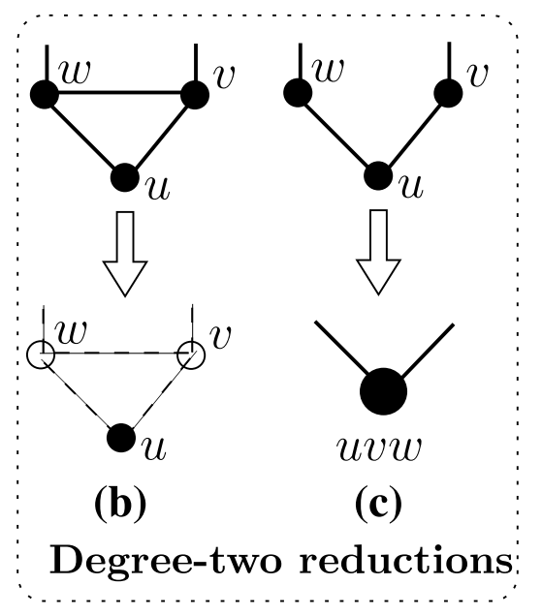
Reduction Rules
Degree-one Reduction
degree-one vertex u with neighbor v
Degree-two Reduction
Isolation
(v, w) ∈ E
degree-two vertex u
Folding
supervertex uvw
Inexact reduction

Slide 7
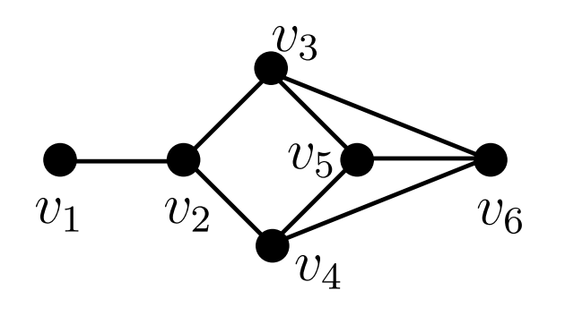

BDOne
Reduction rule
Degree-one reduction
Inexact reduction
Time complexity
O(m)
I , $V_{=1}$, and $V_{≥2}$ be the sets of vertices
Delete vertices

Slide 8
BDTwo
Find a larger independent set than BDOne
Reduction rule
Degree-one reduction
Degree-two reduction
Inexact reduction
Time complexity
O(n × m)
Folding

Slide 9
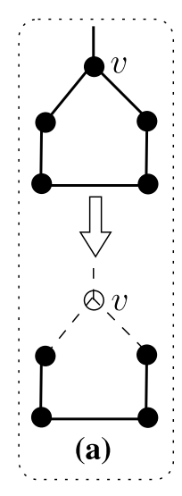
Degree-two Cycle Reductions
Degree-two cycle C
Every vertex in C has degree two

Slide 10
Degree-two Path Reductions
Degree-two path P
Every vertex in P has degree two
v = w

Slide 11
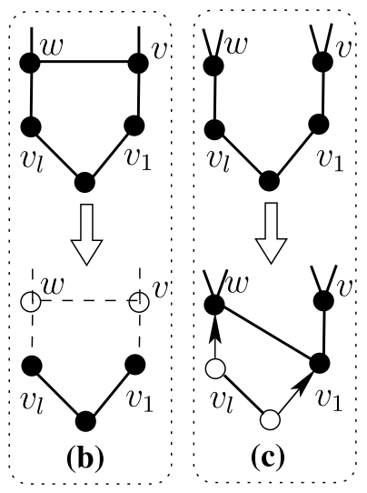

Degree-two Path Reductions (cont.)
$\left|P\right|$ is odd
(v, w) $∈$ E
(v, w) $!∈$ E

Slide 12
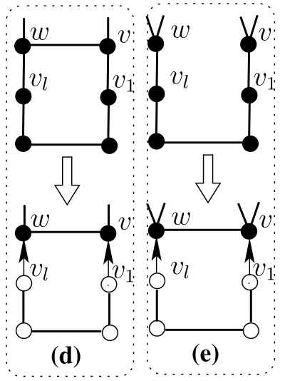

Degree-two Path Reductions(cont.)
$\left|P\right|$ is even
(v, w) $∈$ E
(v, w) $!∈$ E

Slide 13
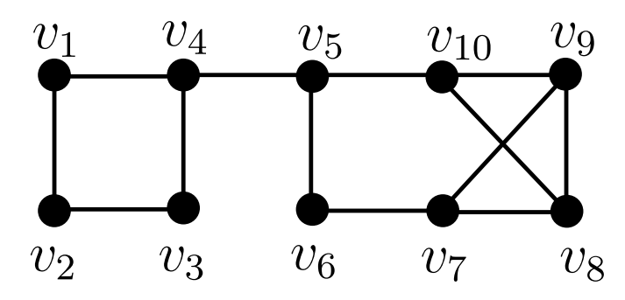
LinearTime
BDTwo has higher time and space complexities than BDOne
Reduction rule
Degree-one reduction
Degree-two path reduction
Inexact reduction
Time complexity
O(m)

Slide 14
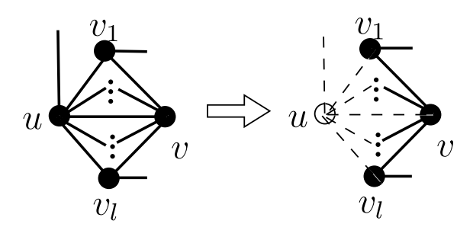
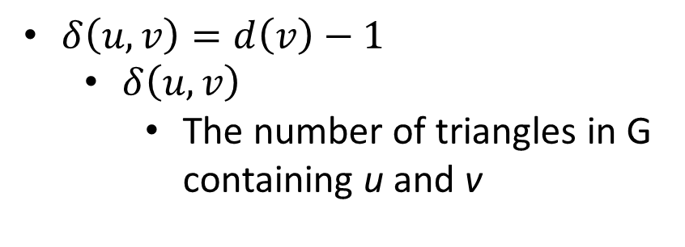
Dominance Reduction
vertex v dominates vertex u
For all neighbors of v (except u) connected to u
$δ\left(u, v\right)=d\left(v\right)−1$
$δ\left(u, v\right)$
The number of triangles in G containing u and v

Slide 15
NearLinear
Find near-maximum independent sets in near-linear time
Reduction rule
Degree-two path reduction
Dominance reduction
Degree-one reduction
Inexact reduction
Time complexity
O(m × Δ)
Δ is the maximum vertex degree
u
v

