Slide 1
The Game of Bridge: A Challenge for ILP
Swann Legras, C’eline Rouveirol, and V’eronique Ventos
28th International Conference, ILP 2018, Ferrara, Italy, September 2–4, 2018, Proceedings
Presenter: Jing-Ping Jan
Date: Oct. 13, 2021

Slide 2
Abstract
Designs of champion-level systems dedicated to a game have been considered as milestones for Artificial Intelligence. Such a success has not yet happened for the game of Bridge because (i) Bridge is a partially observable game (ii) a Bridge player must be able to explain at some point the meaning of his actions to his opponents. This paper presents a simple supervised learning problem in Bridge: given a ‘limit hand’, should a player bid or not, only considering his hand and the context of his decision. We describe this problem and some of its candidate modelisations. We then experiment state of the art propositional machine learning and ILP systems on this problem. Results of these preliminary experiments show that ILP systems are competitive or even outperform propositional Machine Learning systems. ILP systems are moreover able to build explicit models that have been validated by expert Bridge players.

Slide 3
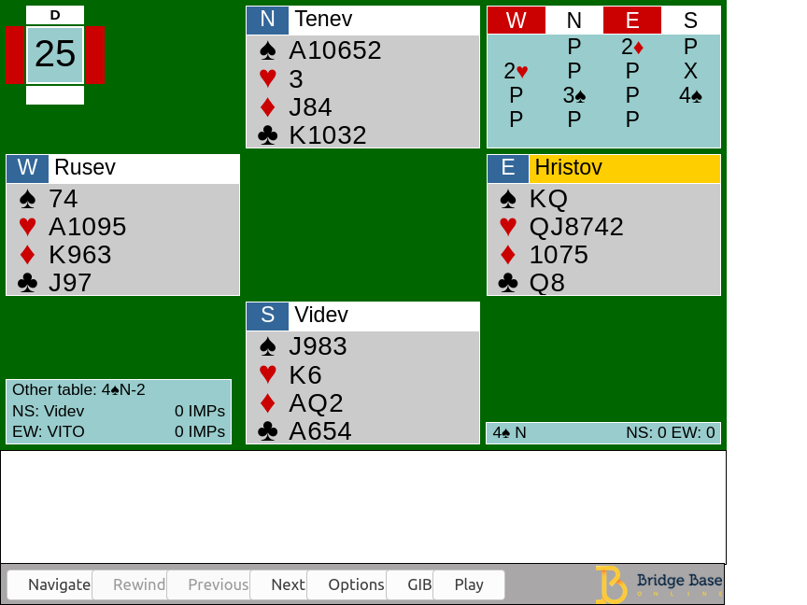
Introduction
Bidding stage Find the most profitable contract for the playing stage
Playing stage 13 rounds of a card-strength competition

Slide 4
Bidding stage
Asserting By making this bid, I assert that my hand has these properties
Denying By making this bid, I deny that my hand has these properties
Asking and Answering Questions If your hand is of type 1, make bid 1; if it is of type 2, make bid 2, etc.
Interrupting The primary purpose of this bid is to stop the opponents communicating

Slide 5
Bidding stage
{1♣,1♦,1♥,1♠,1NT, 2♣,2♦,…,7NT}
Pass
Double
Redouble

Slide 6
Opening Bid Problem

Slide 7
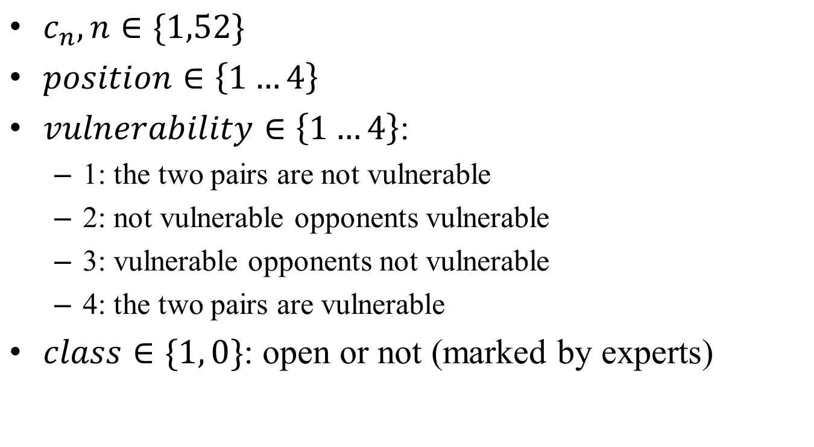
Opening Bid Problem
$c_{n}, n∈\{1,52\}$
$position∈\left\{1…4\right\}$
$vulnerability∈\left\{1…4\right\}$:
1: the two pairs are not vulnerable
2: not vulnerable opponents vulnerable
3: vulnerable opponents not vulnerable
4: the two pairs are vulnerable
$class∈\{1, 0\}$: open or not (marked by experts)

Slide 8
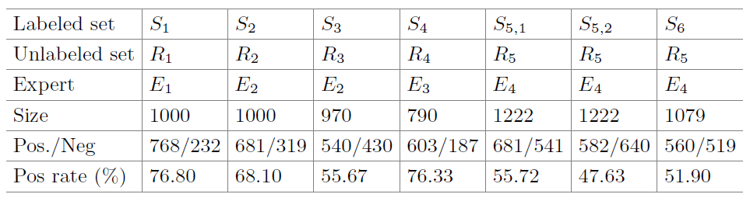
Samples sets

Slide 9
Method
SVM
Building rule sets with Inductive Logic Programming(ILP) system
Aleph
Tilde

Slide 10
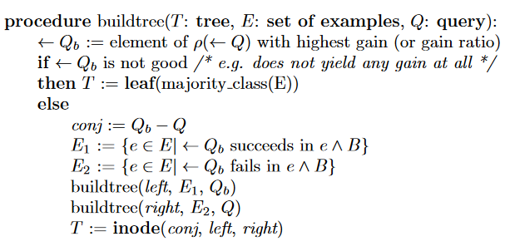
ILP method
Aleph(A Learning Engine for Proposing Hypotheses)
Step1: Select example
Step2: Build most-specific-clause
Step3: Search
Step4: Remove redundant
Tilde: First-Order Logical Decision Trees

Slide 11

Background knowledges
$BK_{0}$:
Open(E, Class)
Has hand(E, H)
Has card(E, C)
Position(E, P)
Vuln(E, V1, V2)
$BK_{1}$:
$BK_{0}$
Has suit(card, suit)
Has rank(card, rank)
Honor(card)
Minor(card)
Small card(card)
Nb(E, suit, number)
Plusvalue(E): card combinations. E.g. (KQ in a 5+suit)
Lteq(number, number)
Greq(number, number)
$BK_{2}$:
$BK_{1}$
List honor(E, Suit, ListH)

Slide 12
Background knowledges
Example:

Slide 13
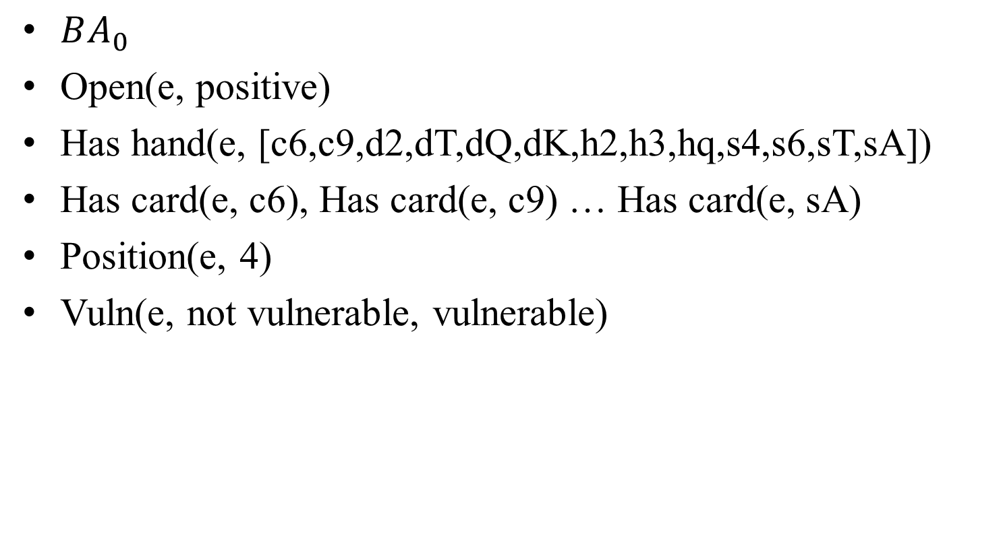
Background knowledges - example
$BA_{0}$
Open(e, positive)
Has hand(e, [c6,c9,d2,dT,dQ,dK,h2,h3,hq,s4,s6,sT,sA])
Has card(e, c6), Has card(e, c9) … Has card(e, sA)
Position(e, 4)
Vuln(e, not vulnerable, vulnerable)

Slide 14
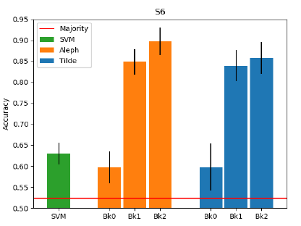
Experiment

Slide 15


Experiment
$$BK_{1}$$
$$BK_{2}$$

Slide 16
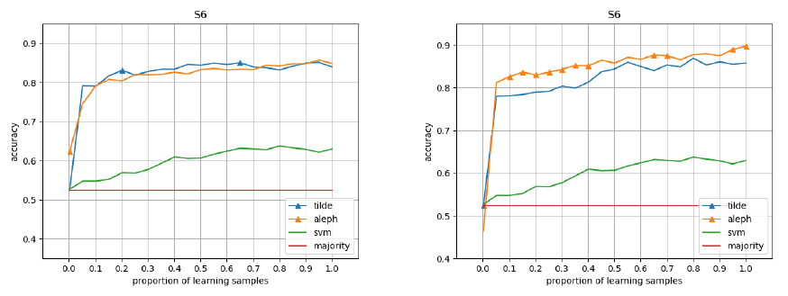
Experiment
$$BK_{1}$$
$$BK_{2}$$

Slide 17
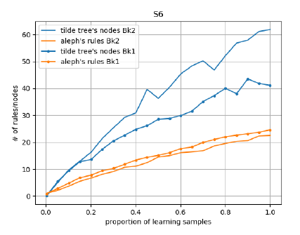
Experiment

Slide 18
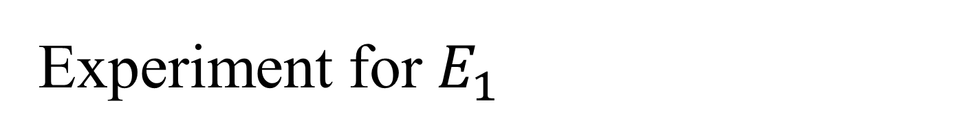
Experiment for $E_{1}$
Number of data: 279 samples
Constrains:
No more than 5 card in a suit
Position != 3

Slide 19
Experiment for $E_{1}$

