Slide 1
An Efficient Algorithm for the Longest Tandem Scattered Subsequence Problem
Adrian Kosowski
11th International Symposium on String Processing and Information Retrieval (SPIRE 2004), Padua, Italy
Vol. 3246, pp. 93-100, 2004
Presenter: Tsung-Lin Lu
Date: Oct. 13, 2021

Slide 2
Abstract
The paper deals with the problem of finding a tandem scattered subsequence of maximum length (LTS) for a given character sequence. A sequence is referred to as tandem if it can be split into two identical sequences. An efficient algorithm for the LTS problem is presented and is shown to have O(n²) computational complexity and linear memory complexity with respect to the length n of the analysed sequence. A conjecture is put forward and discussed, stating that the complexity of the given algorithm may not be easily improved. Finally, the potential application of the solution to the LTS problem in approximate tandem substring matching in DNA sequences is discussed.

Slide 3
Outline
Longest Tandem Subsequence (LTS)
f_{k}(i, j)
d_{k}(i, j) & property 1
a_{k}(i) & property 2
LTSsplit algorithm

Slide 4
Longest Tandem Subsequence (LTS)
LTS = LSS (Longest Square Subsequence )
A non-empty string Y of form XX is called a square.
1-LTS
1-LTS → 2-LCS
LTSsplit : Determine an index l, 1 ≤ l < n for which |LCS([s₁ ... s_{l}], [s_{l+1} ...s_{n}])| takes the maximum possible value.
2-LCS : Compute sequence t = LCS([s₁ ... s_{l}], [s_{l+1} ...s_{n}]) and return as output.
A | B | D | D | C | A | B | D | D | C
B | A | B | C | A | B | D | B | A | C | A
B | A | C | B | A | C

Slide 5
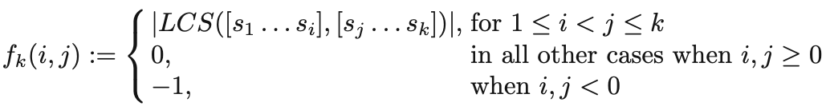
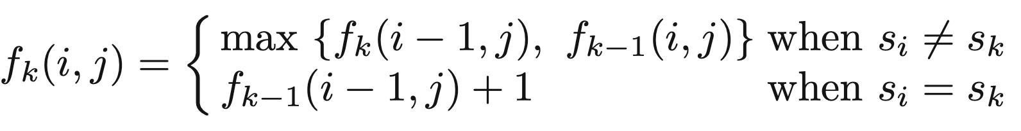
f_{k}(i, j)
1 | 2 | 3 | 4 | 5 | 6 | 7
B | A | B | B | C | A | B
f₆(i, j)
_{i} ^{j} | 1 | 2 | 3 | 4 | 5 | 6
1 | 0 | 1 | 1 | 1 | 0 | 0
2 | 0 | 0 | 2 | 2 | 1 | 1
3 | 0 | 0 | 0 | 2 | 1 | 1
4 | 0 | 0 | 0 | 0 | 1 | 1
5 | 0 | 0 | 0 | 0 | 0 | 1
6 | 0 | 0 | 0 | 0 | 0 | 0
f₇(i, j)
_{i} ^{j} | 1 | 2 | 3 | 4 | 5 | 6 | 7
1 | 0 | 1 | 1 | 1 | 1 | 1 | 1
2 | 0 | 0 | 2 | 2 | 1 | 1 | 1
3 | 0 | 0 | 0 | 3 | 2 | 2 | 1
4 | 0 | 0 | 0 | 0 | 2 | 2 | 1
5 | 0 | 0 | 0 | 0 | 0 | 2 | 1
6 | 0 | 0 | 0 | 0 | 0 | 0 | 1
7 | 0 | 0 | 0 | 0 | 0 | 0 | 0
Index 𝛾_{k}(i) is the largest value of r such that r ≤ i and s_{r} = s_{k}. (previous matched point)

Slide 6
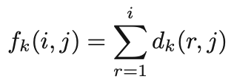
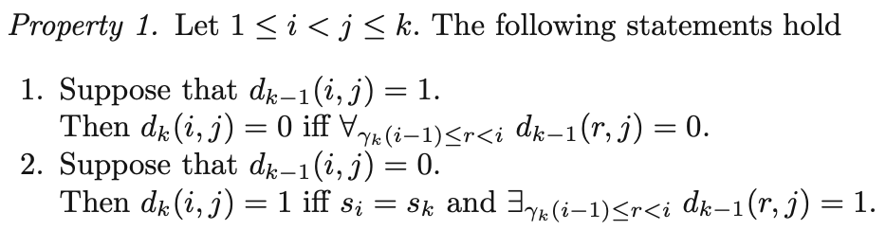
d_{k}(i, j)
1 | 2 | 3 | 4 | 5 | 6 | 7
B | A | B | B | C | A | B
f₆(i, j)
d₆(i, j)
d_{k}(i, j) = f_{k}(i, j) - f_{k}(i-1, j)
_{i} ^{j} | 1 | 2 | 3 | 4 | 5 | 6
1 | 0 | 1 | 1 | 1 | 0 | 0
2 | 0 | 0 | 2 | 2 | 1 | 1
3 | 0 | 0 | 0 | 2 | 1 | 1
4 | 0 | 0 | 0 | 0 | 1 | 1
5 | 0 | 0 | 0 | 0 | 0 | 1
6 | 0 | 0 | 0 | 0 | 0 | 0
_{i} ^{j} | 1 | 2 | 3 | 4 | 5 | 6
1 | 0 | 1 | 1 | 1 | 0 | 0
2 | 0 | 0 | 1 | 1 | 1 | 1
3 | 0 | 0 | 0 | 0 | 0 | 0
4 | 0 | 0 | 0 | 0 | 0 | 0
5 | 0 | 0 | 0 | 0 | 0 | 0
6 | 0 | 0 | 0 | 0 | 0 | 0

Slide 7
Property 1
1 | 2 | 3 | 4 | 5 | 6 | 7
B | A | B | B | C | A | B
f₆(i, j)
d₆(i, j)
f₇(i, j)
d₇(i, j)
_{i} ^{j} | 1 | 2 | 3 | 4 | 5 | 6
1 | 0 | 1 | 1 | 1 | 0 | 0
2 | 0 | 0 | 2 | 2 | 1 | 1
3 | 0 | 0 | 0 | 2 | 1 | 1
4 | 0 | 0 | 0 | 0 | 1 | 1
5 | 0 | 0 | 0 | 0 | 0 | 1
6 | 0 | 0 | 0 | 0 | 0 | 0
_{i} ^{j} | 1 | 2 | 3 | 4 | 5 | 6
1 | 0 | 1 | 1 | 1 | 0 | 0
2 | 0 | 0 | 1 | 1 | 1 | 1
3 | 0 | 0 | 0 | 0 | 0 | 0
4 | 0 | 0 | 0 | 0 | 0 | 0
5 | 0 | 0 | 0 | 0 | 0 | 0
6 | 0 | 0 | 0 | 0 | 0 | 0
_{i} ^{j} | 1 | 2 | 3 | 4 | 5 | 6 | 7
1 | 0 | 1 | 1 | 1 | 1 | 1 | 1
2 | 0 | 0 | 2 | 2 | 1 | 1 | 1
3 | 0 | 0 | 0 | 3 | 2 | 2 | 1
4 | 0 | 0 | 0 | 0 | 2 | 2 | 1
5 | 0 | 0 | 0 | 0 | 0 | 2 | 1
6 | 0 | 0 | 0 | 0 | 0 | 0 | 1
7 | 0 | 0 | 0 | 0 | 0 | 0 | 0
_{i} ^{j} | 1 | 2 | 3 | 4 | 5 | 6 | 7
1 | 0 | 1 | 1 | 1 | 1 | 1 | 1
2 | 0 | 0 | 1 | 1 | 0 | 0 | 0
3 | 0 | 0 | 0 | 1 | 1 | 1 | 0
4 | 0 | 0 | 0 | 0 | 0 | 0 | 0
5 | 0 | 0 | 0 | 0 | 0 | 0 | 0
6 | 0 | 0 | 0 | 0 | 0 | 0 | 0
7 | 0 | 0 | 0 | 0 | 0 | 0 | 0

Slide 8
Property 2 & a_{k}(i)
1 | 2 | 3 | 4 | 5 | 6 | 7
B | A | B | B | C | A | B
f₇(i, j)
d₇(i, j)
a₇(i)
_{i} ^{j} | 1 | 2 | 3 | 4 | 5 | 6 | 7
1 | 0 | 1 | 1 | 1 | 1 | 1 | 1
2 | 0 | 0 | 2 | 2 | 1 | 1 | 1
3 | 0 | 0 | 0 | 3 | 2 | 2 | 1
4 | 0 | 0 | 0 | 0 | 2 | 2 | 1
5 | 0 | 0 | 0 | 0 | 0 | 2 | 1
6 | 0 | 0 | 0 | 0 | 0 | 0 | 1
7 | 0 | 0 | 0 | 0 | 0 | 0 | 0
_{i} ^{j} | 1 | 2 | 3 | 4 | 5 | 6 | 7
1 | 0 | 1 | 1 | 1 | 1 | 1 | 1
2 | 0 | 0 | 1 | 1 | 0 | 0 | 0
3 | 0 | 0 | 0 | 1 | 1 | 1 | 0
4 | 0 | 0 | 0 | 0 | 0 | 0 | 0
5 | 0 | 0 | 0 | 0 | 0 | 0 | 0
6 | 0 | 0 | 0 | 0 | 0 | 0 | 0
7 | 0 | 0 | 0 | 0 | 0 | 0 | 0
i | a₇
1 | 7
2 | 4
3 | 6
4 | 0
5 | 0
6 | 0
7 | 0

Slide 9
LTSsplit Algorithm
There exists an algorithm solving the LTSsplit problem for a given sequence s of length n in O(n²) time and using Θ(n) memory.
For all k, 1 ≤ k ≤ n, compute the column A_{k} by modifying column A_{k-1}, making use of Property 2.
Determine an LTSsplit index l from the values of column A_{n} using the following equation (directly inferred from the definitions of A_{n}, d_{n}, f_{n}):

Slide 10
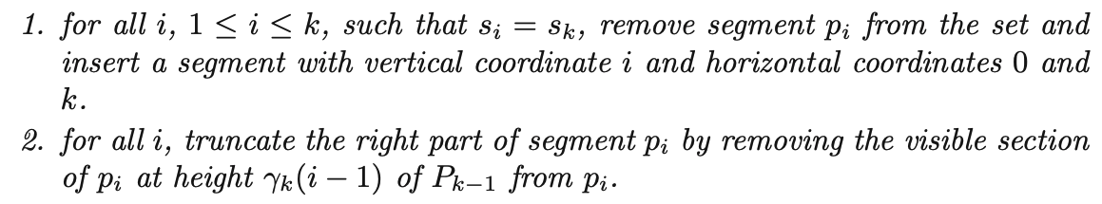
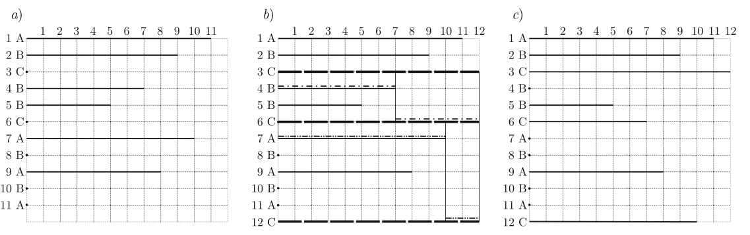
Corollary 1
1 | 2 | 3 | 4 | 5 | 6 | 7 | 8 | 9 | 10 | 11 | 12
A | B | C | B | B | C | A | B | A | B | A | C
P₁₁
P₁₂

Slide 11
Step1. Compute A_{1~n}
1 | 2 | 3 | 4 | 5 | 6 | 7 | 8 | 9 | 10 | 11 | 12
A | B | C | B | B | C | A | B | A | B | A | C
a_{1~12}(i)
d₁₂(i, j)
a₁₂(i)
_{i} ^{k} | 1 | 2 | 3 | 4 | 5 | 6 | 7 | 8 | 9 | 10 | 11 | 12
1 | 0 | 0 | 0 | 0 | 0 | 0 | 7 | 7 | 9 | 9 | 11 | 11
2 | 0 | 0 | 0 | 4 | 5 | 5 | 0 | 8 | 7 | 10 | 9 | 9
3 | 0 | 0 | 0 | 0 | 0 | 6 | 5 | 0 | 0 | 0 | 0 | 12
4 | 0 | 0 | 0 | 0 | 4 | 0 | 0 | 5 | 5 | 7 | 7 | 0
5 | 0 | 0 | 0 | 0 | 0 | 0 | 0 | 0 | 0 | 5 | 5 | 5
6 | 0 | 0 | 0 | 0 | 0 | 0 | 0 | 0 | 0 | 0 | 0 | 7
7 | 0 | 0 | 0 | 0 | 0 | 0 | 0 | 0 | 8 | 0 | 10 | 0
8 | 0 | 0 | 0 | 0 | 0 | 0 | 0 | 0 | 0 | 8 | 0 | 0
9 | 0 | 0 | 0 | 0 | 0 | 0 | 0 | 0 | 0 | 0 | 8 | 8
10 | 0 | 0 | 0 | 0 | 0 | 0 | 0 | 0 | 0 | 0 | 0 | 0
11 | 0 | 0 | 0 | 0 | 0 | 0 | 0 | 0 | 0 | 0 | 0 | 0
12 | 0 | 0 | 0 | 0 | 0 | 0 | 0 | 0 | 0 | 0 | 0 | 0
 | 1 | 2 | 3 | 4 | 5 | 6 | 7 | 8 | 9 | 10 | 11 | 12
1 | 0 | 1 | 1 | 1 | 1 | 1 | 1 | 1 | 1 | 1 | 1 | 0
2 | 0 | 0 | 1 | 1 | 1 | 1 | 1 | 1 | 1 | 0 | 0 | 0
3 | 0 | 0 | 0 | 1 | 1 | 1 | 1 | 1 | 1 | 1 | 1 | 1
4 | 0 | 0 | 0 | 0 | 0 | 0 | 0 | 0 | 0 | 0 | 0 | 0
5 | 0 | 0 | 0 | 0 | 0 | 0 | 0 | 0 | 0 | 0 | 0 | 0
6 | 0 | 0 | 0 | 0 | 0 | 0 | 1 | 0 | 0 | 0 | 0 | 0
7 | 0 | 0 | 0 | 0 | 0 | 0 | 0 | 0 | 0 | 0 | 0 | 0
8 | 0 | 0 | 0 | 0 | 0 | 0 | 0 | 0 | 0 | 0 | 0 | 0
9 | 0 | 0 | 0 | 0 | 0 | 0 | 0 | 0 | 0 | 0 | 0 | 0
10 | 0 | 0 | 0 | 0 | 0 | 0 | 0 | 0 | 0 | 0 | 0 | 0
11 | 0 | 0 | 0 | 0 | 0 | 0 | 0 | 0 | 0 | 0 | 0 | 0
12 | 0 | 0 | 0 | 0 | 0 | 0 | 0 | 0 | 0 | 0 | 0 | 0
i | a₇
1 | 11
2 | 9
3 | 12
4 | 0
5 | 0
6 | 7
7 | 0
8 | 0
9 | 0
10 | 0
11 | 0
12 | 0

Slide 12
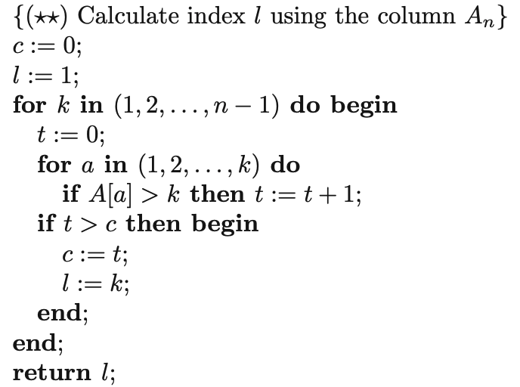
Step2. Determine an LTSsplit index l
1 | 2 | 3 | 4 | 5 | 6 | 7 | 8 | 9 | 10 | 11 | 12
A | B | C | B | B | C | A | B | A | B | A | C
 | 1 | 2 | 3 | 4 | 5 | 6 | 7 | 8 | 9 | 10 | 11 | 12
a₁₂ | 11 | 9 | 12 | 0 | 0 | 7 | 0 | 0 | 0 | 0 | 0 | 0
 | 1 | 2 | 3 | 4 | 5 | 6 | 7 | 8 | 9 | 10 | 11 | 12
l | 1 | 2 | 3 | 3 | 3 | 6 | 6 | 6 | 6 | 6 | 6 | 6
c | 1 | 2 | 3 | 3 | 3 | 4 | 4 | 4 | 4 | 4 | 4 | 4
1 | 2 | 3 | 4 | 5 | 6
A | B | C | B | B | C
7 | 8 | 9 | 10 | 11 | 12
A | B | A | B | A | C

Slide 13
Thank you for listening

Slide 14
Abstract
s

