Slide 1
Efficient Computation of Longest Common
Subsequences with Multiple Substring
Inclusive Constraints
XIAODONG WANG, LEI WANG,
and DAXIN ZHU
JOURNAL OF COMPUTATIONAL BIOLOGY
Volume 26, Number 9, 2019, Pages 938–947
Presenter: Cheng-Han He
Date: Oct. 20, 2021

Slide 2
Abstract(1/2)
In this article, we consider a generalized longest common subsequence (LCS) problem with multiple substring inclusive constraints. For the two input sequences X and Y of lengths n and m, and a set of d constraints P = {P1, …, P_{d}} of total length r, the problem is to find a common subsequence Z of X and Y including each of constraint string in P as a substring and the length of Z is maximized.

Slide 3
Abstract(2/2)
A new dynamic programming solution to this problem is presented in this article. The correctness of the new algorithm is proved. The time complexity of our algorithm is O(d2^{d}nmr). In the case of the number of constraint strings is fixed, our new algorithm for the generalized LCS problem with multiple substring inclusive constraints requires O(nmr) time and space.

Slide 4
M-STR-IC-LCS
X = aabbbba
Y = aabbba
P = {aab‚ aba‚ ba}
LCS(X, Y) = aabbba
M-STR-IC-LCS(X, Y, P) = aaba

Slide 5
Constraints
constraint set P = {aab‚ aba‚ ba}
d = 3
r = 8

Slide 6
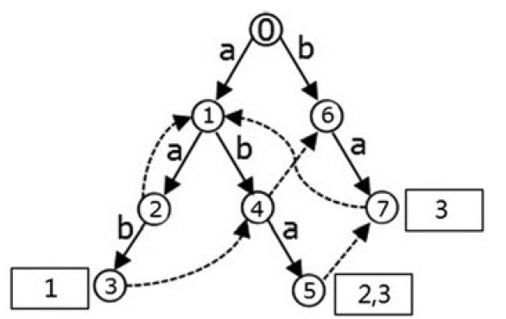
Keyword tree
The keyword tree for set P is a rooted directed tree T satisfying three conditions:
each edge is labeled with exactly one character
any two edges out of the same node have distinct Labels
every string P_{i} in P maps to some node v of T such that the characters on the path from the root of T to v exactly spell out P_{i}, and every leaf of T is mapped to some string in P.

Slide 7
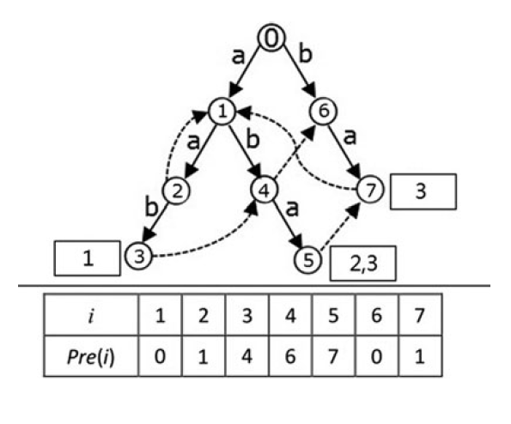
Aho–Corasick automaton
The keyword tree can be extended into an automaton,
Aho–Corasick automaton, which consists of three functions:
Goto (solid edges)
Output
Failure (dashed edges)

Slide 8
Failure list
node(5): {7 → 1 → 0}
node(6): {0}

Slide 9
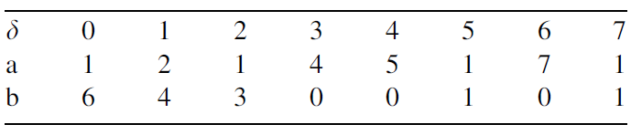
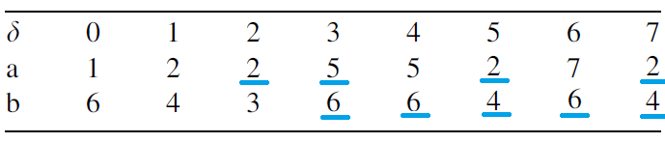
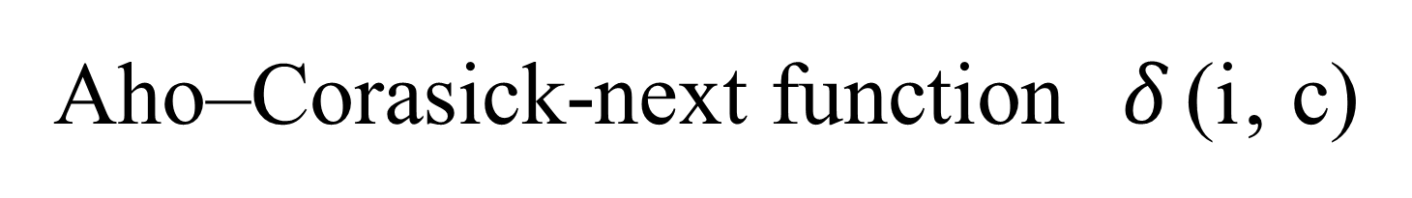
Aho–Corasick-next function $δ$(i‚ c)

Slide 10


State ($α, β$)
$\overline{α}=δ$($α, β$); $\overline{s_{β}}$= $s_{β}Uo_{\overline{α}};$ $\overline{β}$ = g($\overline{s_{β}}$)
($α, β$) => ($δ(α, c$), $γ(α, β, c$))
t2^{d} states

Slide 11

f (i‚ j‚ (𝛼, 𝛽))
f (i‚ j‚ ($α, β$))
$\max_{0 ≤ i < t}{\{f(n, m, (i, { 2}^{d−1}))\}}$

Slide 12
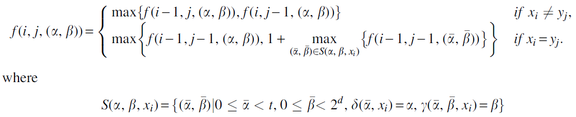
f (i‚ j‚ (𝛼, 𝛽))

Slide 13
M-STR-IC-LCS
X = aabbbba
Y = aabbba
P = {aab‚ aba‚ ba}
LCS(X, Y) = aabbba
M-STR-IC-LCS(X, Y, P) = aaba

Slide 14
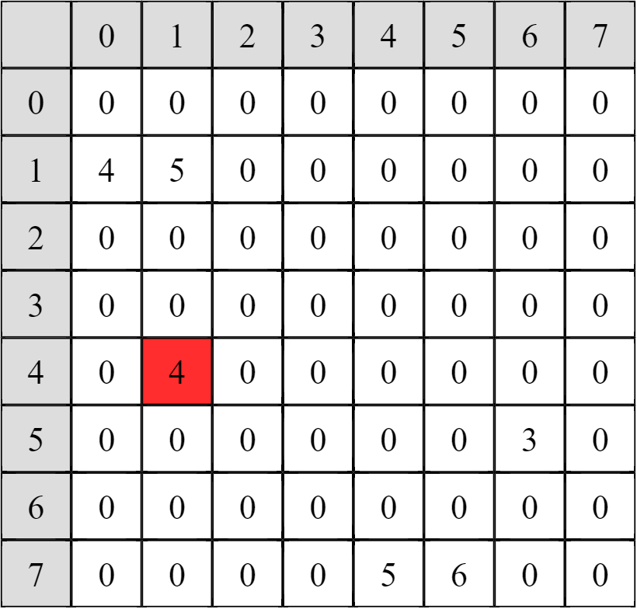
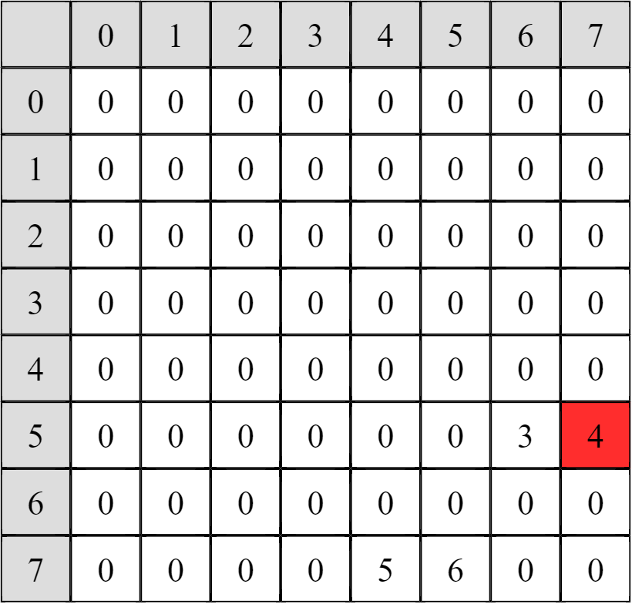




M-STR-IC-LCS
i = 7, j = 6
$$β$$
$$β$$
$$α$$
$$α$$

Slide 15
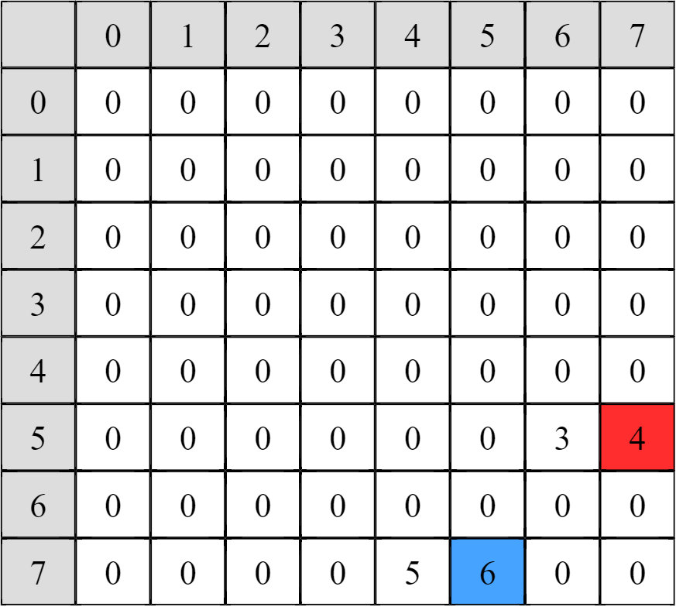


M-STR-IC-LCS
$$β$$
i = 7, j = 6
X = aabbbba
Y = aabbba
A = A[1:3] + a
B = B[1:5] + a
$$α$$

Slide 16
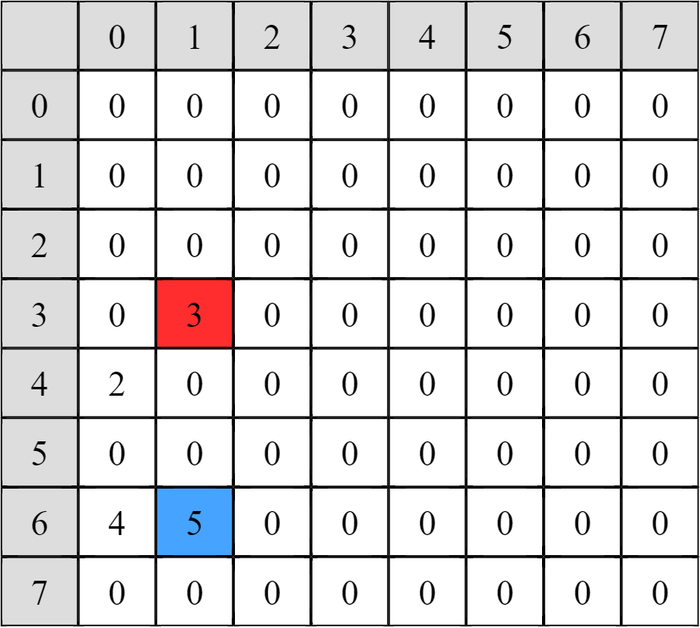


M-STR-IC-LCS
$$β$$
i = 6, j = 5
X = aabbbba
Y = aabbba
A = A[1:3] + a
B = B[1:4] + ba
$$α$$

Slide 17

M-STR-IC-LCS
$$β$$
i = 5, j = 4
X = aabbbba
Y = aabbba
A = A[1:3] + a
B = B[1:3] + bba
$$α$$

Slide 18
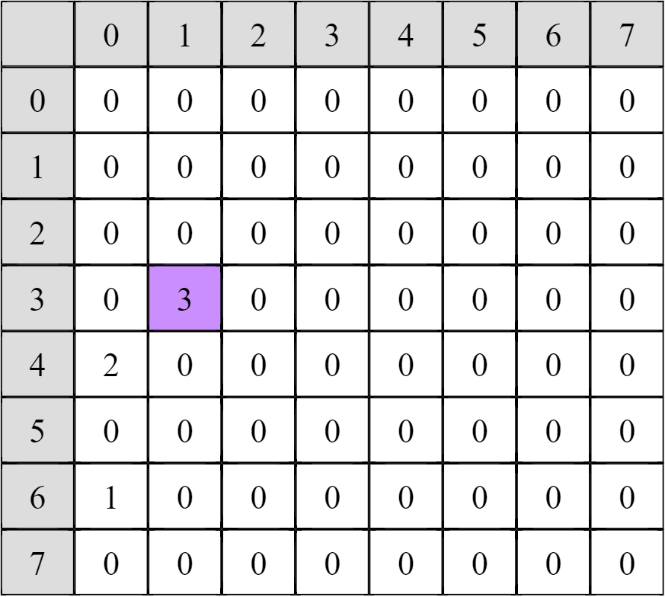

M-STR-IC-LCS
$$β$$
i = 4, j = 3
X = aabbbba
Y = aabbba
A = A[1:2] + ba
B = B[1:2] + bbba
$$α$$

Slide 19
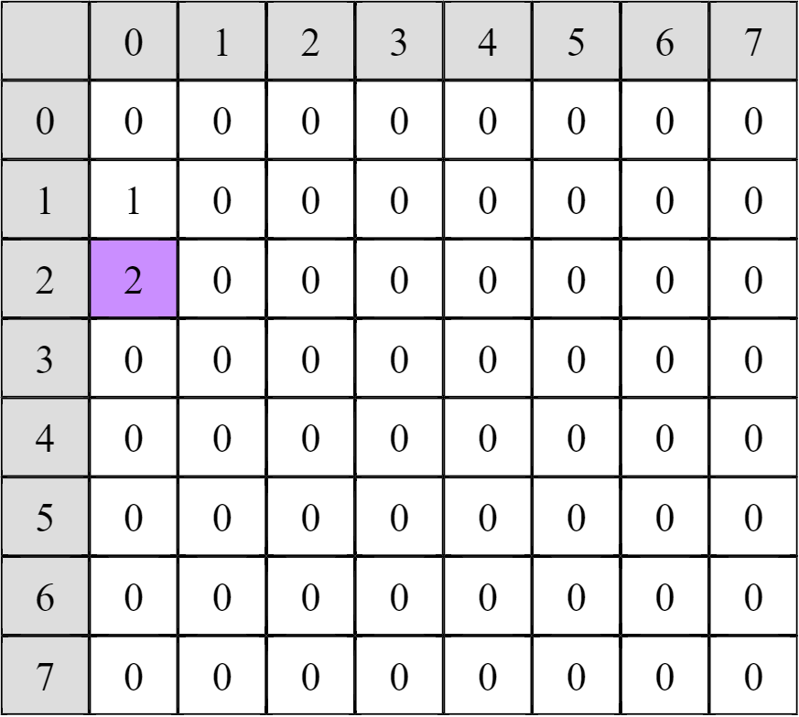


M-STR-IC-LCS
$$β$$
i = 3, j = 2
X = aabbbba
Y = aabbba
A = A[1:2] + ba
B = B[1:2] + bbba
$$α$$

Slide 20



M-STR-IC-LCS
i = 2, j = 2 i = 3, j = 1 X = aabbbba X = aabbbba Y = aabbba Y = aabbba
$$β$$
$$α$$

Slide 21
M-STR-IC-LCS
$$β$$
i = 2, j = 2
X = aabbbba
Y = aabbba
A = A[1] + aba
B = B[1] + abbba
$$α$$

Slide 22
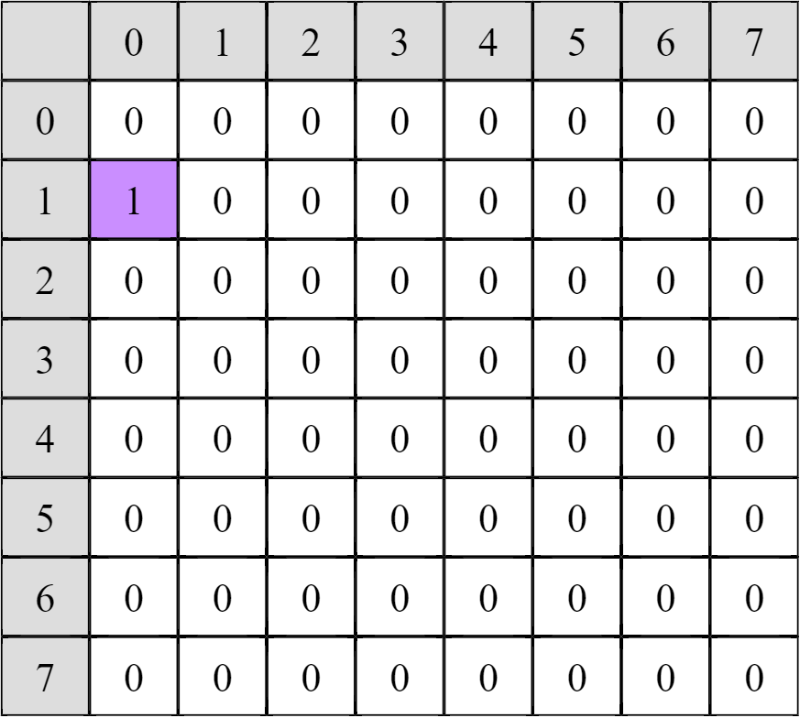
M-STR-IC-LCS
$$β$$
i = 1, j = 1
X = aabbbba
Y = aabbba
A = aaba
B = aabbba
$$α$$

Slide 23
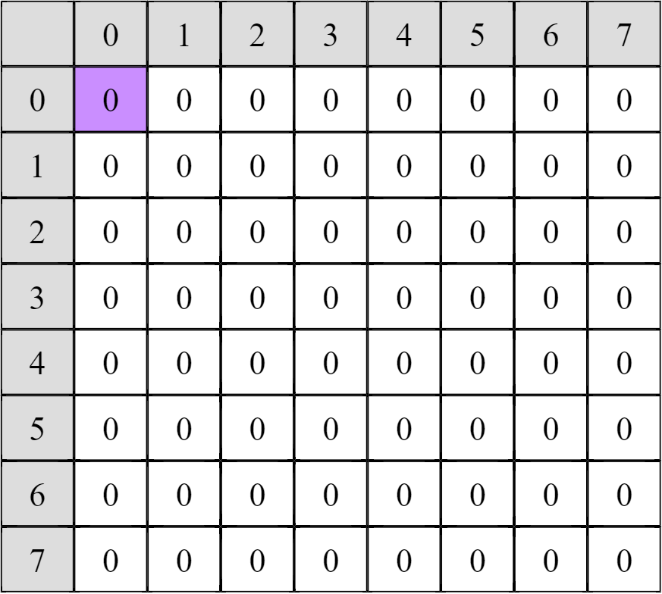


M-STR-IC-LCS
$$β$$
i = 0, j = 0
X = aabbbba
Y = aabbba
A = aaba
B = aabbba
$$α$$

Slide 24
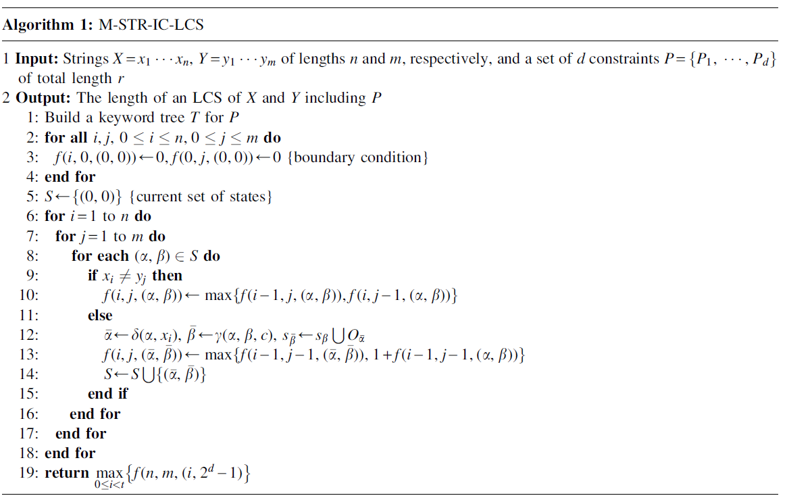

Slide 25
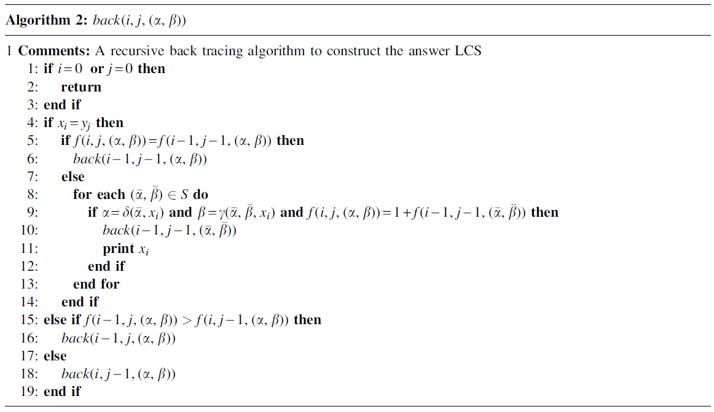

Slide 26
Time complexity
O(d2^{d}nmr)
If d is fixed => O(nmr)

