Slide 1
Hierarchical Overlap Graph
Bastien Cazaux, Eric Rivals
Information Processing Letters 155 (2020) 105862
Presenter : Yu-Ju Liao
Date : Oct. 20, 2021

Slide 2
Abstract
Given a set of finite words, the Overlap Graph (OG) is a complete weighted digraph where each word is a node and where the weight of an arc equals the length of the longest overlap of one word onto the other (Overlap is an asymmetric notion). The OG serves to assemble DNA fragments or to compute shortest superstrings, which are a compressed representation of the input. The OG requires space that is quadratic in the number of words, which limits its scalability. The Hierarchical Overlap Graph (HOG) is an alternative graph that also encodes all maximal overlaps, but uses space that is linear in the sum of the lengths of the input words. We propose the first algorithm to build the HOG in linear space for words of equal length.

Slide 3
Overlap
S₁ = aacaa
S₂ = aagt
S₁-> S₂ = ‘aa’

Slide 4
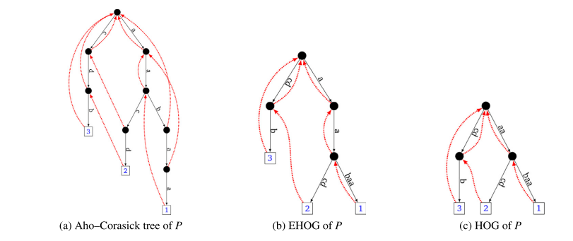
Hierarchical Overlap Graph (HOG)
P = {aabaa, aacd, cdb}

Slide 5
Hierarchical Overlap Graph (HOG)
P = {aabaa, aacd, cdb}

Slide 6
Shortest Common Superstring
P = {aacaa, aagt, gtc}
S = aacaagtc
Overlap
S₁ = aacaa
S₂ = aagt
S₁-> S₂ = ‘aa’

Slide 7
Hierarchical Overlap Graph (HOG)
P = {aabaa, aacd, cdb}

Slide 8
Hierarchical Overlap Graph (HOG)
P = {aabaa, aacd, cdb}

Slide 9
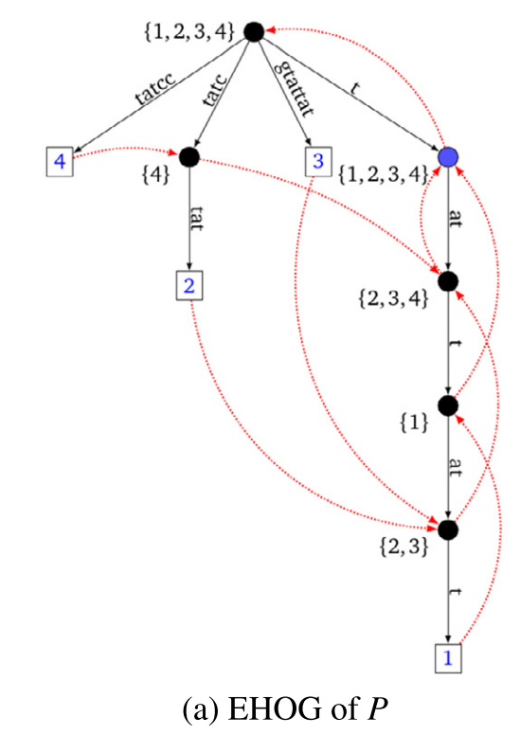
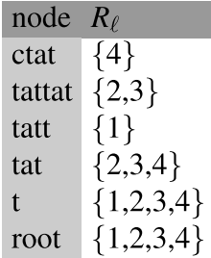
Algorithm
P = {tattatt, ctattat, gtattat, cctat}
Notes:
=>v_{0,3} to v_{4,9}

Slide 10
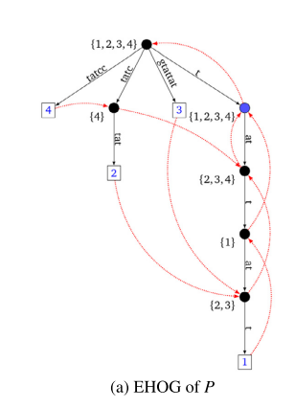
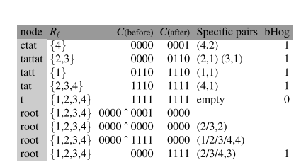
Algorithm
P = {tattatt, ctattat, gtattat, cctat}
Notes:
=>v_{0,3} to v_{4,9}

Slide 11
Algorithm
1
3
P = {tattatt, ctattat, gtattat, cctat}
2
4
Notes:
=>v_{0,3} to v_{4,9}

Slide 12
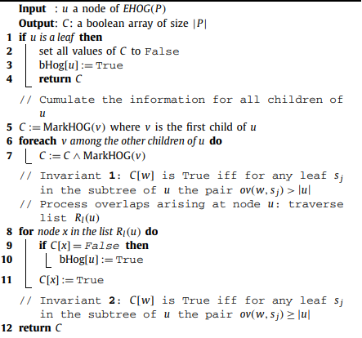
Algorithm

Slide 13
Time complexity
For each node, the corresponding C vector is computed once and merged once during the processing of his parent.
processing all the lists R_{l} for all nodes takes linear time in ||P||.
Altogether all calls of Algorithm 2 require O(||P|| + |P|²)
Notes:
=>v_{0,3} to v_{4,9}

