Slide 1
Appearance-Based Object Recognition Using Weighted Longest Increasing Subsequence
Gede Putra Kusuma, Attila Szabo, Li Yiqun and Jimmy Addison Lee
21st International Conference on Pattern Recognition (ICPR 2012) November 11-15, 2012. Tsukuba, Japan
Presenter: Shin-Cheng Lin
Date: Oct. 20, 2021

Slide 2
Abstract
We proposed in this paper a novel weighted longest increasing subsequence to improve the performance of the appearance-based object recognition. The LIS is employed to find the true keypoint matches that have consistent geometric order in both query and gallery images. Then, the similarity between query and gallery images is measured by the sum of the weights of the true keypoints. The experimental results shown that our approach outperforms the SURF and SURF + RANSAC Homography approaches.

Slide 3
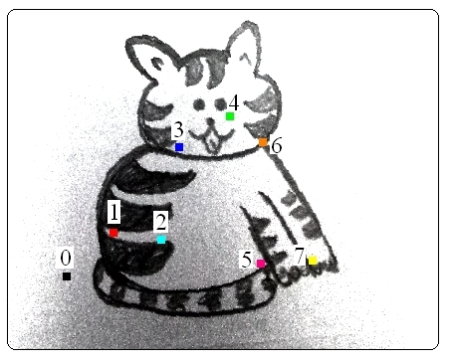
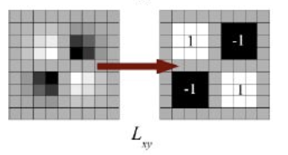
Feature Detection
Find the keypoints in query and gallery images.
Keypoint → Larger gradient

Slide 4

Matching
Measured by the Euclidean distance of their descriptors.
d₁ / d₂ ＜ threshold
a weight for every pair of best matches
d₁: best match, d₂ second best match

Slide 5
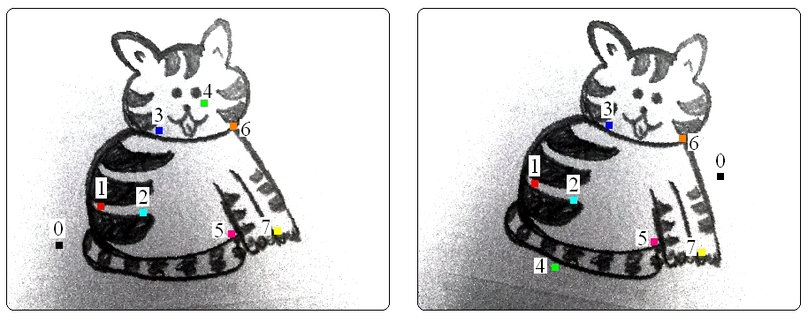
RANSAC
RANSAC (Random sample Consensus)
Randomly select 4 pairs
Calculate the Homography Matrix
Calculate the error value
Record minimum error

Slide 6
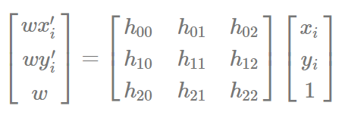
Homography and error value
Homography Matrix
wP’ = HP
COUNT( |HP－P’| < threshold)

Slide 7
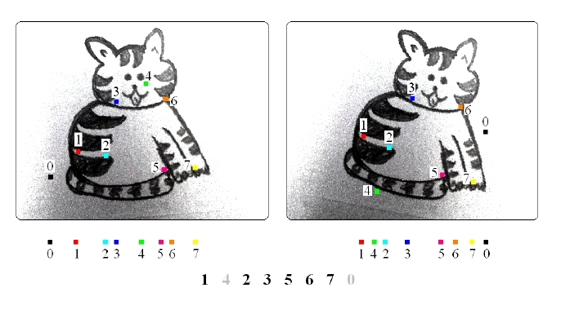
LIS
finding the LIS of the keypoint pairs along the X-axis.
Translate
Scale
Rotation
Affine transformation

Slide 8
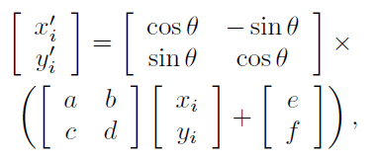
Rotation
Randomly rotate the keypoints and re-compute the LIS.
Affine transformation
Preserve the relative order by rotation.

Slide 9

Similarity Measure
only keep true keypoint matches
f_{i} = 1, consistent feature
f_{i} = 0, otherwise

Slide 10
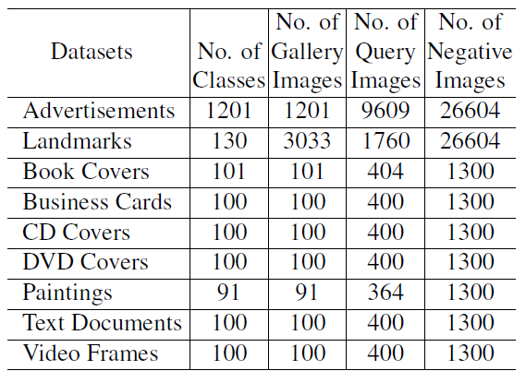

Slide 11
