Slide 1
Dynamic All Scores Matrices for LCS Score
Amir Carmel, Dekel Tsur, Michal Ziv-Ukelson
arXiv preprint arXiv:1808.03553 (2018)
Presenter: Tsung-Lin Lu
Date: Oct. 26, 2021

Slide 2
Abstract (1/2)
The problem of aligning two strings A, B in order to determine their similarity is fundamental in the field of pattern matching. An important concept in this domain is the “all scores matrix” that encodes the local alignment comparison of two strings. Namely, let K denote the all scores matrix containing the alignment score of every substring of B with A, and let T denote the all scores matrix containing the alignment score of every suffix of B with every prefix of A.

Slide 3
Abstract (2/2)
In this paper we consider the problem of maintaining an all scores matrix where the scoring function is the LCS score, while supporting single character prepend and append operations to A and B. Our algorithms exploit the sparsity parameters L = LCS(A, B) and ∆ = |B| − L. For the matrix K we propose an algorithm that supports incremental operations to both ends of A in O(∆) time. Whilst for the matrix T we propose an algorithm that supports a single type of incremental operation, either a prepend operation to A or an append operation to B, in O(L) time. This structure can also be extended to support both operations simultaneously in O(L log log L) time.

Slide 4
Outline
All Scores Matrices (ASM)
k-IASM
Definition
Incremental K Matrix
Incremental T Matrix

Slide 5
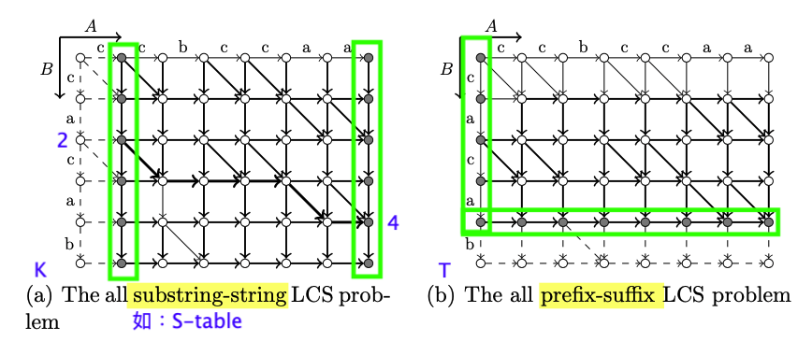
All Scores Matrices (ASM)
An all scores matrix is a matrix that stores the optimal alignment scores of one or more types from the following types
B against every substring of A
A against every substring of B
every suffix of A against every prefix of B
every suffix of B against every prefix of A
L matrix includes all type
K matrix includes type 2
T matrix includes type 4

Slide 6
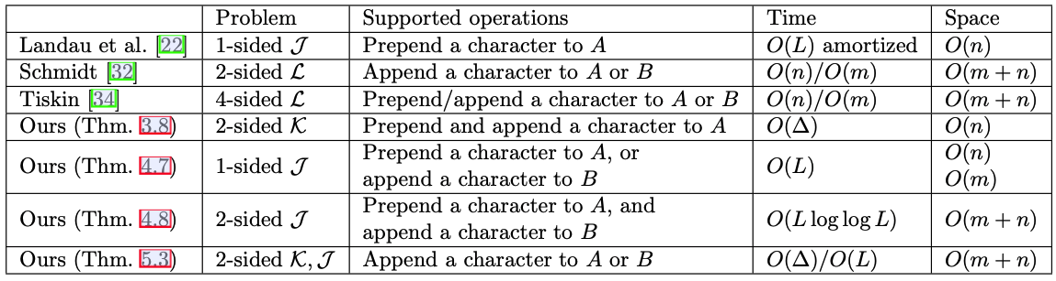
k-IASM
k-sided incremental all scores matrix problem (k-IASM)
Table 1: Comparison of known and new results for k-IASM. A and B denote two strings of lengths m and n, respectively, over a constant alphabet. In this setting, L = LCS(A, B) and ∆ = n − L.

Slide 7
Definition
L = LCS(A, B)
∆ = n − L
NextMatch_{S}(i, σ)
PrevMatch_{S}(j, σ)
K[i, j] = LCS(B[i..j], A)
T[i, j] = LCS(B[i..n], A[0..j])
Density matrix, denoted by D􏰏
D􏰏[i, j] = (D[i, j] + D[i−1, j−1]) -
(斜線-反斜線) (D[i−1, j] + D[i, j−1])

Slide 8
Incremental K Matrix
K′[i, j] = max{K[NextMatch_{B}(i, σ), j] + 1, K[i, j]}
 | 0 | 1 | 2 | 3 | 4 | 5 | 6 | 7 | 8 | 9
0 | 0 | 1 | 2 | 2 | 2 | 2 | 3 | 3 | 3 | 3
1 | -1 | 0 | 1 | 2 | 2 | 2 | 3 | 3 | 3 | 3
2 | -2 | -1 | 0 | 1 | 1 | 2 | 3 | 3 | 3 | 3
3 | -3 | -2 | -1 | 0 | 1 | 2 | 3 | 3 | 3 | 3
4 | -4 | -3 | -2 | -1 | 0 | 1 | 2 | 2 | 2 | 2
5 | -5 | -4 | -3 | -2 | -1 | 0 | 1 | 2 | 2 | 2
6 | -6 | -5 | -4 | -3 | -2 | -1 | 0 | 1 | 2 | 2
7 | -7 | -6 | -5 | -4 | -3 | -2 | -1 | 0 | 1 | 1
8 | -8 | -7 | -6 | -5 | -4 | -3 | -2 | -1 | 0 | 1
9 | -9 | -8 | -7 | -6 | -5 | -4 | -3 | -2 | -1 | 0
 |  | 1 | 2 | 3 | 4 | 5 | 6 | 7 | 8 | 9
 | 0 | 0 | 0 | 0 | 0 | 1 | 1 | 1 | 1 | 1
 | 0 | 0 | 0 | 0 | 0 | 1 | 1 | 1 | 1 | 1
 | 0 | 0 | 0 | 0 | 1 | 1 | 1 | 1 | 1 | 1
 | 0 | 0 | 0 | 0 | 0 | 0 | 0 | 0 | 0 | 0
 | 0 | 0 | 0 | 0 | 0 | 0 | 0 | 1 | 1 | 1
 | 0 | 0 | 0 | 0 | 0 | 0 | 0 | 0 | 0 | 0
 | 0 | 0 | 0 | 0 | 0 | 0 | 0 | 0 | 0 | 0
 | 0 | 0 | 0 | 0 | 0 | 0 | 0 | 0 | 0 | 1
 | 0 | 0 | 0 | 0 | 0 | 0 | 0 | 0 | 0 | 0
 | 0 | 0 | 0 | 0 | 0 | 0 | 0 | 0 | 0 | 0
 |  | 1 | 2 | 3 | 4 | 5 | 6 | 7 | 8 | 9
 | 0 | 1 | 2 | 2 | 2 | 3 | 4 | 4 | 4 | 4
 | -1 | 0 | 1 | 2 | 2 | 3 | 4 | 4 | 4 | 4
 | -2 | -1 | 0 | 1 | 2 | 3 | 4 | 4 | 4 | 4
 | -3 | -2 | -1 | 0 | 1 | 2 | 3 | 3 | 3 | 3
 | -4 | -3 | -2 | -1 | 0 | 1 | 2 | 3 | 3 | 3
 | -5 | -4 | -3 | -2 | -1 | 0 | 1 | 2 | 2 | 2
 | -6 | -5 | -4 | -3 | -2 | -1 | 0 | 1 | 2 | 2
 | -7 | -6 | -5 | -4 | -3 | -2 | -1 | 0 | 1 | 2
 | -8 | -7 | -6 | -5 | -4 | -3 | -2 | -1 | 0 | 1
 | -9 | -8 | -7 | -6 | -5 | -4 | -3 | -2 | -1 | 0
(a) K / K􏰏
(b) C = K' – K / C􏰏 = K'􏰏– K􏰏
(c) K' = K + C / K'􏰏 = K􏰏 + C􏰏
Figure 2: An example of the matrices K, K′, C and C􏰏 for A = bbcac, B = ccabaccaa, and a prepend of the character a to A. Pivotal points are yellow and step indices in C are green.

Slide 9
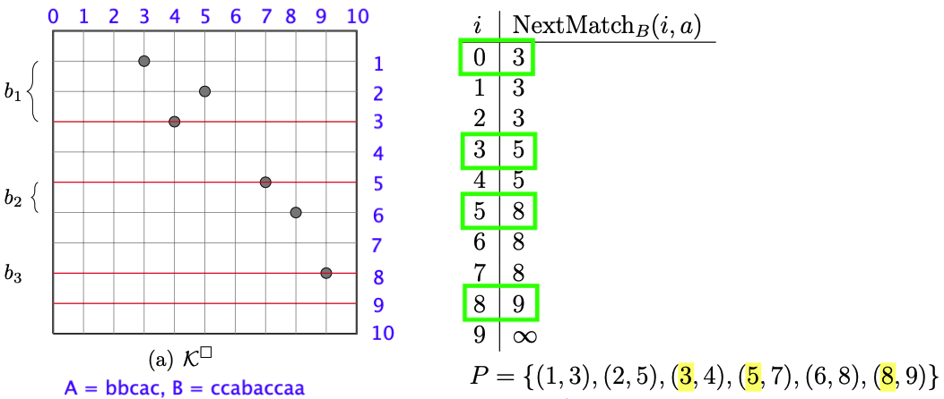
Incremental K Matrix
K → K􏰏→ C
step indices in C: (0, 5) (1,5) (2,4) (4,7) (7,9)
step :{ (0, 5) (1,5) (2,4) (4,7) (7,9)}
Figure 3: A run of the algorithm on the strings A and B of Figure 2, and a prepend of the character a to A. (a) shows the pivotal points of K􏰏. The red lines correspond to the different values of NextMatchB(i,a). b1,b2 and b3 denote blocks of consecutive pivotal points

Slide 10
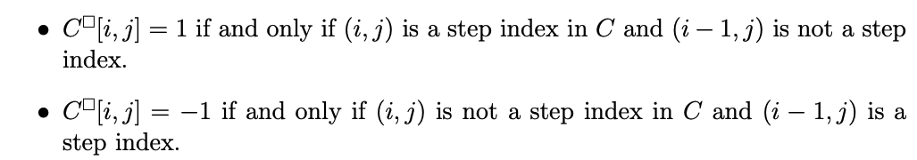
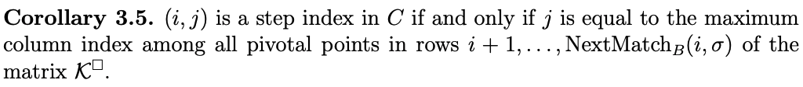
Incremental K Matrix
consecutive pivotal points
C → C􏰏
step index in C

Slide 11
Incremental K Matrix
1-sided incremental K matrix
An O(∆) space data structure that supports prepend (or append) operations to the string A in O(∆) time.
K is encoded via the pivotal points of its density matrix (K􏰏).
P stored pivotal points of K􏰏.
K􏰏 (P) → step indices in C → C 􏰏 → K'􏰏
The number of step indices in C is bounded by ∆. (Lamma3.2)

Slide 12
Incremental T Matrix
T′[i, j] = max{T[i, j], T[NextMatch_{B}(i, σ), j] + 1}
 | 0 | 1 | 2 | 3 | 4 | 5 | 6 | 7
0 | 0 | 1 | 2 | 2 | 2 | 3 | 4 | 4
1 | 0 | 1 | 2 | 2 | 2 | 3 | 4 | 4
2 | 0 | 1 | 2 | 2 | 2 | 3 | 4 | 4
3 | 0 | 1 | 2 | 2 | 2 | 2 | 3 | 3
4 | 0 | 1 | 2 | 2 | 2 | 2 | 3 | 3
5 | 0 | 1 | 1 | 1 | 1 | 1 | 2 | 2
6 | 0 | 0 | 0 | 0 | 0 | 0 | 1 | 1
7 | 0 | 0 | 0 | 0 | 0 | 0 | 0 | 0
 | -1 | 0 | 1 | 2 | 3 | 4 | 5 | 6 | 7
0 | 0 | 1 | 1 | 1 | 1 | 1 | 1 | 1 | 1
1 | 0 | 1 | 1 | 1 | 1 | 1 | 1 | 1 | 1
2 | 0 | 1 | 1 | 1 | 1 | 1 | 0 | 0 | 0
3 | 0 | 1 | 1 | 1 | 1 | 1 | 1 | 1 | 1
4 | 0 | 1 | 0 | 0 | 0 | 0 | 0 | 0 | 0
5 | 0 | 1 | 0 | 0 | 0 | 0 | 0 | 0 | 0
6 | 0 | 1 | 1 | 1 | 1 | 1 | 1 | 0 | 0
7 | 0 | 0 | 0 | 0 | 0 | 0 | 0 | 0 | 0
 | -1 | 0 | 1 | 2 | 3 | 4 | 5 | 6 | 7
0 | 0 | 1 | 2 | 3 | 3 | 3 | 4 | 5 | 5
1 | 0 | 1 | 2 | 3 | 3 | 3 | 4 | 5 | 5
2 | 0 | 1 | 2 | 3 | 3 | 3 | 3 | 4 | 4
3 | 0 | 1 | 2 | 3 | 3 | 3 | 3 | 4 | 4
4 | 0 | 1 | 1 | 2 | 2 | 2 | 2 | 3 | 3
5 | 0 | 1 | 1 | 1 | 1 | 1 | 1 | 2 | 2
6 | 0 | 1 | 1 | 1 | 1 | 1 | 1 | 1 | 1
7 | 0 | 0 | 0 | 0 | 0 | 0 | 0 | 0 | 0
(a) T / T􏰏
(b) C = T' – T / C􏰏 = T'􏰏– T􏰏
(c) T' = T + C / T'􏰏 = T􏰏 + C􏰏
Figure 4: An example of the matrices T′, T, C and C􏰏 for A = bbcbbaa, B = aacabba, and a predend of the character a to A. Pivotal points are yellow and step indices in C are green.

Slide 13
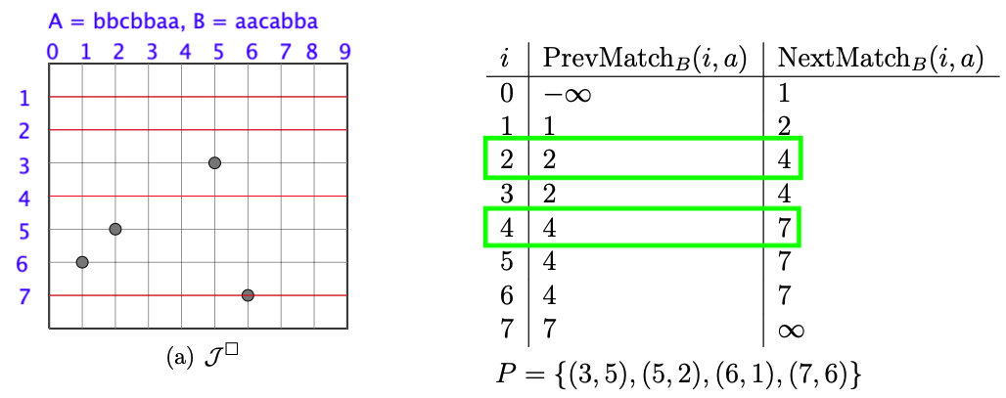
Incremental T Matrix
Lemma4.6
If B[i] ≠ 𝝈 ：
If NextMatch_{B}(i, 𝝈) < ∞ & j < j_{min} & T􏰏[i, j] is pivotal, then C􏰏[i, j] = 1
If j_{min} < ∞, then C􏰏[i, j_{min}] = -1
If B[i] = 𝝈 ：
If NextMatch_{B}(i, 𝝈) < ∞ & j_{min} < ∞, then C􏰏[i, j_{min}] = -1
If T􏰏[i, j] is pivotal, then C􏰏[i, j] = 1
P :{ (3,5) (5,2) (6,1) (7,6)}
Figure 5: A run of the algorithm on the strings A and B of Figure 4, and a prepend of the character a to A.
C􏰏 :{(2,5,-1) (3,5,1) (4,1,-1) (6,1,1) (7,6,1)
(6,6,-1) (7,0,1)}

Slide 14
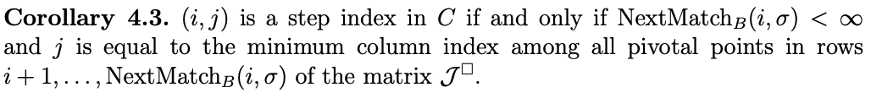
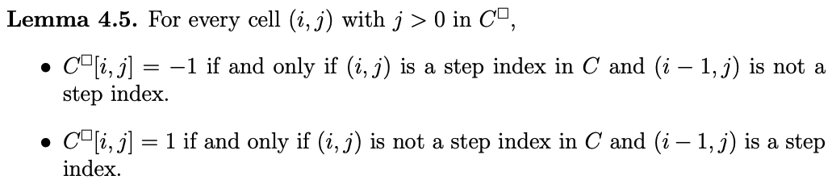
Incremental T Matrix
step index in C
obtain the pivotal point at col 0
C → C􏰏

Slide 15
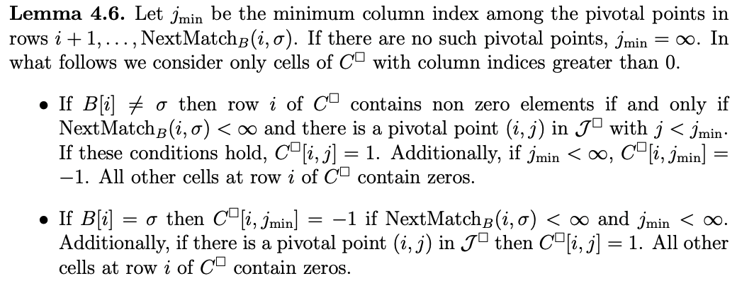
Incremental T Matrix
Lemma4.3 (step index in C) + Lemma4.5 (C →C􏰏) → Lemma4.6

Slide 16
Incremental T Matrix
The size of T is n × m, thus it increases when such operations are performed.
The number of step indices is not bounded by the number of pivotal points.
1-sided incremental T matrix
We compute k₁⁻ = PrevMatch_{B}(i₁, σ) and k₁⁺ = NextMatch_{B}(i₁,σ).
k₁⁻ and k₁⁺ are the starting and ending indices of a block of pivotal points.
We then use Lemma 4.6 to compute C􏰏 efficiently in O(L) time.
We encode the matrix T by the L pivotal points of its density matrix (T 􏰏).

Slide 17
Thank you for listening

Slide 18
Abstract
s

