Slide 1
Computing a longest common almost-increasing subsequence of two sequences
Toan Thang Ta, Yi-Kung Shieh, Chin Lung Lu
Theoretical Computer Science 854 (2021) 44–51
Presenter: Shih-Hong Li
Date: Apr. 2, 2024
Notes:
清華大學 盧錦隆

Slide 2
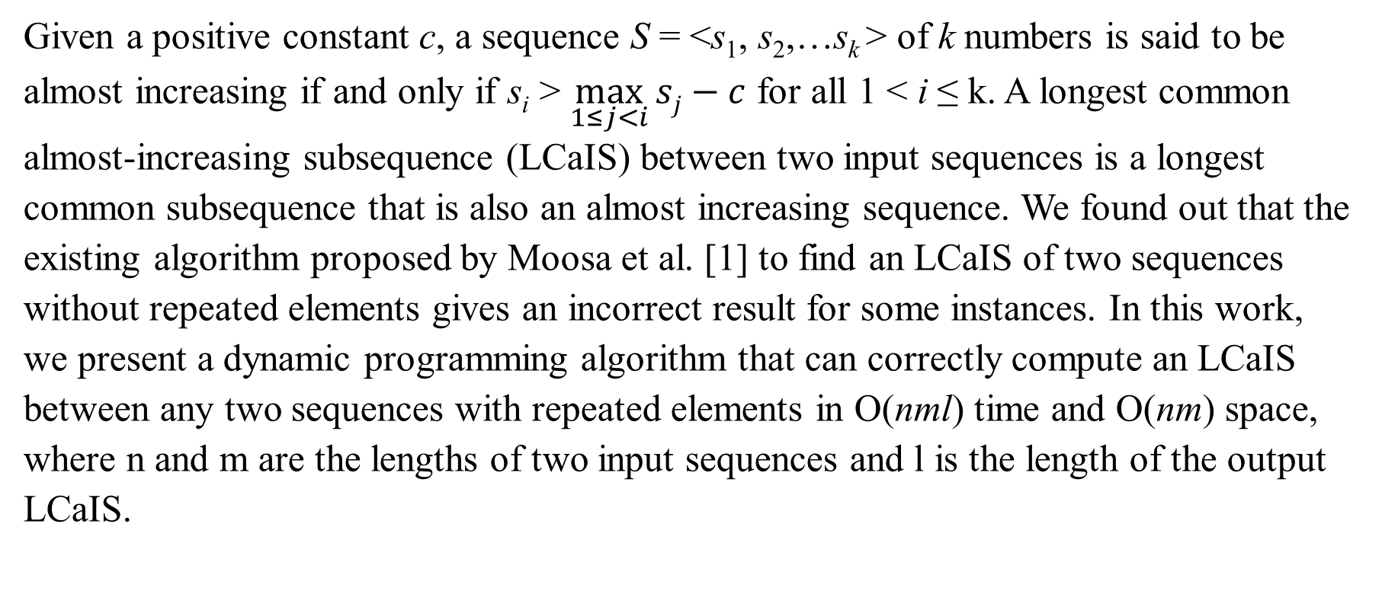
Abstract
Given a positive constant c, a sequence S = <s₁, s₂,…s_{k} > of k numbers is said to be almost increasing if and only if s_{i} > $\max_{1≤j<i}{sj−c}$ for all 1 < i ≤ k. A longest common almost-increasing subsequence (LCaIS) between two input sequences is a longest common subsequence that is also an almost increasing sequence. We found out that the existing algorithm proposed by Moosa et al. [1] to find an LCaIS of two sequences without repeated elements gives an incorrect result for some instances. In this work, we present a dynamic programming algorithm that can correctly compute an LCaIS between any two sequences with repeated elements in O(nml) time and O(nm) space, where n and m are the lengths of two input sequences and l is the length of the output LCaIS.

Slide 3
Longest almost increasing subsequence(LaIS)
Given a sequence A : <7,15,2,14,14,6,8,11,17,15,14,13>，with tolerance c = 2
LaIS = <2,6,8,11,14,13>

Slide 4
Longest almost common increasing subsequence(LCaIS)
Given a sequence A = <3,2,1,3,2> and B = <1,3,3,2> with c = 2
LCaIS = <3,3,2>

Slide 5
Dynamic programming algorithm
Two-dimensional table T (matching table)
A/B | 1 | 3 | 3 | 2
3 |  | * | *
2 |  |  |  | *
1 | *
3 |  | * | *
2 |  |  |  | *

Slide 6
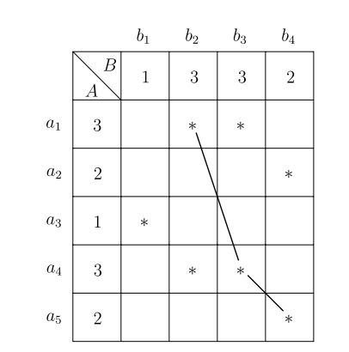
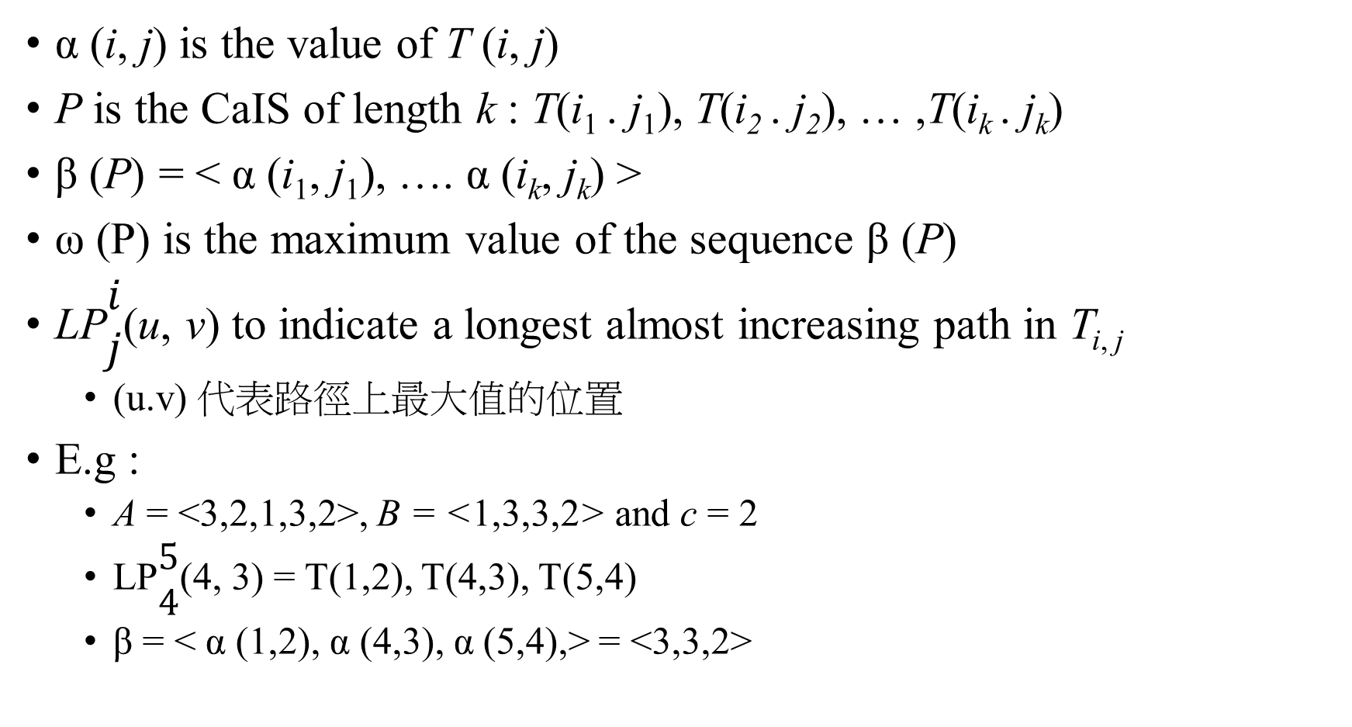
α (i, j) is the value of T (i, j)
P is the CaIS of length k : T(i₁ . j₁), T(i₂ . j₂), … ,T(i_{k} . j_{k})
β (P) = < α (i₁, j₁), …. α (i_{k}, j_{k}) >
ω (P) is the maximum value of the sequence β (P)
LP$\begin{matrix}i \\ j\end{matrix}$(u, v) to indicate a longest almost increasing path in T_{i, j}
(u.v) 代表路徑上最大值的位置
E.g :
A = <3,2,1,3,2>, B = <1,3,3,2> and c = 2
LP$\begin{matrix}5 \\ 4\end{matrix}$(4, 3) = T(1,2), T(4,3), T(5,4)
β = < α (1,2), α (4,3), α (5,4),> = <3,3,2>

Slide 7
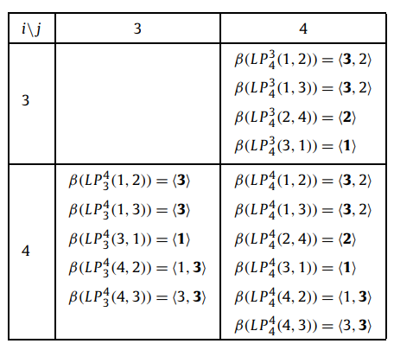
Case 1(not match)(1/3)
add the longest path among all paths in L(i − 1, j) ∪ L(i, j − 1)
A/B | 1 | 3 | 3 | 2
3 |  | * | *
2 |  |  |  | *
1 | *
3 |  | * | *
2 |  |  |  | *

Slide 8
Case 1(not match) (2/3)
add the longest path among all paths in L(i − 1, j) ∪ L(i, j − 1)
A/B | 1 | 3 | 3 | 2
3 |  | * | *
2 |  |  |  | *
1 | *
3 |  | * | *
2 |  |  |  | *

Slide 9
Case 1(not match) (3/3)
add the longest path among all paths in L(i − 1, j) ∪ L(i, j − 1)

Slide 10
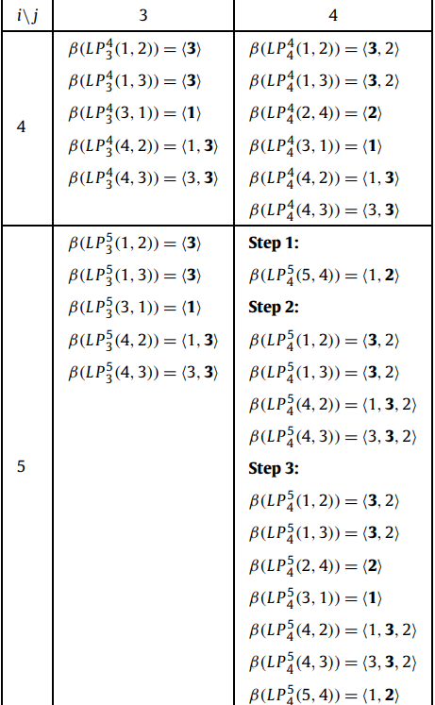

Case 2 (match)(1/3)
Step 1:
ω(P) ≤ α(i, j)
3$≤$ 2 X
3 $≤$2 O
1 $≤$ 2 X
3 $≤$ 2 X
3 $≤$ 2 X

Slide 11

Case 2 (match)(2/3)
Step 2:
α(i, j) $≤\text{ω}\text{(}\text{P}\text{)}$ $≤$ α(i, j) + c
2 $≤$ 3 $≤$ 2+2 O
2 $≤$ 3 $≤$ 2+2 O
2 $≤$ 1 $≤$ 2+2 X
2 $≤$ 3 $≤$ 2+2 O
2 $≤$ 3 $≤$ 2+2 O

Slide 12
Case 2 (match)(2/3)
Step 3:
L(i − 1, j) ∪ L(i, j − 1) ∪ L’ (i, j)

Slide 13

Simplify
每種長度只記一個
Step1: remove all dominated
Step2: removed redundant
Step3: replace each LP$\begin{matrix}i \\ j\end{matrix}$(u, v) in L(i, j) by a 3-tuple

Slide 14
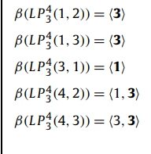
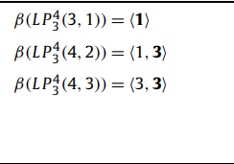
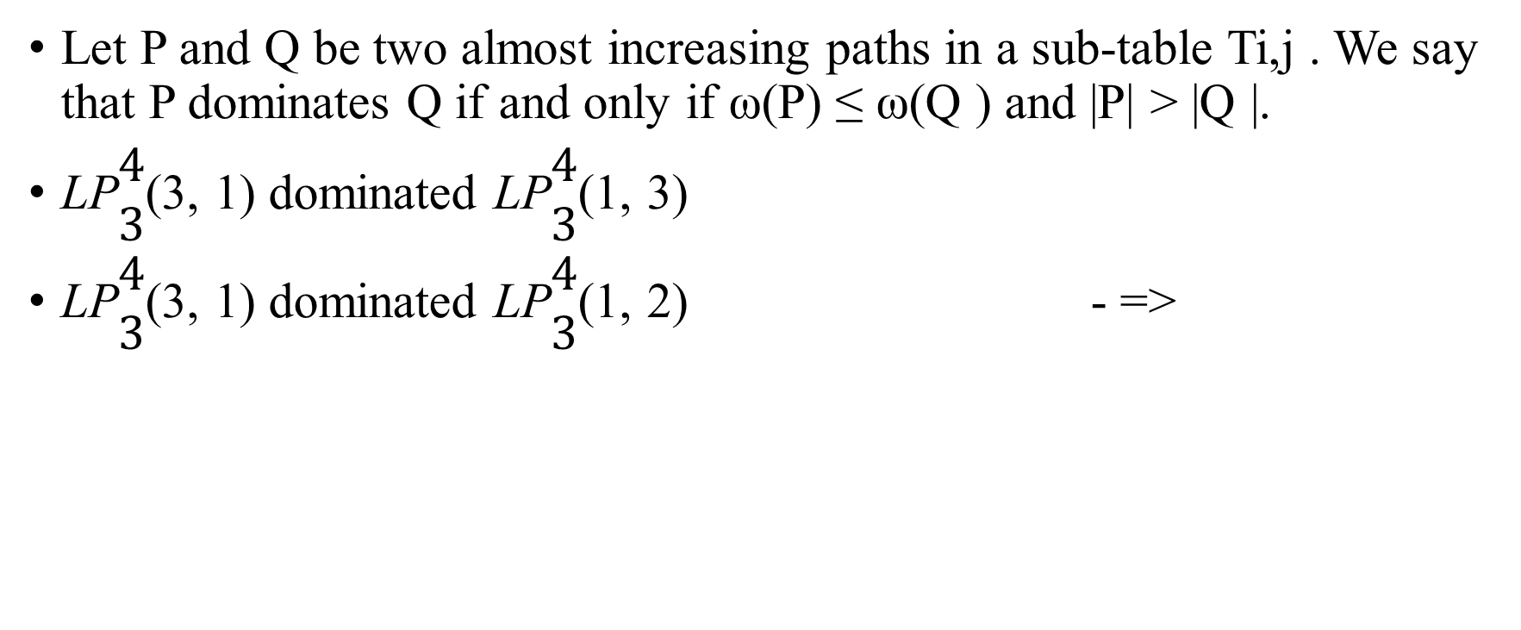
Remove all dominated
Let P and Q be two almost increasing paths in a sub-table Ti,j . We say that P dominates Q if and only if ω(P) ≤ ω(Q ) and |P| > |Q |.
LP$\begin{matrix}4 \\ 3\end{matrix}$(3, 1) dominated LP$\begin{matrix}4 \\ 3\end{matrix}$(1, 3)
LP$\begin{matrix}4 \\ 3\end{matrix}$(3, 1) dominated LP$\begin{matrix}4 \\ 3\end{matrix}$(1, 2) - =>

Slide 15
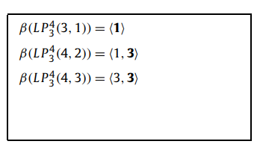

Removed redundant
如果經過step1之後還有每個長度還有大於一個的話，就留第一個
=>

Slide 16
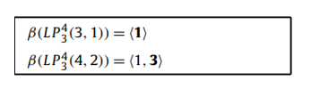


Replace each LP$\begin{matrix}i \\ j\end{matrix}$(u, v) in L(i, j) by a 3-tuple
=>

Slide 17
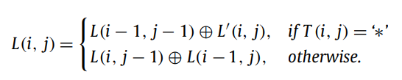
Recursive formula

Slide 18
Conclusion
Time complexity : O(nml)
Space complexity : O(nm)
Notes:
可能可以到O(nm)

Slide 19
Thanks

