Slide 1
The Hanabi challenge: A new frontier for AI research
Nolan Bard, Jakob N. Foerster, Sarath Chandar, Neil Burch, Marc Lanctot, H. Francis Song, Emilio Parisotto, Vincent Dumoulin, Subhodeep Moitra, Edward Hughes, Iain Dunning, Shibl Mourad, Hugo Larochelle, Marc G. Bellemare, and Michael Bowling
Artificial Intelligence, 280, 103216, 2020
Presenter: Yun-An Chen
Date: Apr. 2, 2024

Slide 2
Abstract(1/3)
From the early days of computing, games have been important testbeds for studying how well machines can do sophisticated decision making. In recent years, machine learning has made dramatic advances with artificial agents reaching superhuman performance in challenge domains like Go, Atari, and some variants of poker. As with their predecessors of chess, checkers, and backgammon, these game domains have driven research by providing sophisticated yet well-defined challenges for artificial intelligence practitioners.

Slide 3
Abstract(2/3)
We continue this tradition by proposing the game of Hanabi as a new challenge domain with novel problems that arise from its combination of purely cooperative gameplay with two to five players and imperfect information. In particular, we argue that Hanabi elevates reasoning about the beliefs and intentions of other agents to the foreground. We believe developing novel techniques for such theory of mind reasoning will not only be crucial for success in Hanabi, but also in broader collaborative efforts, especially those with human partners.

Slide 4
Abstract(3/3)
To facilitate future research, we introduce the open-source Hanabi Learning Environment, propose an experimental framework for the research community to evaluate algorithmic advances, and assess the performance of current state-of-the-art techniques.

Slide 5
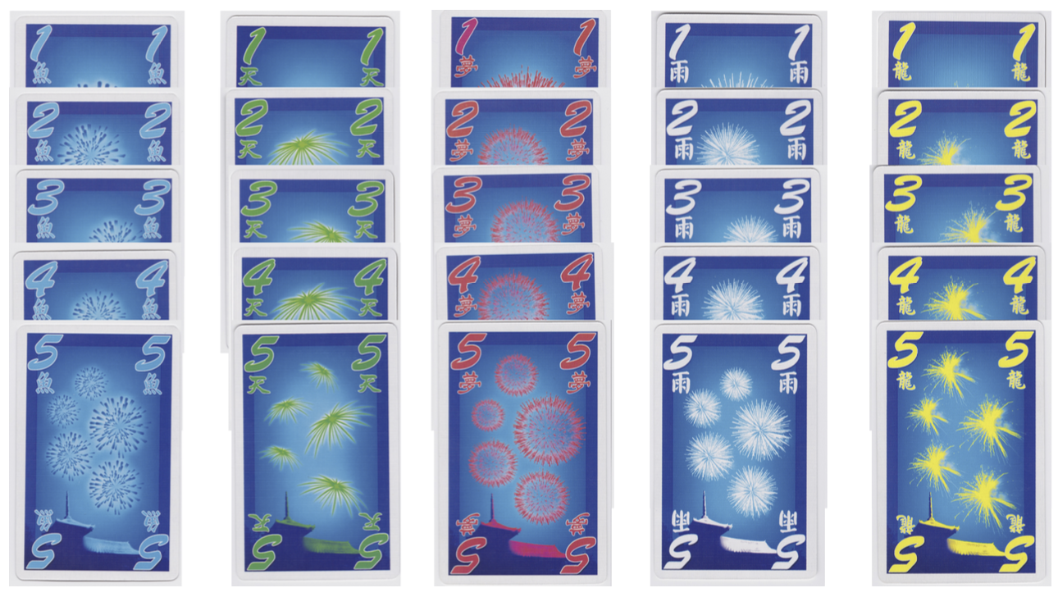
Hanabi
Picture: Cox, C., De Silva, J., Deorsey, P., Kenter, F. H., Retter, T., & Tobin, J. (2015). How to make the perfect fireworks display: Two strategies for hanabi. Mathematics Magazine, 88(5), 323-336.

Slide 6
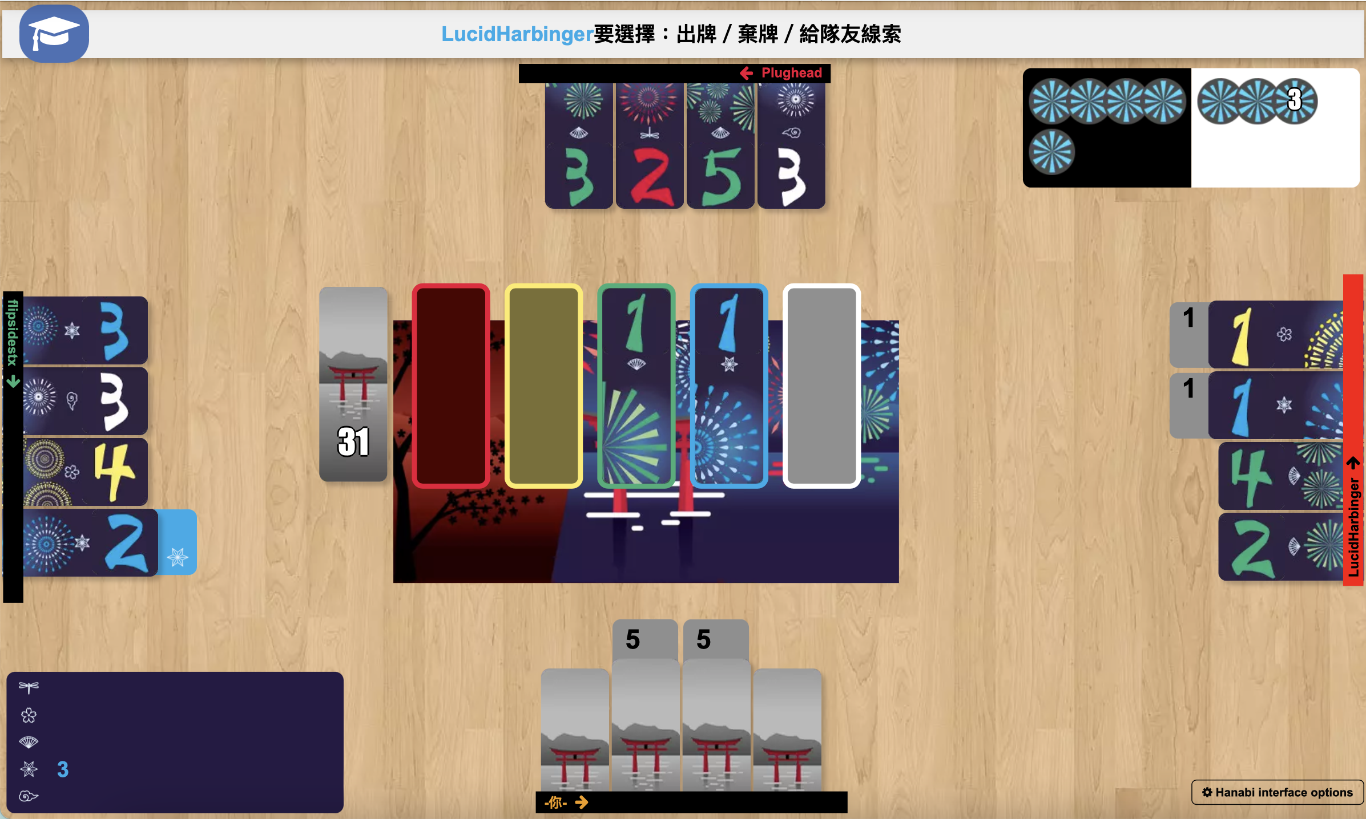
Hanabi
Deck (50 cards)
Information token
Stacks
Discards
Picture: https://en.boardgamearena.com/gamepanel?game=hanabi

Slide 7
Hanabi
Actions:
Hint (rank or color).
Discard.
Play.
Game over:
Complete all five stacks.
Three lives have been lost.
A player draws the last card from the deck and every player has taken one final turn.
Picture: https://en.boardgamearena.com/gamepanel?game=hanabi

Slide 8
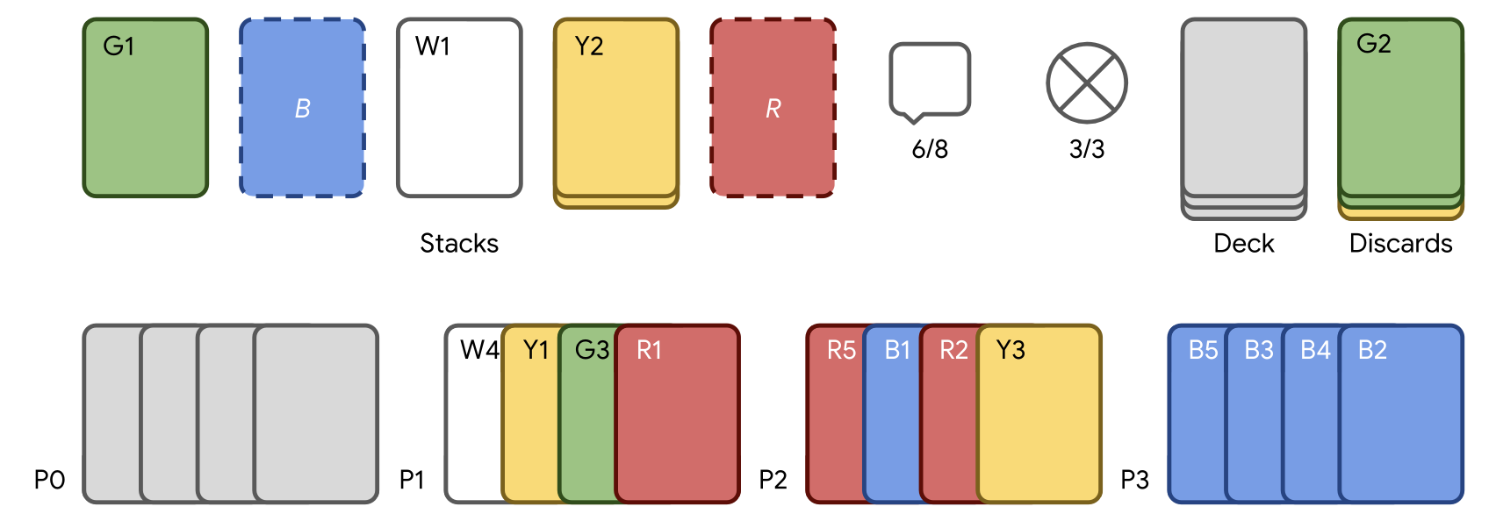
Strategy
Lower-ranked cards
Implicit communication
Finesse

Slide 9
The challenges
Imperfect information environments.
No “cheap-talk” communication channel.
Self-play learning
Sample limited regime (SL)
Unlimited regime (UL)
Ad-hoc teams

Slide 10
Problem setup
Open-source environments: Openai gym
Learning agents
Actor-Critic-Hanabi-Agent
Rainbow-Agent
BAD-Agent
Rule-based approaches
SmartBot
HatBot and WTFWThat
FireFlower

Slide 11
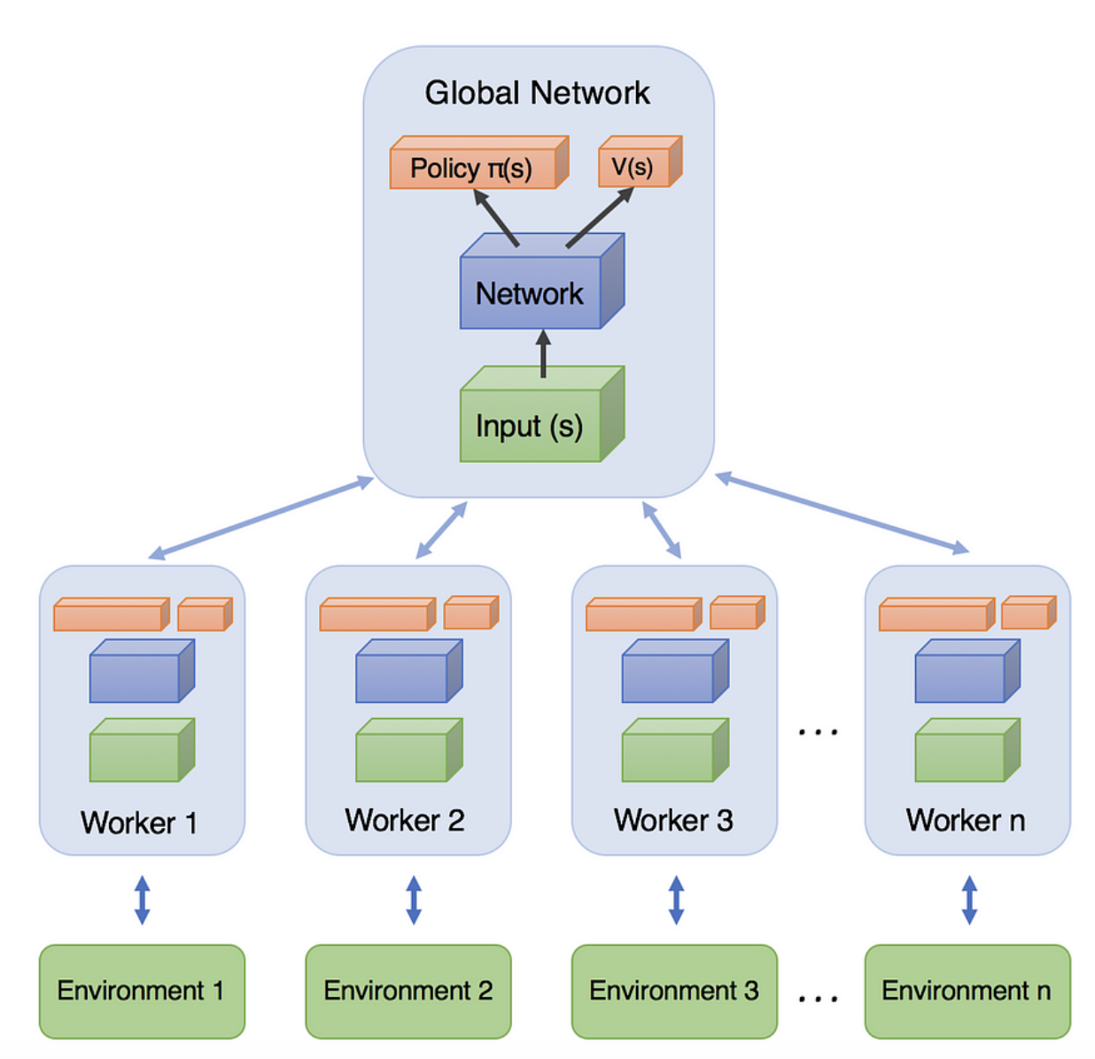
Actor-Critic-Hanabi-Agent (ACHA)
Softmax
256-unit
LSTM layer
256-unit
LSTM layer
256-unit
hidden layer
Discard 1~5
Play 1~5
Hint color 1~5
Hint rank 1~5
Observations
Picture: https://aemah.github.io/2018/06/26/A3C/

Slide 12
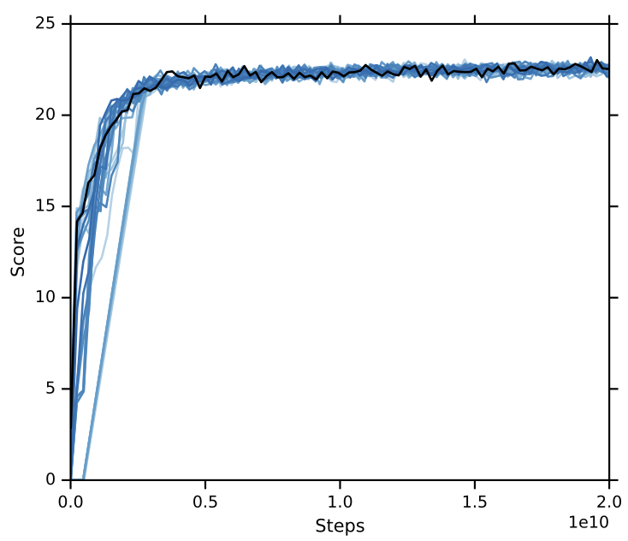
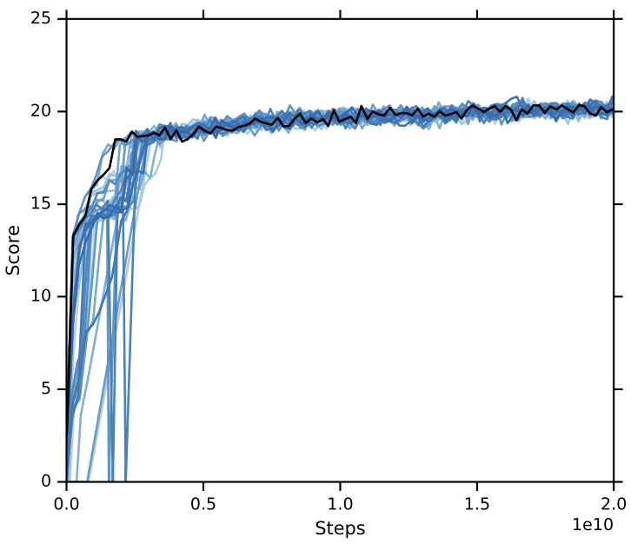
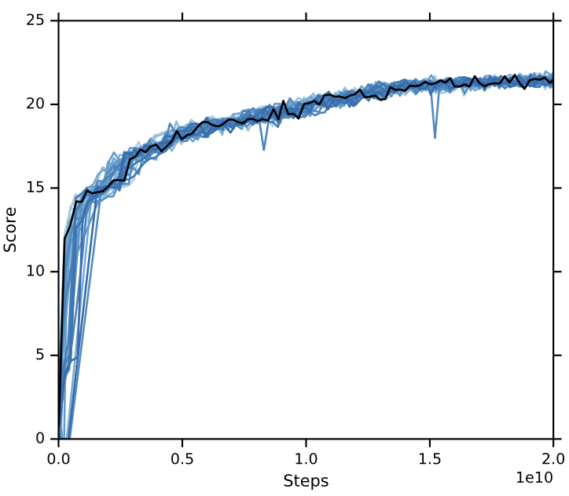
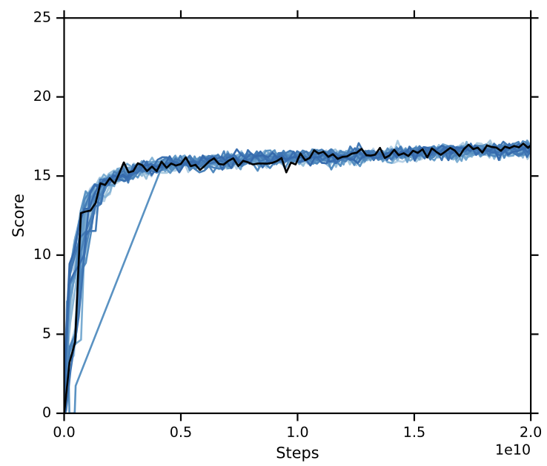
Amateur player
20 billion steps
Two players
Three players
Four players
Five players

Slide 13
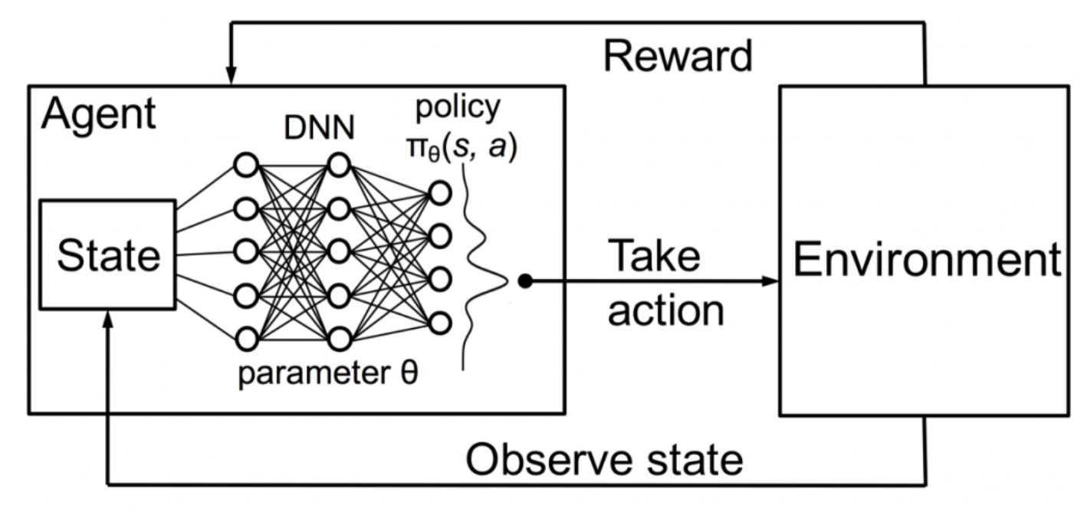
Rainbow-Agent
Deep Q-Networks algorithm (DQN).
Q(s, a): The expected value of an action in a particular state.
Picture: https://towardsdatascience.com/using-deep-q-learning-in-fifa-18-to-perfect-the-art-of-free-kicks-f2e4e979ee66

Slide 14
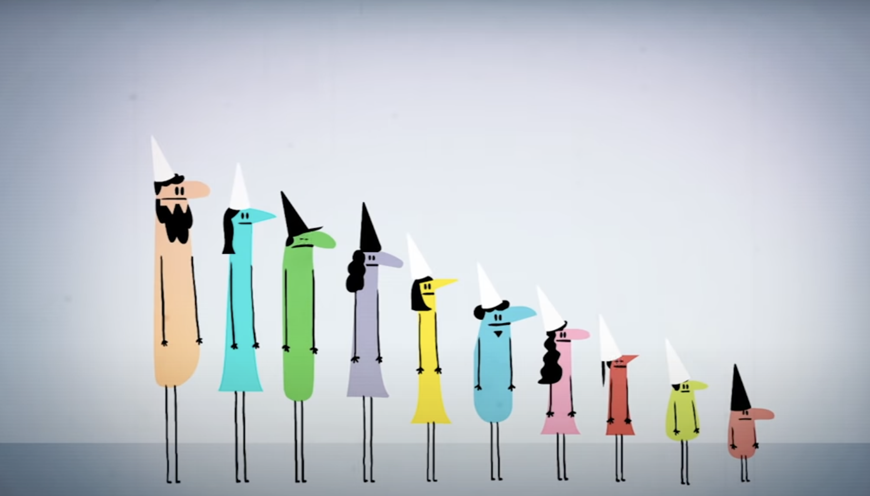
HatBot
Hat puzzle
Black
Picture: https://www.youtube.com/watch?v=N5vJSNXPEwA

Slide 15
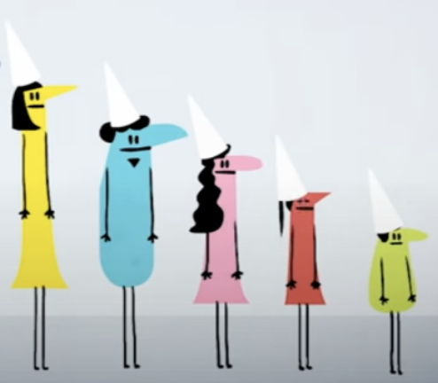
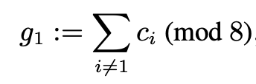
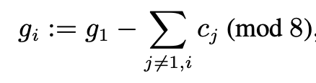
Multiple color hat guessing game
5 players: P₁, P₂, ..., P₅.
8 different “color hat” : 0, 1, ..., 7.
Player P₁:
Player P_{i} (i > 1)
5
3
1
5
4
Picture: https://www.youtube.com/watch?v=N5vJSNXPEwA
Cox, C., De Silva, J., Deorsey, P., Kenter, F. H., Retter, T., & Tobin, J. (2015). How to make the perfect fireworks display: Two strategies for hanabi. Mathematics Magazine, 88(5), 323-336.

Slide 16
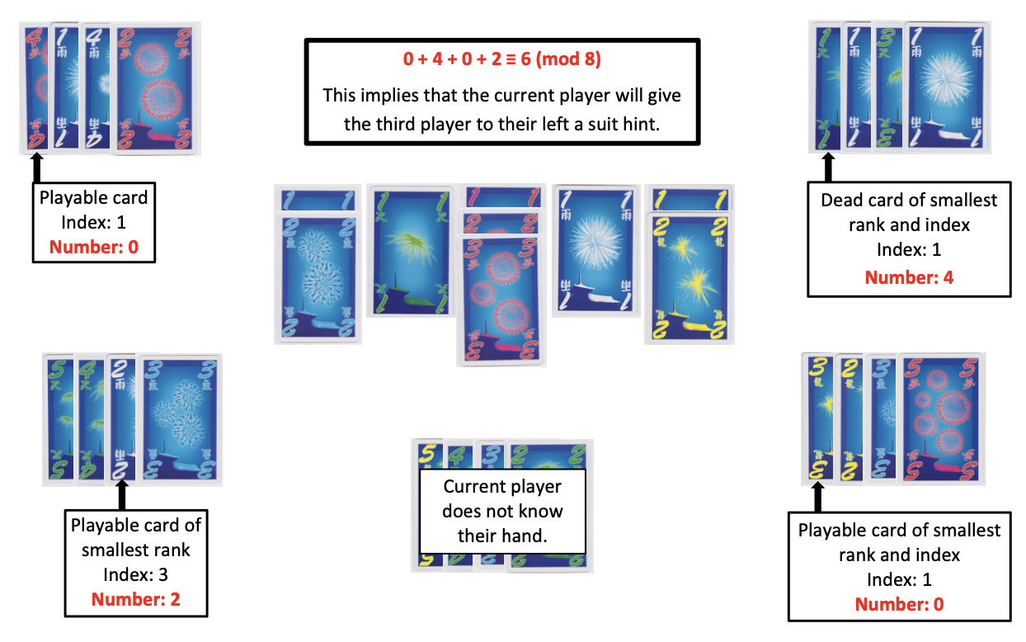
Number
0. Play card c₁
Play card c₂
Play card c₃
Play card c₄
Discard card c₁
Discard card c₂
Discard card c₃
Discard card c₄
Hat puzzle
Priority
Playable card
Dead card
Indispensable
Picture: Cox, C., De Silva, J., Deorsey, P., Kenter, F. H., Retter, T., & Tobin, J. (2015). How to make the perfect fireworks display: Two strategies for hanabi. Mathematics Magazine, 88(5), 323-336.

Slide 17
0. Rank hint to the player in position 1
1. Rank hint to the player in position 2
2. Rank hint to the player in position 3
3. Rank hint to the player in position 4
4. Suit hint to the player in position 1
5. Suit hint to the player in position 2
6. Suit hint to the player in position 3
7. Suit hint to the player in position 4
Picture: Cox, C., De Silva, J., Deorsey, P., Kenter, F. H., Retter, T., & Tobin, J. (2015). How to make the perfect fireworks display: Two strategies for hanabi. Mathematics Magazine, 88(5), 323-336.

Slide 18
FireFlower
Implements a set of human-style conventions.
Hints generally indicate play cards, and generally newer cards first.
Hints “chain” on to other hints.
If A hints to B a playable red 2 as red
B hint back to A a red 3 in A’s hand as red.
Discards probably useless cards.
Discarding known playable cards signals to the teammates that they have a copy of that card.

Slide 19
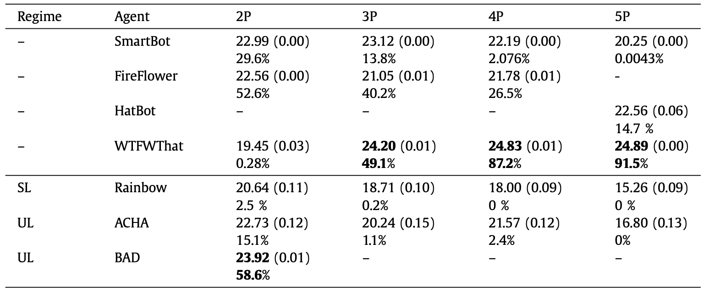
Experimental results

Slide 20
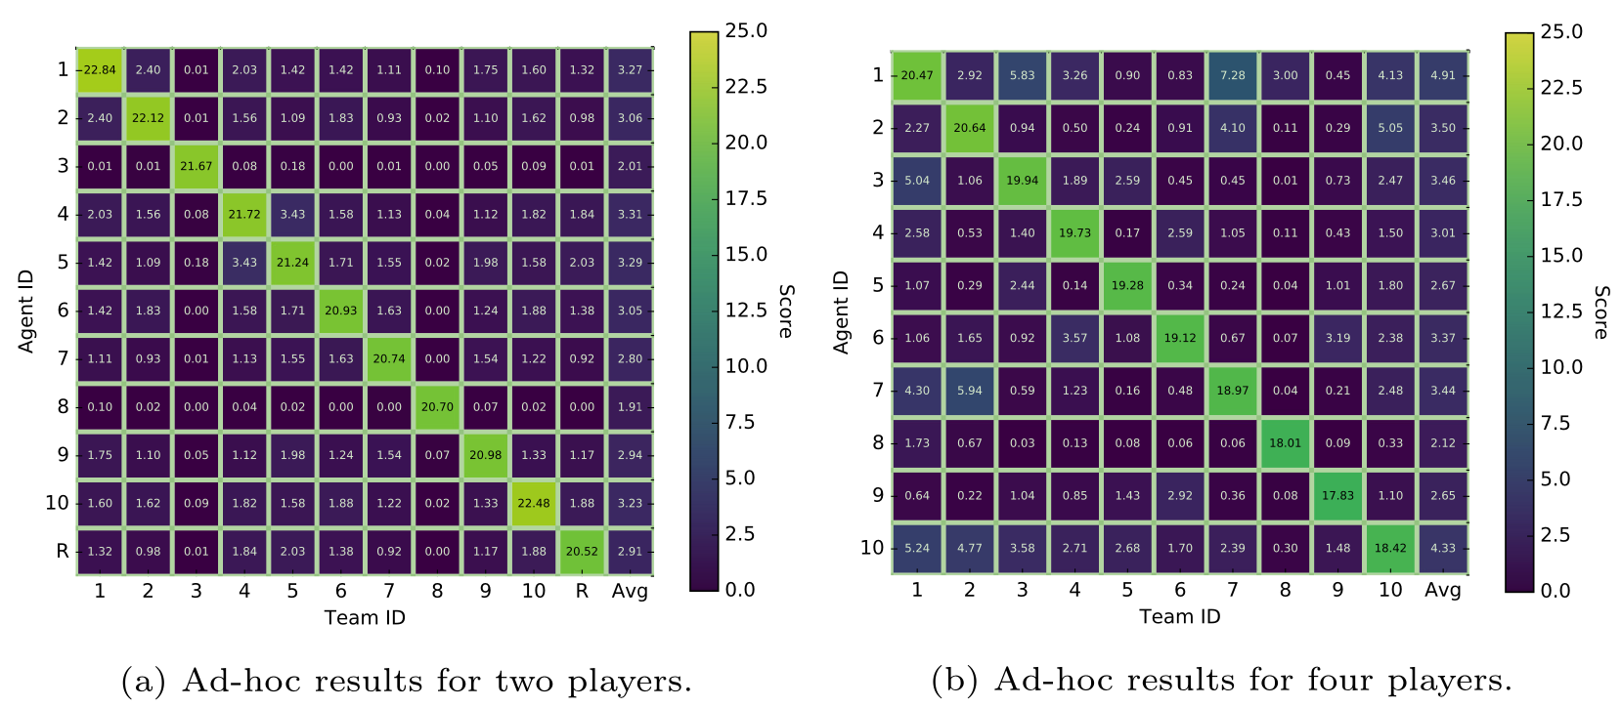
Experimental results
1000 trials

Slide 21
Conclusion
Limited success: Algorithms are insufficient to surpass hand-coded bots in self-play.
Failure in ad-hoc team setting: Agents are unable to collaborate with unknown teammates.
Importance of human Hanabi gameplay theory.

