Slide 1
Random Numbers Fall Mainly in the Planes
George Marsaglia
Proceedings of the National Academy of Sciences, 61(1), 25-28. 1968.
Presenter: Yen-Yu Chen
Date: Apr.2, 2024
Notes:
論文連結
https://www.pnas.org/doi/epdf/10.1073/pnas.61.1.25

Slide 2
Pseudo Random Number Generator(PRNG)
A pseudorandom number generator (PRNG), also known as a deterministic random bit generator (DRBG), is an algorithm for generating a sequence of numbers whose properties approximate the properties of sequences of random numbers. The PRNG-generated sequence is not truly random, because it is completely determined by an initial value, called the PRNG's seed.
Source: Wikipedia, "Pseudo Random Number Generator"
Notes:
PRNG 產生的 random number 其實是確定的(deterministic)
基於 seed

Slide 3
Multiplicative Congruential Generator
$$r_{i+1}≡kr_{i} \text{mod} m$$
Notes:
論文討論的PRNG

Slide 4

Marsaglia’s theorem - Point
$$u_{1}=\frac{r_{1}}{m},u_{2}=\frac{r_{2}}{m},u_{3}=\frac{r_{3}}{m},…$$
$$π_{1}=\left(u_{1},u_{2},…,u_{n}\right),π_{2}=\left(u_{2},…,u_{n+1}\right),π_{3}=\left(u_{3},…,u_{n+2}\right),…$$
$π$ is point in n-cube
Notes:
Pi 是
2. n個u所形成的tuple
1. n維空間中的點

Slide 5
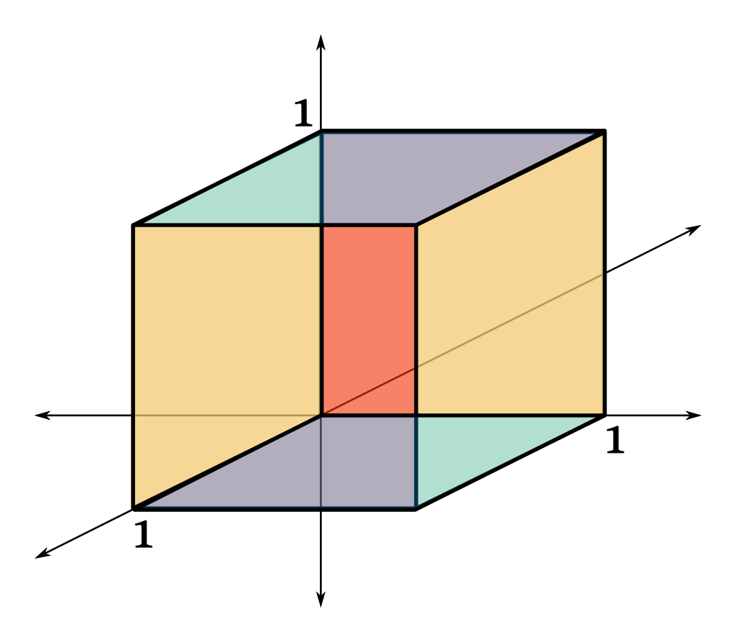
N-cube
Notes:
N維空間的 unit cube

Slide 6

Marsaglia’s theorem - Bound
All n-tuples of resulting random numbers lie in at most ${\left(n!m\right)}^{1/n}$ hyperplanes.

Slide 7
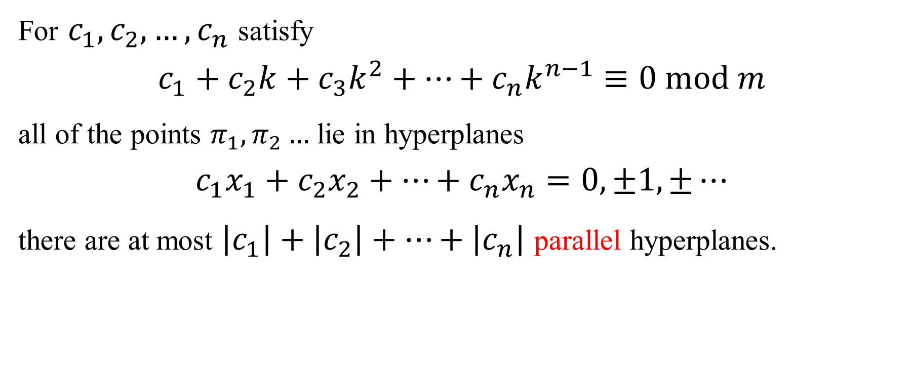
Marsaglia’s theorem – Parallel Hyperplane
For $c_{1},c_{2},…, c_{n}$ satisfy
$$c_{1}+c_{2}k+c_{3}k^{2}+…+c_{n}k^{n−1}≡0 mod m$$
all of the points $π_{1},π_{2}…$ lie in hyperplanes
$$c_{1}x_{1}+c_{2}x_{2}+…+c_{n}x_{n}=0,±1, ±…$$
there are at most $\left|c_{1}\right|+\left|c_{2}\right|+…+\left|c_{n}\right|$ parallel hyperplanes.
Notes:
找到滿足公式的c1~cn，所有的點會處於下面的平行超平面上
也就是說當滿足這個條件時，超平面數量會更少

Slide 8
Visual Demonstration of Marsaglia’s Theorem

Slide 9
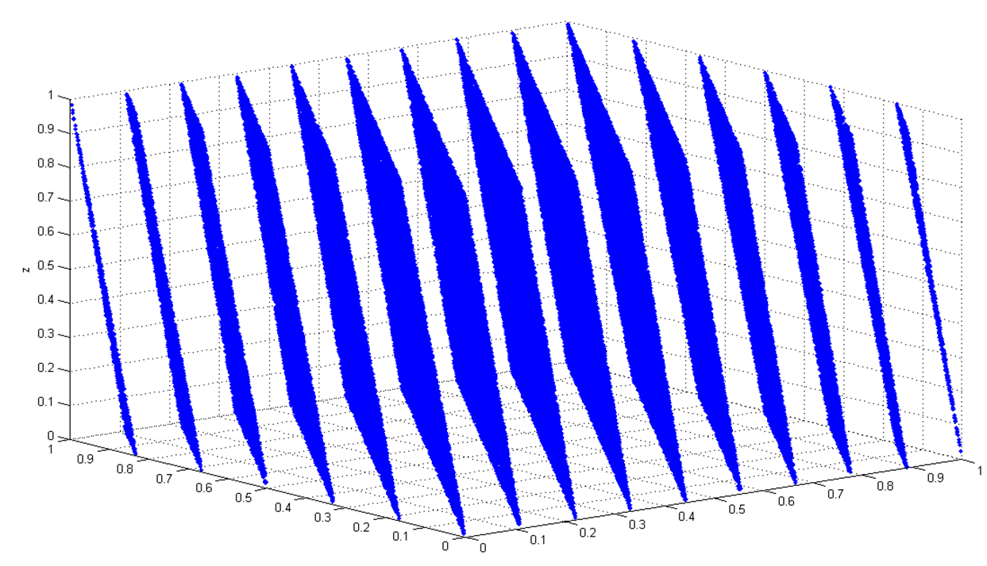
Schematic Diagram
Three-dimensional plot of 100,000 values generated with RANDU. Each point represents 3 consecutive pseudorandom values. It is clearly seen that the points fall in 15 two-dimensional planes.
Source:
Wikipedia, "Marsaglia’s theorem"

Slide 10
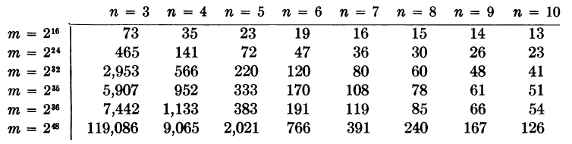
Upper Bound for the Number of Planes Containing All n-tuples

Slide 11
Linear Congruential Generator(LCG)
$$X_{n+1}=\left(aX_{n}+c\right) \text{mod} m$$
Notes:
補充，LCG也會符合論文的發現

Slide 12
Xorshift RNGs
George Marsaglia
Journal of Statistical software, 8, 1-6. 2003.
Presenter: Yen-Yu Chen
Date: Apr.2, 2024
Notes:
論文連結
https://www.jstatsoft.org/article/view/v008i14

Slide 13

Abstract
Description of a class of simple, extremely fast random number generators (RNGs) with periods $2^{k}−1$ for k = 32, 64, 96, 128, 160, 192. These RNGs seem to pass tests of randomness very well.

Slide 14

Period of RNG
$f()$ is a one-to-one function on seed set $𝒵$. $z$ is an element in $𝒵$.
Sequence $f\left(z\right), f^{2}\left(z\right), f^{3}\left(z\right)…$ , where $f^{2}\left(z\right)=f\left(f\left(z\right)\right)$ , have the period $p$ when $f^{p}\left(z\right)=z$

Slide 15
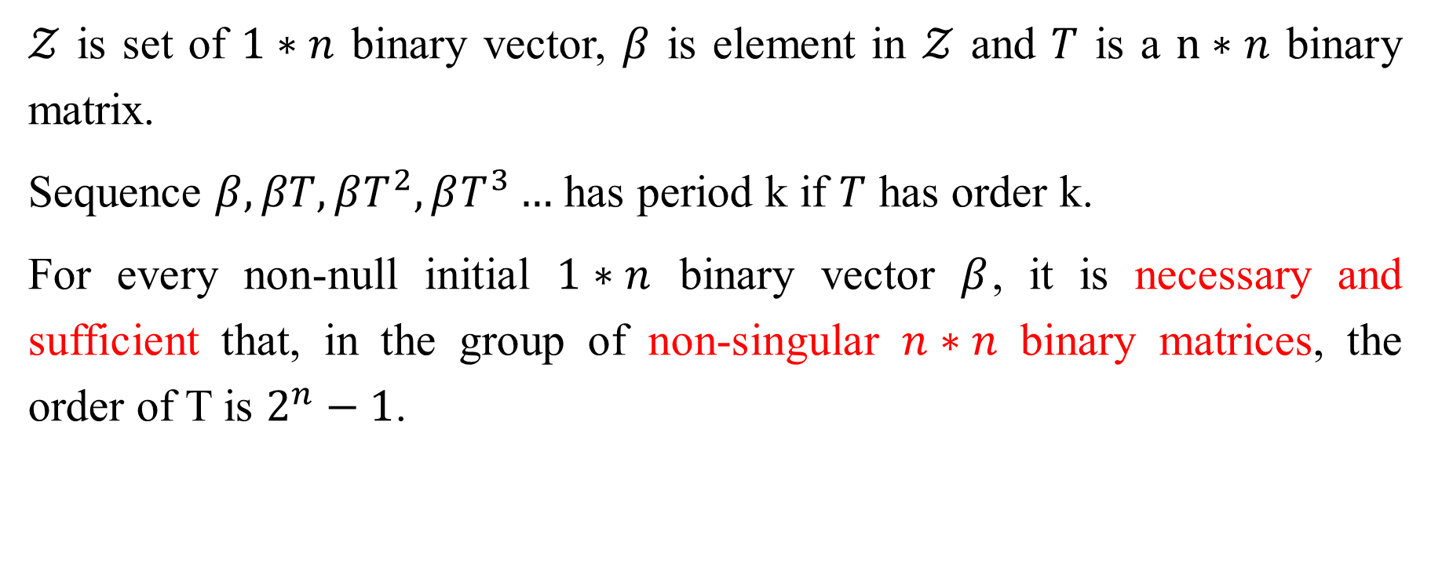
Algorithm (1/2)
$𝒵$ is set of $1∗n$ binary vector, $β$ is element in $𝒵$ and $T$ is a $n∗n$ binary matrix.
Sequence $β, βT, βT^{2}, βT^{3}…$ has period k if $T$ has order k.
For every non-null initial $1∗n$ binary vector $β$, it is necessary and sufficient that, in the group of non-singular $n∗n$ binary matrices, the order of T is $2^{n}−1$.
Notes:
任何 nxn 的 non-singular matrix 都可以使 period 為 2^n-1
但是矩陣運算的成本很高

Slide 16
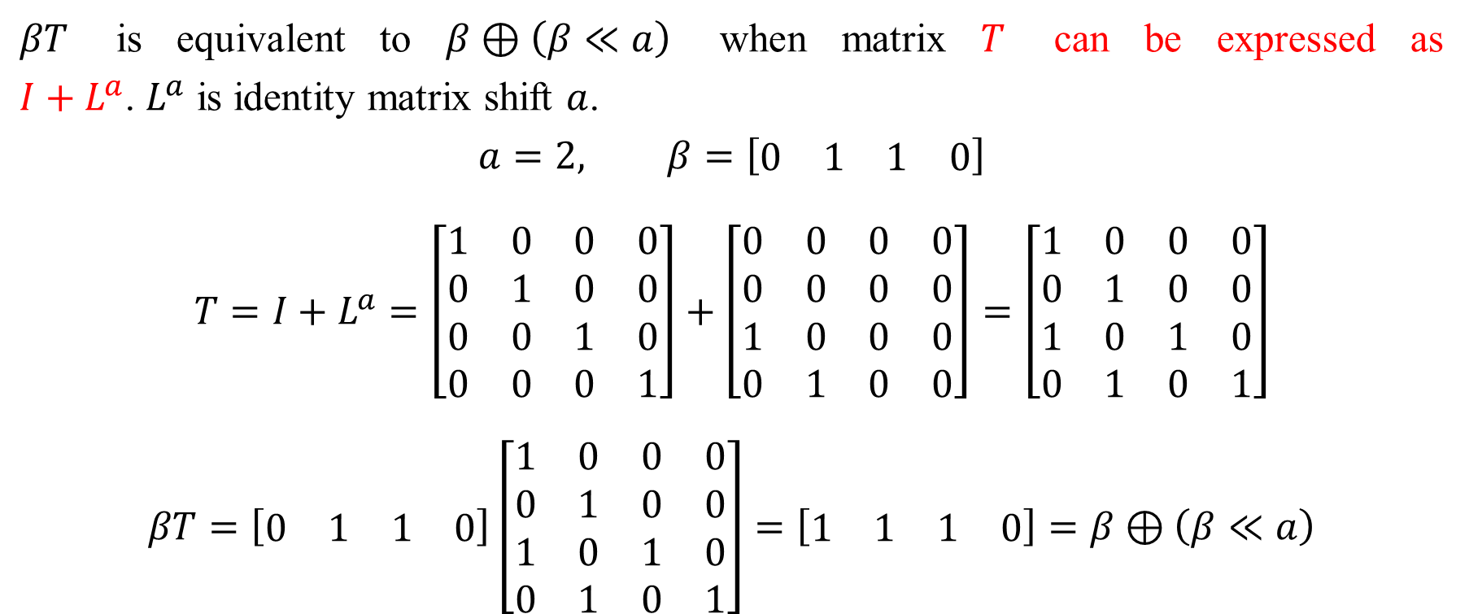
Algorithm (2/2)
$βT$ is equivalent to $β⊕\left(β≪a\right)$ when matrix $T$ can be expressed as $I+L^{a}$. $L^{a}$ is identity matrix shift $a$.
$$a=2, β=\left[\begin{matrix}0 & 1 & 1 & 0\end{matrix}\right]$$
$$T=I+L^{a}=\left[\begin{matrix}1 & 0 & 0 & 0 \\ 0 & 1 & 0 & 0 \\ 0 & 0 & 1 & 0 \\ 0 & 0 & 0 & 1\end{matrix}\right]+\left[\begin{matrix}0 & 0 & 0 & 0 \\ 0 & 0 & 0 & 0 \\ 1 & 0 & 0 & 0 \\ 0 & 1 & 0 & 0\end{matrix}\right]=\left[\begin{matrix}1 & 0 & 0 & 0 \\ 0 & 1 & 0 & 0 \\ 1 & 0 & 1 & 0 \\ 0 & 1 & 0 & 1\end{matrix}\right]$$
$$βT=\left[\begin{matrix}0 & 1 & 1 & 0\end{matrix}\right]\left[\begin{matrix}1 & 0 & 0 & 0 \\ 0 & 1 & 0 & 0 \\ 1 & 0 & 1 & 0 \\ 0 & 1 & 0 & 1\end{matrix}\right]=\left[\begin{matrix}1 & 1 & 1 & 0\end{matrix}\right]=β⊕\left(β≪a\right)$$

Slide 17
Choose T
Non-singular
Expressed as $I+L^{a}$
Expressed as 𝐼+𝐿^𝑎
Notes:
non-singular 可以保證 period 為 2^n-1
表示成 I+La 可以用 bitwise 取代矩陣乘法

Slide 18
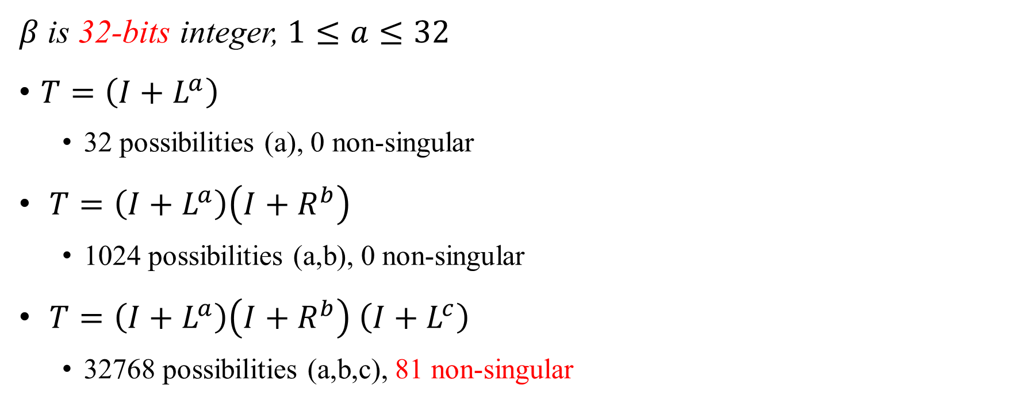
Check Every Possible Arguments
$β$ is 32-bits integer, $1≤a≤32$
$T=\left(I+L^{a}\right)$
32 possibilities (a), 0 non-singular
$T=\left(I+L^{a}\right)\left(I+R^{b}\right)$
1024 possibilities (a,b), 0 non-singular
$T=\left(I+L^{a}\right)\left(I+R^{b}\right)$ $\left(I+L^{c}\right)$
32768 possibilities (a,b,c), 81 non-singular

Slide 19
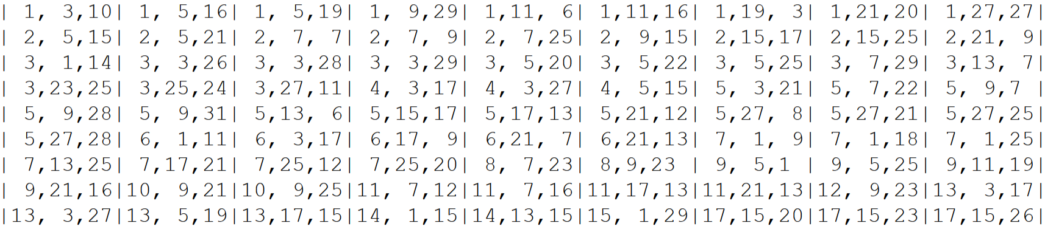
81 Triples (a,b,c), a<c

Slide 20
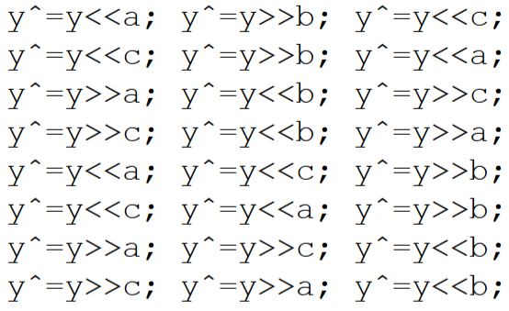
Xorshift Code

Slide 21
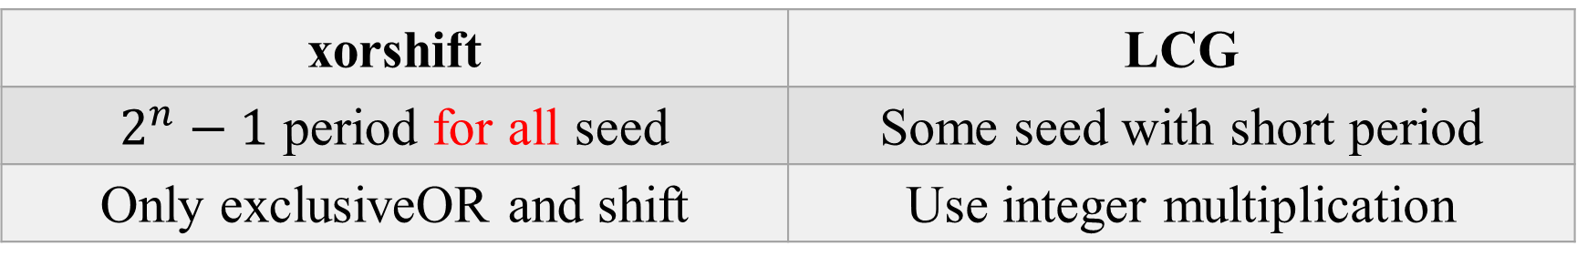
Comparation
xorshift | LCG
$2^{n}−1$ period for all seed | Some seed with short period
Only exclusiveOR and shift | Use integer multiplication

