Slide 1
Pattern-defeating Quicksort
Orson R. L. Peters (2021).
Pattern-defeating quicksort. arXiv preprint arXiv:2106.05123.
Presenter: Yen-Yu Chen
Date: May 7, 2024

Slide 2
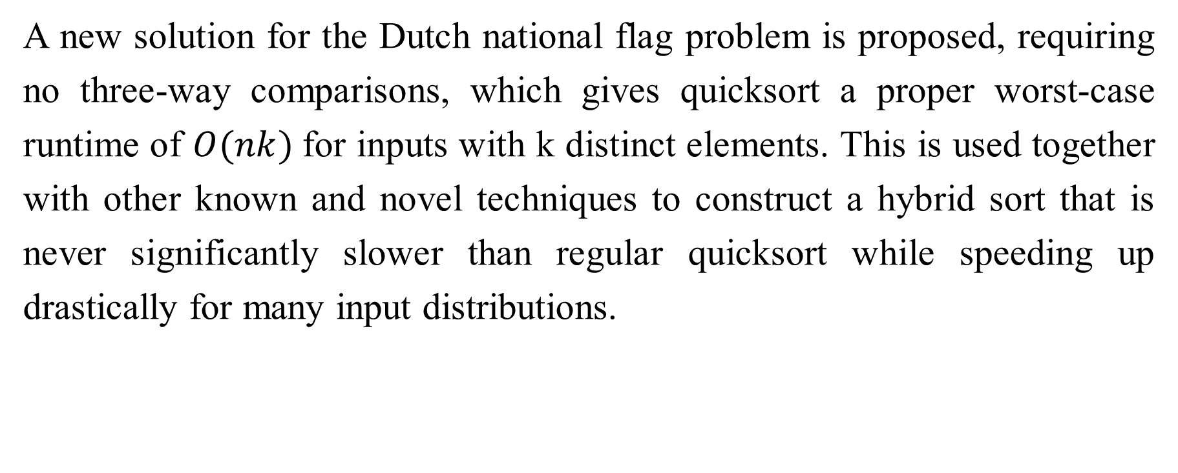
Abstract
A new solution for the Dutch national flag problem is proposed, requiring no three-way comparisons, which gives quicksort a proper worst-case runtime of $O(nk)$for inputs with k distinct elements. This is used together with other known and novel techniques to construct a hybrid sort that is never significantly slower than regular quicksort while speeding up drastically for many input distributions.

Slide 3

Quicksort Worst Case
A naive quicksort implementation might trigger the $Θ\left(n^{2}\right)$worst case on the all-equal input distribution by placing equal comparing elements in the same partition.

Slide 4




Partition
Partition right
Partition left
$$<p$$
p
$$≥p$$
$$≤p$$
p
$$>p$$

Slide 5














Tripartite Partitioning
Partition right
Partition left
$$<p_{1}$$
$$p_{1}$$
$$p_{2}$$
$$≥p_{1}$$
$$<p_{1}$$
$$p_{1}$$
$$≤p_{2}$$
$$p_{2}$$
$$>p_{2}$$
$$<p_{1}$$
$$p_{1}$$
$$=p$$
$$p_{2}$$
$$>p_{2}$$
Notes:
重點是right partition結束後要剛好有一個 p2 在左邊的最右邊 這樣就不用額外的空間以及判斷

Slide 6
Algorithm
predecessor
p | q
no
if p==q
yes
left
Partition right
right
Partition left
Return
Notes:
同顏色交換

Slide 7
Example(1/5)
12 | 6 | 7 | 10 | 12 | 4 | 5 | 9 | 3 | 6 | 7 | 1 | 7
1 | 6 | 6 | 3 | 5 | 4 | 12 | 9 | 10 | 7 | 7 | 12 | 7
1 | 6 | 6 | 3 | 5 | 4 | 7 | 9 | 10 | 7 | 7 | 12 | 12

Slide 8
Example(2/5)
1 | 6 | 6 | 3 | 5 | 4 | 7 | 9 | 10 | 7 | 7 | 12 | 12
1 | 6 | 6 | 3 | 5 | 4
recursion
1 | 3 | 4 | 5 | 6 | 6

Slide 9

Example(3/5)
1 | 3 | 4 | 5 | 6 | 6
7 | 9 | 10 | 7 | 7 | 12 | 12
$$≠$$
9 | 10 | 7 | 7 | 12 | 12
9 | 10 | 7 | 7 | 12 | 12
9 | 7 | 7 | 10 | 12 | 12
7 | 7 | 9 | 10 | 12 | 12

Slide 10






Example(4/5)
1 | 3 | 4 | 5 | 6 | 6
7
7 | 7 | 9 | 10 | 12 | 12
$$=$$
7 | 7
7 | 7
$$<p_{1}$$
$$p_{1}$$
$$=p$$
$$p_{2}$$
$$>p_{2}$$

Slide 11
Example(5/5)
1 | 3 | 4 | 5 | 6 | 6
7
7 | 7
9
10 | 12 | 12
10 | 12 | 12
recursion
10 | 12 | 12

Slide 12

Time Complexity
pdqsort has complexity $O(nk)$when the input distribution has k distinct values.
Notes:
每一次 recursion(sequence) 都可以處理 1 個數字，一層會有超過一個 sequence 被處理，除非每次 partition 都是 bad partition

Slide 13
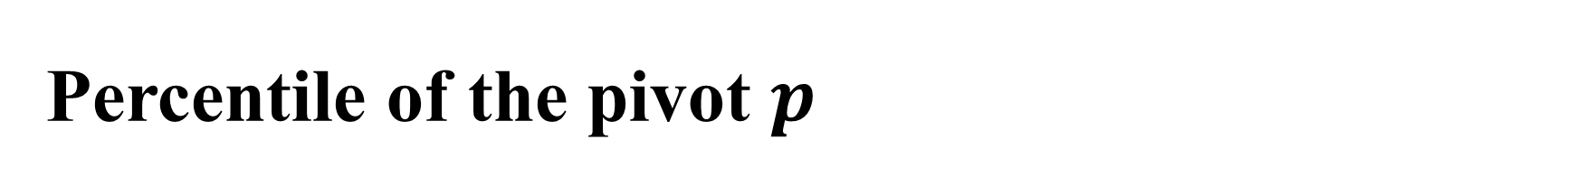
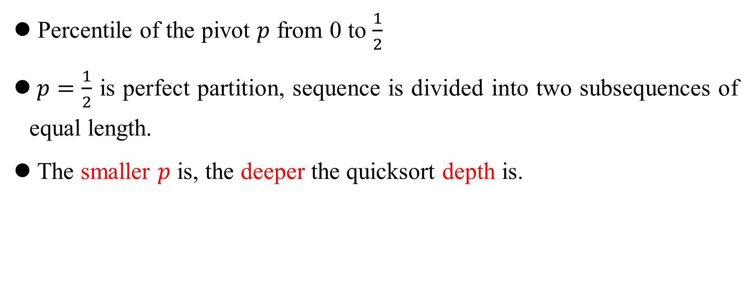
Percentile of the pivot $p$
Percentile of the pivot $p$ from 0 to $\frac{1}{2}$
$p=\frac{1}{2}$ is perfect partition, sequence is divided into two subsequences of equal length.
The smaller $p$ is, the deeper the quicksort depth is.

Slide 14
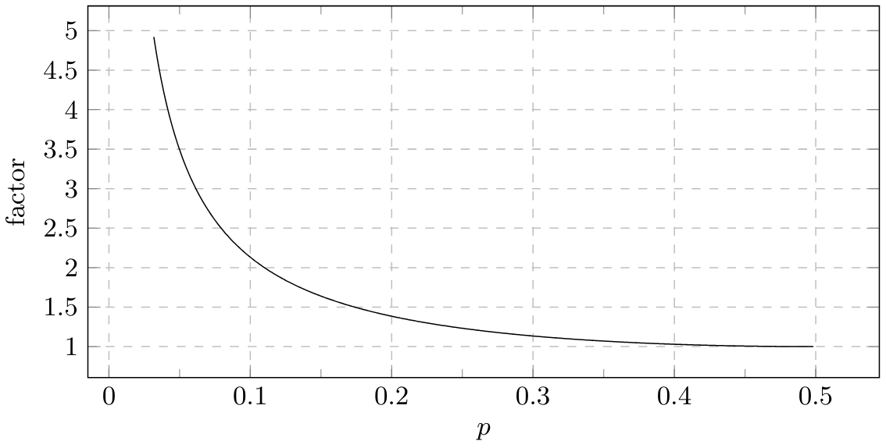
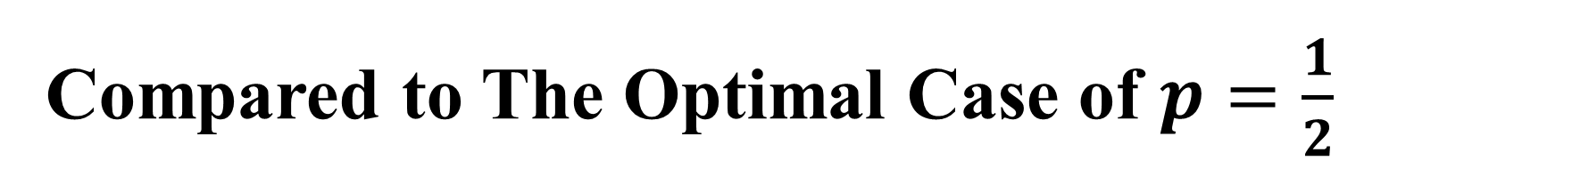

Compared to The Optimal Case of $p=\frac{1}{2}$
$factor= \frac{T(n,p)}{T(n,\frac{1}{2})}$ , $\lim_{n→∞}{\frac{T(n,p)}{T(n,\frac{1}{2})}}=H(p)$
Notes:
論文證明 factor 在 n 很大時 會接近 H(p)，H是香濃商，以此畫出圖表

Slide 15

Bad Partition
It will be almost twice as slow as the optimal case when $p=0.125$
Notes:
p = 0.125 時會大約比 optimal case 慢兩倍，所以論文將 devide 比例超過 0.125:0.875 的例子視為 bad partition
(論文選擇會慢兩倍以上的p作為閥值是為了與後面的談到的heapsort並用，並不是亂選的)

Slide 16

Heap Sort
From benchmarks we’ve found that heapsort is roughly about twice as slow as quicksort for sorting randomly shuffled data.
If the number of bad partitions exceeds counter($log⁡n$), use heapsort directly.
Notes:
因為論文選擇p=0.125，bad partition 會比 optimal case 慢2倍以上
而headsort會是quicksort的兩倍，所以此時用heapsort 不會更差，這也是為何p要是0.125
Counter 是一個閥值，之所以選擇 log n 是為了之後提及的時間複雜度

Slide 17

Time Complexity with Heapsort
At most $O(n\log{n})$time is spent in pdqsort on bad partitions.
Notes:
論文證明counter是log n時
時間複雜度為 O(n logn)

Slide 18
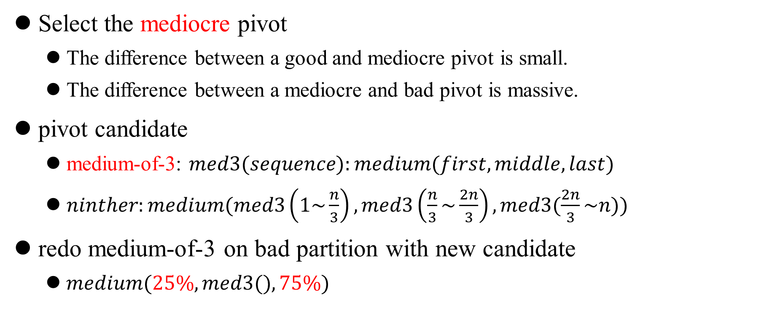
Select pivot
Select the mediocre pivot
The difference between a good and mediocre pivot is small.
The difference between a mediocre and bad pivot is massive.
pivot candidate
medium-of-3: $med3(sequence):medium(first, middle, last)$
$ninther:medium(med3\left(1\sim \frac{n}{3}\right), med3\left(\frac{n}{3}\sim \frac{2n}{3}\right), med3(\frac{2n}{3}\sim n))$
redo medium-of-3 on bad partition with new candidate
$medium(25\%, med3(), 75\%)$
Notes:
不用選最好(花時間)的pivot但是要選mediocre(平庸的)
Bad partition 時 使用新的 candidate 做 med3

Slide 19
Insertion Sort
Essentially all optimized quicksort implementations switch to a different algorithm when recursing on a small (≤ 16–32 elements) subsequence, most often insertion sort.
Use a series of moves instead of swaps
Eliminates a lot of unnecessary shuffling
Eliminating bounds checking on subsequence that is not leftmost
Notes:
不需要邊界檢查是因為左邊的partition一定比較小會自動跳出，就不用每次都判斷
Move 取代 swap 可能需要配合特殊結構

Slide 20
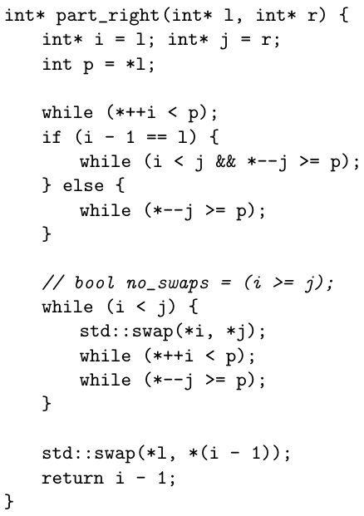
Optimistic insertion sorting on a swapless partition
Check if it is sorted on a swapless partition
Can be done with a single comparison
Do a partial insertion sort
Aborts it has to do more than a tiny number of corrections
p
1 | 2 | 3 | 4 | 5 | 4 | 6
Example for swapless partition
Notes:
這個方法就算把 bad case 拿來做也只會多一倍的時間尚可接受

Slide 21
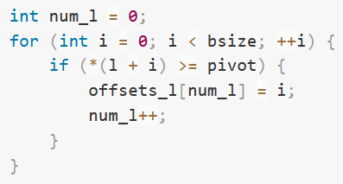
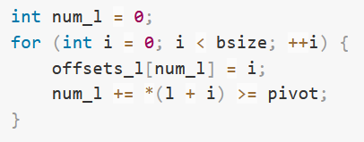
Branchless Compare sort
Replacing branches with data-dependent moves followed by unconditional swaps.

Slide 22
Experimental
Present a performance evaluation of pattern-defeating quicksort with (bpdq) and without (pdq) block partitioning, introsort from libstdc++’s implementation of std::sort (std), Timothy van Slyke’s C++ Timsort implementation (tim), BlockQuicksort (bq) and the sequential version of In-Place Super Scalar Samplesort (is4o).

Slide 23
Conclusion
Pattern-defeating quicksort have little overhead, and effectively handle various input patterns.
Pattern-defeating quicksort is often the best choice of algorithm overall for small to medium input sizes or data type sizes.
Pattern-defeating quicksort and other quicksort variants suffer from datasets that are too large to fit in cache.

Slide 24
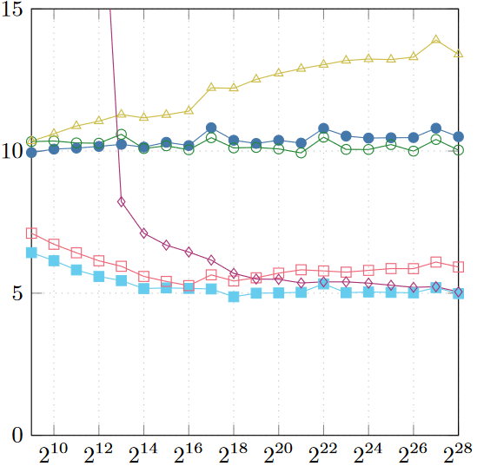
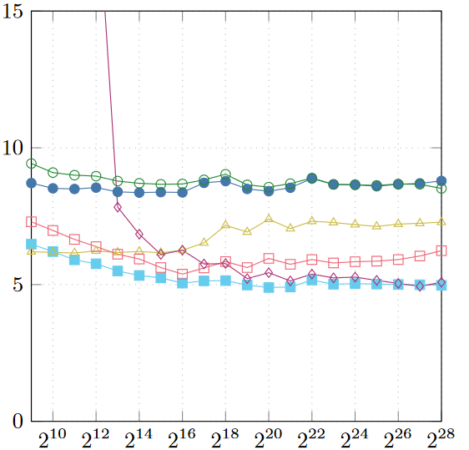
INT Benchmark
UNIFORM
SORT50

